Slide 1

Financing mechanisms for
decarbonisation and retrofitting
of vessels for inland shipping
BUSINESS CASE
BANKABILITY
FINANCING
Key findings and policy recommendations
Study requested by the European Parliament’s Committee on Transport and Tourism (TRAN)
Matthijs Otten, CE Delft
Peter Scholten, CE Delft
4 November 2026
Notes:
[Sources]
- European Parliament, Terms of Reference CASP/TRAN/2026-05, objective and presentation requirements.
- CE Delft & Logistic Navigators, draft study “Financing mechanisms for decarbonisation and retrofitting of vessels for inland shipping”, 2026.

Slide 2
The central question is not
“is finance available?”
but
“is the investment bankable?”
Notes:
[Sources]
- Terms of Reference, section 2.2: investment needs, financing mechanisms, fuel-price predictability, small operators, infrastructure and policy recommendations.
- Draft study, Executive Summary and Chapters 5–6: weak business case and bankability as central financing barrier.

Slide 3
Agenda
Investment challenge
-> How large are the additional costs for vessels and infrastructure?
Financing challenge
-> Why do existing financing and funding mechanisms fall short?
Policy response
-> How can policy improve the business case, reduce risks and mobilise finance?
2

Slide 4
Investment challenge
01

Slide 5
Investment challenge
Market context
Share of inland freight
(tonne-km):
~75%
~ 13 400
~80%
~2 000
EU ~5%; NL ~40%;
Romania and Bulgaria
>20%
of EU inland-waterway freight tonne-km is cross-border
Cargo vessels operate on European waterways
Of dry-cargo vessels were built in the twentieth century
Passenger vessels, including ~400 river-cruise vessels
This makes financing highly vessel-specific
Many older vessels are modernised through targeted retrofits rather than replaced with newbuilds.
Mainly small independent owner-operators active on the Rhine and large fleet operators on the Danube.
There is no single technology pathway: vessel size, route, energy demand and infrastructure availability matter.
Support therefore needs to be flexible while keeping common EU rules and assessment approaches.
Sources: Eurostat (2024); CCNR Market Observation; EPRS (2016); CE Delft (2026), Ch. 2. Owner-operator share: western European freight firms.
Notes:
[Sources]
- Eurostat, tran_hv_frmod, Modal split of inland freight transport, 2024 (percentage of inland freight tonne-km carried by road, rail and inland waterways): EU-27 5.2% (estimated), Netherlands 40.4%, Romania 23.4%, Bulgaria 21.9%. This is NOT a share of all freight including maritime shipping.
https://ec.europa.eu/eurostat/databrowser/view/tran_hv_frmod/default/table?lang=en
- CCNR (2025), Inland navigation in Europe: Market Observation, Annual Report 2025, Freight transport performance: in the EU-27 in 2024 import = 27.0%, export = 27.9%, transit = 20.8%; together 75.7% of inland-waterway tonne-km. Cross-border means at least one border crossed, not that 76% of individual vessel movements were international.
https://inland-navigation-market.org/annees/2025-en/?lang=en
- CCNR (2025), same annual report, Fleet section: 13,392 cargo vessels in the European fleet (includes propelled and unpropelled vessels; reference years differ by region) and approximately 80% of dry-cargo vessels built in the twentieth century.
https://inland-navigation-market.org/wp-content/uploads/2025/11/CCNR_annual_report_EN_2025_WEB.pdf
- SPB & DST (2026), SYNERGETICS D5.2: approximately 1,505 day-trip vessels and 185 ferries; CCNR (2025) reports 408 river-cruise vessels. Together approximately 2,100 passenger vessels, rounded on the slide to around 2,000.
https://www.synergetics-project.eu/wp-content/uploads/2026/07/SYNERGETICS_D5.2_Updated-transition-pathways-landscape-of-synergies_FINAL.pdf
- CE Delft (2026), Financing mechanisms for decarbonisation and retrofitting of vessels for inland shipping, FINAL report for the European Parliament TRAN Committee (manuscript completed September 2026), Chapter 2, especially Sections 2.1–2.2, for fleet context, ownership and retrofitting practices.

Slide 6
Investment challenge
Decarbonisation pathways and costs for IWT
Biodiesel (HVO)
Battery-electric
Methanol / hydrogen
Existing vessels
Major retrofit or newbuild
Major retrofit or newbuild
+
Minimal modifications
+
Zero tailpipe emissions
+
Potential for longer-range operation
−
Residual CO₂-emissions
−
Range and charging
−
Fuel storage and infrastructure challenges
RETROFIT | existing vessel
NEWBUILD | purpose-built vessel
+ Reuse vessel; lower upfront cost
+ Optimised powertrain and storage
− Space and remaining-life constraints
− Higher CAPEX and delivery time
Sources: SYNERGETICS (2024–26); PLATINA4Action D4.1/D4.2; CE Delft & Logistic Navigators (2026), Ch. 3.
Notes:
[Sources]
- Draft study, Chapter 3.3: conservative pathway additional accumulated TCO €2.43–6.38bn; innovative pathway €5.26–10.19bn versus BAU over 2020–2050.
- Draft study, Chapter 3.2.3: 110 m vessel CAPEX comparison; hydrogen fuel cells roughly 5x and battery charging almost 4x the Stage V diesel reference.
- PLATINA4Action D4.2 as cited in the study: current-policy TCO versus Net Zero Emissions scenario.

Slide 7
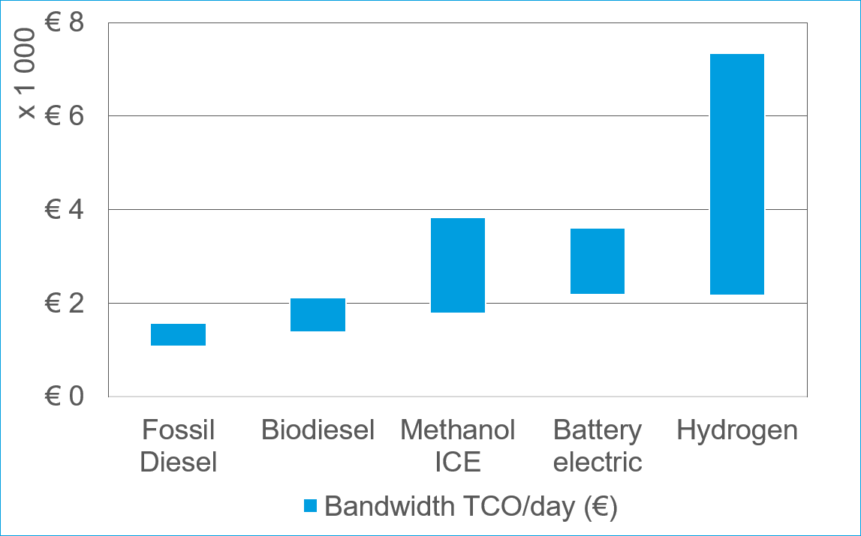
Investment challenge
Total Cost of Ownership in 2028 for 110 m vessel
TCO = CAPEX + OPEX
Including energy, maintenance and other operating costs
Energy costs are the main driver of TCO differences over the ownership period.
Source: DST et al. (2021); PLATINA4Action D4.2; CE Delft & Logistic Navigators (2026), Chapter 3.
Notes:
[Sources]
- Draft study, Chapter 3.3: conservative pathway additional accumulated TCO €2.43–6.38bn; innovative pathway €5.26–10.19bn versus BAU over 2020–2050.
- Draft study, Chapter 3.2.3: 110 m vessel CAPEX comparison; hydrogen fuel cells roughly 5x and battery charging almost 4x the Stage V diesel reference.
- PLATINA4Action D4.2 as cited in the study: current-policy TCO versus Net Zero Emissions scenario.

Slide 8
Investment challenge
Decarbonisation involves substantially higher costs than business as usual
Additional accumulated total cost of ownership for the European IWT fleet, compared with business-as-usual (2020–2050)
Biofuel pathway
€2.4–6.4 bn
Zero-emission pathway
€5.3–10.2 bn
0
2
4
6
8
10
€ billion
Policy can make low- and zero-emission technologies more cost-competitive.
Source: DST et al. (2021); PLATINA4Action D4.2; CE Delft & Logistic Navigators (2026), Chapter 3.
Notes:
[Sources]
- Draft study, Chapter 3.3: conservative pathway additional accumulated TCO €2.43–6.38bn; innovative pathway €5.26–10.19bn versus BAU over 2020–2050.
- Draft study, Chapter 3.2.3: 110 m vessel CAPEX comparison; hydrogen fuel cells roughly 5x and battery charging almost 4x the Stage V diesel reference.
- PLATINA4Action D4.2 as cited in the study: current-policy TCO versus Net Zero Emissions scenario.

Slide 9
Why current financing falls short
02

Slide 10
Why current financing falls short
Existing financing mechanisms
Commercial finance
Public funding
Emerging models
Bank loans + owner equity
Cash flow + collateral matter
Harder for smaller operators
EU and national grants
Reduce CAPEX, rarely OPEX
Applications can be complex
Leasing and pay-per-use
Lower upfront costs; share risks
Still limited in inland shipping
Grants can reduce CAPEX, but the OPEX gap remains and customers rarely pay more for cleaner freight.
Source: CE Delft (2026, final study), Chapter 4 and Section 5.2; PLATINA3 (2022).
Notes:
[Sources]
- CE Delft (2026), Financing mechanisms for decarbonisation and retrofitting of vessels for inland shipping, FINAL report for the European Parliament TRAN Committee (manuscript completed September 2026), Section 4.1 (conventional/alternative vessel financing), Sections 4.2–4.3 (EU and Member State funding), Section 5.2 (financing barriers).
- SPB, EICB, CCNR & PDM (2022), PLATINA3 D2.5, Funding and financing the energy transition of the European IWT fleet, Sections 3.1–3.2: fragmented programmes, transaction costs and the limited scope for commercial loans where TCO is not competitive.
https://platina3.eu/wp-content/uploads/2022/10/221024_PLATINA3_D2.5_Fundingfinancing-energy-transition-European-IWT-fleet.pdf
- WAT (2024), PLATINA4Action D5.1, Funding opportunities for RD&I and deployment activities at European level: overview of public funding instruments.
https://platina4action.iwtprojects.eu/wp-content/uploads/2025/01/250123_PLATINA4Action_D5.1_Funding_opportunities_for_RDI_and_deployment_activities_at_the_European_level.pdf
- Port of Rotterdam (2026), Condor H2: emerging pay-per-use hydrogen arrangements.
https://www.portofrotterdam.com/en/port-future/energy-transition/making-logistics-chains-more-sustainable/condor-h2
- Zero Emission Services, About ZES: swappable batteries, service-based energy provision.
https://zeroemissionservices.nl/en/about-zes/
[Speaker update / script alignment]
A central revenue problem is the absence of a reliable premium for green inland-waterway freight; operators must largely compete on price with conventional ships, including fully depreciated diesel vessels. Exceptions exist through dedicated long-term contracts, but are not the general market. Source: CE Delft (2026), final report, Sections 5.1.1, 5.2.1 (Income perspective: no green premium); CCNR (2024) market structure.
[Expanded presenter explanation retained from prior slide]
Commercial finance: Vessel owners generally use commercial loans and own equity. A bank needs predictable cash flows, sufficient vessel collateral, and risk-sharing. This is harder for small owner-operators.
Public support: EU and national programmes support vessel investments, research and infrastructure. Grants can reduce upfront CAPEX, while support for recurring OPEX remains limited; applications may be complex for smaller firms.
Emerging models: Leasing, pay-per-use, pay-as-you-save and public-private arrangements can reduce upfront costs and shift some technology/residual-value risks, but these models are not yet widely deployed across IWT.

Slide 11
Why current financing falls short
Central finding
General barriers to IWT decarbonisation
Higher upfront and operating costs
No extra freight revenue;
short-term contracts
Technology, regulatory and infrastructure uncertainty
Small operators with
limited financial capacity
Resulting financial barriers
Weak or
uncertain cash flows
Higher investment and residual-value risk
Limited capacity to absorb or share risks
Difficult to demonstrate repayment capacity
Limited decarbonisation investments
Low bankability of IWT decarbonisation investments
Source: CE Delft & Logistic Navigators (2026), Chapters 5–6; stakeholder interviews; Condor ZE analysis.
Notes:
[Sources]
- Draft study, Executive Summary: weak business case is the central financing barrier; small operators face limited collateral and administrative capacity.
- Draft study, Chapter 5.2: financiers focus on repayment capacity, collateral and risk-sharing.
- Draft study, Chapter 5.2.1 and Condor ZE analysis: 20-year competitiveness may not align with a roughly 10-year financing assessment horizon.
Financing instruments cannot by themselves make a structurally unviable business case bankable.

Slide 12

Why current financing falls short
Lender’s view
Lenders finance a credible repayment plan.
Loan / financing
Operational cash flow
Collateral / residual vessel value
Financier
Vessel owner or borrower
Guarantees
Cash flows, collateral and guarantees make investments bankable.
The obstacle is often the investment case — not an unwillingness to lend.
Source: CE Delft (2026, final study), Figure 10 and Sections 5.2–5.3.
Notes:
[Sources]
- CE Delft (2026), Financing mechanisms for decarbonisation and retrofitting of vessels for inland shipping, FINAL report for the European Parliament TRAN Committee (manuscript completed September 2026), Sections 4.1–4.3 and 5.2, and conclusions of Chapters 4 and 5.
- SPB, EICB, CCNR & PDM (2022), PLATINA3 D2.5, Sections 3.1–3.2, on business-case and bankability barriers.
https://platina3.eu/wp-content/uploads/2022/10/221024_PLATINA3_D2.5_Fundingfinancing-energy-transition-European-IWT-fleet.pdf
- Condor (2026), Whitepaper: Van TCO-inzicht tot financierbaarheid in de praktijk, particularly financing and collateral conditions.
https://condor-ze.com/wp-content/uploads/2026/05/CONDOR-financiering-2.pdf
[Speaker update / script alignment]
The central diagram is rebuilt from the editable native shapes in supplied Figure 10.pptm, not a flattened picture: labels, arrows and rectangles can be modified in PowerPoint. Two illustrative icons remain small, independent image objects.
From the lender’s perspective, a green-vessel retrofit can receive finance if (1) projected cash flows are adequate and sufficiently predictable for debt service, (2) collateral/residual asset value offers security, and (3) remaining risks can be shared or guaranteed. A bank does not necessarily refuse out of unwillingness: it may be unable to establish those conditions with a currently weak business case. Time horizon: a technology can approach TCO parity over a twenty-year lifetime, while financing assessments often use a shorter horizon (stakeholder interviews indicate around 10 years); future carbon-price-driven benefits do not substitute for near-term cash flow. Grants/leasing may reduce initial capital need but not persistent OPEX disadvantage. Sources: CE Delft (2026), FINAL report, Figure 10 and Section 5.2.1–5.2.2; Condor (2026), TCO time-horizon analyses.

Slide 13
Policy response
03

Slide 14
Policy response
Policy architecture
1. Strengthen the business case
2. Reduce deployment risks
3. Share remaining financing risks
Cost € ↓
Revenues ↑
Cost & revenues certainty ↑
Technology & Infrastructure development
Standardisation
Guarantees
Concessional finance
Risk-sharing
Source: CE Delft & Logistic Navigators (2026), Chapter 6.
Notes:
d

Slide 15
Policy response
Strengthening the business case: get prices and demand right
Improve the business case through three complementary mechanisms
Reduce the cost gap -> Create value -> Create demand
A. Narrow the operating-cost gap
B. Give emission reductions economic value
C. Use public procurement to create early demand
Improve and align price signals
Carbon pricing (ETS2)
Energy taxation
Renewable fuel obligation (RED III)
Bridge remaining gaps
Operating cost support
Price stabilising mechanisms
Emission reduction targets (FuelEU-type) for operators
Shipper-side targets
Verified emission-reduction credits
Public-service vessels and public works contracts
Apply environmental specifications, award criteria and life-cycle costing
Source: CE Delft & Logistic Navigators (2026), Chapter 7 recommendations.

Slide 16


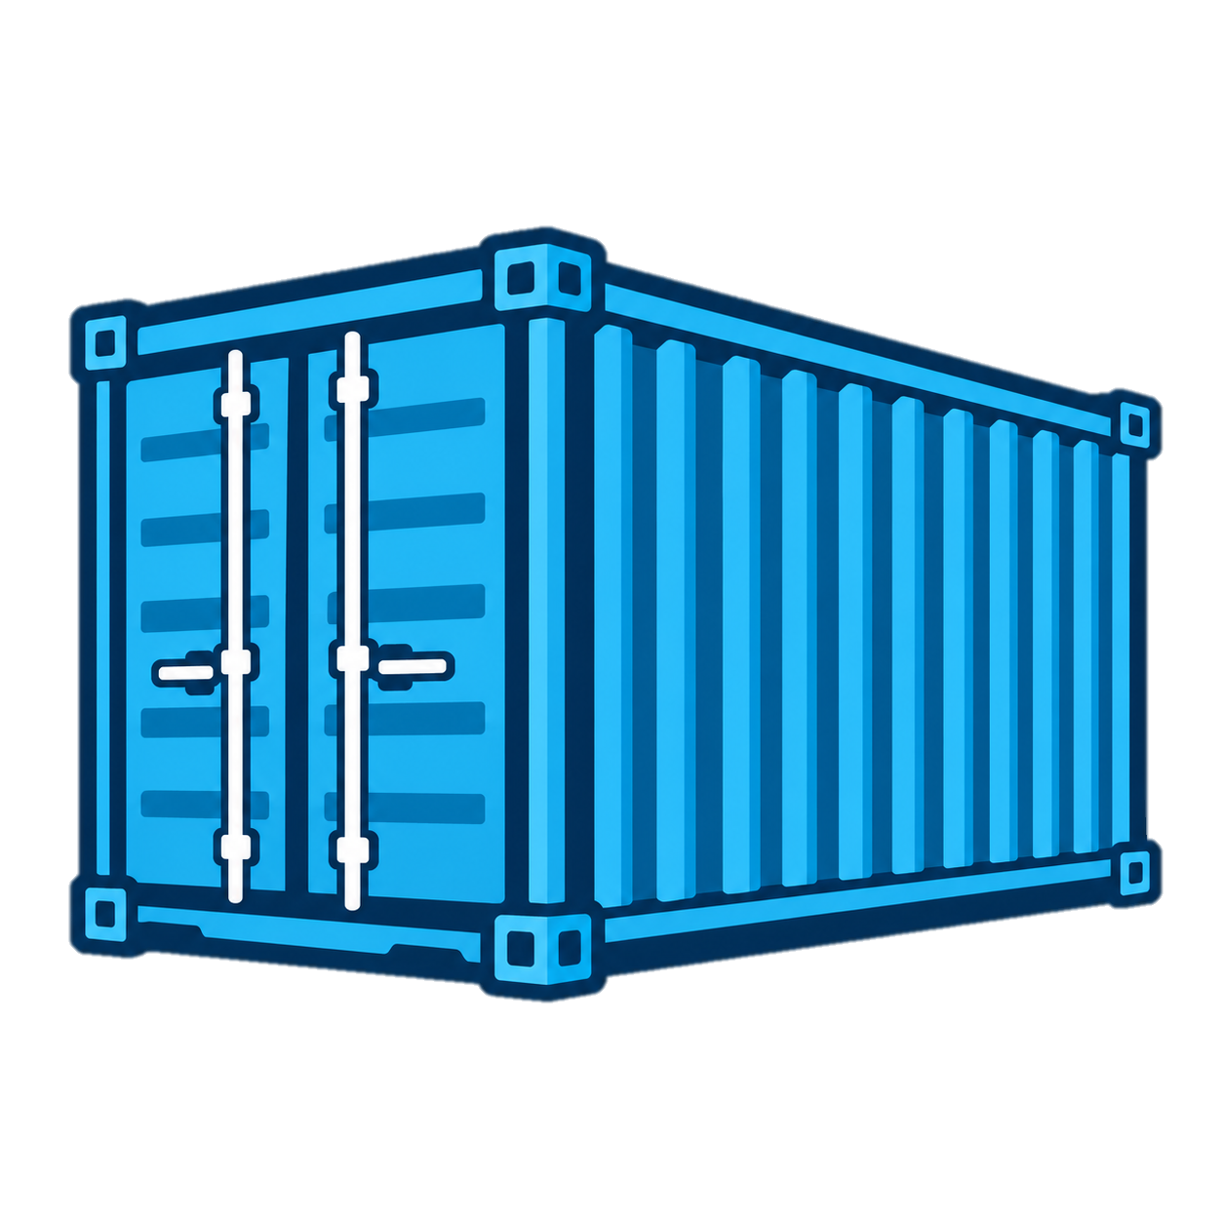





Policy response
Coordinate deployment, mobilise capital and simplify access
D. Coordinate vessel investment and infrastructure deployment
E. Develop a dedicated blended-finance facility
F. Make support easier to access
Concessional finance
Guarantees
Align infrastructure investment (CEF, AFIF) with vessel-support schemes and corridor-specific technology deployment
Support common technical standards and approval routes
Simplify procedures
Aggregate small projects
Provide financing & technical support (e.g. Ship Financing Portal)
Lower transaction costs especially for small operators
Commercial finance
Grants
EU instruments:
InvestEU, European Competitiveness Fund
Source: CE Delft & Logistic Navigators (2026), Chapters 6–7.
Notes:
[Sources]
- Draft study, Chapter 7: coordinate vessel and infrastructure policy; develop a dedicated blended-finance facility; develop an IWT financing and technical-support one-stop shop.
- Draft study, Chapter 6.2.1: technology standardisation, industrial scale-up and clearer approval routes reduce deployment risk and complement the formal recommendations.

Slide 17
Policy response
Implications for the European Parliament
Create a coherent EU policy framework
Lower investment risk
Coordinate support and
improve access to support
Promote coherent EU-wide price and demand signals across Member States
Keep monitoring and compliance proportionate
Establish an IWT financing window under the next Multiannual Financial Framework to develop a dedicated blended-finance facility
Combine grants, risk-sharing and private finance
Ensure a coherent framework for IWT decarbonisation, with:
coordinated vessel and infrastructure support, and
effective access to support, especially for small operators
Takeaway: financing follows bankability.
Private capital can be mobilised when policy improves cash-flow certainty, reduces deployment risks and shares remaining financing risks.
Source: Terms of Reference CASP/TRAN/2026-05; CE Delft & Logistic Navigators (2026), Chapters 6–7.
Notes:
[Sources]
- Terms of Reference, section 2: recommendations should be relevant to EU decision-making, with particular focus on the role and competences of the European Parliament.
- Draft study, Chapters 6–7: integrated policy package, EU coordination, dedicated blended finance, infrastructure coordination and simplified access for small operators.
- This slide is an authors’ synthesis of how the study recommendations map onto Parliament’s legislative, budgetary and scrutiny functions.

