Slide 1
SMEs in Critical Technologies
Enhancing competitiveness through Cohesion Policy Funds
Authors: PPMI, part of the Verian group
Presenter: Stefan Apostol, Senior Researcher
Notes:
Opening (30–40 seconds)
This study was requested by the REGI Committee to examine how EU Cohesion Policy supports SMEs operating in critical technologies. The focus is on competitiveness, scale-up, and territorial implications, particularly in the context of STEP and the upcoming 2028–2034 Multiannual Financial Framework. The analysis combines quantitative evidence with firm-level data and qualitative case studies.

Slide 2

Objectives of the study
Examines how EU Cohesion Policy contributes to strengthening the competitiveness of SMEs operating in critical technology sectors
Formulates policy recommendations for the 2028-2034 Cohesion Policy framework

Slide 3
Critical technologies and the role of SMEs
01

Slide 4
From crisis response to coordinated investment
Critical technologies and the role of SMEs
Sept 2022
Sovereignty Fund announced (SOTEU)
June 2023
EU Economic Security Strategy
Oct 2023
10 Critical Technology Areas defined
2024-25
STEP operational; defence window added
May 2021
Strategic dependencies mapping (137 products)
Notes:
This timeline illustrates how the concept of critical technologies evolved from strategic reflection to operational investment.
May 2021 – Strategic Dependencies Mapping.
Following the COVID-19 shock, the Commission conducted a systematic review of strategic dependencies. It identified 137 products where the EU was highly import-dependent. Importantly, this exercise extended beyond goods to technologies, highlighting risks in areas such as microelectronics and cloud infrastructure. This marked the beginning of a more structured approach to economic security.
September 2022 – Sovereignty Fund announced.
In the State of the Union address, the idea of a European Sovereignty Fund was introduced. This reflected growing recognition that reducing dependencies requires not only regulation, but large-scale investment capacity at EU level.
June 2023 – Economic Security Strategy.
The EU formalised a comprehensive economic security framework. It identified risks related to supply chains, infrastructure security, technology leakage and economic coercion. This created the policy basis for defining which technologies are considered “critical”.
October 2023 – Ten Critical Technology Areas defined.
The Commission adopted a Recommendation identifying ten strategic technology domains, with particular sensitivity attached to semiconductors, AI, quantum and biotechnology. This moved the concept from principle to operational definition.
2024–2025 – STEP operational; defence window added.
Finally, STEP translated strategy into coordinated investment. Rather than creating a new standalone fund, it pooled resources across 11 EU programmes, including Cohesion Policy. By late 2025, a defence window was added, reflecting the growing dual-use dimension of critical technologies.

Slide 5
Critical technologies are central to EU competitiveness and economic security
Critical technologies and the role of SMEs
SMEs are key innovators, but struggle to scale and commercialise
EU is strong in AI & biotech research, weaker in scale-up and capital-intensive tech
Cohesion Policy is a major, but under-examined, lever
Notes:
Why this study matters
Context setting (1–1.5 minutes)
Critical technologies have moved to the centre of EU policy debates because they underpin competitiveness, economic security, and the green and digital transitions. SMEs are key actors in these technologies. They generate innovation, supply specialised components, and anchor value chains locally.
At the same time, SMEs face persistent barriers in scaling and commercialising innovations, especially in capital-intensive and regulated sectors. While the EU performs relatively well in research-driven areas such as artificial intelligence and biotechnology, it lags behind global competitors in scaling and industrial deployment.
Cohesion Policy is one of the EU’s largest investment instruments, yet its role in supporting SMEs in critical technologies has not been systematically assessed. This study addresses that gap.

Slide 6
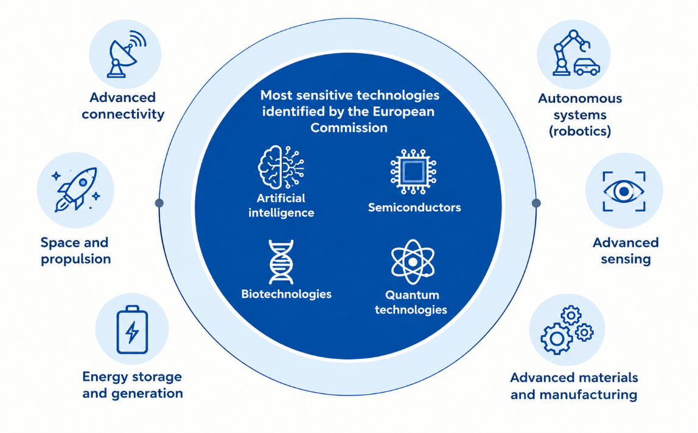
10 critical technologies identified by the European Commission
Critical technologies and the role of SMEs
Source: The European Commission’s 2023 Recommendation on Critical Technology Areas

Slide 7
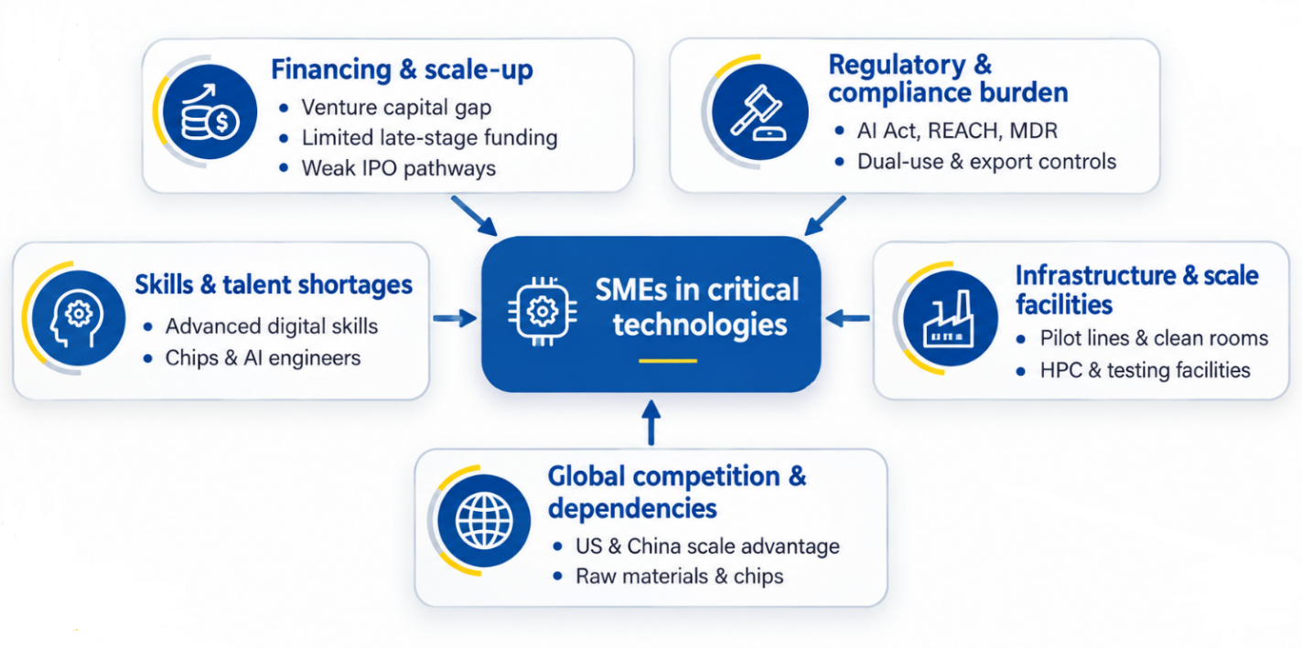
Structural barriers of SMEs
Critical technologies and the role of SMEs
Many of these constraints affect SMEs more broadly, but capital intensity, regulatory complexity and specialised infrastructure make them particularly acute in critical technologies.
Notes:
Barriers faced by SMEs
Structural constraints (1.5 minutes)
Across all technologies, SMEs face a combination of structural barriers. These go well beyond access to finance.
First, scale-up finance gaps remain significant, particularly for late-stage and high-risk investments. Second, regulatory and administrative complexity imposes high fixed costs on SMEs, especially in biotechnology and AI. Third, skills shortages and uneven access to specialised infrastructure—such as pilot lines, testing facilities, or computing capacity—constrain growth.
These barriers are cumulative and particularly acute in capital-intensive and highly regulated technologies.

Slide 8
From context to evidence
02

Slide 9
Support is concentrated in digital technologies
From context to evidence
EU contribution by critical technology (2014-2023)
Sources: Based on Kohesio and ORBIS datasets.
Notes:
Where funding goes
Funding patterns (1–1.5 minutes)
The analysis shows a strong concentration of Cohesion Policy support in digital technologies. Artificial intelligence and advanced connectivity account for the largest share of projects and funding.
By contrast, biotechnology and energy technologies receive significantly lower allocations, despite their strategic relevance for health, resilience, and decarbonisation.
Across all technologies, support is predominantly oriented towards R&D, innovation, and technology transfer, with comparatively limited funding for market deployment and scale-up.

Slide 10
Support is weighted toward R&D and technology transfer
From context to evidence
Market deployment and scale-up receive comparatively less support
Sources: Based on Kohesio and ORBIS datasets.
Notes:
Where funding goes
Funding patterns (1–1.5 minutes)
The analysis shows a strong concentration of Cohesion Policy support in digital technologies. Artificial intelligence and advanced connectivity account for the largest share of projects and funding.
By contrast, biotechnology and energy technologies receive significantly lower allocations, despite their strategic relevance for health, resilience, and decarbonisation.
Across all technologies, support is predominantly oriented towards R&D, innovation, and technology transfer, with comparatively limited funding for market deployment and scale-up.

Slide 11
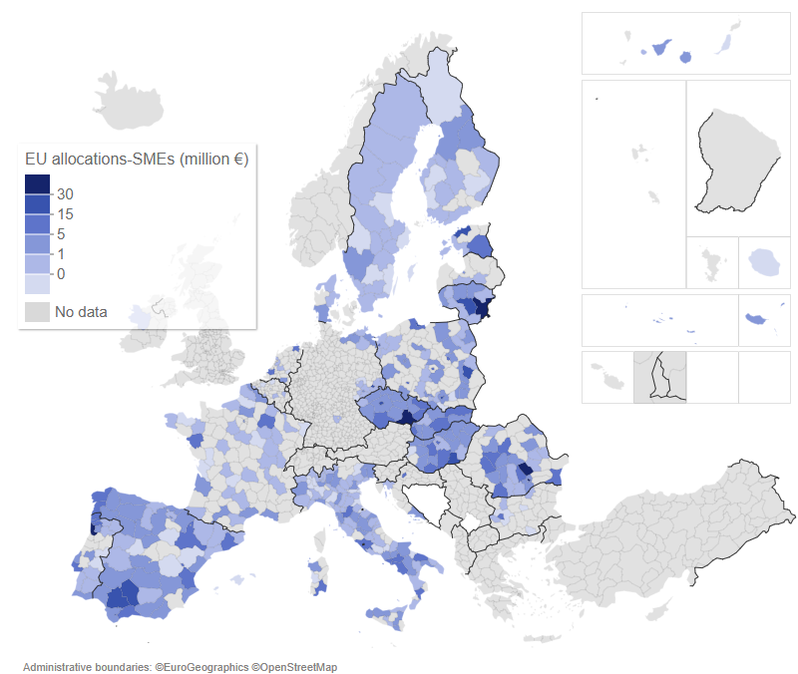
Cohesion Policy spreads critical technologies across regions
From context to evidence
Regional distribution of EU contribution to SMEs (cumulative for the four critical technologies)
Strong territorial reach
Supports convergence
But diffusion remains uneven
Source: Based on Kohesio and ORBIS datasets.
Notes:
Territorial patterns
Regional dimension (1 minute)
Cohesion Policy funding to SMEs in critical technologies is geographically concentrated in Southern, Central and Eastern Europe. This reflects cohesion objectives and smart specialisation priorities.
Digital technologies show the widest territorial spread, indicating successful diffusion. Energy technologies also display broad regional coverage.
Biotechnology, however, remains geographically concentrated in a limited number of regions, reflecting high capital intensity, regulatory barriers, and infrastructure needs.

Slide 12
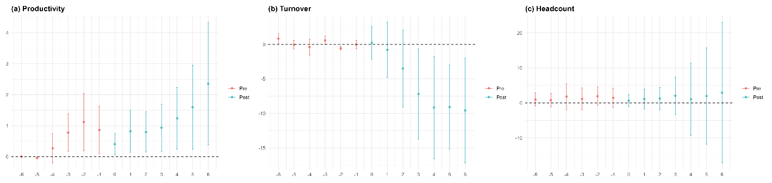
Firm-level effects are limited in the short term
From context to evidence
Dynamic treatment effects (ATT) on outcomes of energy SMEs before and after Cohesion Policy support
↗
≈
→
Positive signal after support
No clear positive effect
Limited short-term response
Source: Based on Kohesio and ORBIS datasets.
Notes:
Firm-level effects
What changes for SMEs (1.5–2 minutes)
Firm-level econometric analysis shows that short-term effects are generally limited. Clear productivity gains are observed mainly among energy-related SMEs, where projects are closer to deployment and process optimisation.
For AI and biotechnology, impacts on productivity, turnover, and employment are weak or delayed within the observed period. This reflects long innovation cycles, regulatory requirements, and the early-stage nature of many supported projects.
Overall, Cohesion Policy should be understood primarily as an enabling investment, with impacts materialising over longer horizons and in combination with complementary support.

Slide 13

Cohesion Policy works best as an enabler
From context to evidence
Artificial
intelligence
Biotechnology
Energy
technology
Notes:
Cohesion Policy works best as an enabler – case study insight (45-60 secs)
The case studies show very clearly that Cohesion Policy works best as an enabling instrument, rather than as a source of immediate firm-level performance gains.
Across AI, biotechnology and energy technologies, SMEs consistently reported that Cohesion Policy funding was decisive in allowing them to start or continue high-risk innovation activities that would not have been financed by the market alone. In AI and biotechnology, support mainly enabled early-stage research, validation and proof of concept, where uncertainty and regulatory barriers are high.
In energy technologies, projects are closer to deployment, and Cohesion Policy funding helped SMEs move from demonstration towards commercial maturity, which helps explain the stronger productivity effects observed in this sector.
Beyond individual firms, Cohesion Policy strengthened regional ecosystems through shared infrastructure, pilot facilities and collaboration with research organisations. At the same time, the case studies confirm limits: administrative complexity and weak follow-on support mean that many SMEs reach validation without a clear scale-up pathway.

Slide 14
Policy recommendations
03

Slide 15
Cohesion Policy is necessary but not sufficient
Policy recommendations
Strong at early stages, weak at scale-up & deployment
Administrative & financing barriers limit effectiveness
STEP improves strategic alignment, but scale matters
Notes:
Key conclusions
Synthesis (1 minute)
Three conclusions stand out.
First, Cohesion Policy is effective in supporting early-stage innovation and regional ecosystems.
Second, it is less effective in supporting scale-up, market deployment, and industrial integration of SMEs in critical technologies.
Third, administrative complexity and financing constraints limit participation by some high-potential SMEs.

Slide 16
Policy recommendations
Five priorities for the 2028-2034 MFF
Strategic concentration on fewer, mature projects
Sector-sensitive design (esp. energy & biotech)
Stronger sequencing with EU-level instruments
Reduced admin & financing barriers for high-risk SMEs
Strategic use of ESF+ for critical-tech skills
Notes:
Policy recommendations
Forward-looking (2 minutes)
The study proposes five priorities for the 2028–2034 MFF.
These include greater strategic concentration on fewer, more mature projects in capital-intensive technologies; sector-sensitive programme design, particularly for energy and biotechnology; and more systematic coordination with EU-level instruments through sequencing and cumulative funding.
Further priorities are reducing administrative and financing barriers for high-risk SMEs and strengthening the strategic use of ESF+ to address critical technology skills shortages.

Slide 17

Cohesion Policy remains central to EU competitiveness
Policy recommendations
Essential for territorial coverage & ecosystems
Needs stronger scale-up logic post-2027
STEP offers a workable blueprint
Notes:
Take-away for REGI
Closing (30–45 seconds)
In conclusion, Cohesion Policy remains central to EU competitiveness and territorial inclusion. However, its effectiveness in critical technologies will depend increasingly on strategic focus, scale, and coordination with EU-level instruments.
STEP provides a workable blueprint for this alignment in the next programming period.
Thank you, and I look forward to your questions.

Slide 18
Thank you!
SMEs in Critical Technologies
Enhancing competitiveness through Cohesion Policy Funds
Authors: PPMI, part of the Verian group
Presenter: Stefan Apostol, Senior Researcher

