Slide 1
Allocation of fishing opportunities in the EU
Griffin CARPENTER
Independent consultant
Committee on Fisheries (PECH) – 1 September 2026
Notes:
Accessibility - Instructions for the end user:
The slide 1 should always have the European Parliament logo as first item in the reading order / Selection Pane (note that the Selection Pane shows the objects in the reverse reading order. The object at the bottom of the list is the first one the be read out. The first on the list is the last one).
You can find the selection panel under the Home menu > Arrange > Position Objects > Selection Pane (In this particular slide you will see the correct reading order – remember, it’s from bottom to top – 1st EP Logo, 2nd Title and 3rd Subtitle)
Every slide should have a title and the title should be unique for each slide inside one PPT. If several slides belong to the same section, example: (Media Section) Media: Press; Media: Video: Media; Live events.

Slide 2
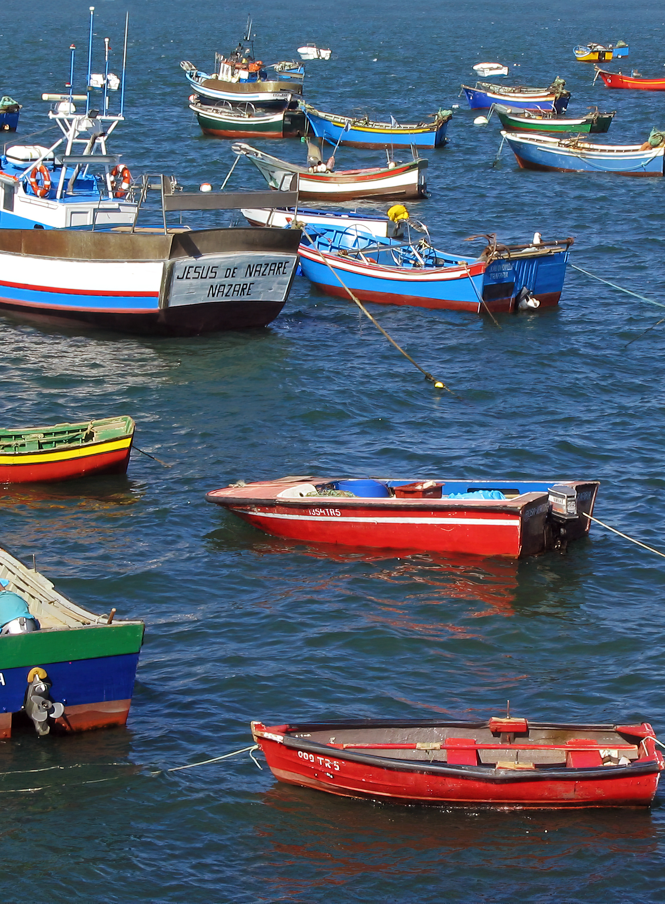
Who gets to fish?
Introduction
Fishing opportunities are quantified legal entitlements to fish, typically expressed as limits on catches (e.g. 100 tonnes of mackerel) or fishing effort (e.g. 100 days at sea).
Finite in nature, which makes them valuable.
Their allocation shapes the structure and performance of fisheries.
Some criteria must be used; there is no neutral system.

Slide 3
What Article 17 asks of Member States
EU policy
Article 17 of the Common Fisheries Policy Regulation (2014) states that Member States:
  Shall use transparent and objective criteria of an environmental, social and economic nature.
  May include impact on the environment, history of compliance, contribution to the local economy, historical catches.
  Shall endeavour to provide incentives for lower-impact fishing.
Allocation is a Member State competence, confirmed by the 2025 vade mecum.

Slide 4
EU-wide picture
Study overview
22
237
141
coastal Member States
examples of criteria in use
distinct Member State–criterion combinations

Slide 5
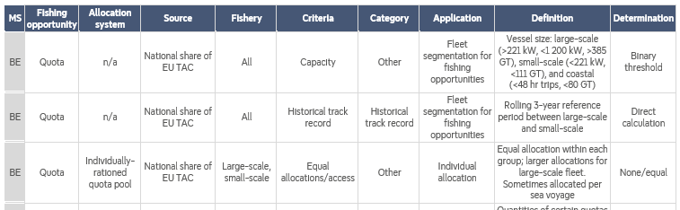
A library of criteria usage
The resource
The 237 examples are documented in a standardised library for this study.
Systems far more complex than they are usually credited for.

Slide 6
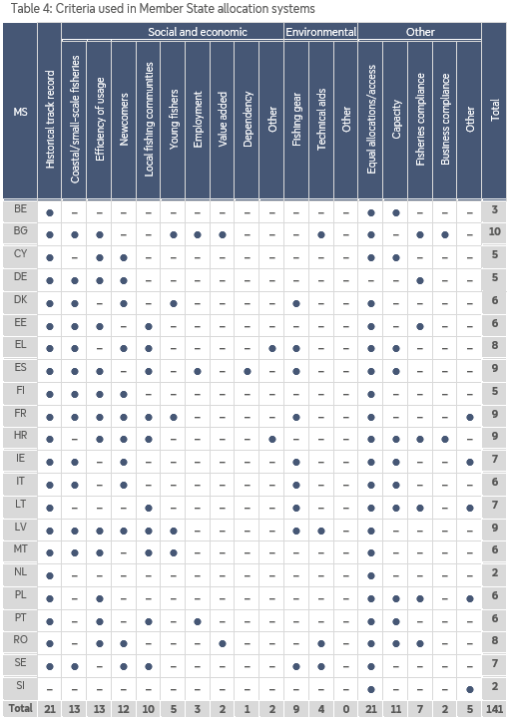
Who uses what
Findings
Almost all Member States use:
Historical catch (21)
Equal access (21)
Most Member States use:
Coastal/small-scale fisheries (13)
Efficiency of usage (13)
Newcomers (12)
Capacity (11)

Slide 7
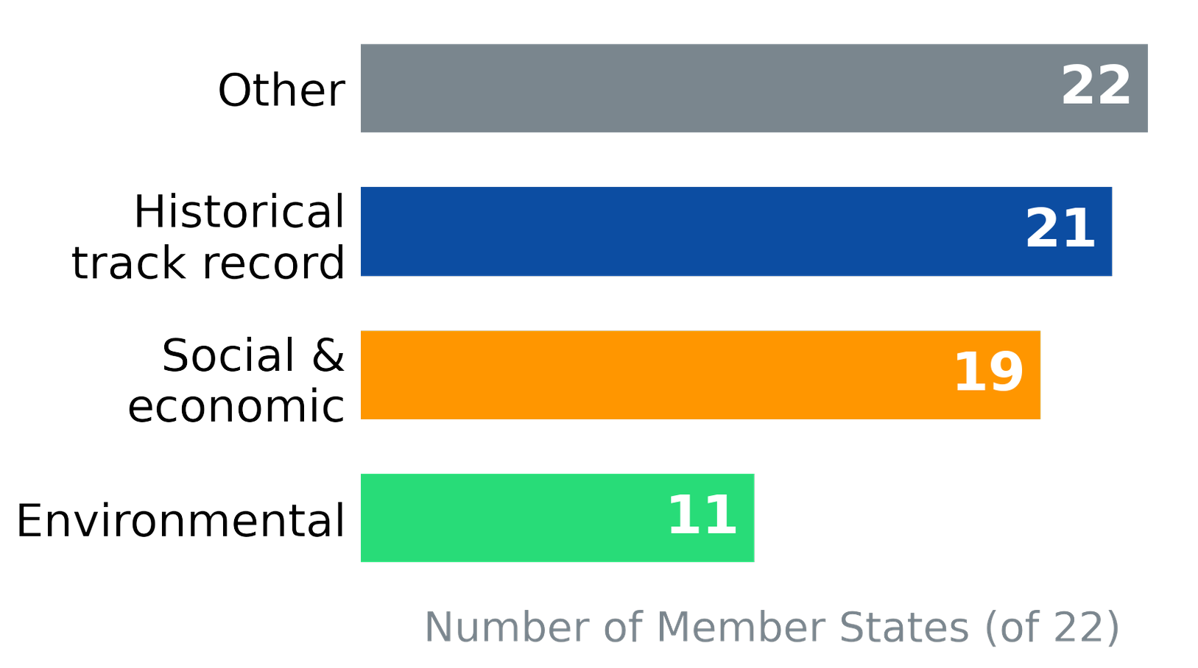
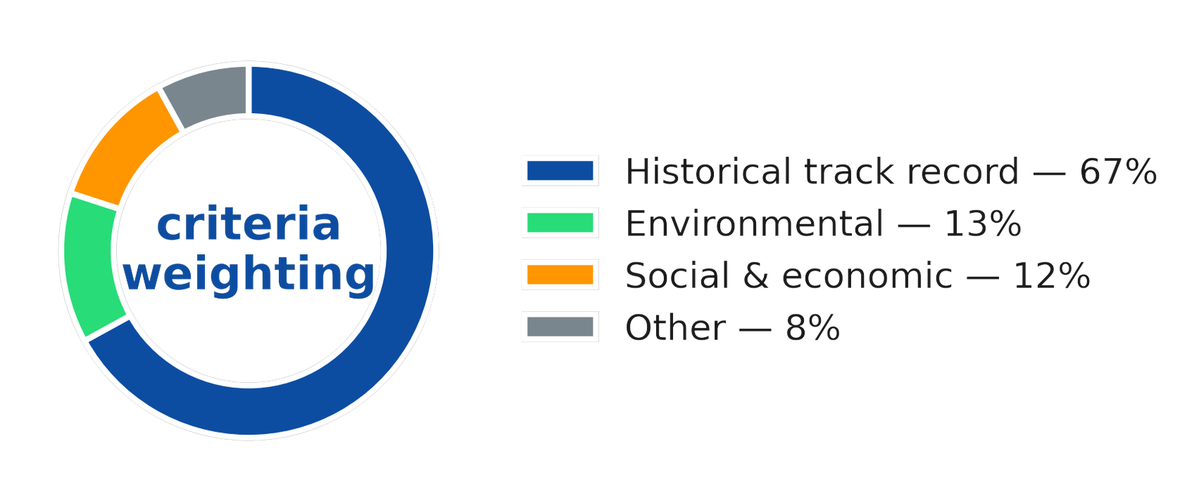
Summary of usage and weight
Findings

Slide 8
The letter of the law is weak
Key message 1
Broad and permissive: no requirement for any specific criteria or usage; left a Member State competence.
A low bar: in 12 years, no Member State system has been found non-compliant.
No effect: no Member State has changed allocation because of Article 17.
Expectations gap: between Article 17's promise and practice.

Slide 9
Member States face their own barriers to change
Key message 2
Legal: fear of ‘legitimate expectation’ litigation if quota is reallocated.
Political: fishing is politically marginal; ministers avoid a contentious overhaul.
Practical: new criteria are genuinely hard to design and administer.
Structural: secure allocations, devolved allocations and pooled allocations tie hands of Member States.

Slide 10
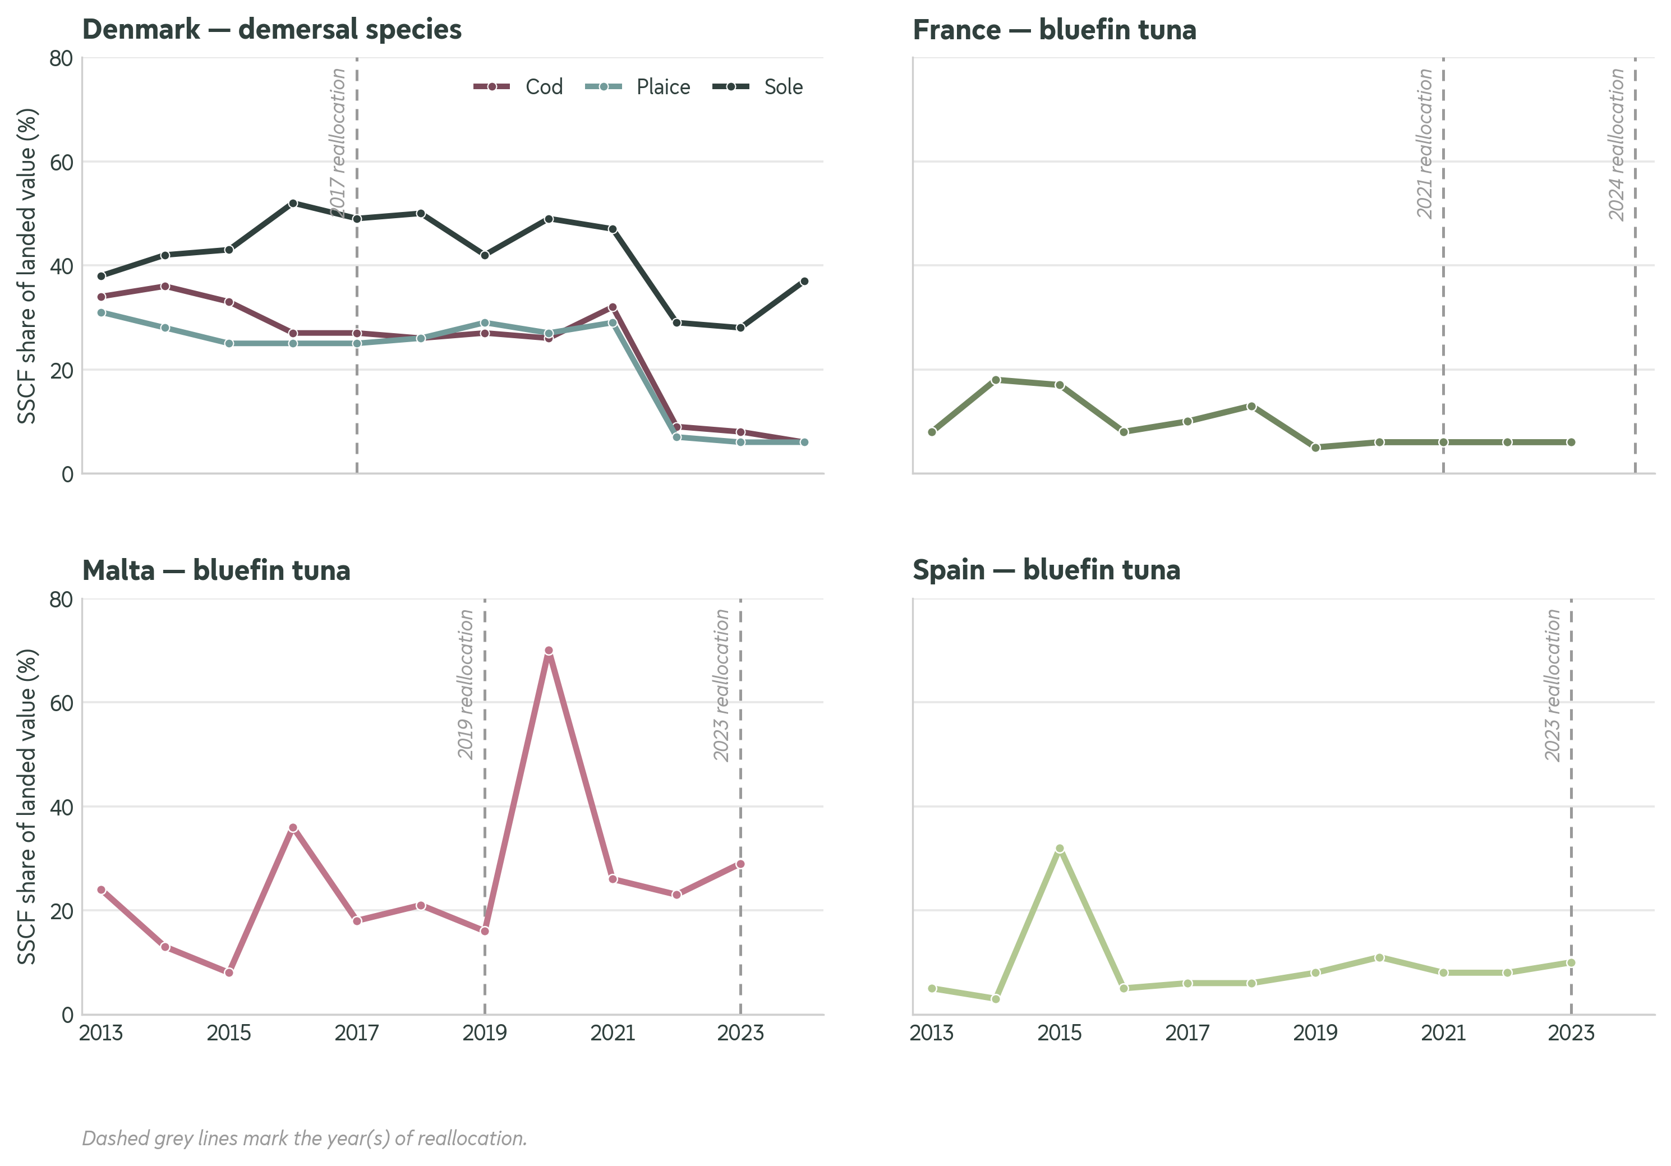
Even the spirit of the law has not delivered
Key message 3
Small-scale fleet: reallocation has not lifted its share of landings above 4%.
Environment: criteria are binary gear rules, never performance-based.
Transparency: published rules still leave stakeholders unsatisfied.
The upside: genuinely inventive approaches from points systems to quota reserves can be shared.

Slide 11
How to move forward
Policy recommendations
Peer learning: help Member States share what works.
Policy innovation: pilot and test new, performance-based criteria.
Transparency: publish who gets what, and why.
European Commission questionnaires: standardise reporting via this study's library.
Evidence base: research needed to track what drives outcomes.

Slide 12
Three things to take away
In summary
Article 17 has not shifted allocation; historical catch still rules.
The intended winners, including small-scale fishers and the environment, have not gained.
Change lies with Member States – the EU can only make it easier, better-informed, and more visible.

