Slide 1



Competitiveness of the Aviation Sector: The Impact of Fuels Prices in the Aftermath of the Middle East Crisis
David Chiaramonti
Politecnico di Torino, Italy
Photo by John McArthur su Unsplash
Notes:
Accessibility - Instructions for the end user:
The slide 1 should always have the European Parliament logo as first item in the reading order / Selection Pane (note that the Selection Pane shows the objects in the reverse reading order. The object at the bottom of the list is the first one the be read out. The first on the list is the last one).
You can find the selection panel under the Home menu > Arrange > Position Objects > Selection Pane (In this particular slide you will see the correct reading order – remember, it’s from bottom to top – 1st EP Logo, 2nd Title and 3rd Subtitle)
Every slide should have a title and the title should be unique for each slide inside one PPT. If several slides belong to the same section, example: (Media Section) Media: Press; Media: Video: Media; Live events.

Slide 2

Outlook
Section 0 - Agenda
Section 1 – Setting the scene: before Hormuz
Section 2 – The crisis: impact on EU Aviation fuel market
Section 3 – The EU reaction
Section 4 – SAF: towards EU security, autonomy and competitiveness
Section 5 – Conclusions on possible policies, regulations, industrial measures
Acronyms
bbl – oil barrel (42 US gallon, 159 liters)
BFP – CEM BioFuture Platform
CAF – Conventional Aviation Fuels
CEM – Clean Energy Ministerial
CORSIA – Carbon Offsetting and Reduction Scheme for International Aviation
EASA – EU Aviation Safety Agency
IGHG – Greenhouse Gas
IATA – International Air Transport Association
IEA – International Energy Agency
ICAO – International Civil Aviation Organization
IMO – International Maritime Organization
mb/d, kbd –Thousands barrel per day
SAF – Sustainable Aviation Fuels
Questa foto di Autore sconosciuto è concesso in licenza da CC BY-SA-NC

Slide 3


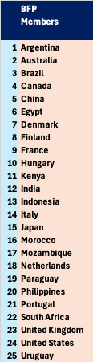




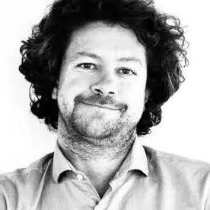







Who we are: Fit4Foresight Team @ POLITO
Section 0 - Agenda
Team Lead
Scientific and Technical expertise on biomass conversion processes, product characterization, process design, sustainability assessment, techno-economic analysis, market&economic impact assessment, carbon markets
Supporting UN-ICAO, UN-IMO, EC, IT MASE, MIT, MASAF, IT Regions, associations and private stakeholders as industries and farmers
CEM BioFuture Platform Chair since 2025. 25 Member Countries.
Facilitator
(secretariat)
Prof. David
Chiaramonti
Prof. Matteo Prussi
Prof. Carlo Cambini
Prof. Michel Noussan
Prof. Debora Fino
Prof. Samir Bensaid
Dr. Ing.Viviana Negro
Dr. Ing. Giacomo Talluri
Dr. Flavio Pino

Slide 4

The picture before the Hormuz crisis
01
Setting the scene

Slide 5
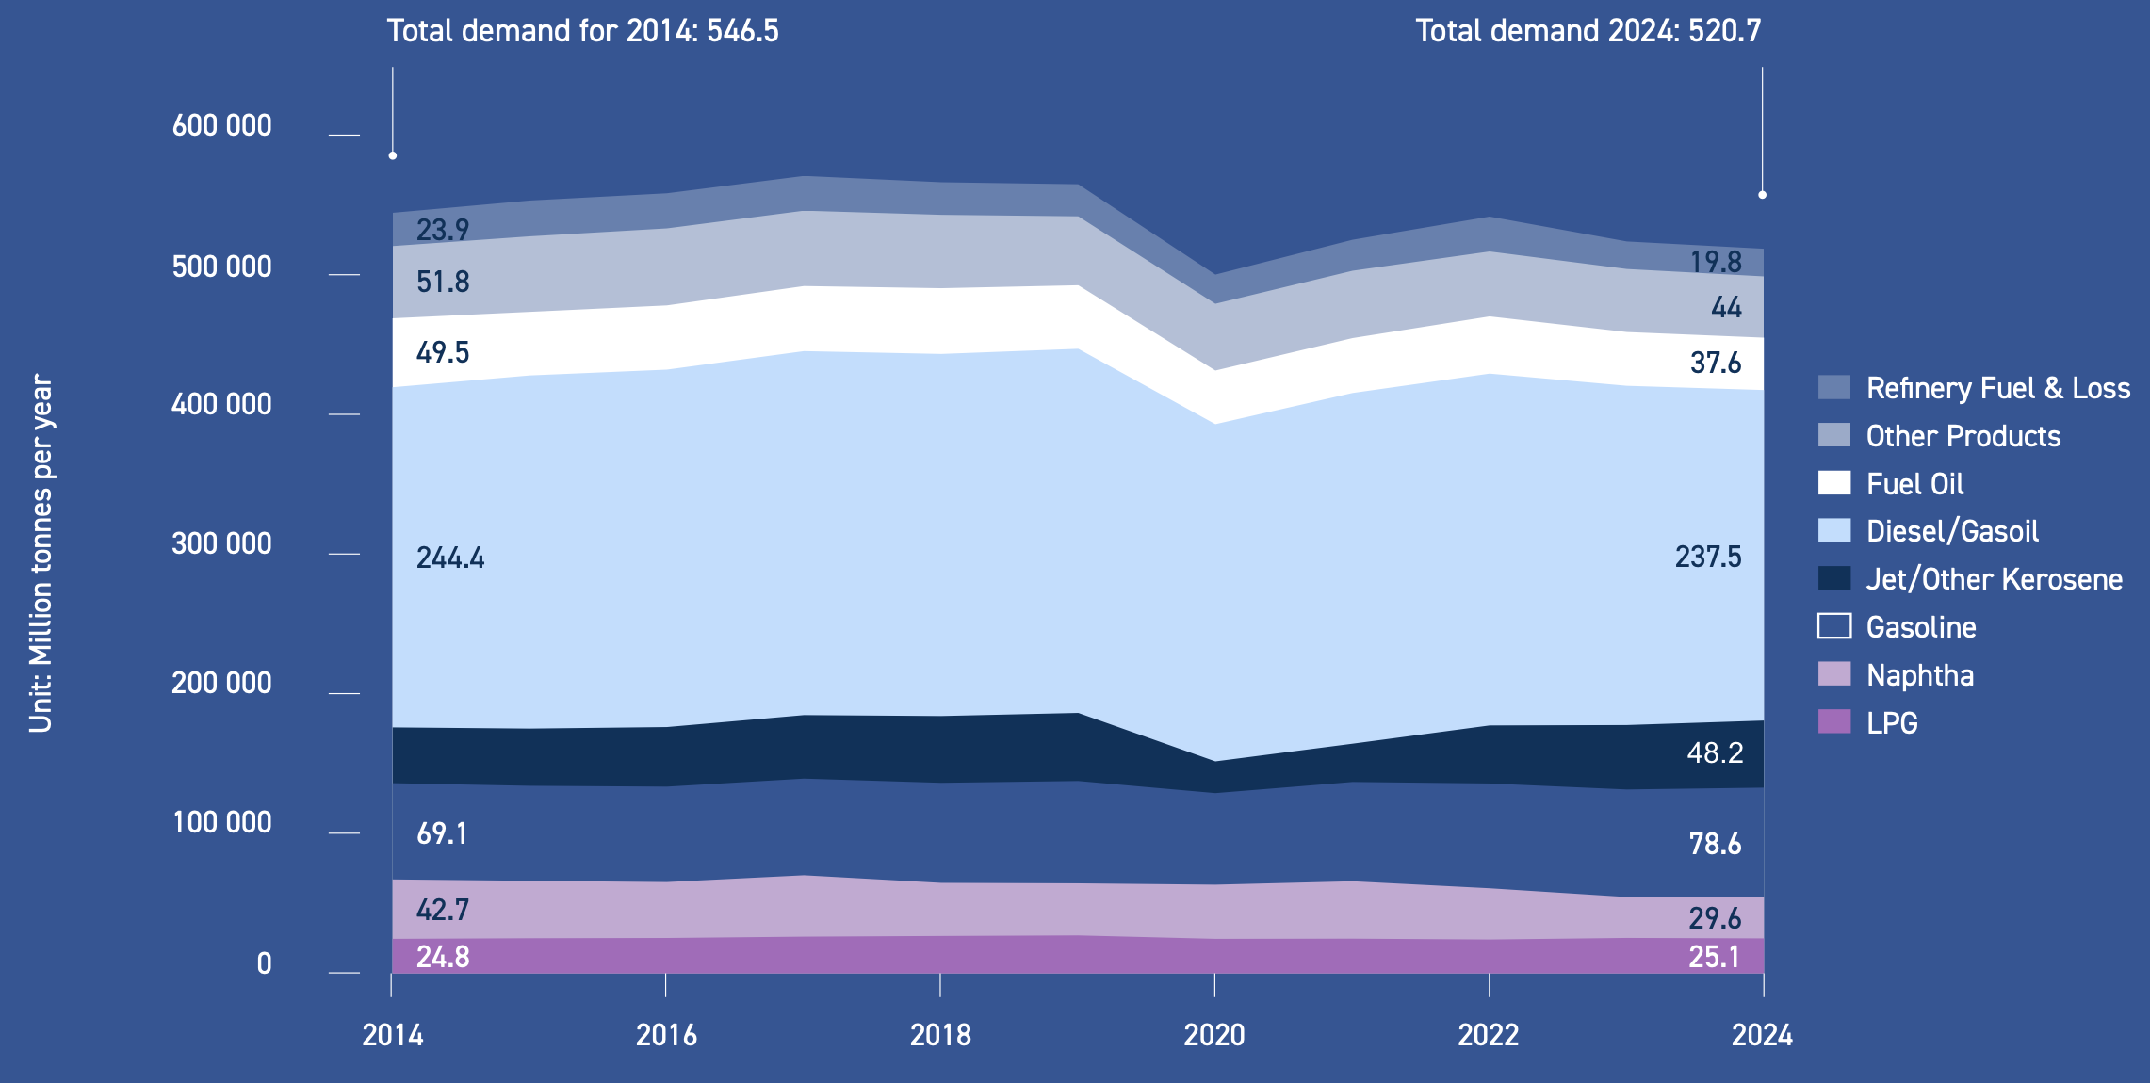


Historical fuel demand for Oil Products in the EU-27
Section 1 – Setting the scene: the picture before the Hormuz crisis
Source: Fuels Europe/Wood Mackenzie, 2025 Statistical Report
COVID
2013 to 2019
slight increase in EU demand - mainly due to rise in diesel/gasoil and kerosene demand
2020
total demand of oil products decreased by 11% vs 2019 due to Covid-19
2021 to 2024: stronger demand but did not reach 2019’s level
Notes:
2014: anno interessante perché a fronte di una produzione in espansione, la domanda globale di carburanti ha rallentato perché la Cina e l'Europa hanno frenato economicamente, i motori sono diventati più efficienti ed è iniziata spinta verso carburanti alternativi verdi (SAF).

Slide 6
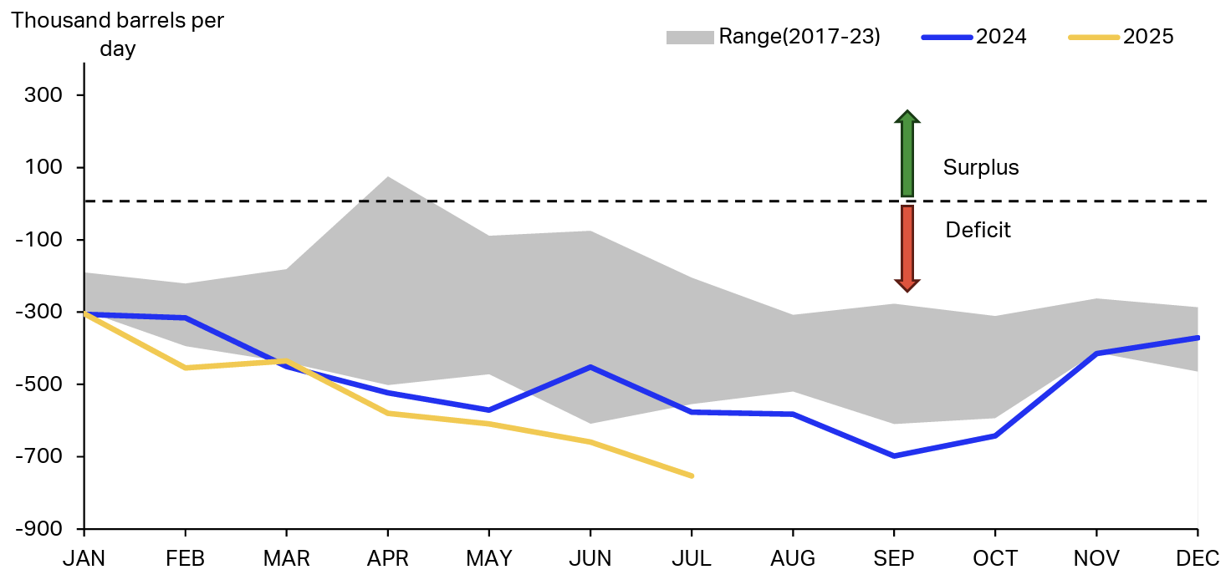

Europe’s jet fuel production minus demand
Section 1 - Setting the scene: the picture before the Hormuz crisis
2025: 4 EU refineries ceased crude oil processing (loss of ∼400,000 bpd)
Tot EU refining capacity could decline by > 5 mill.bpd by 2050, ∼ 50% of region’s 2024 capacity (13 mill.bpd)
Source: S&P Global Commodity Insights
Year
Source: IATA/Kpler
EU depends on jet fuel imports, most from Middle East and the Asia Pacific region

Slide 7
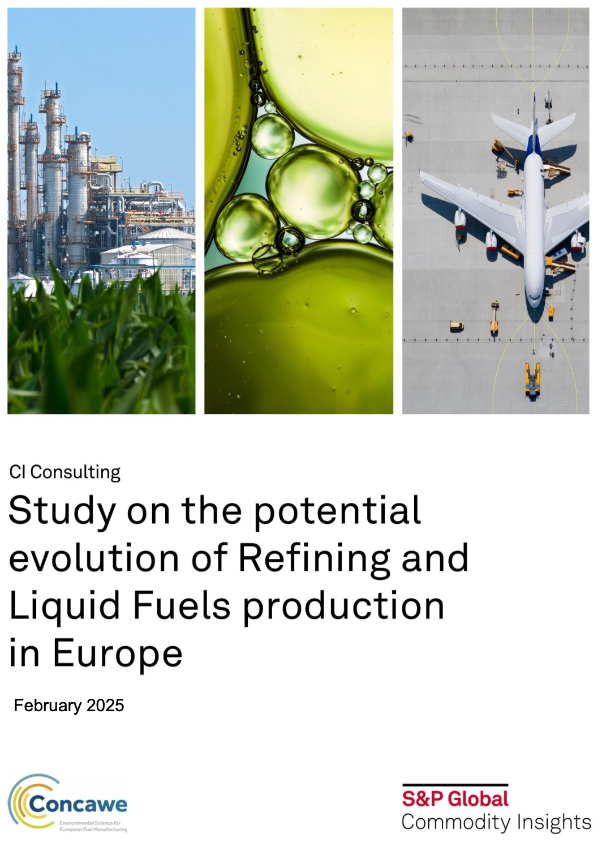
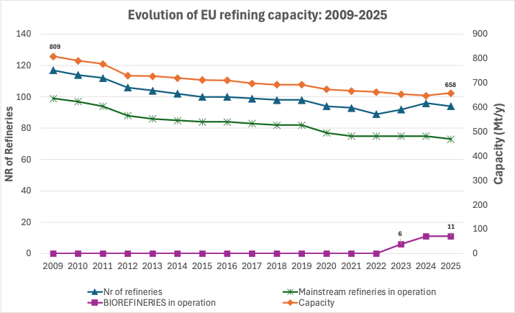
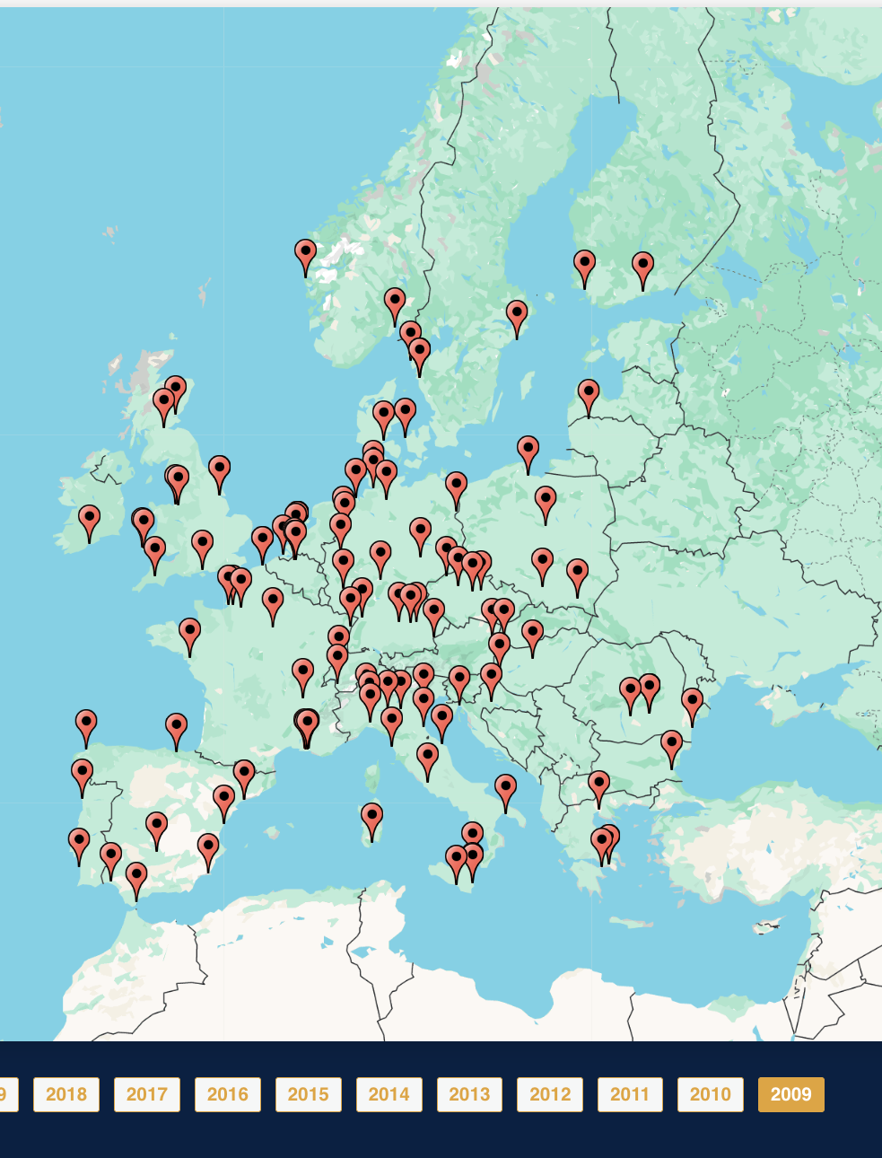
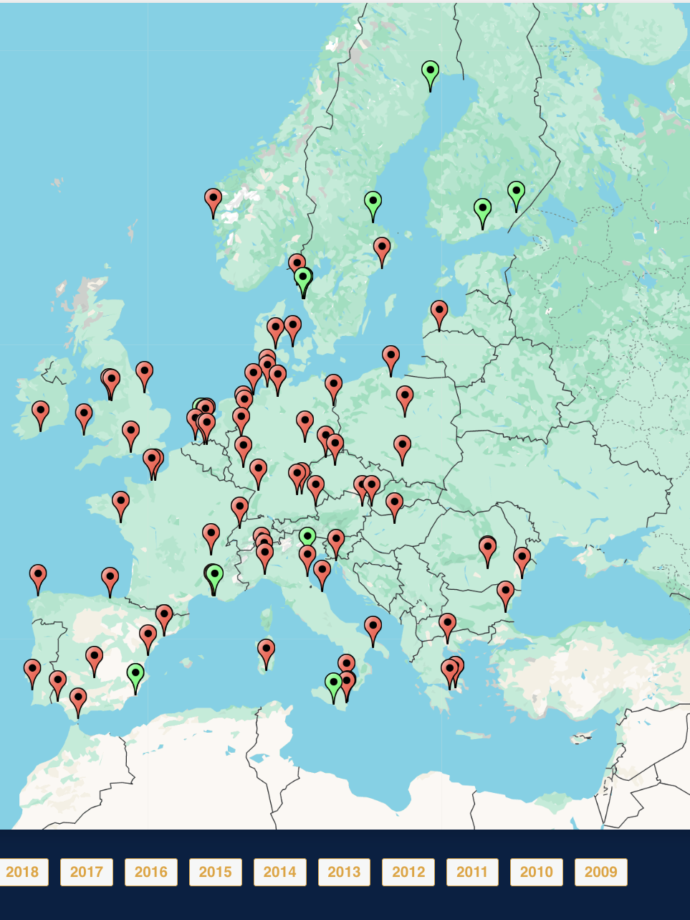
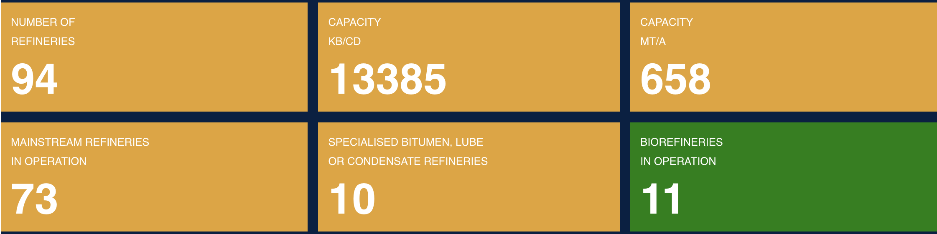
Refineries in the EU
Source:
Section 1 - Setting the scene: the picture before the Hormuz crisis
The evolution of EU Refining: from 2009 to 2025
2009
2025
https://www.concawe.eu/refineries-map/
EU has just 73 mainstream oil refineries in operation, compared with more than 130 in the US and about 300 across Asia
Source: elaborated from Financial Times and Concawe. June 2026

Slide 8
The crisis: impact on EU Aviation fuel market
02

Slide 9

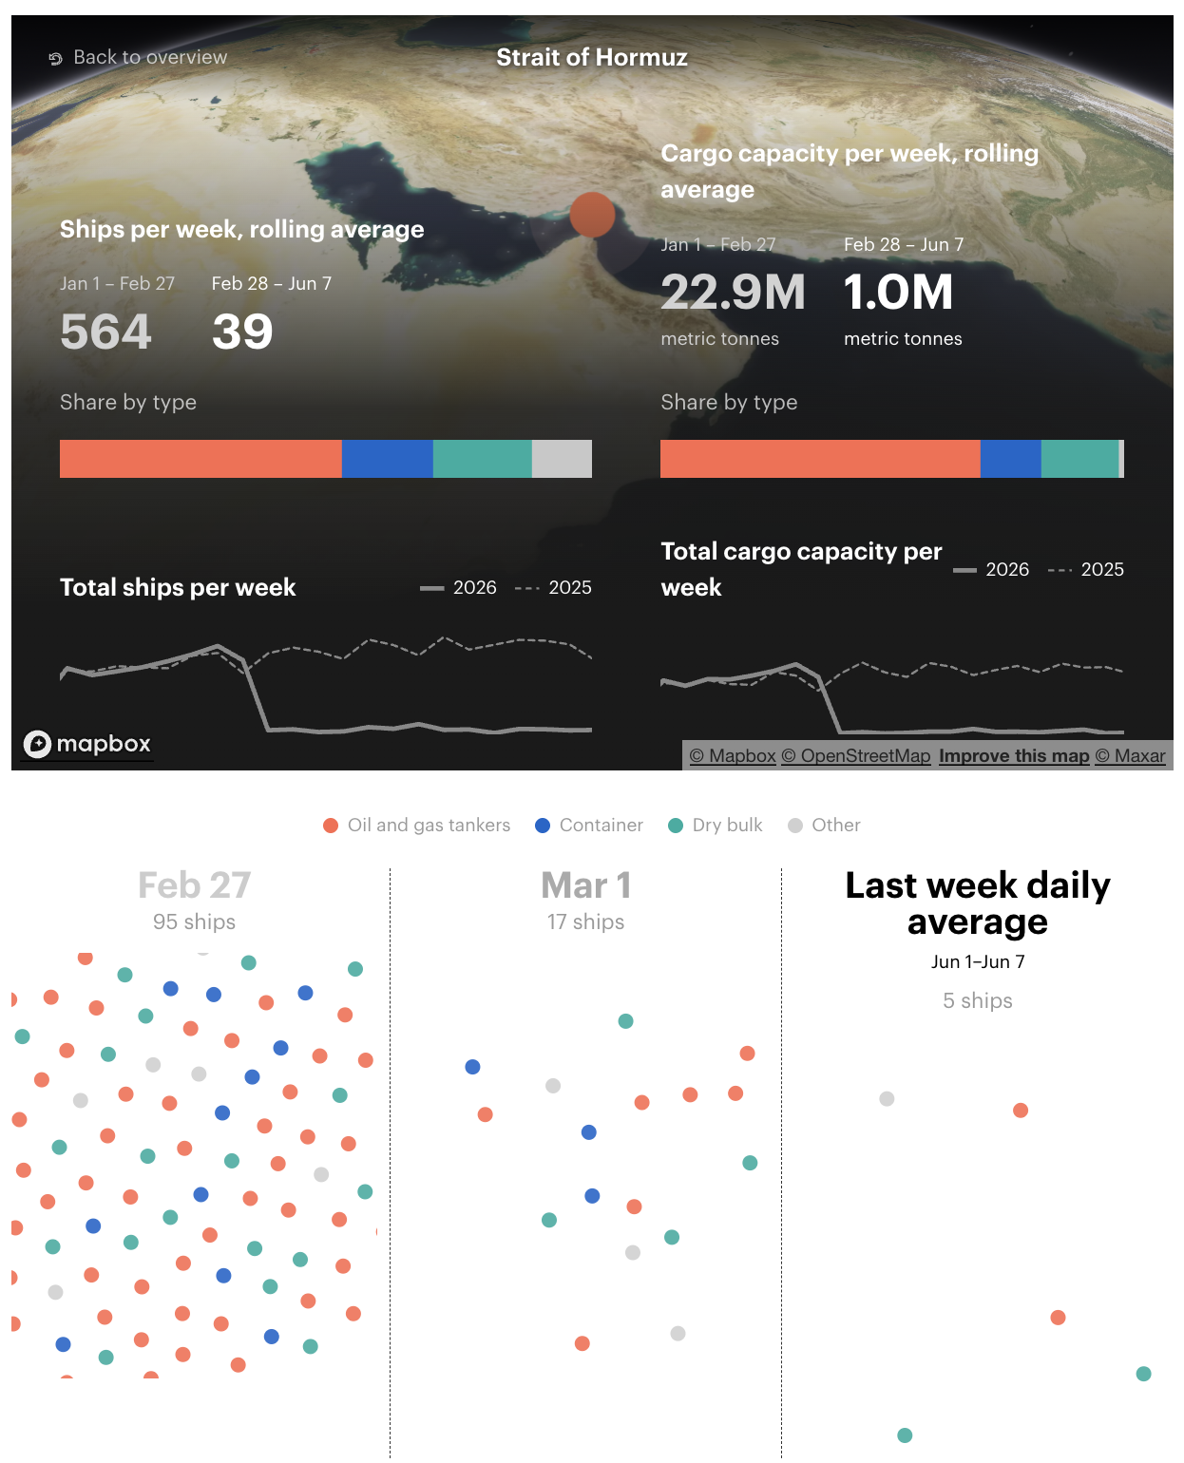
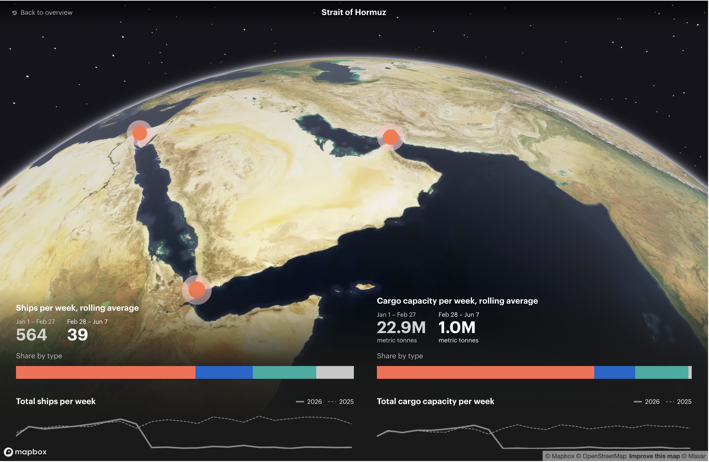
IEA - Middle East Maritime
Chokepoints Shipping Monitor
Section 2 - The crisis: impact on EU Aviation fuel market
IEA Interactive map
IEA: the largest supply disruption in the history of the global oil market, while also impeding critical flows of natural gas and other key commodities. 3 months interruption of 20% global oil supplies
…but….
oil did not reach 2008 all time spike ($ 140), nor the 2022 figure of $ 114 after the invasion of Ukraine, reaching $ 109 in April 2026
(considering WTY NIMEX inflation adjusted average-USD)
Suez Canal
Strait of Hormuz
Strait of Bab
el-Mandeb
Notes:
The reason for the all time high being China demand growth vs under-investments

Slide 10

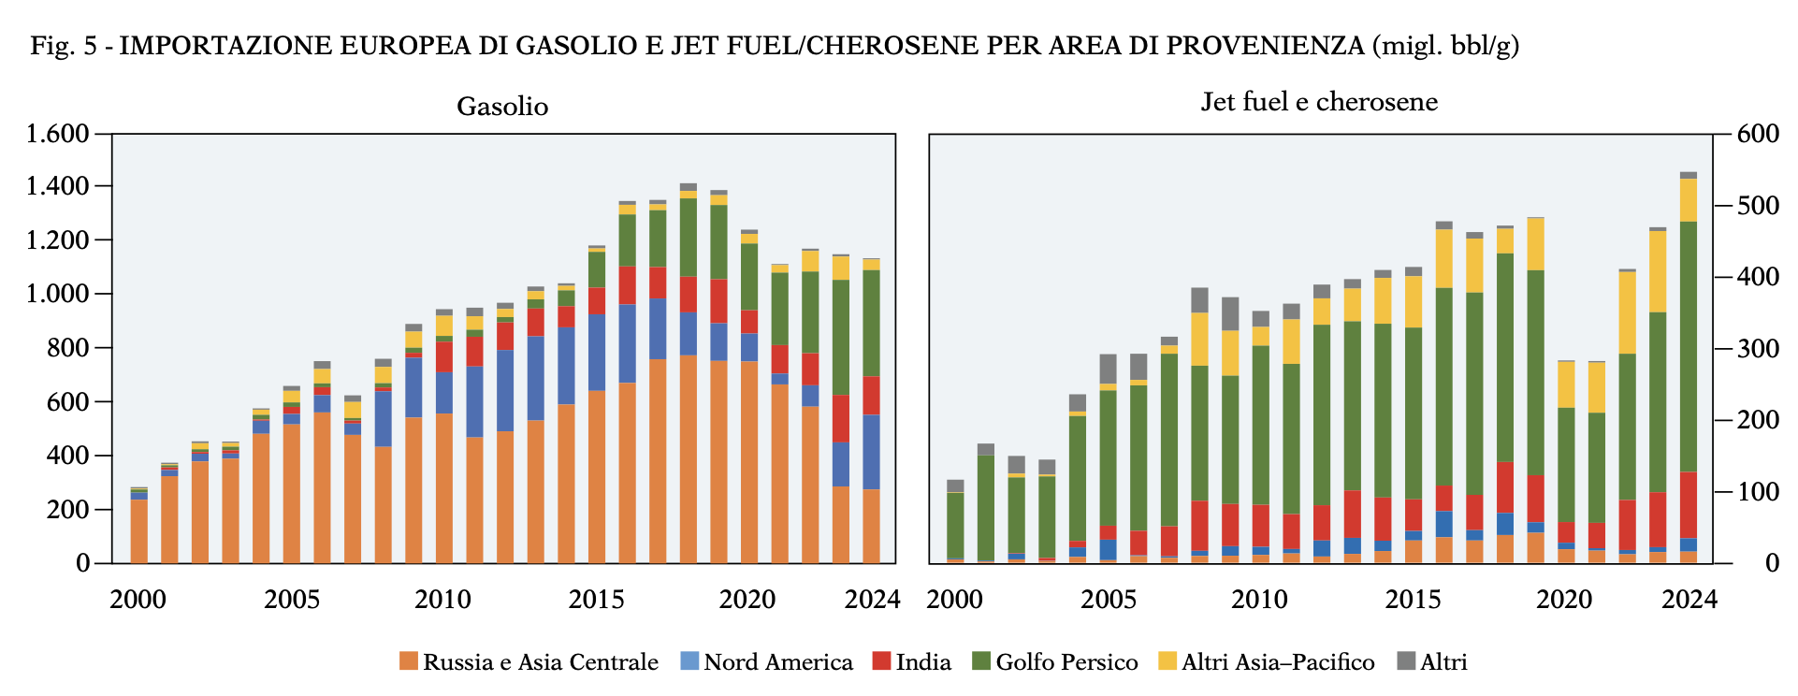

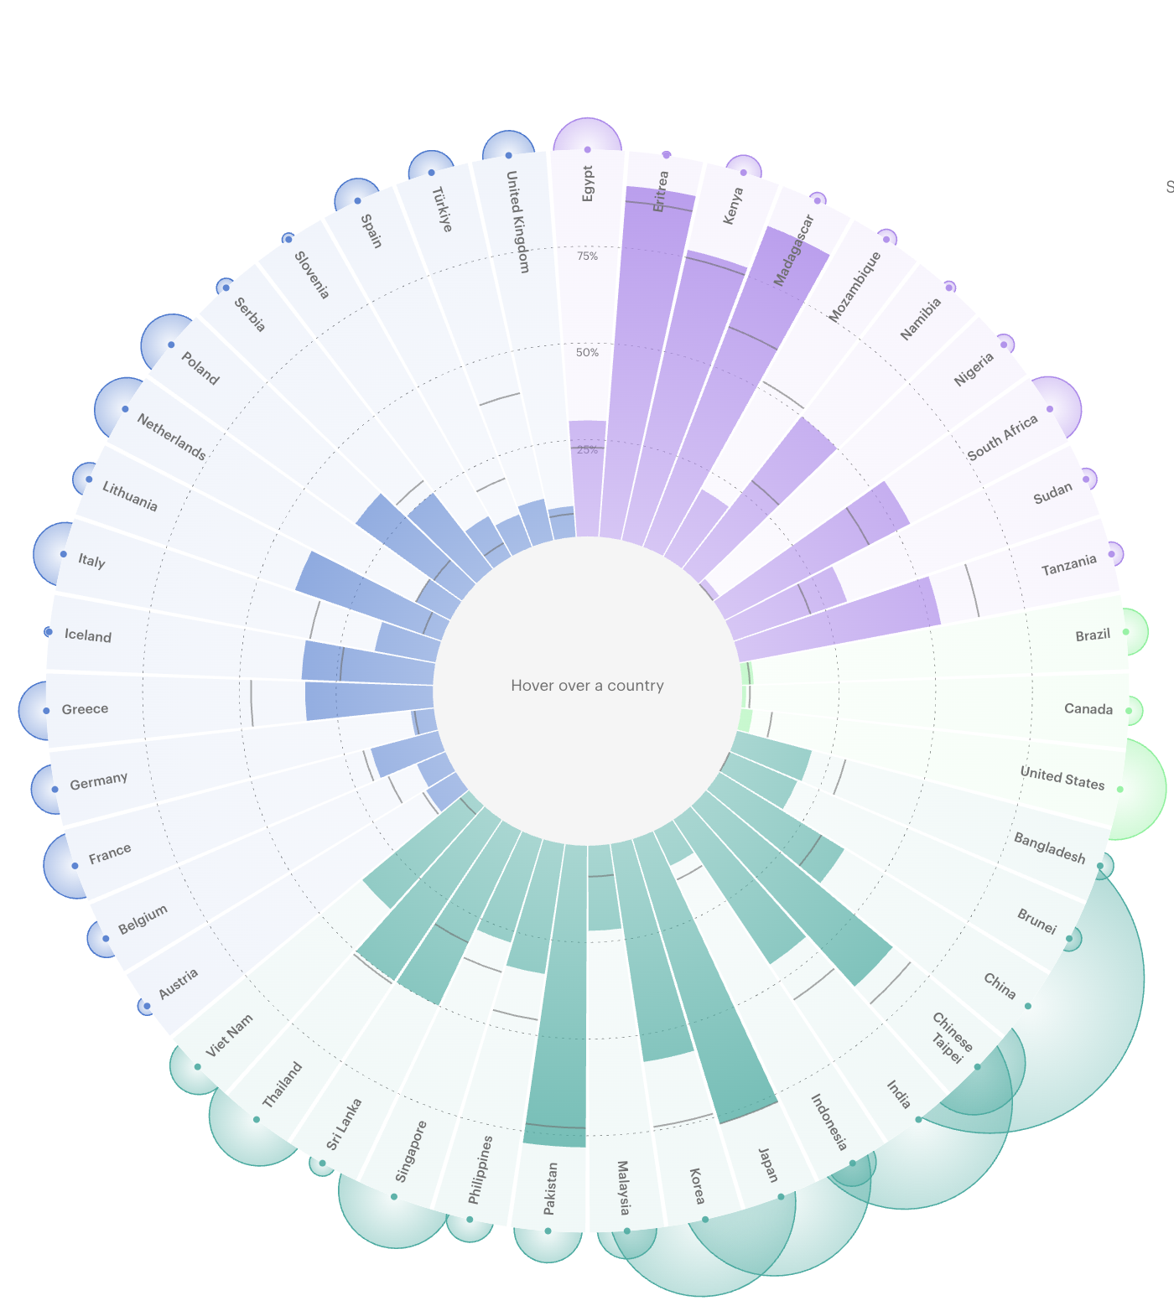
Reliance on Middle East
Oil Supplies by Country
Oil
Jet/Kero
Source: Ulivieri R, A. Energia, , 2026
Section 2 - The crisis: impact on EU Aviation fuel market
EU import of diesel & jet/kerosene
per region of origin (mbbl/d)
Diesel
Interactive map
 | 2024 (kt) | 2017 (kt) | Import Volume (kt)
Austria | 1 | 2 | -0,32
Belgium | 5 | 10 | -5
France | 15 | 20 | -6
Germany | 8 | 7 | 2
Greece | 11 | 17 | -5
Iceland | 0,33 | 0,23 | 0,1
Italy | 14 | 30 | -17
Lithuania | 4 | 0,6 | 3
Netherlands | 14 | 16 | -2
Poland | 13 | 3 | 10
Serbia | 1 | 1 | -0,8
Slovenia | 0,59 | 0,21 | 0,38
Spain | 7 | 17 | -10
Turkiye | 7 | 23 | -16
United Kingdom | 9 | 8 | 1
EU+Tur+
UK
Africa
Jet Fuel &
kerosene
Americas
Asia
Most of jet fuel import from Gulf
https://www.iea.org/data-and-statistics/data-tools/reliance-on-middle-east-oil-and-gas-supplies-by-country?utm_campaign=IEA+newsletters&utm_medium=Email&utm_source=SendGrid

Slide 11
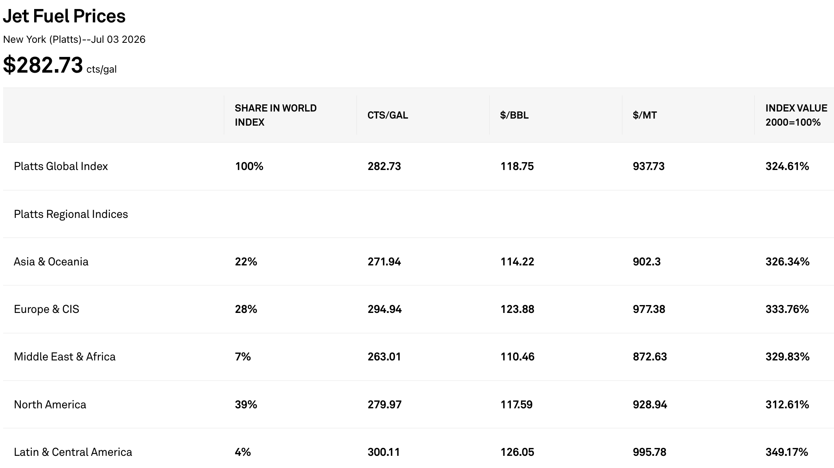
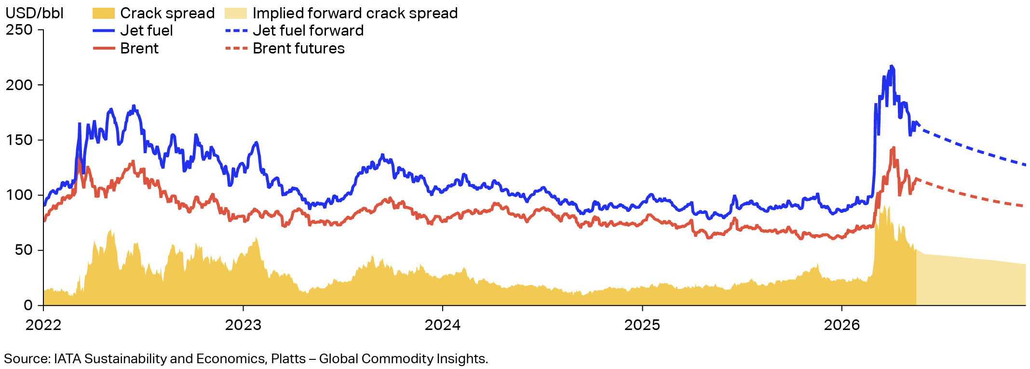


Jet price monitoring
Section 2 - The crisis: impact on EU Aviation fuel market
Notes:
Around 25% of the world’s seaborne oil trade transited the Strait in 2025, and options for oil flows to bypass the Strait of Hormuz are limited. Only Saudi Arabia and the UAE have operational crude pipelines that could potentially reroute flows to bypass the Strait, with an estimated 3.5 mb/d to 5.5 mb/d of available capacity. Other countries, including Iran, Iraq, Kuwait, Qatar and Bahrain, rely on the Strait to deliver the vast majority of their oil exports.
About 80% of oil and oil products transiting the Strait in 2025 was destined for Asia.
In addition, over 110 bcm of LNG passed through the Strait of Hormuz in 2025. About 93% of Qatar’s and 96% of the UAE’s LNG exports transited through the Strait, representing almost one-fifth of global LNG trade. There are no alternative routes to bring these volumes to market.
Most LNG from Qatar and the UAE goes to Asia. In 2025, almost 90% of the total volumes exported via the Strait of Hormuz was destined for the Asian market – accounting for more than a quarter of the region's total LNG imports. Just over 10% went to Europe.
Various other commodities markets have also been affected by disruptions to shipping in the Strait of Hormuz, with implications for energy and beyond.
Fertiliser supply is particularly exposed. More than 30% of global trade of urea moves through the Strait, along with about 20% of trade of ammonia and phosphate. This creates risks for food prices and security. Moreover, disruptions in this sector could have indirect effects on energy markets, since some countries use imported LNG to run domestic fertiliser plants.
Additionally, the Gulf region produces around 8% of the global supply of aluminium, which is used in numerous energy technologies, as well as in construction and manufacturing. About 5 million tonnes of the metal are shipped each year through the Strait from smelters in Bahrain, Qatar, Saudi Arabia and the United Arab Emirates.
Around half of global seaborne sulphur trade also moves through the Strait of Hormuz. Sulphuric acid is used not only to produce fertiliser and chemicals, but also in the refining of petroleum and critical minerals such as copper, nickel and zinc.

Slide 12
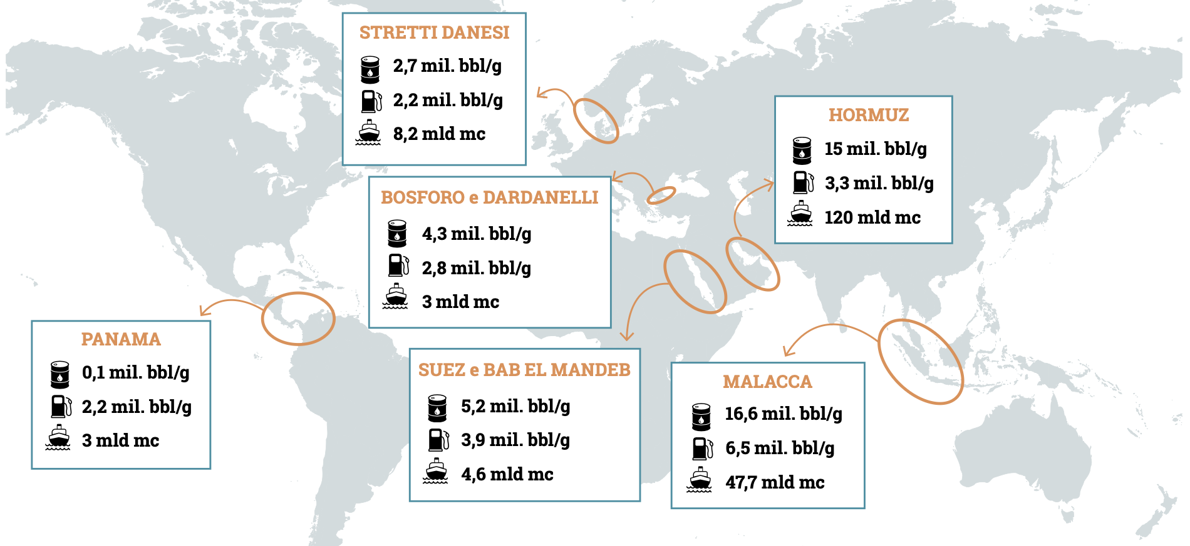

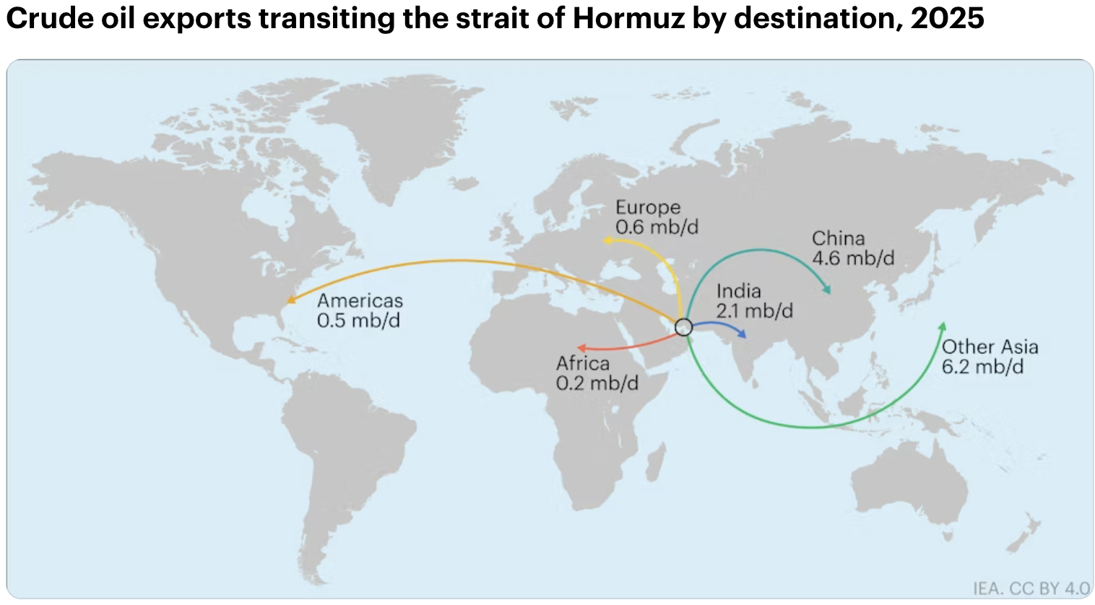
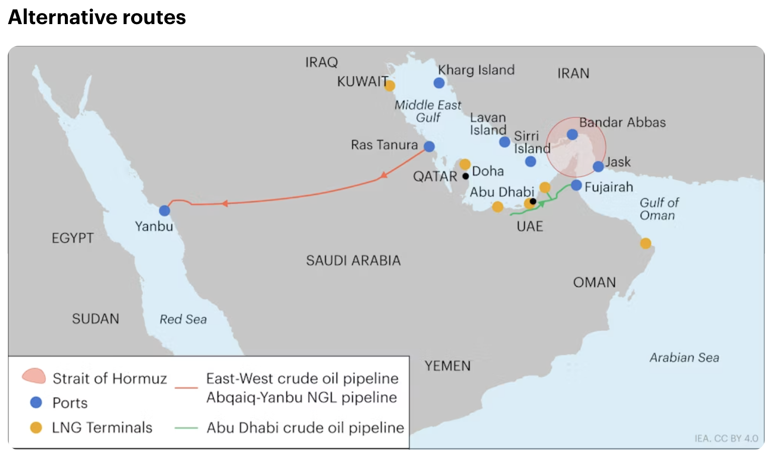

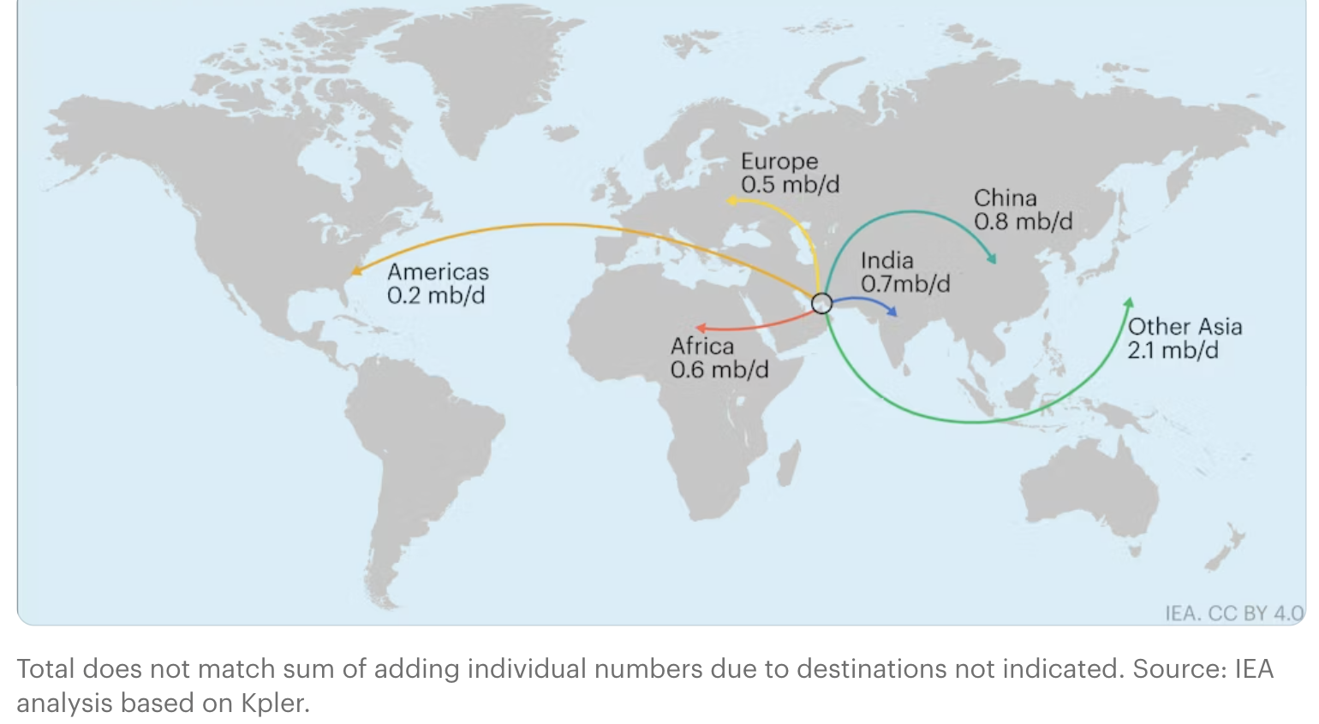
Oil & Alternative routes
Data refer to 1° semester 2025 - Source: Gugliotta, A. Energia, , 2026
Section 2 - The crisis: impact on EU Aviation fuel market
DANISH STRAITS
Danish straits
HORMUZ
Oil
Refined Products
LNG
BosPhorus & Dardanelles
TOT export through Hormuz: 14.2 mb/d
Crude Oil from Gulf to EU: 4.2%
PANAMA
4.2%
SUEZ&BAB EL MANDEB
MALACCA
32.4 %
3.5 %
14.8 %
43.7 %
Africa 1.4 %
TOT export through Hormuz: 4.9 mb/d
Yanbu: 7 mill bbl/d
(1.8 Saudi refin.capac.)
Fujairah: 1.5-1.8 mill bbl/d
(to be doubled)
10.2%
16.3 %
4.1 %
14.3 %
42.9 %
Oil products from Gulf to EU: 10.2%
Africa 12.2 %
Other: Iraq (up to 1.5 mill.bbl/d)
Notes:
Around 25% of the world’s seaborne oil trade transited the Strait in 2025, and options for oil flows to bypass the Strait of Hormuz are limited. Only Saudi Arabia and the UAE have operational crude pipelines that could potentially reroute flows to bypass the Strait, with an estimated 3.5 mb/d to 5.5 mb/d of available capacity. Other countries, including Iran, Iraq, Kuwait, Qatar and Bahrain, rely on the Strait to deliver the vast majority of their oil exports.
About 80% of oil and oil products transiting the Strait in 2025 was destined for Asia.
In addition, over 110 bcm of LNG passed through the Strait of Hormuz in 2025. About 93% of Qatar’s and 96% of the UAE’s LNG exports transited through the Strait, representing almost one-fifth of global LNG trade. There are no alternative routes to bring these volumes to market.
Most LNG from Qatar and the UAE goes to Asia. In 2025, almost 90% of the total volumes exported via the Strait of Hormuz was destined for the Asian market – accounting for more than a quarter of the region's total LNG imports. Just over 10% went to Europe.
Various other commodities markets have also been affected by disruptions to shipping in the Strait of Hormuz, with implications for energy and beyond.
Fertiliser supply is particularly exposed. More than 30% of global trade of urea moves through the Strait, along with about 20% of trade of ammonia and phosphate. This creates risks for food prices and security. Moreover, disruptions in this sector could have indirect effects on energy markets, since some countries use imported LNG to run domestic fertiliser plants.
Additionally, the Gulf region produces around 8% of the global supply of aluminium, which is used in numerous energy technologies, as well as in construction and manufacturing. About 5 million tonnes of the metal are shipped each year through the Strait from smelters in Bahrain, Qatar, Saudi Arabia and the United Arab Emirates.
Around half of global seaborne sulphur trade also moves through the Strait of Hormuz. Sulphuric acid is used not only to produce fertiliser and chemicals, but also in the refining of petroleum and critical minerals such as copper, nickel and zinc.

Slide 13

The EU reaction: diversification of Jet fuel supply and ramping up EU refining. Risks to competitiveness and autonomy
03

Slide 14
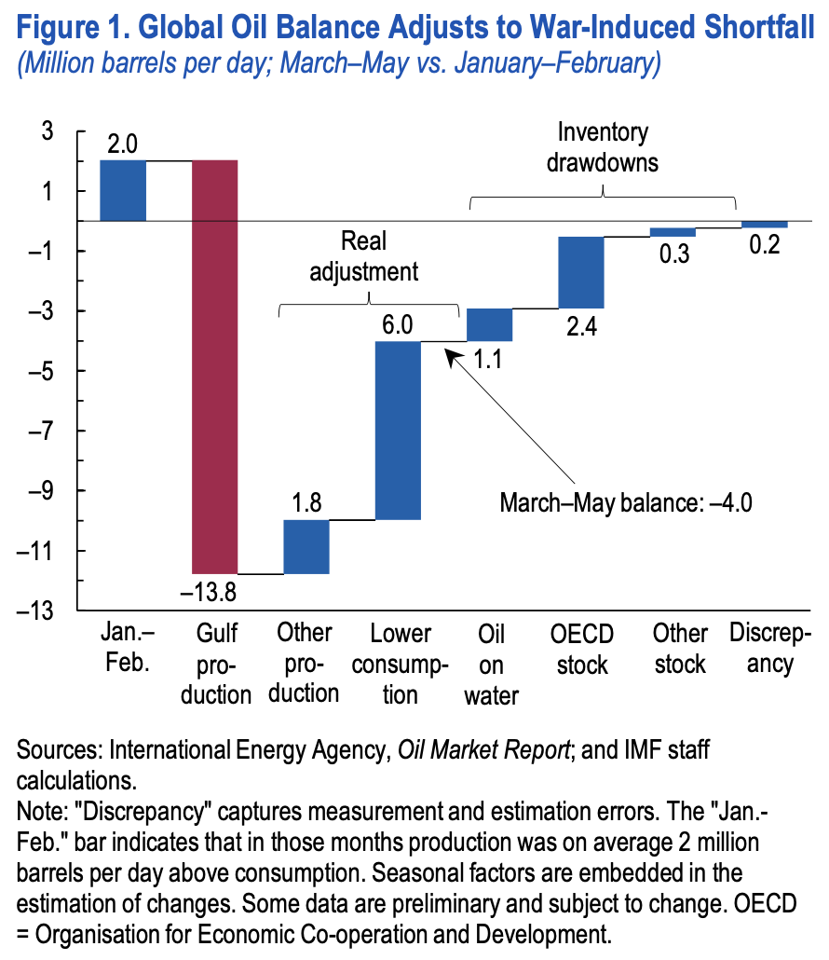
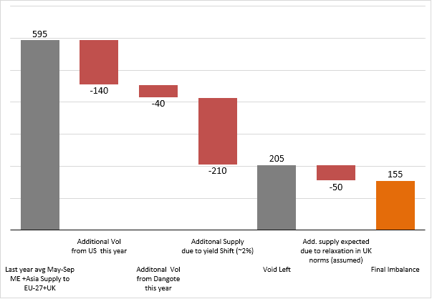

EU27+UK reaction to Jet
Fuel Hormuz disruption
Section 3 - The EU reaction: diversification of jet fuel supply and ramping up EU refining. Risks.
..part of the decrease in oil flows through the Strait of Hormuz has been compensated for by a drawdown of inventories, containing the need for oil consumption and production to adjust through prices..
Loss of ~ 400 kbd from ME region, in a ~ 700 kbd jet fuel structurally short region (May-Sept 2025)
Quick EU27+UK rebalancing, but EU short of ~ 150 kbd in summer months
  140 + 40 + 210 =
  390 kbd (recovery loss)
(fom 9% to 11% volume)
Source: KPLER analysis, May 27°, 2026. Available at https://www.kpler.com/blog/how-europe-rebalanced-its-jet-fuel-supplies-to-keep-planes-in-the-air

Slide 15
SAF: towards EU security, autonomy and competitiveness through RES
04

Slide 16
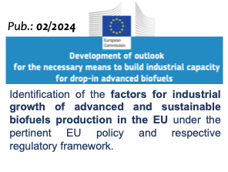
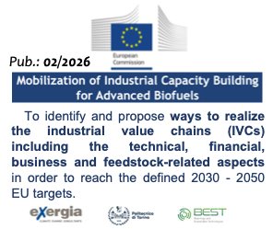
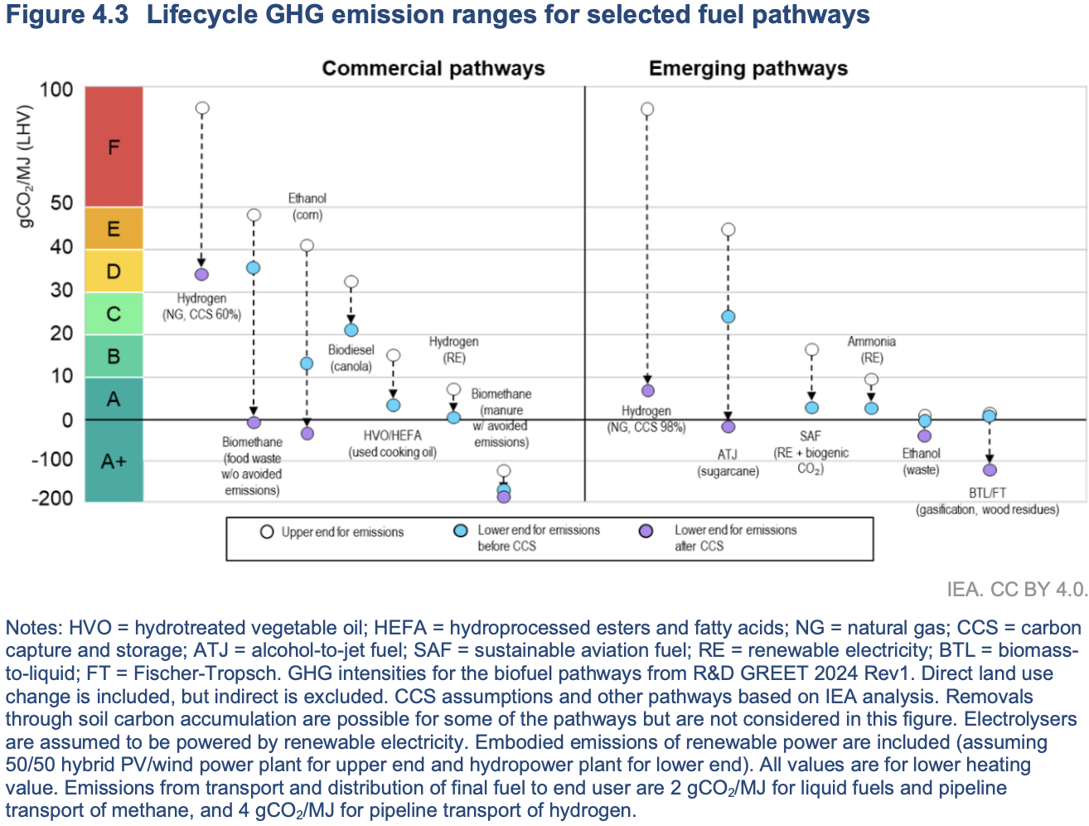
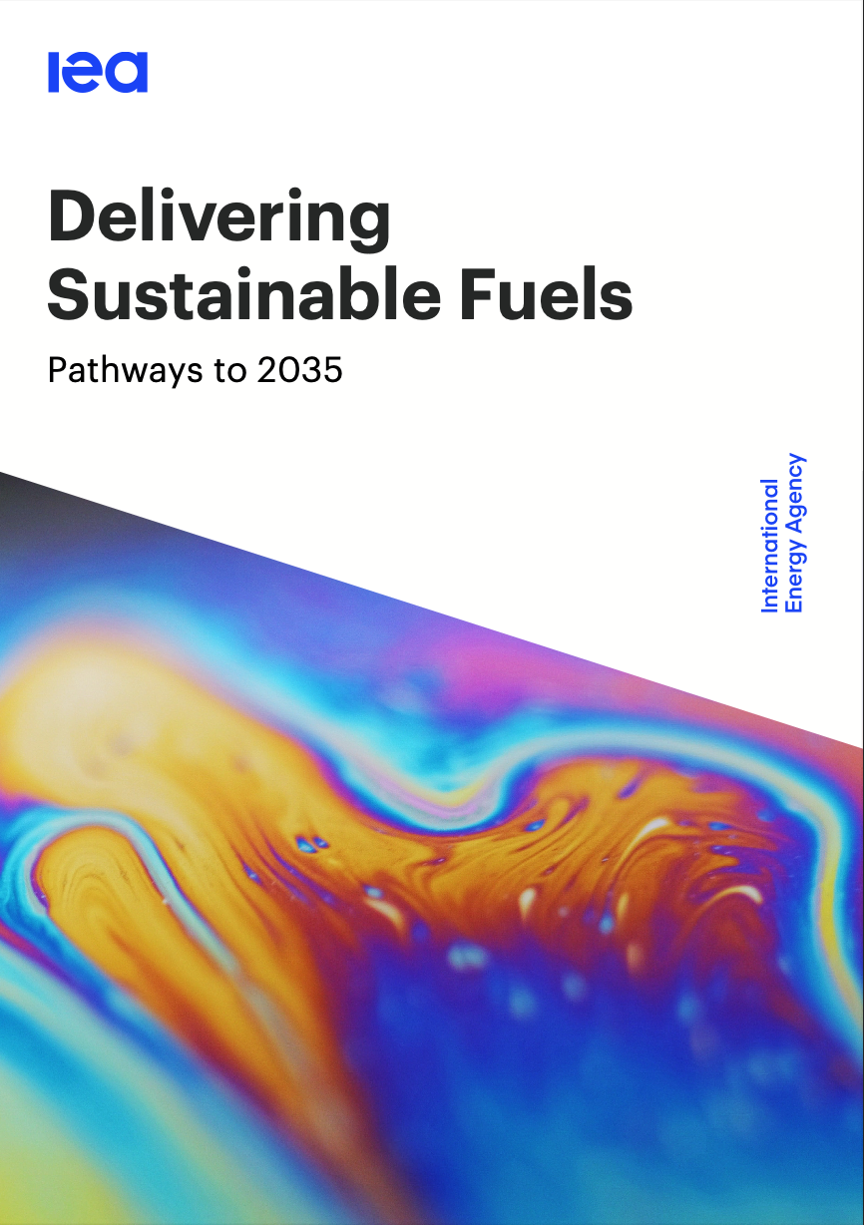
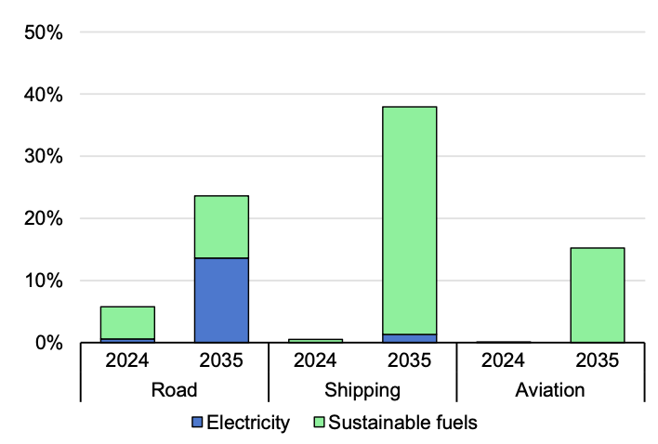
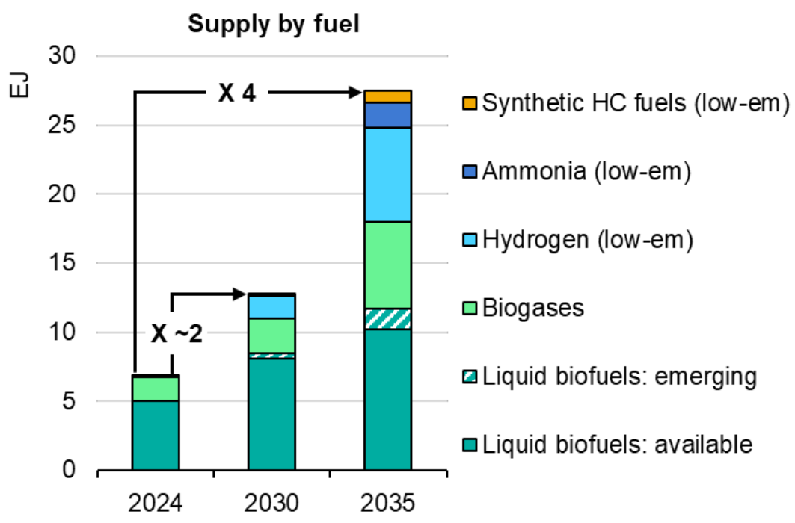
GHG emissions and Labelling
2025 IEA report “Delivering Sustainable Fuels”, released at preCOP30, Oct 2025
Roughly 50% of EU 2030 biofuels can be advanced
2-2.5 demand increase by 2030 vs 2021 (from 16.5 Mtoe in 2021 to between 32 and >40 Mtoe in 2030, meeting policy climate targets). Production NOT capped by feedstocks
….towards C-negative Sustainable biofuels
(large amount of biogenic C in coproducts)
Low
Carbon
Carbon
Negative
(CDR)
→ 4x Belém pledge, endorsed by 29 Countries
→ Massive growth in shipping & aviation, still significant role in road
16

Slide 17
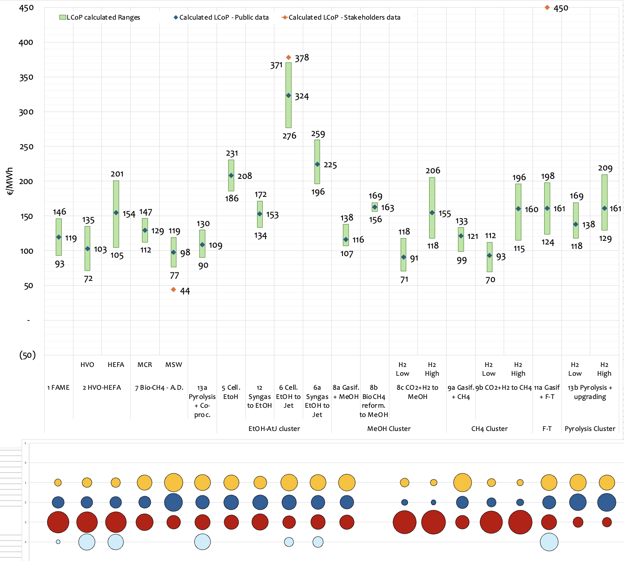
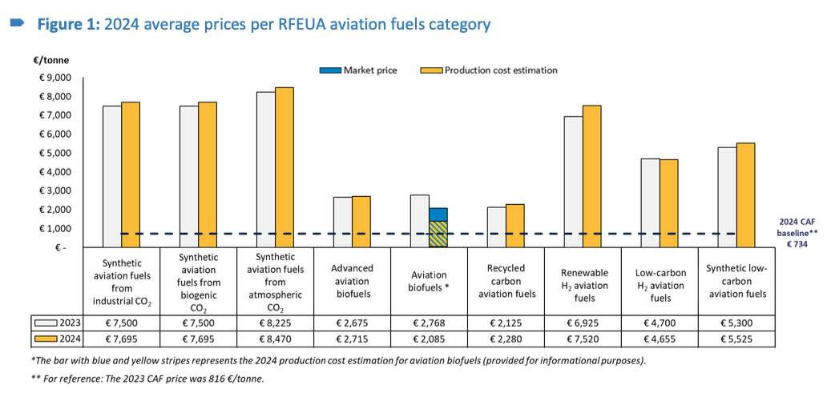

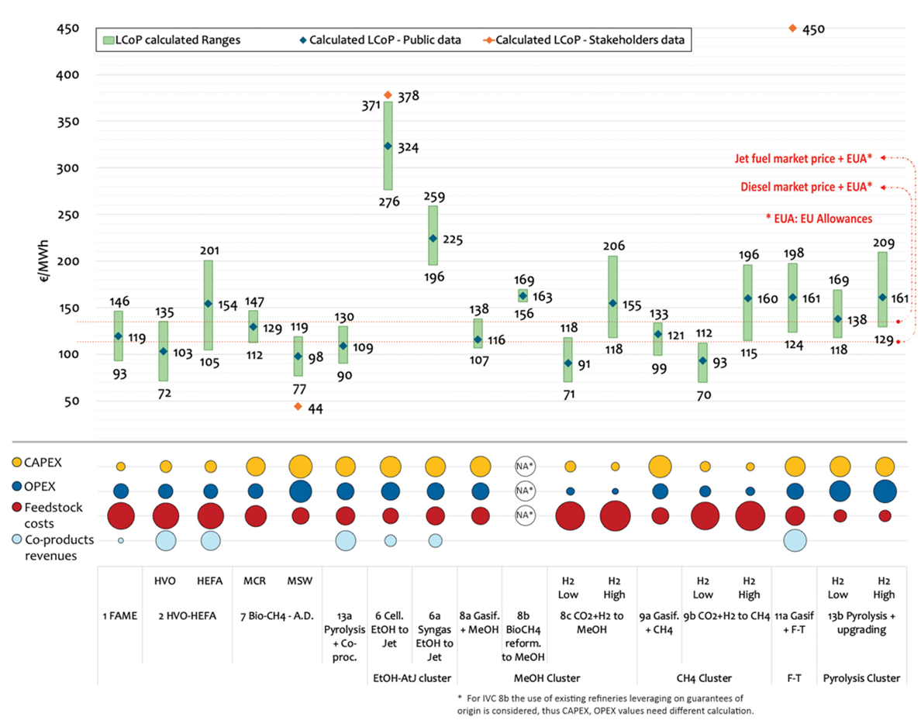
Cost estimates
SAF
Section 4: SAF: towards EU security, autonomy and competitiveness through RES
SAF
Different SAF cost estimates are consistent.
SAF
HEFA (SAF from lipids) still dominating in medium terms
SAF prices currently 3 to 10 times more expensive than conventional fuel, although they are expected to reduce substantially as production technologies scale up
CAPEX
OPEX
Feedstock
Co-products
Before Hormuz
Diesel: 84 €/MWh
JetA1: 65 €/MWh
No inflation considered

Slide 18
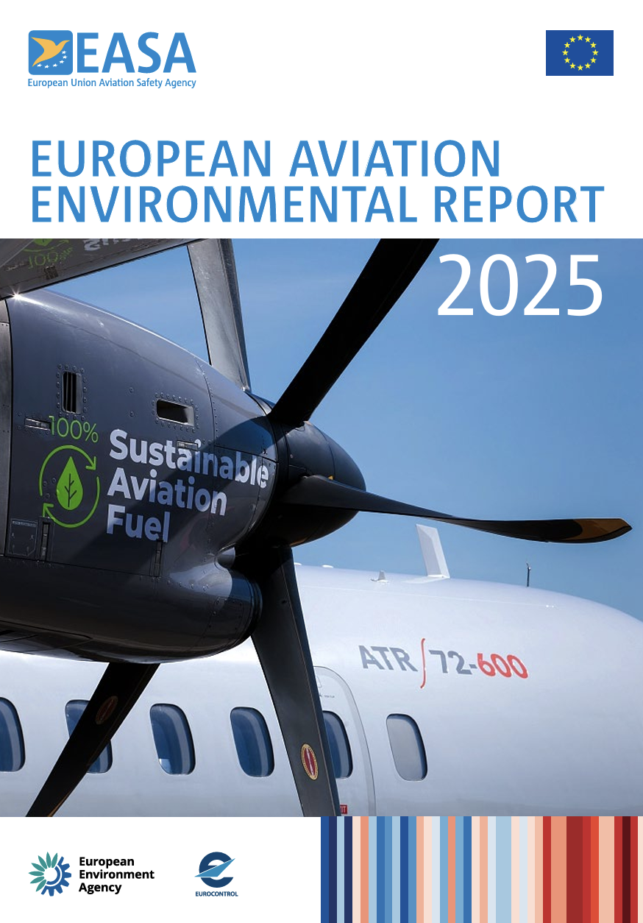

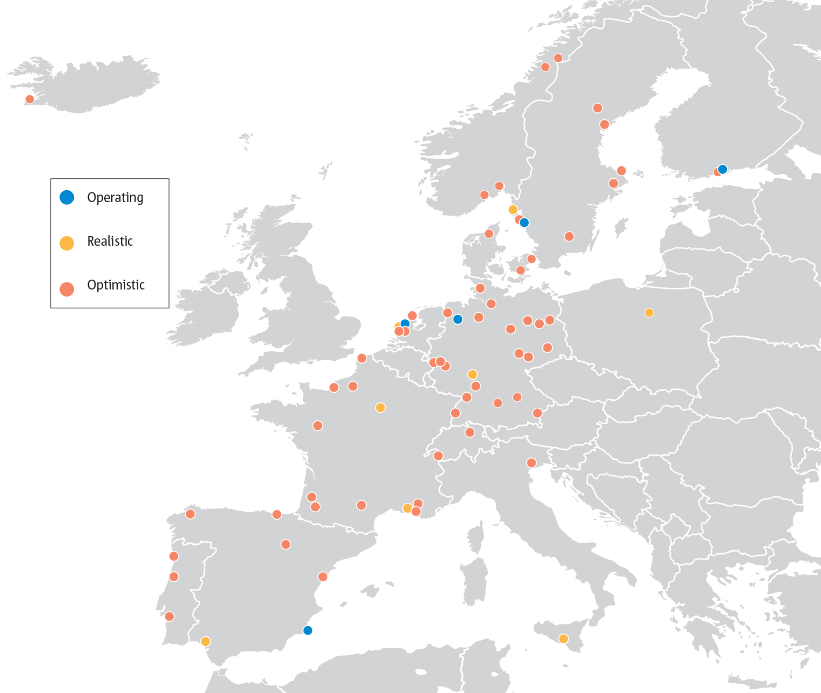
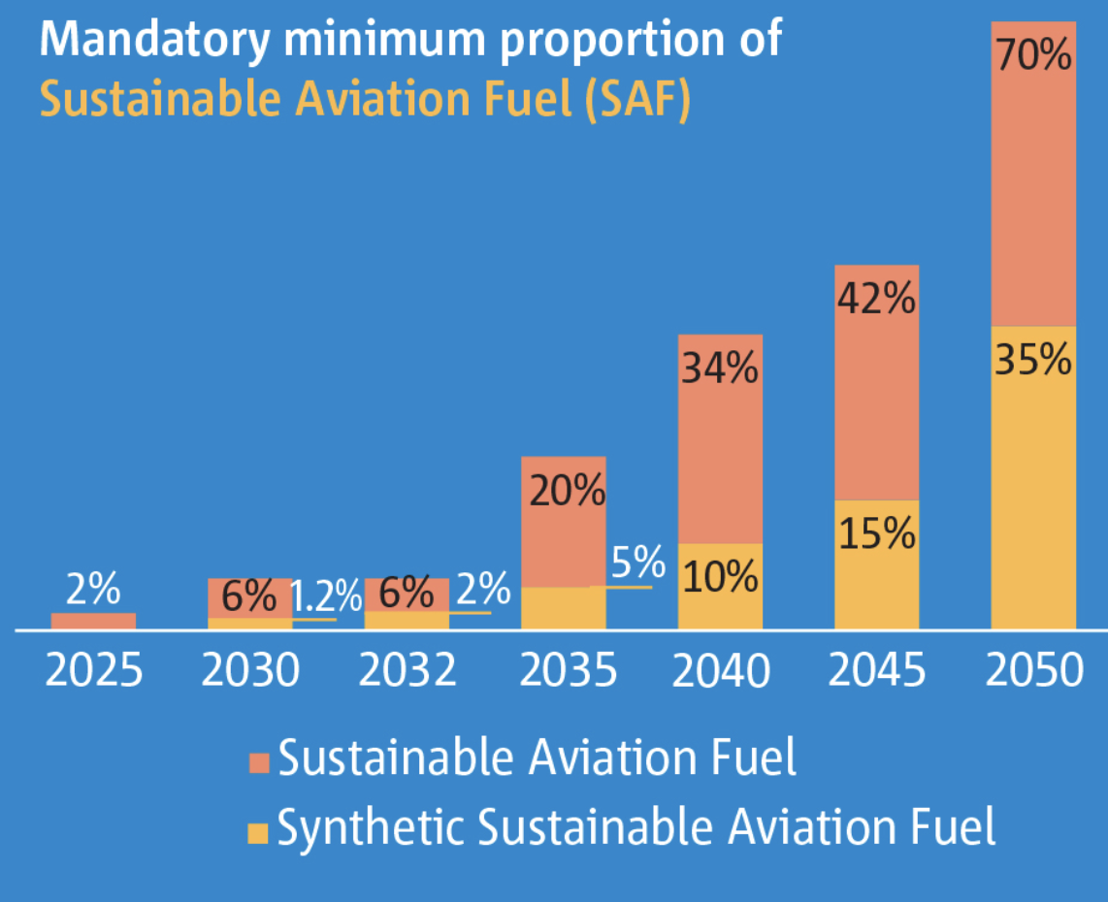
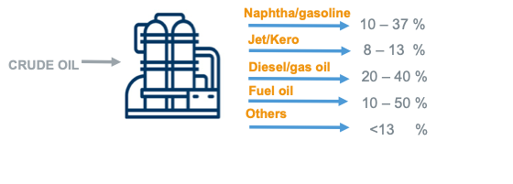
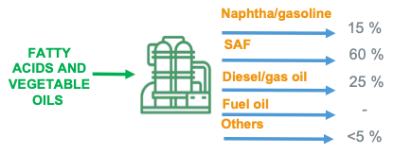
Current and Projected EU SAF capacity
Section 4: SAF: towards EU security, autonomy and competitiveness through RES
2024: SAF production only 0.53% of global jet fuel use.
Most relevant issue for EU HEFA-SAF production:
broadening the eligible feedstock base (RED, 996 Reg)
SAF production capacity currently under construction could supply the 3.2 Mt of SAF required by ReFuelEU Aviation in 2030 but would be required to ramp up quickly thereafter.
CAF – LCAF
Typical yields
ReFuelEU Aviation
mandates
(Bio-)Refining: multi-feedstock, multi-product
Bio-SAF
In a SAF-maximised mode
(e-SAF similar distribution)
Operating: current SAF EU prod.capacity: > 1 Mt/y (not accounting for coprocessing) - almost all HEFA
Realistic: includes facilities under construction, SAF prod.capacity in 2030 up to 3.5 Mt, HEFA-dominated
Optimistic : all projects in pipeline in operation by 2030 incl. PtL, → projected SAF capacity of 5.6-5.5 Mt.
Notes:
Operating scenario: current SAF EU prod.capacity: > 1 Mt/y(not accounting for coprocessing) - almost all HEFA
Realistic Scenario: includes facilities under construction, SAF prod.capacity in 2030 up to 3.5 Mt, HEFA-dominated
Optimistic scenario: includes all projects in the pipeline to be in operation by 2030 and includes PtL projects, → projected SAF capacity of 5.6-5.5 Mt. (EASA or SkyNRG outlook, respectively)

Slide 19

Conclusions: possible policy, regulatory and industrial measures for biorefineries and aviation
05

Slide 20




Sustainable Fuels and Carbon: main Policies
Section 5: Conclusions: possible policy, regulatory and industrial measures for biorefineries and aviation
A very complex and frequently evolving legislative environment
In force:
REDII/REDII–IR and REDIII on Sustainable Biofuels
ReFuelEU Aviation. And FuelEU Maritime
CRCF: Carbon Removals and Carbon Farming, DG Clima. Relevant to voluntary and (possibly) mandated (ETS revision, EC proposal in 2026) carbon markets
ICAO for SAF
Incoming:
CO2 Regulation (for Passenger cars/LDV, HDV)
996 RED Implementing Regulation (intermediate crop, soil carbon)
New EU RED
EU ETS: 2026 revision; ETS2, delayed, on buildings and road transport sector and fuels for additional sector
IMO: announced April 2025, decision postponed to late 2026

Slide 21
Possible policy, regulatory and industrial measures
Section 5: Conclusions: possible policy, regulatory and industrial measures for biorefineries and aviation
Policies and regulations in the EU are extremely complex and diversified: risks of investments abroad, limiting EU growth and economic development
  EU Refining capacity should be preserved, as well as supply chains diversified as possible
  EU Refining will continue to operate in a high-prices for middle distillate (jet, kero and diesel), but it will be difficult to place EU gasoline on the market
  In case of demand reduction → refining excess capacity → lower margins and rationalisation → risks for EU. New PHEV/RE powertrains opportunity for gasoline?
  Building EU capacity essential on sustainable EU and non-EU feedstock
  HEFA (from lipids) dominating (no change in short- to medium-terms)→ 996 Reg. (interm.crops, sust.farming) and new RED (Advanced Biofuel def)
  From list of advanced crops (Annex IX A) and wastes (Annex B) to sustainable farming + intermediate crops + marginal land + GHG accounting metric
  Frame EU in the global context (ICAO CORSIA market-based scheme)
Security cost component in domestic Sust.Jet and Transport Fuels
Policies designed for multi-feedstock / multi-product biobased refining
Fossil:
  SAF:

Slide 22
Possible policy, regulatory and industrial measures
Section 5: Conclusions: possible policy, regulatory and industrial measures for biorefineries and aviation
Policies and regulations should focus on industrially and socially viable Roadmaps beyond just targets.
  Beyond the goal, key is how to reach the goal
  Security cannot be achieved with urgent measures only
  Concerns exist among stakeholders on future role of security policy once the crisis is over
  Build EU capacity, diversify supply chains
  Renewables as a factor for EU security and competitiveness
  Short- and medium-/long-term plans to be equally developed
  EU region as part of a wider global action on SAF (ICAO CORSIA), as well as other equally relevant sectors (IMO-Maritime, road)
  Long-term stable policies needed to deploy investments
  EU Governance: Directives vs Regulations

Slide 23


Thanks for your attention
David Chiaramonti
Politecnico di Torino
david.chiaramonti@polito.it
23

