Slide 1
Cross-border cooperation in fisheries management
Best practices from the Mediterranean Sea
Matteo CHIARINI, Isabella BITETTO, Pierluigi CARBONARA, Maria Teresa SPEDICATO
COISPA Foundation, Italy
Committee on Fisheries (PECH) – 15 July 2026
Notes:
Accessibility - Instructions for the end user:
The slide 1 should always have the European Parliament logo as first item in the reading order / Selection Pane (note that the Selection Pane shows the objects in the reverse reading order. The object at the bottom of the list is the first one the be read out. The first on the list is the last one).
You can find the selection panel under the Home menu > Arrange > Position Objects > Selection Pane (In this particular slide you will see the correct reading order – remember, it’s from bottom to top – 1st EP Logo, 2nd Title and 3rd Subtitle)
Every slide should have a title and the title should be unique for each slide inside one PPT. If several slides belong to the same section, example: (Media Section) Media: Press; Media: Video: Media; Live events.

Slide 2
Agenda
1
Introduction – Background
Introduction – Aims of the study
Overview – Mediterranean governance and fisheries management
Mapping cross-border cooperation – EU Member States
Mapping cross-border cooperation – in the GFCM
Best practices in cross-border cooperation
Lessons learnt
2
3
4
5
6
7

Slide 3
Background
Introduction
The Mediterranean Sea framework
profound ecological diversity and socio-economic importance
complex geopolitical architecture (8 EU countries – 14 non-EU countries)
need of a high degree of cross-border synergy (shared stocks and essential fish habitats)
Unilateral management is consequently insufficient to:
meet the sustainability requirements of the common fisheries policy, and the EU engagements in the overarching framework of the European Green Deal and the EU Biodiversity Strategy 2030

Slide 4
Aims of the study
Introduction
Investigate fisheries cooperation in the Mediterranean, focusing on the actions taken by the General Fisheries Commission for the Mediterranean (GFCM) to support cross-border cooperation and management of fisheries resources to harmonize conservation measures
Which are the processes and the governance context required to establish effective technical and conservation measures in the Mediterranean Sea?
  GFCM "data-to-advice-to-adoption" process
  critical factors for bilateral and multilevel cooperation among GFCM members
  comparative analysis of flagship fisheries restricted areas in the Adriatic Sea
Notes:
Don't explain what FAO is

Slide 5
Mediterranean governance and fisheries management
Overview
Key actors
GFCM coordinates the efforts of countries towards the conservation and sustainable use of living marine resources at different levels
(e.g. biological, social, economic and environmental)
Member States (MS) representatives and European Commission (DG-MARE) representing all EU MS
Non-governmental organizations (NGOs) and private sector (stakeholders)
Scientists all over the Mediterranean region
Notes:
NGO and Scientist are not representatives!

Slide 6
Mediterranean governance and fishery management
Overview
Management target
2030 GFCM Strategy: promotes the establishment and enforcement of spatial conservation measures grounded in the best available scientific evidence to safeguard essential fish habitats (EFH) and vulnerable species, ensuring that the vulnerable marine ecosystems (VME) are protected and actively restored
synergy with
European Green Deal and Biodiversity Strategy for 2030 (European Green Deal)
Marine Strategy Framework Directive (MSFD)
Marine Spatial Planning (MSP) Directive

Slide 7
Mediterranean governance and fishery management
Overview
Key elements
science-driven "data-to-advice-to-adoption" cycle
diverse array of technical and conservation measures designed to achieve the maximum sustainable yield (MSY) for the key commercial stocks and to protect marine biodiversity
(e.g. catch and/or effort limits, gear restrictions, selectivity measures, spatial/temporal closures)
Key challenge:
harmonizing technical standards across sub-regions
Tools -> Scientific guidelines and minimum standards
Standard form for the submission of proposals for GFCM fisheries restricted areas in the Mediterranean and the Black Sea
Notes:
To say «Management measures» when referring to «technical and conservation measures»

Slide 8
Cooperation among EU Member States
Mapping cross-border cooperation
The multiannual management plan (MAP) in the Western Mediterranean Sea
According to CFP regionalisation and the landing obligation
Western Mediterranean MAP involving Spain, France and Italy established a progressive reduction system for fishing effort
Support of STECF as scientific and technical body
Notes:
Slides to be displayed quickly, theoretically these are aspects well known by the EU parliament

Slide 9
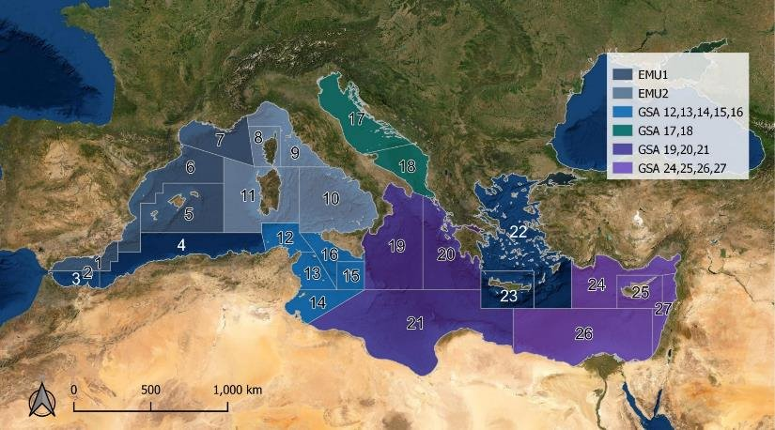
Regional cooperation in the GFCM
Mapping cross-border cooperation
The multiannual management plans implemented through GFCM recommendations
robust framework of science-based MAPs to coordinate conservation efforts across various GSAs
• European eel (Anguilla anguilla)
• red coral (Corallium rubrum)
• common dolphinfish (Coryphaena hippurus)
• blackspot seabream (Pagellus bogaraveo) in the Alboran Sea (GSAs 1-3)
• small pelagics in the Adriatic Sea (GSAs 17-18)
• demersal stocks in the Adriatic (GSAs 17–18)
• demersal stocks in the Strait of Sicily (GSAs 12–16)
• deep-water red shrimps in the Strait of Sicily (GSAs 12-16), the Ionian Sea (GSAs 19-21) and the Levantine Sea (GSAs 24-27).

Slide 10
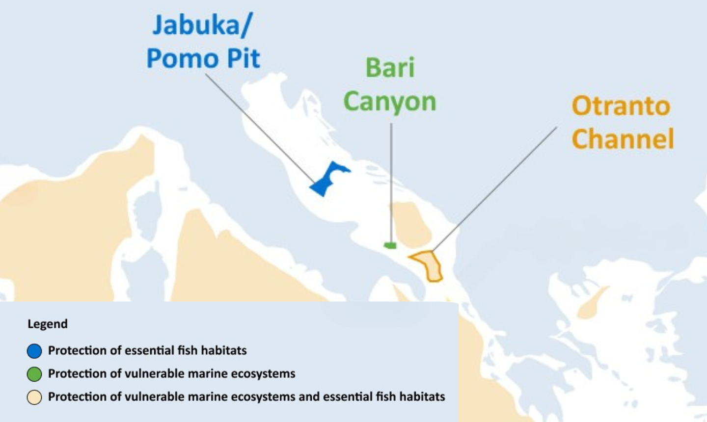
Fisheries restricted areas in the Adriatic Sea
Best practices in cross-border cooperation
The implementation of strategic FRAs has positioned the Adriatic Sea as the Mediterranean region with the highest level of seabed protection getting successful and operational examples of cross-border cooperation
in the field of spatial/temporal management measures.
The adoption of FRAs was supported by:
shared scientific evidence,
stakeholder involvement,
coordinated fisheries governance processes.
These experiences provide useful and potentially replicable models for similar initiatives across the Mediterranean.

Slide 11
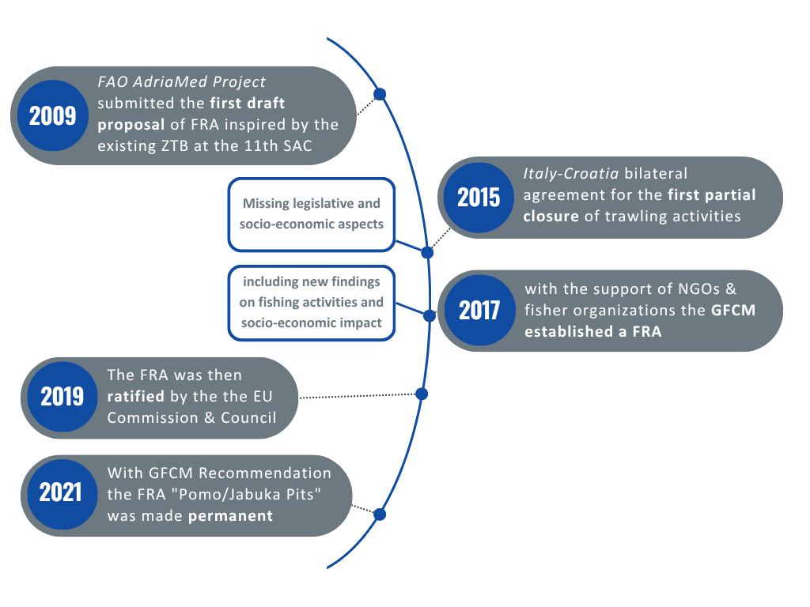
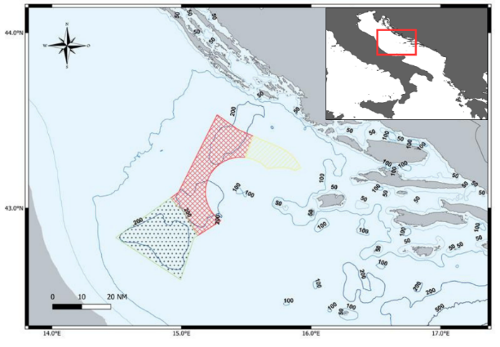
Jabuka/Pomo Pit
Best practices in cross-border cooperation
Notes:
Emphasizes that this process stimulated the FRA proposal

Slide 12
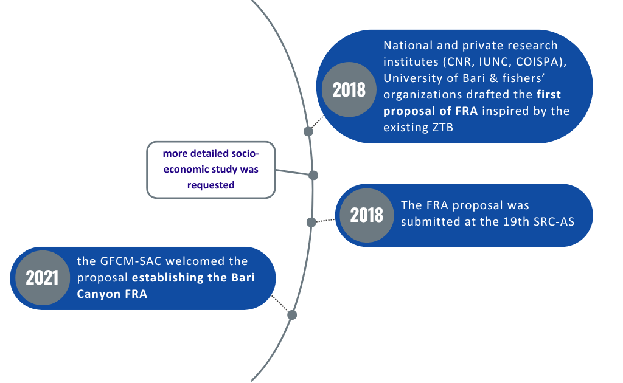
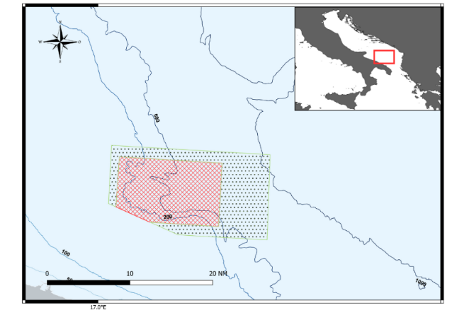
Bari Canyon
Best practices in cross-border cooperation

Slide 13
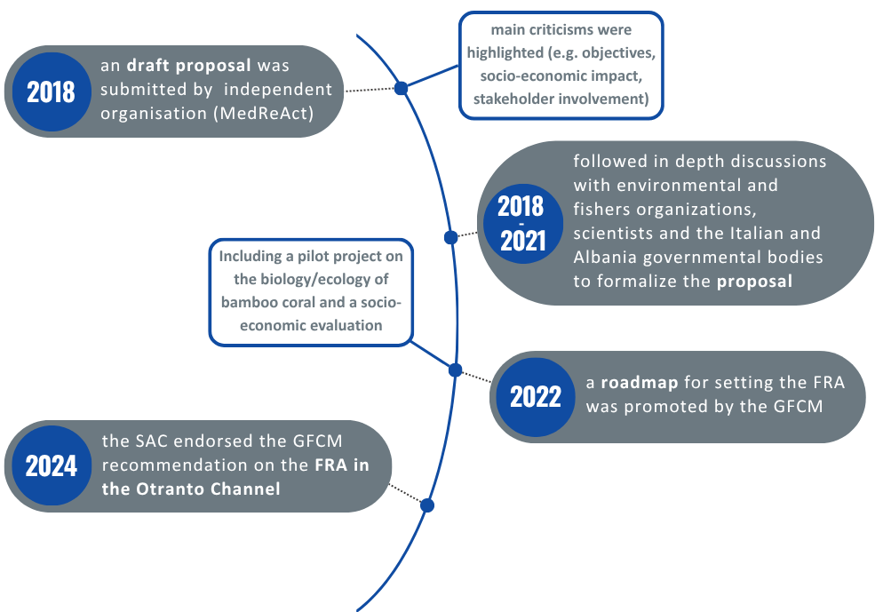
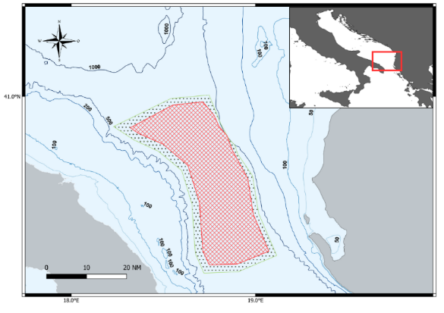
Otranto Channel
Best practices in cross-border cooperation

Slide 14
Lessons learnt
Conclusions & Recommendations
Actions towards cross-border spatial fisheries management measures
Identify ecological priorities: screening data gaps and utilizing predictive modelling to map EFH, VME and distribution of critical life stages of commercial stocks.
Engage stakeholders through co-design: identify and involve all affected EU and non-EU entities early in the process to ensure their voices are integrated from the initial steps.
Conduct initial standardized assessments: develop proposals that include ecological and socio-economic analysis to maximize conservation, while minimizing adaptation costs for regional fleets.

Slide 15
Lessons learnt
Conclusions & Recommendations
Actions towards cross-border spatial fisheries management measures
Strengthen monitoring and enforcement: expand the implementation of comprehensive vessel tracking systems (VMS/AIS) and electronic logbooks to ensure transparent compliance.
Implement adaptive management cycles: periodic reviews on ecological and socio-economic indicators with clear triggers for adjusting measures in response to stock status, considering the effects on fish populations and fisheries.
Evaluate governance performance: incorporate transdisciplinary framework assessments to identify weaknesses (e.g., inclusivity, coordination, acceptability, etc..).
Ensure policy coherence: enhance the integration of fisheries management measures with maritime spatial planning and the Marine Strategy Framework Directive.

Slide 16
Thank you for your attention

