Slide 1

Competitiveness of the Aviation Sector: The Impact of Fuels Prices in the Aftermath of the Middle East Crisis
Aisling J. Reynolds-Feighan
Professor of Transport Economics
UCD School of Economics
University College Dublin
Ireland
Notes:
Good morning.
Thank you Madame Chair. I appreciate the opportunity to address the Committee.
I will focus on the impacts of the ME crisis on the jet fuel prices and the competitiveness of European aviation

Slide 2
Agenda
Instability & disruption in fuel availability: Impacts on prices, carriers and airports
Risks to competitiveness
Measures to strengthen the sector
Notes:
In my talk, I will look at the volatility of fuel prices and disruption to supply and their impacts on airlines and airports
I will examine the risks to the competitiveness of European aviation and suggest measures to help strengthen the sector

Slide 3
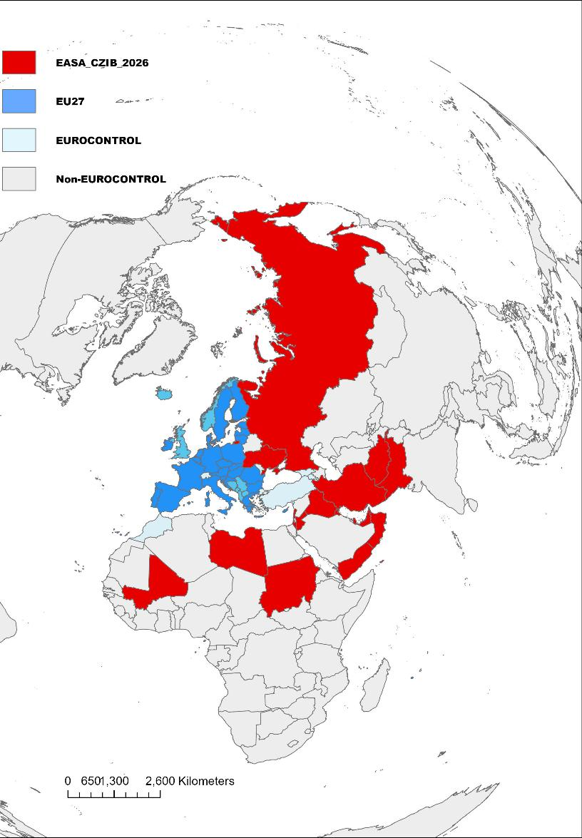

EASA Conflict Zones Advisories
Airspace Restrictions; Fuel Shortages
Northern corridor - Türkiye, Georgia & Azerbaijan
Air Space Closures: Further restriction of flight paths for long haul
Impacting connectivity to Asia; Australasia
EU carriers have withdrawn ME service
Increased stage length for long haul: increased fuel burn & emissions for re-routed flights
Southern corridor - Saudi Arabia & Oman
https://www.easa.europa.eu/en/domains/air-operations/czibs
https://www.eurocontrol.int/sites/default/files/2026-03/eurocontrol-aviation-trends-issue-11.pdf
Notes:
The attacks by Israel & the US starting on February 28th this year resulted in the closure of air space over Iran, Iraq and several ME countries bordering the Persian Gulf
This further restricted flight paths between Europe and Asia and Australasia, where restrictions have already closed air space over Russia and Ukraine since 2022.
This has reduced long haul flights to 2 narrow corridors - North (over Turkey, Georgia and Azerbaijan) and South (over Saudi Arabia and Oman), - increasing distance travelled, fuel burn and associated emissions

Slide 4
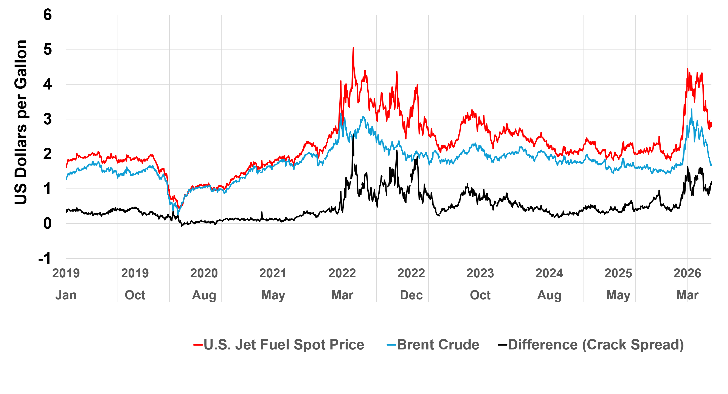
Jet fuel prices peaked in April 2026 – highest ever
SAF prices also surged
Implications for aviation fuels prices
Limited European data availability
National reserves drawn down
  Alternate suppliers (US & West Africa) – No EU airport shortages reported
  Regulators clarified use of US Jet-A in Europe
  Fuel stocks globally
Additional premium on European & Asian jet fuel of 10-15% (IATA)
Source: US EIA/Thompson Reuters
Notes:
The attacks had an immediate and dramatic impact on jet fuel prices and availability, with jet fuel reaching an historic high price in April 2026
The figure shows the price of crude oil in blue, the price of US jet fuel in red and the difference between the two in black – this is know as the crack spread.
European jet fuel prices were reported by IATA to be 10-15% higher than US jet fuel prices during the worst period in March/April.
This reflects the refining costs, demand and refining supply
By drawing down national reserves and quickly finding alternate suppliers, the immediate supply constraints have been eased for summer 2026, but global stocks remain low.
Sustainable Aviation Fuels (SAFs) also experienced sharp price increases and remain more than double the price of kerosene jet fuel

Slide 5
Price Impacts: European Airline Hedging Strategies
Airline | Share hedged 2026
Air France | 87%
Easyjet | 84%
Finnair | 70-95%
IAG | 75%
Icelandair | 20-50%
Lufthansa | 76%
Norwegian | 45%
Ryanair | 80%
SAS | up to 50%
Wizz | 83%
Most EU Carriers hedge
Hedging insulates from price spikes - variation in duration & hedged share
Costly when jet fuel prices fall – so do not hedge 100%
Fuel not hedged is expensive when prices spike
    Example: Q1-2026: Ryanair hedged 80% @ $67pbl; €76pbl in 2025 Non-hedged fuel doubled in April & May to $140pbl*;
US carriers reduced amount of fuel hedged – greater stability in crack spread 2023-2025
Fuel costs significantly impact airline profitability;
EU Carriers: expect 5-10% increase in fuel costs in 2026
Source: Reuters
* Ryanair Investor Results May 2026
Notes:
Most European airlines buy future contracts – or hedge - a significant share of their fuel requirement, typically 70-80% as the table shows.
Hedging insulates against price volatility, though the contract duration and the share of the airline’s fuel requirements that is hedged, vary significantly
The portion of the fuel requirement not hedged is expensive when jet fuel prices spike as in March/April
To give an example, Ryanair in Q1 2026 had hedged 80% of its fuel requirement at $67 per barrel, down from the hedge price of $76 per barrel in 2025. The non-hedged jet fuel cost doubled in March/April to $140 per barrel
US carriers have generally stopped hedging as there was a long period of price stability from 2023 to 2025
Fuel costs account for between 25% and 35% of an airline’s costs and can therefore significantly impact profitability
For European carriers, it is expected that the ME crisis could give rise to an increase in fuel costs of 5-10% for 2026

Slide 6
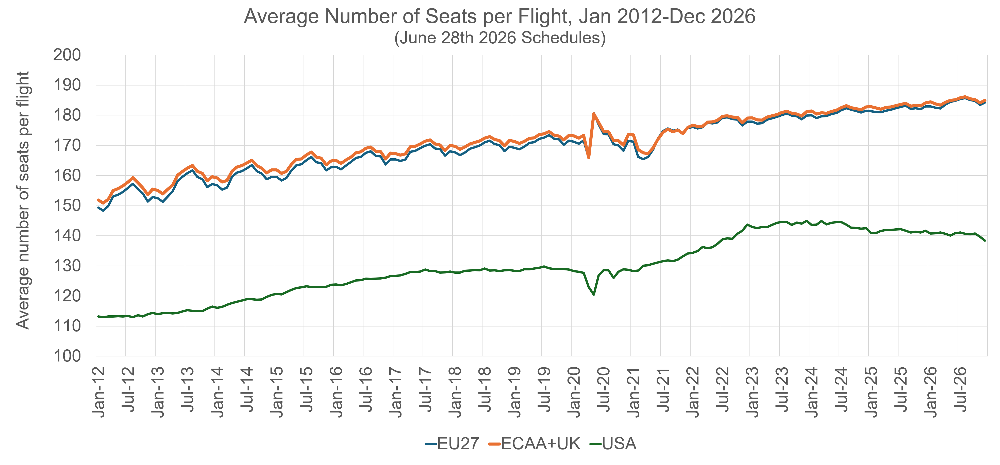
Responses to Jet Fuel Price Volatility
Financial Resilience & Sustainability
Fleet renewal: larger, more fuel-efficient aircraft
Operations: minimising ground fuel burn & routing decisions
Direct routings Vs connections in US market
Data Source: Cirium SRS Analyser
Notes:
The most important way in which airlines can reduce their fuel requirement is by investing in newer aircraft which have significantly improved fuel efficiency and are larger
The graph shows the average number of seats per aircraft has been steadily increasing, reflecting the gradual renewal of the European fleet.
Carriers also look to minimise fuel burn when on the ground, and in routing decisions
European carrier network strategies also minimise fuel burn per passenger with mostly direct routings between origin-destination pairs rather than the typical connecting routes which dominate US domestic Hub-and-spoke networks

Slide 7
European Market:
Spatially dispersed relative to Asia, North America, USA
Direct connections between EU states and cities
Financial Resilience & Sustainability
Direct routings Vs connections in US market
2025 | Routes | Airports | Max No. Routes | %
EU27 | 12,642 | 375 | 70,125 | 18%
ECAA | 15,782 | 504 | 126,756 | 12%
Asia | 15,034 | 934 | 435,711 | 3%
North America | 11,267 | 969 | 468,996 | 2%
USA | 8,411 | 638 | 203,203 | 4%
ECAA Carriers delivering efficient mobility across internal market
Competitive industry with multiple operators - strategically & economically important
Risks to single market when mobility curtailed
Notes:
To illustrate the importance of network strategy, this table shows that the 27 Member States had 375 airports receiving jet services at some point during 2025
With 12 and a half thousand direct routings with service.
If every pair of airports were directly connected, that would be 70,125 routes, so in 2025, 18% of all possible routes had service.
This is significantly higher than for other global regions, where air traffic is much more spatially concentrated along a smaller share of high traffic corridors only. The US for example operated just 4% of all possible routes in 2025

Slide 8
Media Reports of Jet Fuel Shortages
Risks to Competitiveness: Profitability
Strong demand in 2026 but…….
Passengers booking closer to travel period – delay due to fear of cancellation
Airlines reduce prices when sales below expected booking curve
  Squeezing revenue over peak summer period
  No surcharges permitted after sale of tickets
Airline profitability = Revenue – Cost
Revenue – downward pressure
Costs – upwards pressures
  Fuel volatility; SAF mandate; ReFuelEU
  ETS & taxes
Expect reduced profitability in 2026
Estimated booking curve
} Spoilage (empty seats)
Reservations
Time
Date of Departure
Notes:
Passenger demand has been strong in 2026, but media reporting of potential jet fuel shortages impacted consumer purchase decisions, with delays in purchasing flights until much closer to departure time
When airlines experience sales below what they expect (below the estimated booking curve), they will drop fares to avoid operating flights with empty seats (spoilage)
This has squeezed airline revenue for summer 2026
Airlines cannot add surcharges once the tickets have been sold
Airline profits, vital for longer term investment in fleet renewal for example, depend on revenue, costs and the difference between the two
So revenues in 2026 are under downward pressure, while costs have escalated upwards
Additional costs related to the ETS and SAF mandates in Europe, will further pressure carriers and lead to reduced profitability in 2026

Slide 9
Regulatory framework supported & clarified response
Key regulatory mechanisms
Commission Communication 8.5.2026 C(2026) 3172 final: clarifies EU rules for passengers & operators
“However, cancellations caused by exceptionally high fuel prices, as opposed to local fuel shortages, cannot be considered as constituting “extraordinary circumstances”.
Airlines prohibited from adding fuel surcharges
Regulation (EU) 2023/2405 (ReFuelEU) on uplift obligations remain in force
Notes:
The European Commission clarified rules for passengers and for operators in their communication on May 8th
Cancellations due to exceptionally high fuel prices are not considered ‘Extraordinary Circumstances’,, though officially notified airport fuel shortages are
So fuel surcharges are not permitted
The Commission also clarified that the ReFuelEU uplift obligation of 90% fuel purchase at each airport served would also be in force

Slide 10
ECAA Monthly Seats
Demand: Schedule Impacts
Strong pax growth - Jan & Feb 2026
More capacity than 2025
Reduction during Q2-2026, but still ahead of 2025
Increased capacity for H2: 2026
Covid lessons
Air Cargo?
Data Source: Cirium SRS Analyser
Seats made available for sale up to 12 months forward. Schedules revised weekly
Notes:
Passenger growth in January and February 2026 was strong and carriers were optimistic about the year in general, so additional capacity over 2025 was offered in the 2026 schedules
Airlines publish their schedules 6-12 months in advance and make seats available for sale before the service is provided
The figures shows the monthly 2025 seats in blue for the ECAA, the published February 2026 schedule is shown in red and the June 2026 schedule is shown in black
Airlines cut back on their seat offerings between February and June as the crisis unfolded, though seats are still ahead of 2025 and there is increased capacity on offer for the second half of 2026
Airlines learned from their experience during the Covid-19 pandemic to continue to keep offering capacity as a way of generating revenue, and then re-assessing much closer to departure time by augmenting, consolidating or cutting services
Very little data is available for air cargo as most capacity is not publicly sold

Slide 11
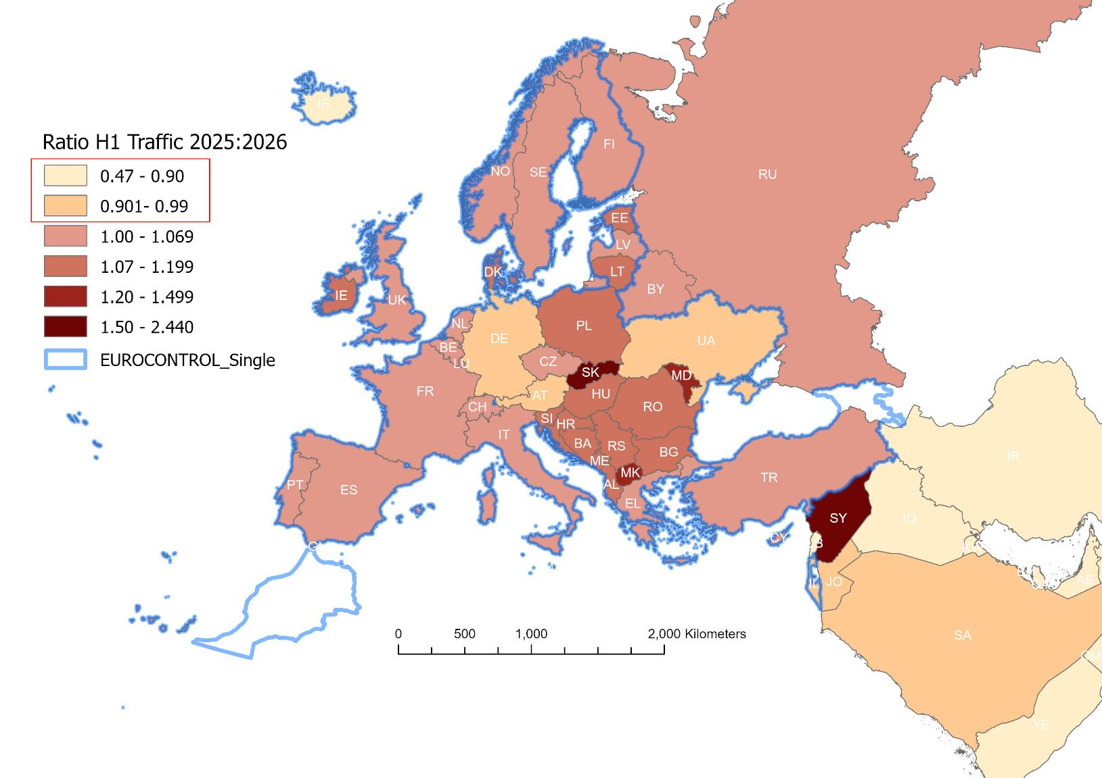
H1 2026 Seats Versus H1 2025
Distributional Impacts of Traffic Changes – Member States
Increase over H1 2025 traffic volumes in most states (DE & AT)
Eastern ECAA & Balkans show significant increases
Strong growth in large Mediterranean states
Re-orientation away from ME by EU carriers – most ME routes cut (except CY & EL)
Traffic Measure: Available Seats
Data Source: Cirium SRS Analyser
Notes:
This map shows the ratio of seats performed in the first half of 2026 relative to the first half of 2025 for the Eurocontrol countries
The map shows that most EU Member States saw an increase, with the exceptions of Germany and Austria
Growth was strongest in Eastern Europe and the Balkans as well as in the large Mediterranean markets
European carriers cut most Middle East services and re-oriented routes within the single market towards the Mediterranean

Slide 12
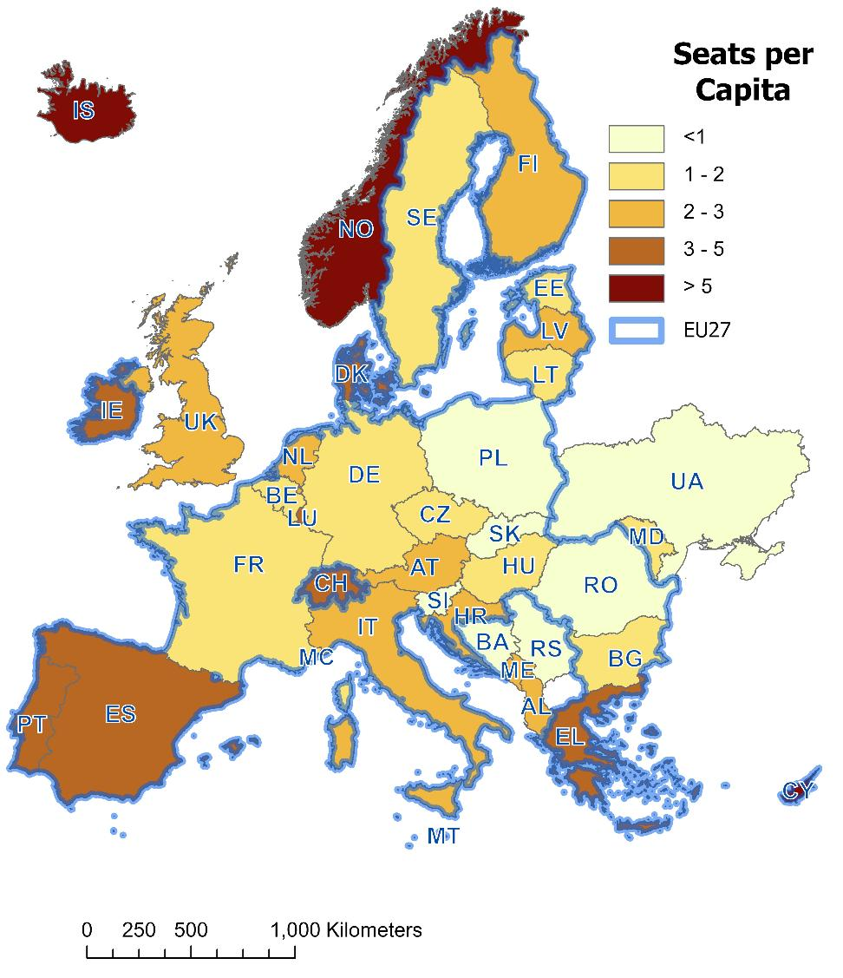
2025 Seats per Capita
Distributional Impacts of Traffic Changes – Member States
Growth in Eastern ECAA & Balkans increased seats per capita towards EU27 average (2/pc) – enabling mobility
Diverted capacity from Ukraine
New direct intra-ECAA routes
Traffic Measure: Available Seats
Data Sources: Cirium SRS Analyser; EUROSTAT
Notes:
The strong growth in 2025 and 2026, particularly in Eastern Europe and the Balkans has increased the average number of seats per head of population towards the EU27 average of 2 departing seats per head of population
This has significantly increased mobility in these states - There are many new direct intra-ECAA services from these states
Some of the growth may reflect diverted traffic arising from closed Ukraine air space

Slide 13
Competitiveness in Global Regional Markets
ECAA Carrier Shares for Extra-ECAA Flights
ECAA carrier shares falling in most external markets
ECAA carriers less exposed in ME market relative to other major regions served
Notes:
Taking a longer term view of European carriers, it is concerning that in external markets, most ECAA carriers have experienced a declining market share
So for the largest external market, the North Atlantic, ECAA carriers have seen their share of all departing seats between the two continents fall from 48% in 2019 to 43% in 2025
European carriers were less exposed in Middle East markets, where their share was 10% of all available departing seats in 2025

Slide 14
EU27 Carrier Shares for Extra-EU27 Flights
Competitiveness in Global Regional Markets
EU27 carrier shares falling in all external markets
2025 | EU27 | ECAA
EU27 | 60% | 56%
ECAA | 15% | 16%
North America | 5% | 6%
Middle East | 4% | 5%
Africa | 4% | 4%
Asia | 3% | 4%
Notes:
Even more notable is that for EU27 registered carriers, shares fell in every external market between 2019 and 2025
The table shows the shares of EU27 carrier seats across the main internal and external markets, where again North America is the largest external market.
Here, EU27 carrier share of traffic fell from 38% to 37% between 2019 and 2025

Slide 15
Competitiveness of European Aviation
Financial Resilience of Legacy Carriers
Emission Trading Scheme; Energy Taxation Directive (ETD); SAF Mandate;
  Disproportionately driving up all EU carrier costs relative to external competitors
  Delaying fleet renewal investments
  Potentially undermining financial resilience of legacy carriers
Notes:
The EU’s Emissions Trading Scheme and the proposals in the Energy Taxation Directive, as well as the SAF mandate will disproportionately drive up costs for EU carriers relative to external competitors
European carriers will likely continue to experience declining market shares, with passengers potentially avoiding these taxes and charges by flying with the external competitor airlines
By increasing costs and eroding profitability, this risks delaying fleet renewal investments and potentially damaging the financial resilience of European airlines

Slide 16
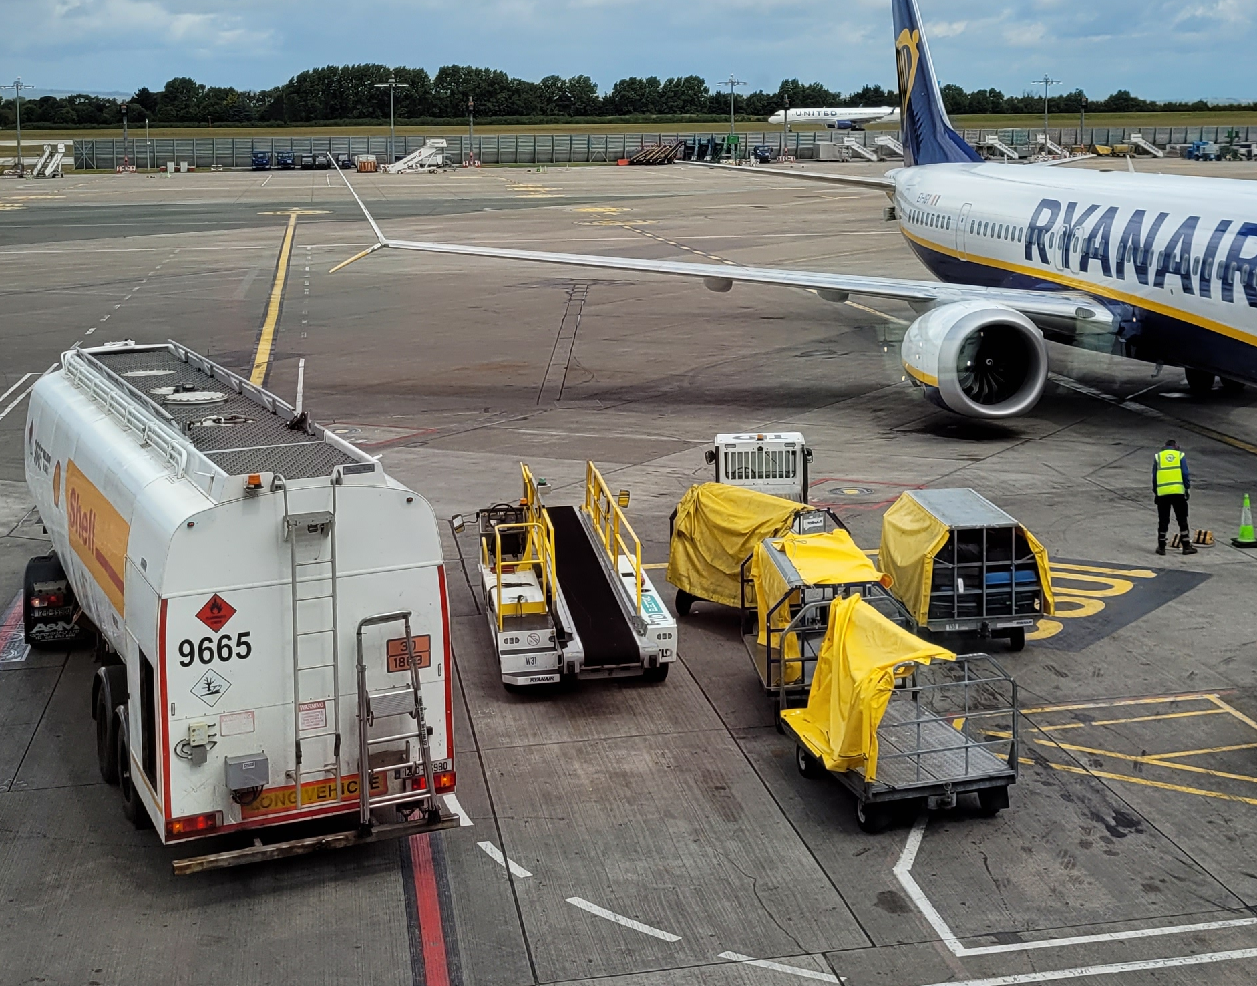

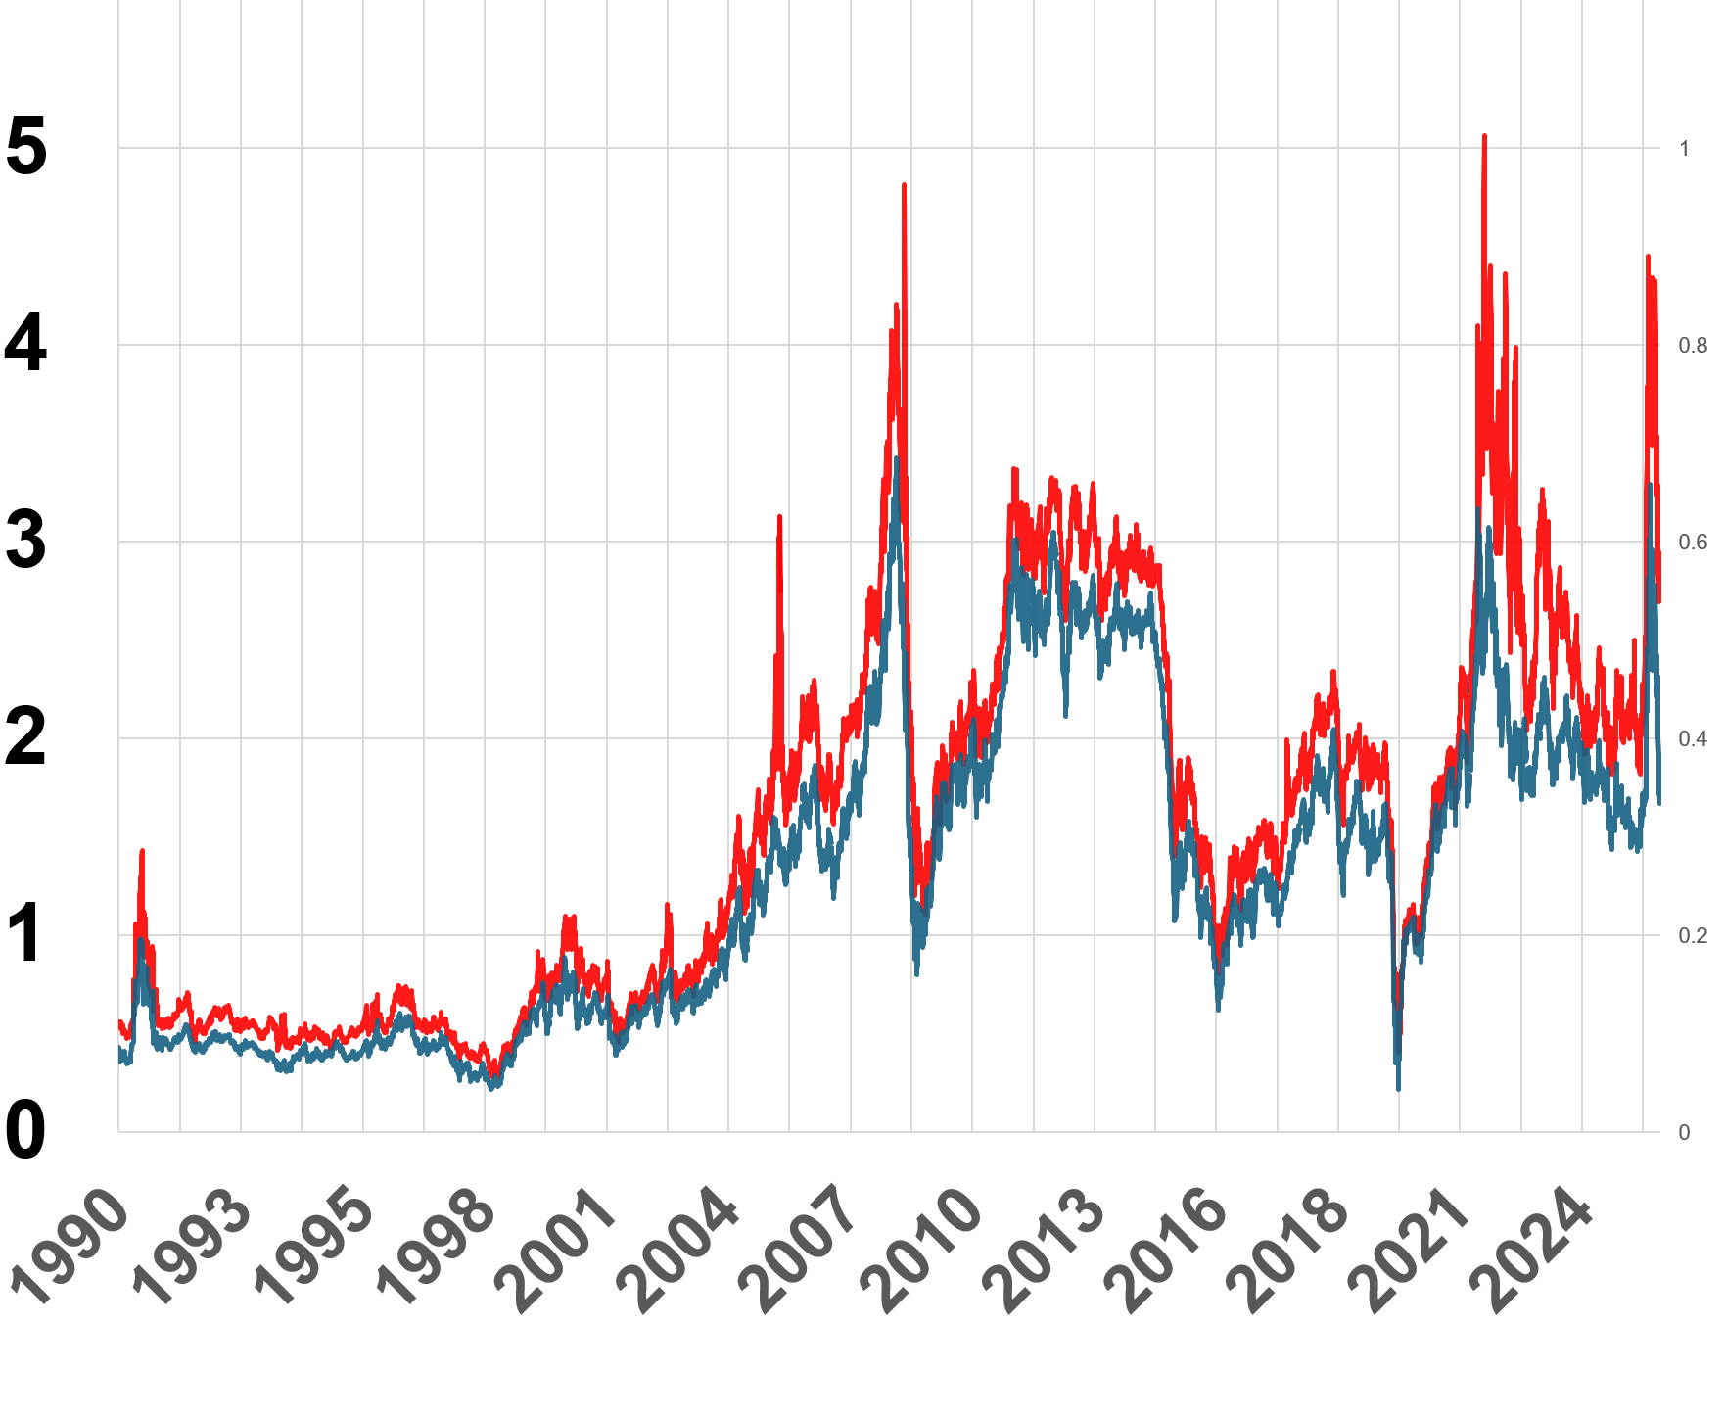
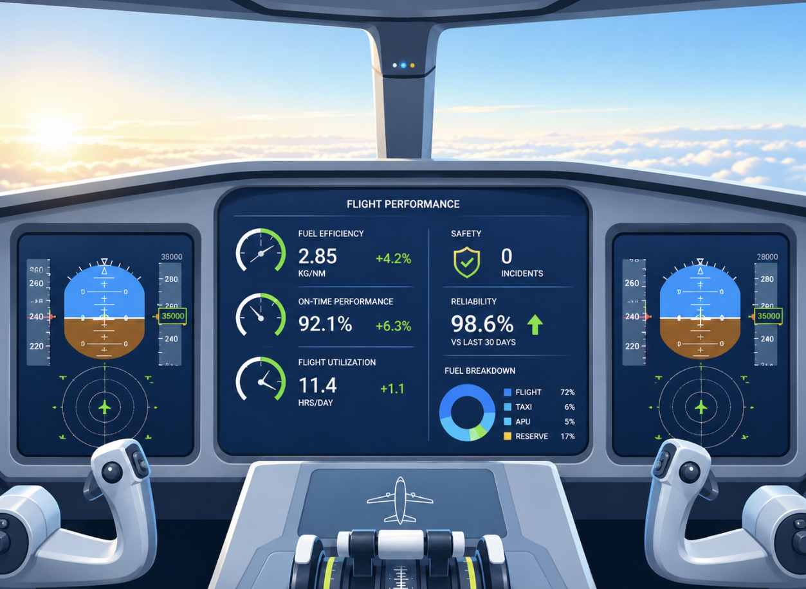
Minimum Jet Fuel Stocks
Policy Recommendations
Delay imposing additional regulatory costs
Data availability on fuel prices
Monitor KPIs for Aviation Sector
Council Directive 2009/119/EC Minimum Stocks of Oil
Worked Well, but
require specified stocks of jet fuel
(May 2026: 9%)
Carriers under cost & revenue pressure in 2026 due to ME crisis
Taxes: Disadvantages EU carriers – further reduce market share on extra-ECAA routes
Track European fuel prices and quantities
Limited public information from EU sources on European jet fuel prices; SAF etc.
Mandate regular reporting of strategically important service industry KPIs by regulatory bodies (cargo & pax)
Notes:
So to look at what policymakers can do, I have four recommendations:
The Minimum stocks of oil requirements worked very well in dealing with the Crisis in March/April, specified stocks of jet fuel are not required. Given the strategic importance of aviation, specific requirements for jet fuel should be mandated
EU carriers are under considerable financial pressure this year with downward pressure on revenues and upward pressures on costs due to the ME crisis. Policy makers should consider delaying imposition of additional environmental taxation measures
There is limited public information to allow tracking of European jet fuel prices and quantities as well as SAF information. Such data would aid analysis linked to environmental, transport and climate policy goals and should be reported in a timely and detailed format from official sources
Finally, policymakers should mandate regular reporting of Key Performance Indicators for strategically important sectors such as aviation – both air cargo and air passenger – to allow Member States to monitor and better assess sector performance
Thank you again for the opportunity to present this morning

Slide 17
Thank you aisling.reynolds@ucd.ie

