Slide 1
The Bioeconomy in the Agriculture of the Future:
Its Role in Promoting Farms’ Economic Sustainability
Committee on Agriculture and Rural Development (AGRI)
2 June 2026
Authors: Pavla Vrabcová, Miroslav Hájek, Hana Urbancová, Lukáš Čechura Context: Study prepared for the Committee on Agriculture and Rural Development of the European Parliament (April 2026)
Notes:
Accessibility - Instructions for the end user:
The slide 1 should always have the European Parliament logo as first item in the reading order / Selection Pane (note that the Selection Pane shows the objects in the reverse reading order. The object at the bottom of the list is the first one the be read out. The first on the list is the last one).
You can find the selection panel under the Home menu > Arrange > Position Objects > Selection Pane (In this particular slide you will see the correct reading order – remember, it’s from bottom to top – 1st EP Logo, 2nd Title and 3rd Subtitle)
Every slide should have a title and the title should be unique for each slide inside one PPT. If several slides belong to the same section, example: (Media Section) Media: Press; Media: Video: Media; Live events.

Slide 2
Purpose of the Study
The Bioeconomy in the Agriculture of the Future: Its Role in Promoting Farms’ Economic Sustainability
Analyse the role of the bioeconomy in the future of EU agriculture
Identify successful circular and value‑added models
Assess economic effects at farm level
Provide policy options to support scaling

Slide 3
Agriculture as a Pillar of the Bioeconomy
01

Slide 4
Key Trends in the EU Bioeconomy
Agriculture as a Pillar of the Bioeconomy
Integration with the circular economy
Rapid technological and digital innovation
Strong shift toward ecological and climate‑neutral models
Increased policy attention after 2018 and 2025 strategies

Slide 5
Drivers of Change
Agriculture as a Pillar of the Bioeconomy
Residues valorisation and cascading use of biomass
Precision technologies and smart farming
New plant breeding and biotechnology
Growing demand for renewable materials and energy

Slide 6
Successful Business Models
02

Slide 7
Success Stories
Successful Business Models
Table 1 Subgroups and Engagement Types from COOPID* project
Subgroup | Name (Country) | Sector | Bioeconomy engagement
By‑product Biorefineries & Cascading Use | Oleícola El Tejar (Spain) | Olive | By‑product biorefinery; cascading use
 | Caviro (Italy) | Wine | Full waste valorisation; bio‑based extracts + energy
Regional Bioeconomy Ecosystems & Industrial Symbiosis | Grand Est ecosystem (France) | Cereals / wood | Regional cluster; industrial symbiosis
Manure‑Based Biogas & Organic Fertilisers | Biogal (Poland) | Livestock | Biogas; digestate fertiliser
Poultry, Dairy & Vegetable Circular Systems | Pindos (Greece) | Poultry | Energy + compost; nutrient cycling
 | Valio (Finland) | Dairy | Biomethane from manure; cooperative chain
 | ZP Victor Asenov (Bulgaria) | Vegetables | Residue pellets/renewables; water recycling; bio‑waste compost
Whole‑Crop Fractionation & Bio‑based Materials | Møllerup Brands (Denmark) | Hemp | Whole‑crop fractionation; materials + food products
Source: Authors.
*COOPeration of bioeconomy clusters for bio-based knowledge transfer via Innovative Dissemination techniques in the primary production sector

Slide 8
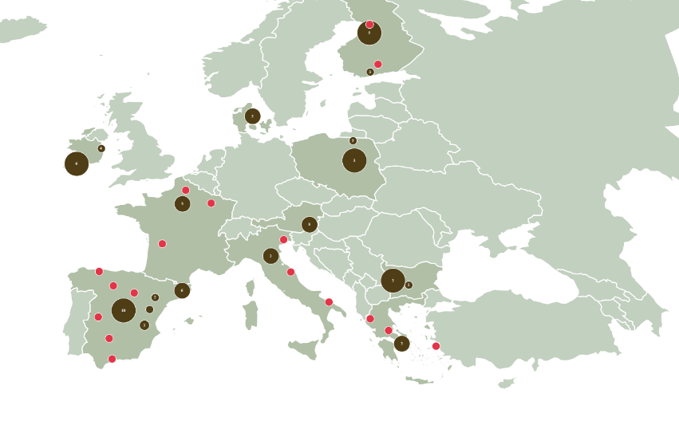
Common Success Factors
Successful Business Models
Full use of residues and by‑products
Use every stream, nothing is wasted
Strong cooperatives/collective structures
Work together to reach scale and share costs
Regional embeddedness and industrial symbiosis
Local links: one actor’s by‑product is another’s input
Knowledge transfer through Agricultural Knowledge and Innovation Systems (AKIS)
Advice and training help farmers adopt solutions faster
Stable policy and market environment
Clear rules and stable demand support investment
Figure 1 COOPID Bioeconomy Clusters

Slide 9
Economic Impact Model
03

Slide 10
Key Empirical Findings
Economic Impact Model
The analysis uses the Farm Sustainability Data Network dataset for the years 2018–2023.
Bioeconomy participation is approximated by the share of Other Gainful Activities (OGA) in total farm output.

Slide 11
Key Empirical Findings
Economic Impact Model
Higher diversification (OGA share) is linked to lower agricultural income per hectare.
    A 10% increase in long‑run OGA share is associated with 18.7% lower income per hectare.
Farms with higher long‑term OGA shares experience greater income volatility.
    A 10% increase in OGA share is associated with income fluctuations roughly 2.5% wider, indicating that diversified income streams can themselves be unstable.
Subsidies significantly stabilise farm income.
    10% increase in subsidies per hectare reduces income variability by about 0.5%.

Slide 12
Policy Options
04

Slide 13
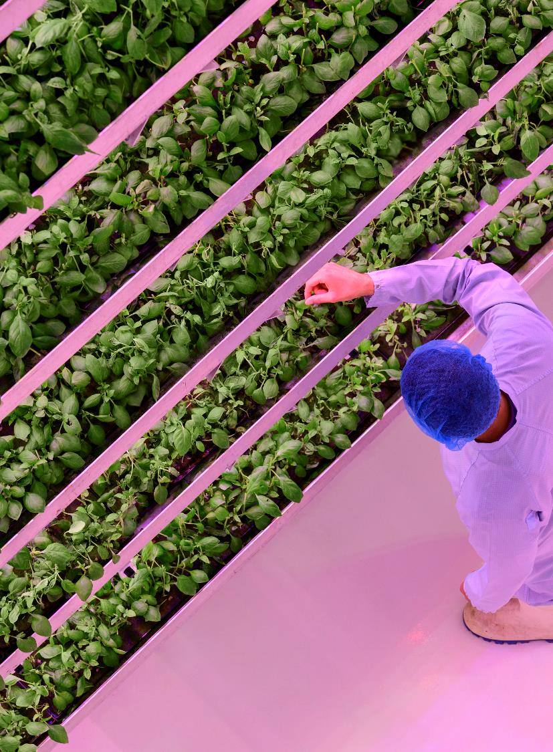
Policy Option A
Policy Options
Strengthening the CAP for Bioeconomy Scaling
Schemes supporting circularity and soil health
Investments in infrastructure for biomass handling and processing
Support for cooperatives and regional clusters
Risk‑sharing financial instruments

Slide 14
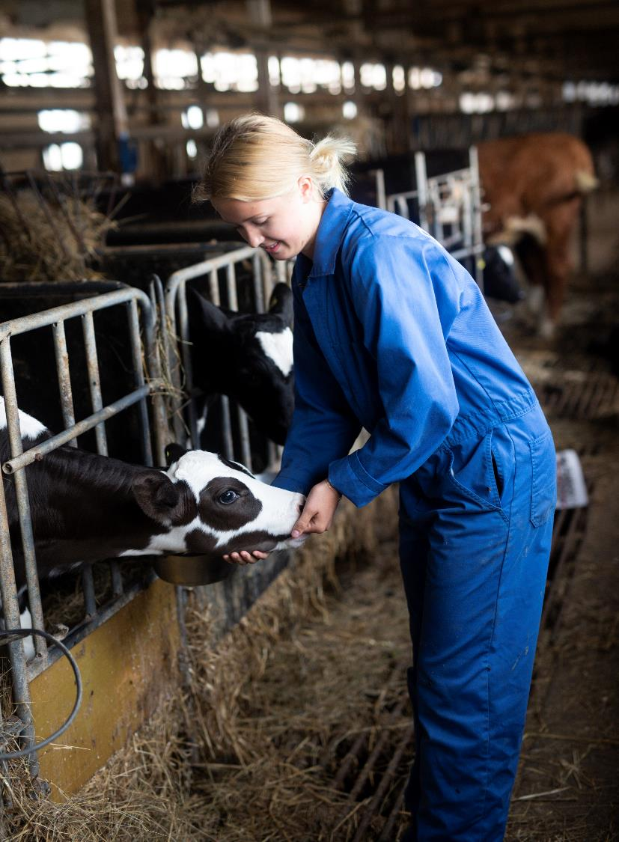
Policy Option B
Policy Options
Value‑Chain Contracts and Standards
Long‑term written contracts for residues and biomass
Harmonised EU‑wide quality standards
Stronger bargaining position for primary producers

Slide 15
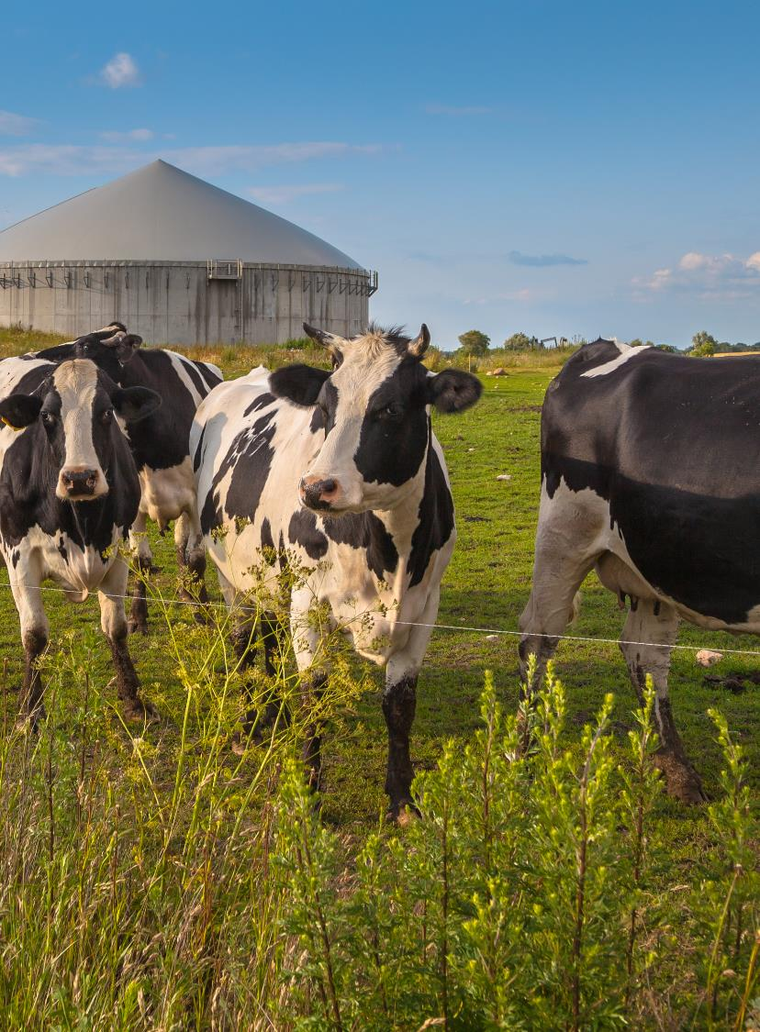
Policy Option C
Policy Options
Residues‑First Principle
Preference for by‑products and waste streams
Reduced competition for land with food production
Regional planning for processing capacity

Slide 16
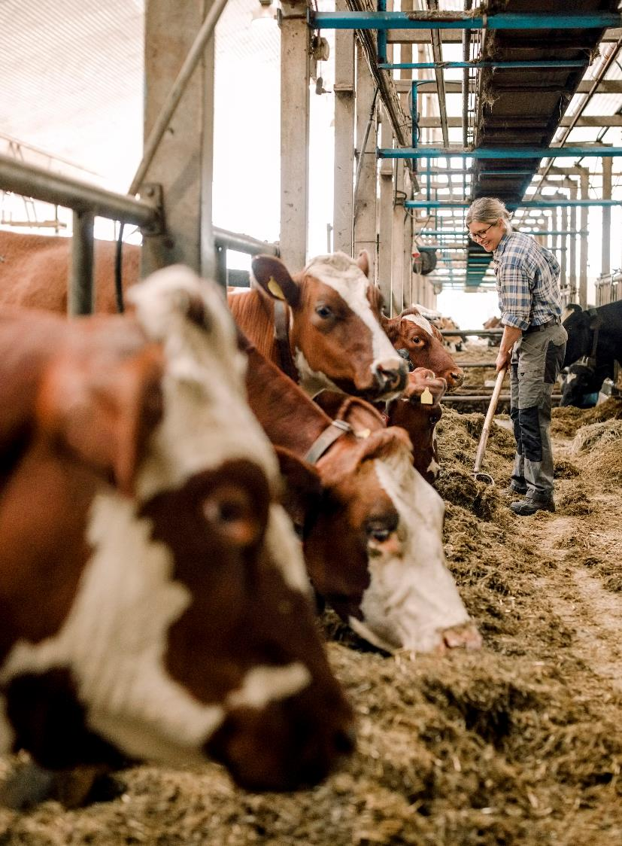
Policy Option D
Policy Options
Investment Packages and Blended Finance
Combination of grants, guarantees and loans
Support for capital‑intensive technologies
Financing tied to secured offtake

Slide 17
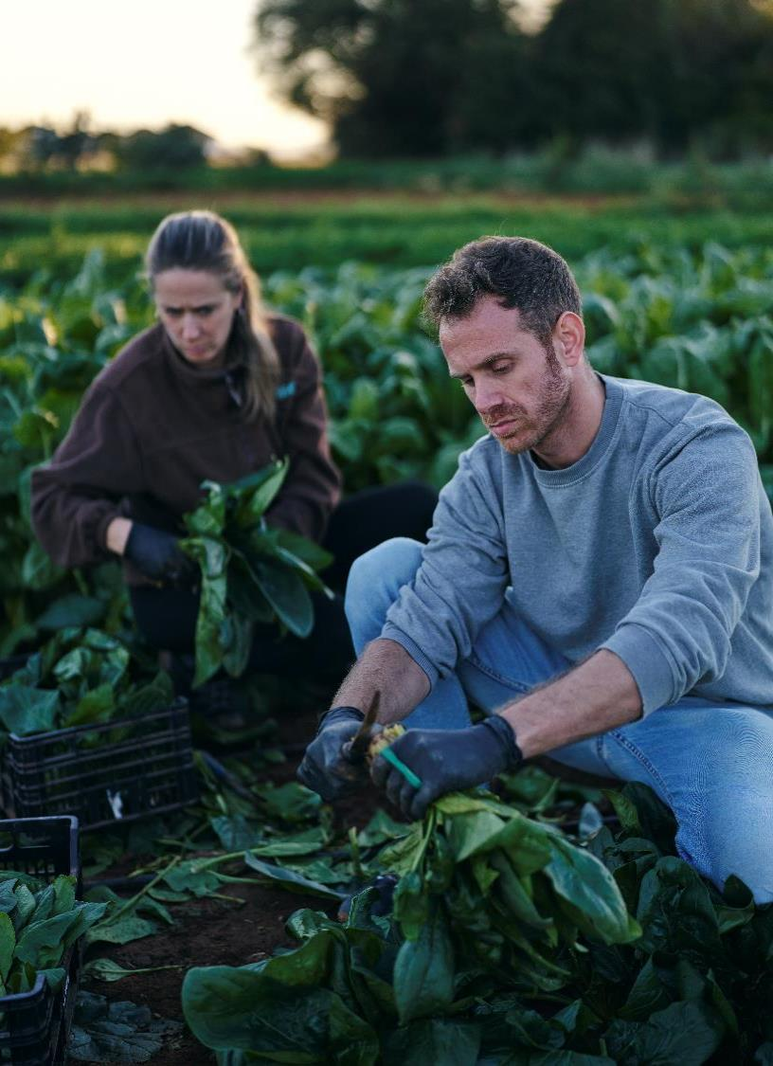
Policy Option E
Policy Options
Strengthening Advisory Systems (AKIS)
Skills for contract negotiation, nutrient flows, carbon accounting
Innovation brokerage and demonstration farms
Digital monitoring and traceability support

Slide 18
Conclusion
05

Slide 19
Conclusion
Conclusion
Scaling is about bankability, not technology: without offtake contracts, clear standards, and risk-sharing, bioeconomy projects remain pilots.
Success cases: residues-first + cascading use + cooperatives/clusters + regional industrial symbiosis → highest replication potential.
Hard empirical signal → diversification is not an automatic stabiliser (it is often structural).
The most consistent stabiliser is public support.
CAP must de-risk and target support by farm type/capital intensity.

Slide 20
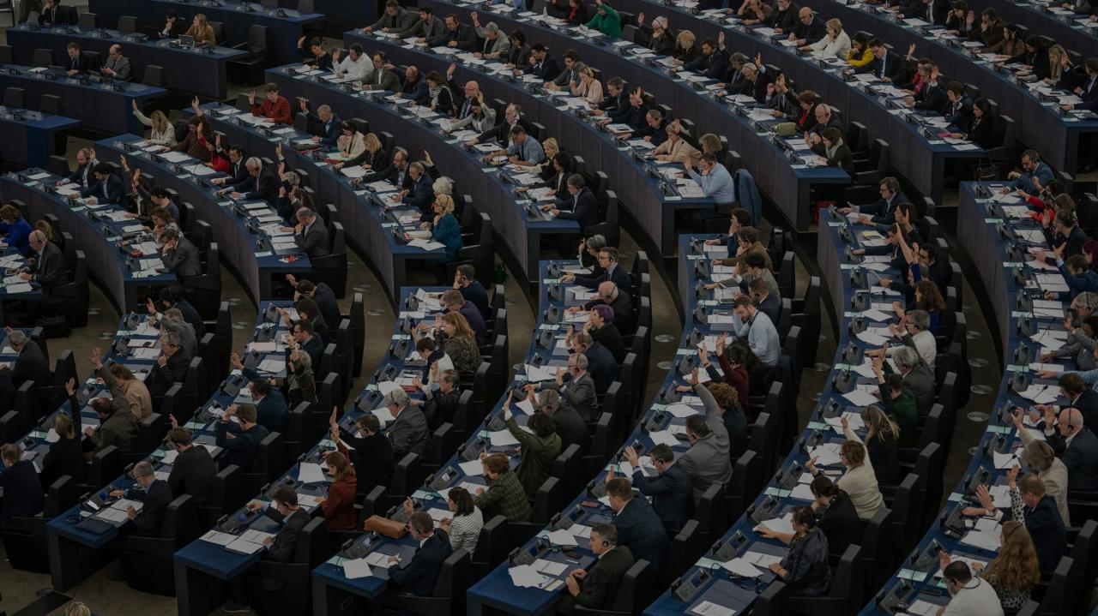

Thank you for your attention!
Assoc. Prof. Miroslav Hájek, Ph.D.
Czech University of Life Sciences Prague
Notes:
Accessibility - Instructions for the end user:
Title is always the first element in the reading order of the selection pane.
In a presentation slide the background image is generally decorative. When that is the case, put the image in the background (Master slide).
When the image is not decorative, then you can have it in this order, if you need to have a full screen image, that covers all the slide.
The alternative would be to have a layout as in slide #31. An image that is one or two thirds of the slide, leaving enough space to have the text next to image and not on top of it, thus respecting the correct reading order.
All mages that are not decorative require alternative-text (with the mouse, right-click on the image > Format Picture > Size & Properties > Alt Text > and insert a short and meaningful text in the Description field, ignoring the Title field)
If it is decided to use a full screen/slide background image, different images than the ones suggest in this template, be aware of contrast ratio between the background image and the foreground text. Any other colour than white in the text would be difficult to read.

