Slide 1
The Bioeconomy in the Agriculture of the Future
Its Role in Promoting Farms’ Economic Sustainability
Authors: Pavla Vrabcová, Miroslav Hájek, Hana Urbancová, Lukáš Čechura Context: Study prepared for the Committee on Agriculture and Rural Development (AGRI) of the European Parliament (March 2026)
Notes:
Accessibility - Instructions for the end user:
The slide 1 should always have the European Parliament logo as first item in the reading order / Selection Pane (note that the Selection Pane shows the objects in the reverse reading order. The object at the bottom of the list is the first one the be read out. The first on the list is the last one).
You can find the selection panel under the Home menu > Arrange > Position Objects > Selection Pane (In this particular slide you will see the correct reading order – remember, it’s from bottom to top – 1st EP Logo, 2nd Title and 3rd Subtitle)
Every slide should have a title and the title should be unique for each slide inside one PPT. If several slides belong to the same section, example: (Media Section) Media: Press; Media: Video: Media; Live events.

Slide 2
Purpose of the Study
The Bioeconomy in the Agriculture of the Future: Its Role in Promoting Farms’ Economic Sustainability
Analyse the role of the bioeconomy in future EU agriculture
Identify successful circular and value‑added models
Assess economic effects at farm level
Provide policy options to support scaling

Slide 3
Agriculture as a Pillar of the Bioeconomy
01

Slide 4
Background
Agriculture as a Pillar of the Bioeconomy
Agriculture produces the majority of primary biomass and accounts for two thirds of total employment in the EU bioeconomy sector.
A shift is underway from simple commodity production toward a systemic role as a provider of multifunctional services and renewable resources.
Main opportunity: Income diversification and risk reduction through the transformation of residues into high value‑added products.

Slide 5
Key Trends in the EU Bioeconomy
Agriculture as a Pillar of the Bioeconomy
Integration with the circular economy
Rapid technological and digital innovation
Strong shift toward ecological and climate‑neutral models
Increased policy attention after 2018 and 2025 strategies

Slide 6
Drivers of Change
Agriculture as a Pillar of the Bioeconomy
Residues valorisation and cascading use of biomass
Precision technologies and smart farming
New plant breeding and biotechnology
Growing demand for renewable materials and energy

Slide 7
Successful Business Models
02

Slide 8
Biorefineries and Cascading Use
Successful Business Models
Spain – Oleícola El Tejar
Large second‑tier cooperative processing 2 million tonnes of olive pomace annually.
Converts what was previously waste (alperujo) into pomace oil, animal feed, activated carbon, organic fertilisers and bioenergy pellets.
Leader in environmentally efficient technologies, including the HYGROSCOPIC CYCLE, reducing water use and CO₂ emissions.
France – Grand Est Bioeconomy Ecosystem
Regional, highly integrated system processing ~4 million tonnes of biomass annually.
Outputs include sugar, wheat‑based products, ethanol, bio‑CO₂ and advanced wood materials.
Strong industrial symbiosis between agriculture, forestry, processing and research institutions.

Slide 9
Circular Wine and Food Chains
Successful Business Models
Italy – Caviro Group
Largest Italian wine cooperative, exporting to 70+ countries.
100% circular model: grape pomace and lees transformed into alcohol, tartaric acid, extracts for pharmaceuticals and cosmetics, as well as bioethanol, biomethane and electricity.
Fully closes the loop by returning nutrients to fields via organic fertilisers.

Slide 10
Poultry, Dairy and Vegetable Circular Systems
Successful Business Models
Greece – Pindos Poultry Cooperative
Integrated poultry chain using by‑products for bioenergy production, compost and feed.
Produces AGROSYN organic fertiliser from chicken manure.
Finland – Valio Dairy Cooperative
Major producer with 3,200 farms.
Joint venture aims to produce 1 TWh of biomethane by 2030 from livestock manure.
Biomethane used as low‑carbon fuel for logistics, reducing transport emissions.
Bulgaria – ZP Victor Asenov Greenhouse Production
Uses pellets from sunflower residues for heating, recycles rainwater and drainage, and converts biological waste into compost and biofertilisers.
Plans to integrate blockchain for plant monitoring and expand greenhouse capacity.

Slide 11
Manure‑Based Biogas and Organic Fertilisers
Successful Business Models
Poland – Biogal
Processes 100,000 tonnes of biomass annually, mainly pig manure and food waste.
Produces electricity (sold to the grid), heat (used locally), and Naturgal organic fertiliser.
Contributes to lower emissions and local energy independence.
Ireland – Carbery Group
Cascading use of dairy raw materials; converts lactose residues into 12 million litres of bioethanol annually.
Remaining ethanol is used to produce biogas for internal energy needs.
Produces high‑value cheese, whey ingredients and organic fertiliser as co‑product.

Slide 12
Cooperative‑Led Residue Pelletisation
Successful Business Models
Austria – Pelletierungsgenossenschaft eGen
Cooperative transforming straw, grass, wine pomace and other residues into high‑quality bedding pellets and fibre‑rich feed pellets.
Processes ~2,000 tonnes of biomass annually.
Enables farmers to valorise residues and preserve grassland habitats through targeted pelletisation.

Slide 13
Common Success Factors
Successful Business Models
Full use of residues and by‑products
Strong cooperatives/collective structures
Regional embeddedness and industrial symbiosis
Knowledge transfer through AKIS
Stable policy and market environment

Slide 14
Economic Impact Model
03

Slide 15
Farm‑level Incremental Assessment
Economic Impact Model
The model evaluates the economic effect of a bioeconomy activity by comparing a farm’s current system with a hypothetical reference system in which the activity is not implemented.
It quantifies the incremental change, reflecting the real decision farmers face: continue with the existing system or adopt a new bioeconomy solution.

Slide 16
Evaluation across four Economic Dimensions
Economic Impact Model
The model examines how bioeconomy activities reshape the farm’s economic structure across four interconnected areas:
Costs and input savings – effects on fertilisers, energy, feed, waste management, and operational costs.
Revenues and diversification – new income streams from biomass, by‑products, energy, or ecosystem‑service payments.
Value added and internal integration – improved retention of value by processing or using biomass on‑farm instead of selling raw materials.
Economic stability and resilience – reduced exposure to price volatility, improved predictability of cash flow and long‑term stability.

Slide 17
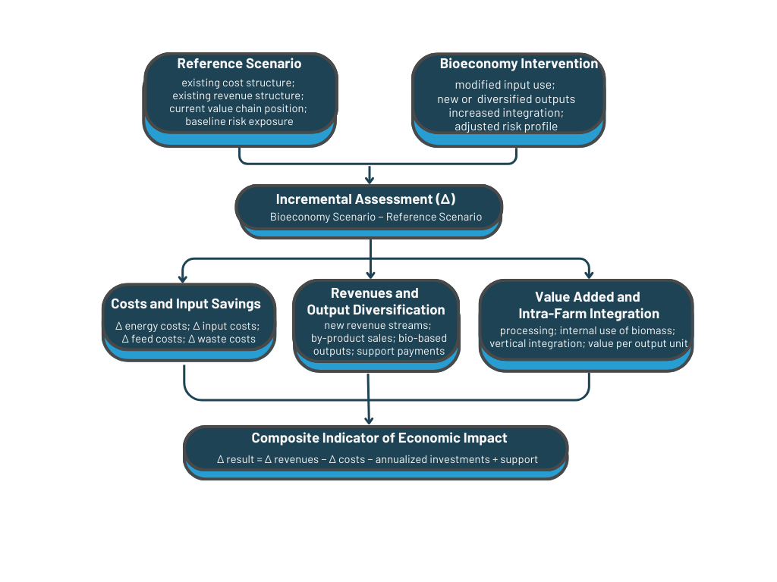
Composite Economic Indicator
Economic Impact Model
Figure 1: Conceptual Framework of the Model for Assessing the Economic Impacts of Bioeconomy Activities at Farm Level
Composite indicator (the net annual change in farm performance)
This indicator can be shown:
per farm,
per hectare,
per unit of labour or output.
It integrates cost savings, additional revenues, value added, investment costs (as annualised equivalents), and stability effects into one interpretable measure of economic impact.

Slide 18
Key Empirical Findings
Economic Impact Model
Methodology
The analysis uses the FADN Standard Results dataset for the years 2018–2023.
Each observation represents a representative farm stratum defined by:
Member State
Region
One of 14 types of farming
Economic size class
The final analytical sample contains 7,659 observations after cleaning steps (removal of missing values, implausible values, insufficient panel length).

Slide 19
Key Empirical Findings
Economic Impact Model
Methodology
Bioeconomy participation is approximated by the share of Other Gainful Activities (OGA) in total farm output.
OGA includes, for example:
On‑farm processing of crops or animal products,
Contracting services,
Agritourism,
Forestry activities.
This variable is the closest available indicator of farm‑level diversification into bio‑based or complementary income streams.

Slide 20
Key Empirical Findings
Economic Impact Model
Methodology
Three core dimensions of farm economic performance are analysed:
1. Income per hectare
Farm Net Income / Utilised Agricultural Area
2. Cost ratio (cost efficiency)
Intermediate consumption / Total output
3. Income stability (income volatility)
Coefficient of variation of farm net income over 2018–2023
Captures dispersion relative to the mean

Slide 21
Key Empirical Findings
Economic Impact Model
Higher diversification (OGA share) is linked to lower agricultural income per hectare
Empirical analysis shows that farms with persistently higher shares of Other Gainful Activities (OGA) report significantly lower agricultural income per hectare.
A 10‑percentage‑point increase in long‑run OGA share is associated with approximately 18.7% lower income per hectare after controlling for farm size, labour, capital and subsidies.
This reflects structural differences between farm types rather than a simple causal effect.

Slide 22
Key Empirical Findings
Economic Impact Model
No clear evidence of an effect on cost efficiency
Across models, the relationship between diversification and cost efficiency remains statistically inconclusive.
The estimates for the cost ratio are too imprecise to confirm whether diversification improves or worsens operational cost structures.
Therefore, the data do not allow firm conclusions about cost‑saving effects of OGA engagement.

Slide 23
Key Empirical Findings
Economic Impact Model
Diversification is associated with greater income variability
Contrary to common assumptions, farms with higher long‑term OGA shares experience greater income volatility.
A 10‑percentage‑point increase in OGA share is associated with income fluctuations roughly 2.5 percentage points wider, indicating that diversified income streams can themselves be unstable.
This pattern reflects structural differences and the nature of OGA markets, which may be more variable than primary agricultural outputs.

Slide 24
Key Empirical Findings
Economic Impact Model
Subsidies significantly stabilise farm income
Public support plays a crucial stabilising role.
The econometric analysis shows that a 10% increase in subsidies per hectare reduces income variability by about 0.5 percentage points.
Direct payments function as a stable, predictable income component, helping offset volatility associated with diversification and high capital intensity.

Slide 25
Policy Options
04

Slide 26
Policy Option A
Policy Options
Strengthening the CAP for Bioeconomy Scaling
Eco‑schemes supporting circularity and soil health
Investments in infrastructure for biomass handling and processing
Support for cooperatives and regional clusters
Risk‑sharing financial instruments

Slide 27
Policy Option B
Policy Options
Value‑Chain Contracts and Standards
Long‑term written contracts for residues and biomass
Harmonised EU‑wide quality standards
Stronger bargaining position for primary producers

Slide 28
Policy Option C
Policy Options
Residues‑First Principle
Preference for by‑products and waste streams
Reduced competition for land with food production
Regional planning for processing capacity

Slide 29
Policy Option D
Policy Options
Investment Packages and Blended Finance
Combination of grants, guarantees and loans
Support for capital‑intensive technologies
Financing tied to secured offtake

Slide 30
Policy Option E
Policy Options
Strengthening Advisory Systems (AKIS)
Skills for contract negotiation, nutrient flows, carbon accounting
Innovation brokerage and demonstration farms
Digital monitoring and traceability support

Slide 31
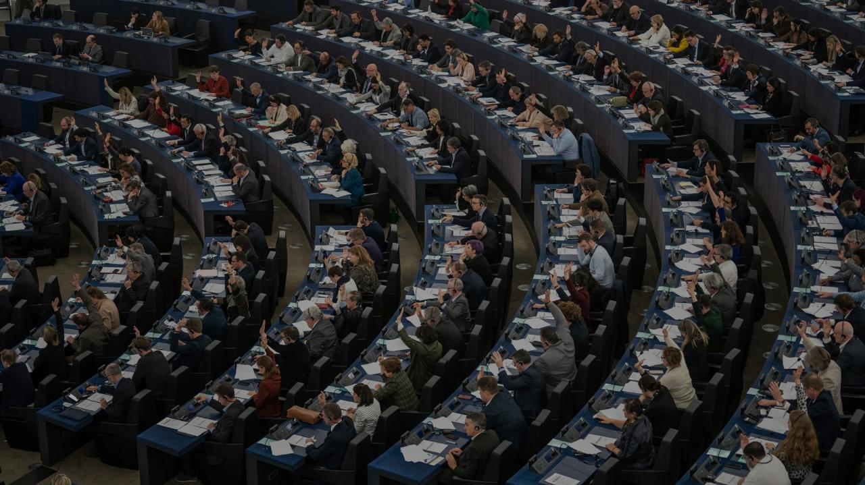

Thank you for your attention!
Assoc. Prof. Miroslav Hájek, Ph.D.
Czech University of Life Sciences Prague
Notes:
Accessibility - Instructions for the end user:
Title is always the first element in the reading order of the selection pane.
In a presentation slide the background image is generally decorative. When that is the case, put the image in the background (Master slide).
When the image is not decorative, then you can have it in this order, if you need to have a full screen image, that covers all the slide.
The alternative would be to have a layout as in slide #31. An image that is one or two thirds of the slide, leaving enough space to have the text next to image and not on top of it, thus respecting the correct reading order.
All mages that are not decorative require alternative-text (with the mouse, right-click on the image > Format Picture > Size & Properties > Alt Text > and insert a short and meaningful text in the Description field, ignoring the Title field)
If it is decided to use a full screen/slide background image, different images than the ones suggest in this template, be aware of contrast ratio between the background image and the foreground text. Any other colour than white in the text would be difficult to read.

