Slide 1
Student housing through the lens of social infrastructure
Ensuring social cohesion in urban communities.
Yvonne Franz
University of Vienna, Department of Geography and Regional Research
Notes:
Accessibility - Instructions for the end user:
The slide 1 should always have the European Parliament logo as first item in the reading order / Selection Pane (note that the Selection Pane shows the objects in the reverse reading order. The object at the bottom of the list is the first one the be read out. The first on the list is the last one).
You can find the selection panel under the Home menu > Arrange > Position Objects > Selection Pane (In this particular slide you will see the correct reading order – remember, it’s from bottom to top – 1st EP Logo, 2nd Title and 3rd Subtitle)
Every slide should have a title and the title should be unique for each slide inside one PPT. If several slides belong to the same section, example: (Media Section) Media: Press; Media: Video: Media; Live events.

Slide 2
Agenda
More than a roof: Student housing and
social infrastructure.
The Vienna case: Learnings and
emerging contestations.
Critical reflections & recommendations.

Slide 3
More than a roof: Student housing as social infrastructure.
01

Slide 4
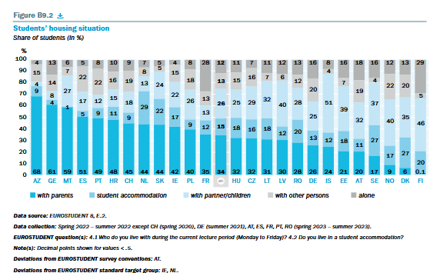
Purpose-Built-Student-Accomdation (PBSA) after “with parents” and “with partner”
Student housing as social infrastructure.
High diversity of students‘ housing situation amongst EU countries.
Most common category: „with parents“
  Important role of family networks
    due to lack of opportunities.
„with partner/children“ implies
  significant dependency of young households on non-PBSA housing segments
Hauschildt et al. (2024)

Slide 5
Understanding student housing beyond its residential function (1/2)
Student housing as social infrastructure.
Access to adequate and affordable housing is key for cohesive societies.
Social cohesion is supported by access to housing and social infrastructure
  e.g. education and care facilities, medical services
As well as
  local everyday economy
  open and public space
  cultural facilities, e.g. theaters, markets, cinemas
  (rapid) public transport etc.
Key determinants
for vibrant cities
See Franz & Gruber, 2022; Latham & Layton, 2023; Layton & Lathman, 2023.

Slide 6
Understanding student housing beyond its residential function (2/2)
Student housing as social infrastructure.
To fully grasp the role of PBSA, a critical assessment is needed:
(see See Franz & Gruber, 2022; Gruber & Franz, 2024)
inclusiveness of the overall local housing market
  Particularly for young households including vocational training, temporary entry-level professionals, students
socio-spatial disparities:
  Availability, particularly housing market entry mechanism
  Accessibility / proximity
  Quality of everyday life.
“A home is not just four walls and a roof. It is safety, warmth, a place for family and friends. It is belonging. […].”
President von der Leyen, 2025 State of the Union address.

Slide 7
The Vienna case: Learnings and emerging contestations.
02

Slide 8



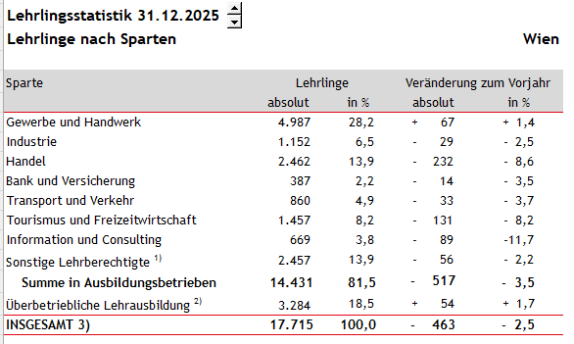
Students + gentrification = studentification?
The Vienna case: Learnings and emerging contestations.
Vienna is known as one of the most livable cities.
(e.g. studies by Mercer, 2024; Economist, 2025; Time Out Magazine, 2025)
Vienna is the major university city in Austria
  nine universities and more HEI
HEI sector as important driver for urban economy (Musil & Eder, 2013)
Apprentice statistics
Apprentices by sector
Vienna
Sector
Apprentices
Change previous year
Business and crafts
Industry
Trade
Finance and insurance
Inter-company training
TOTAL
Source: WKO, 2025. Own translations.

Slide 9
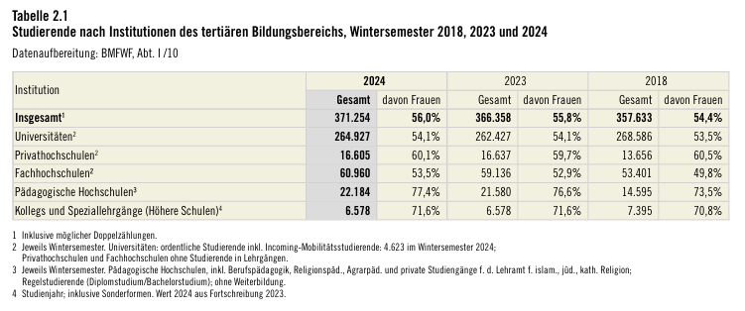
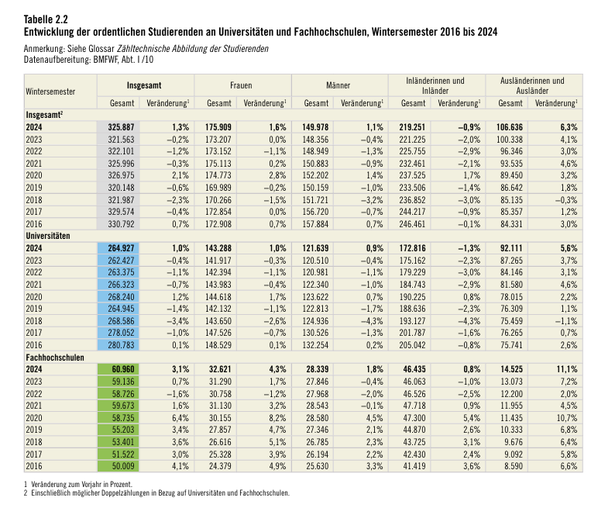
Driving force: Increasing student numbers
The Vienna case: Learnings and emerging contestations.
Number of regular students at universities and universities of applied sciences, winter term 2016-2024
Students by tertiary education institution, winter term 2018, 2023 and 2024
Total
Female
Male
Domestic
Non-Domestic
Total
Universities
Private Univ.
Univ. Applied
Univ. Colleges
Colleges
Universities
Source:
Bundesministerium für Frauen, Wissenschaft und Forschung (2025): Statistisches Taschenbuch 2025. p. 30.
Author’s translations.
Univ. Applied
Source:
Bundesministerium für Frauen, Wissenschaft und Forschung (2025):
Statistisches Taschenbuch 2025. p. 31.
Author’s translations.

Slide 10
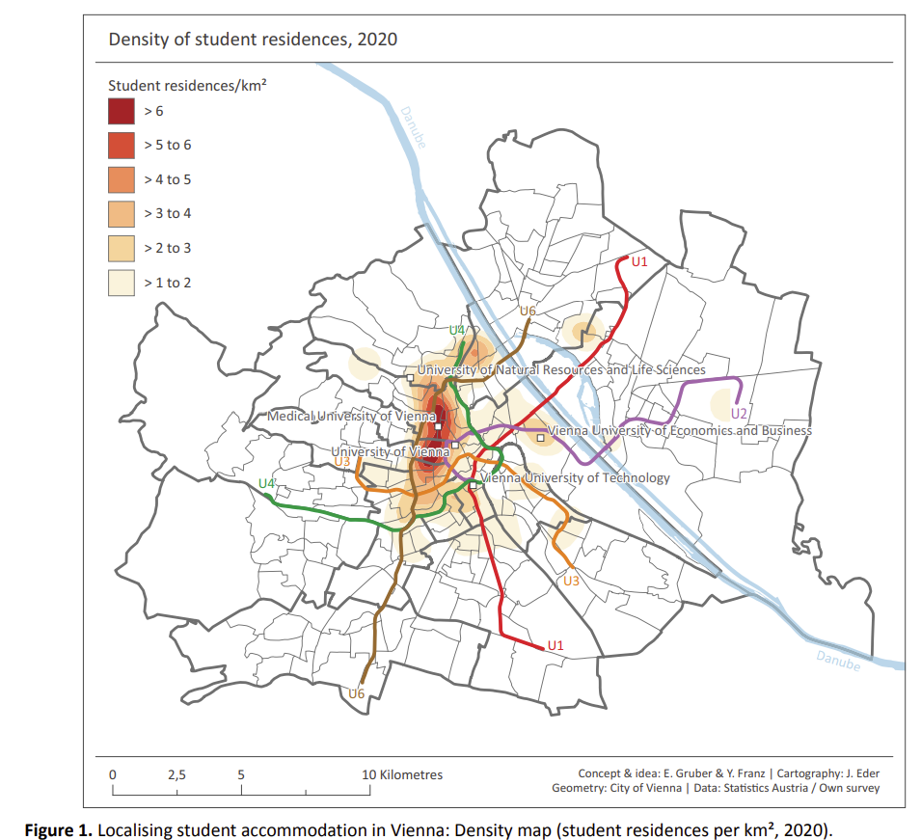
Where are the purpose--built student accommodations (PBSA)?
The Vienna case: Learnings and emerging contestations.
Source: Franz & Gruber, 2022.

Slide 11
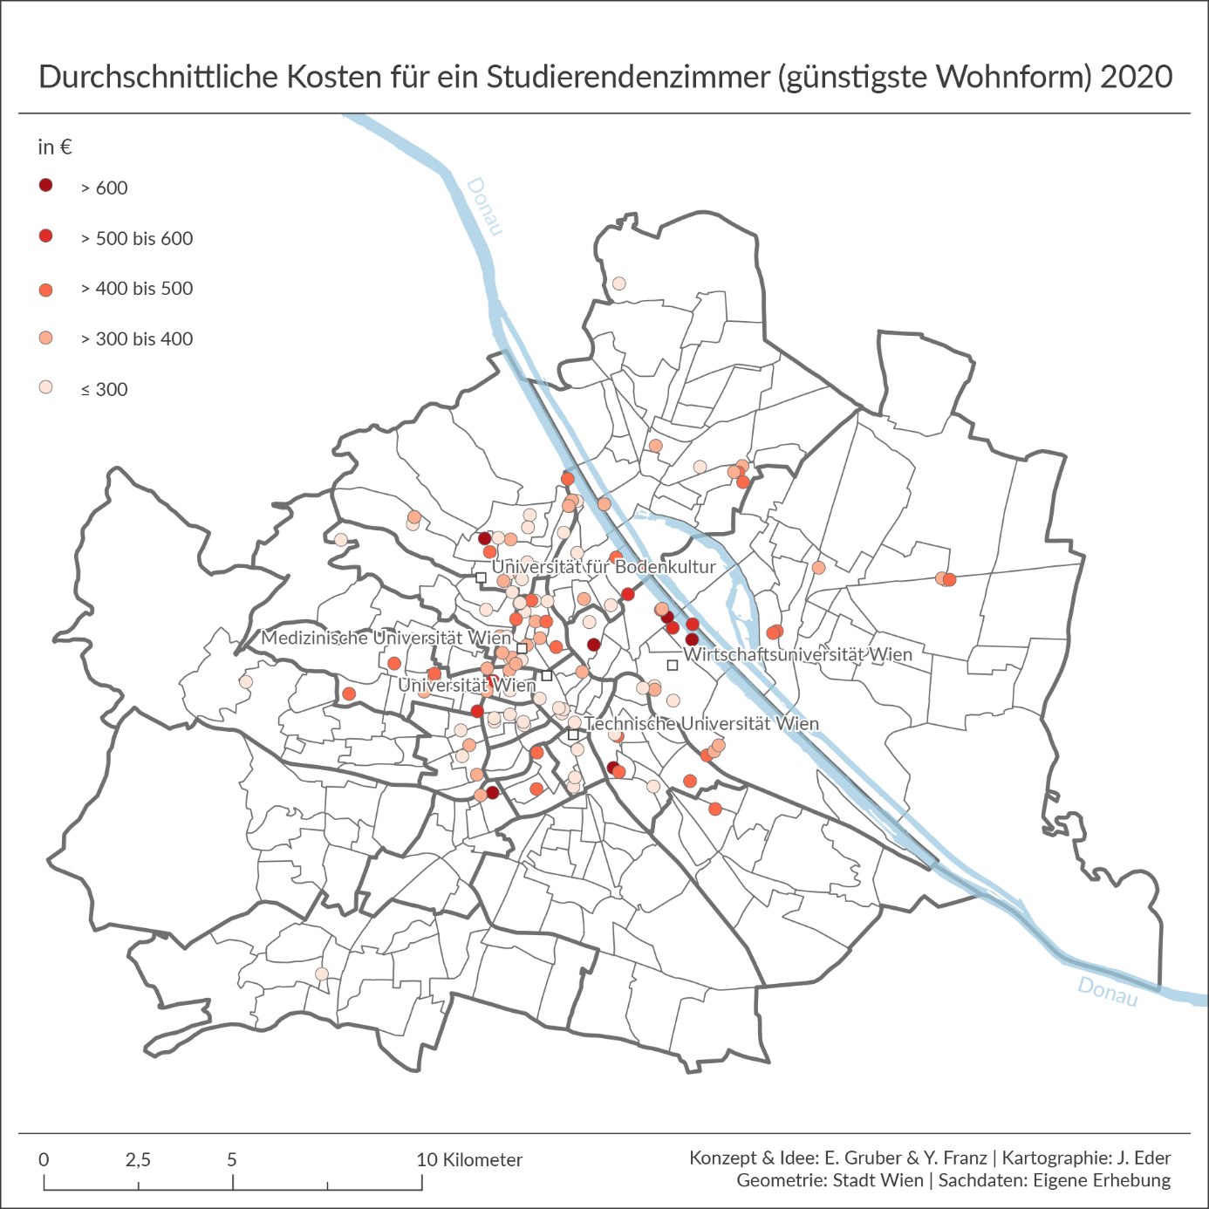
Students + gentrification = studentification?
Average costs for a student room (cheapest form of accommodation), 2020
The Vienna case: Learnings and emerging contestations.
Source: Franz & Gruber, 2022.

Slide 12
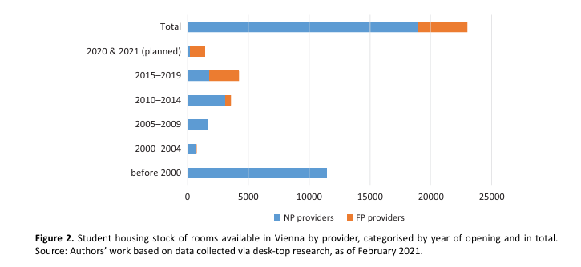
The rise of for-profit PBSA
The Vienna case: Learnings and emerging contestations.
Non-profit providers
For-profit providers
Franz & Gruber (2022): p. 462.

Slide 13
The rise of for-profit PBSA
The Vienna case: Learnings and emerging contestations.
Momentum for for-profit investors created by:
Global level: transformations in financial and real eststate market
National level: Reduction of funding for the construction of new (non-for-profit) PBSA housing
Local level: planning decision to support PBSA in new urban development areas
  ‘pioneer residents’ in category B locations
market entry of international investors and operators created
  Competition amongst non-for-profit and for-profit PBSA developers in terms of
    accomodation quality;
    marketing & customer acquisition.
Non-profit providers
For-profit providers
Franz & Gruber (2022): 462.

Slide 14
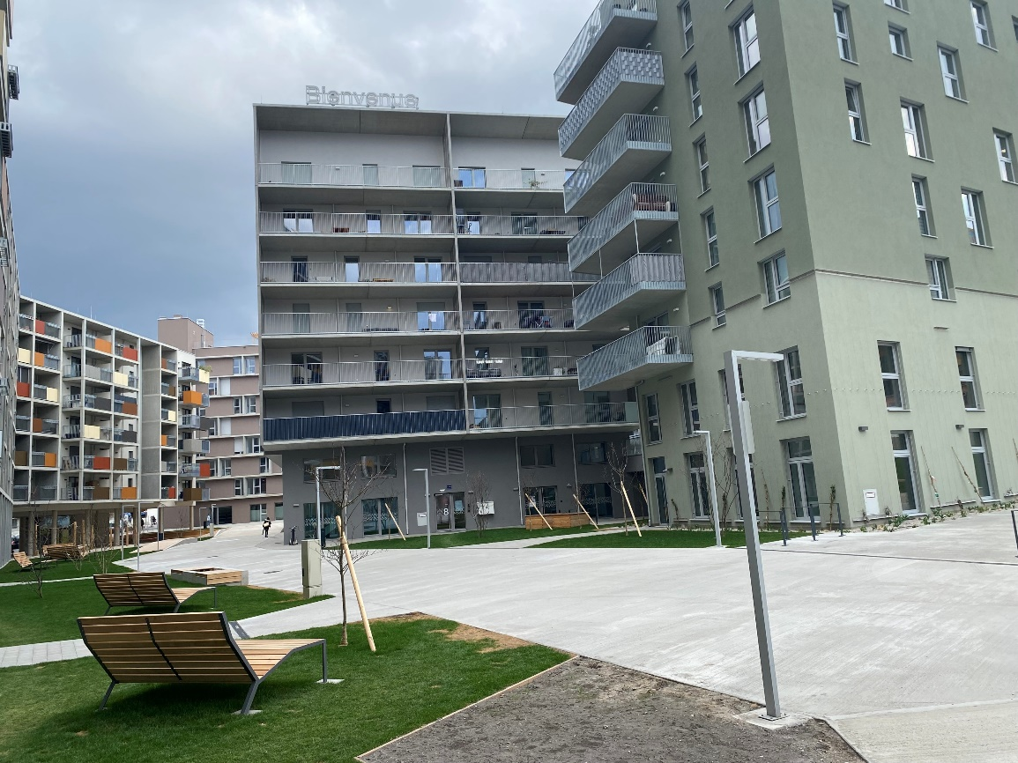
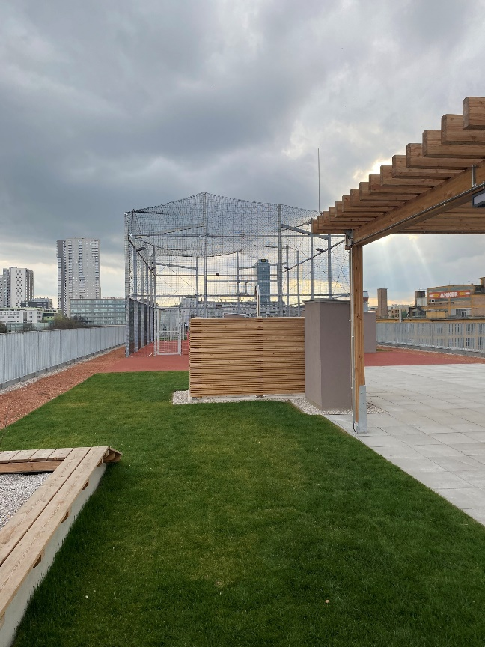
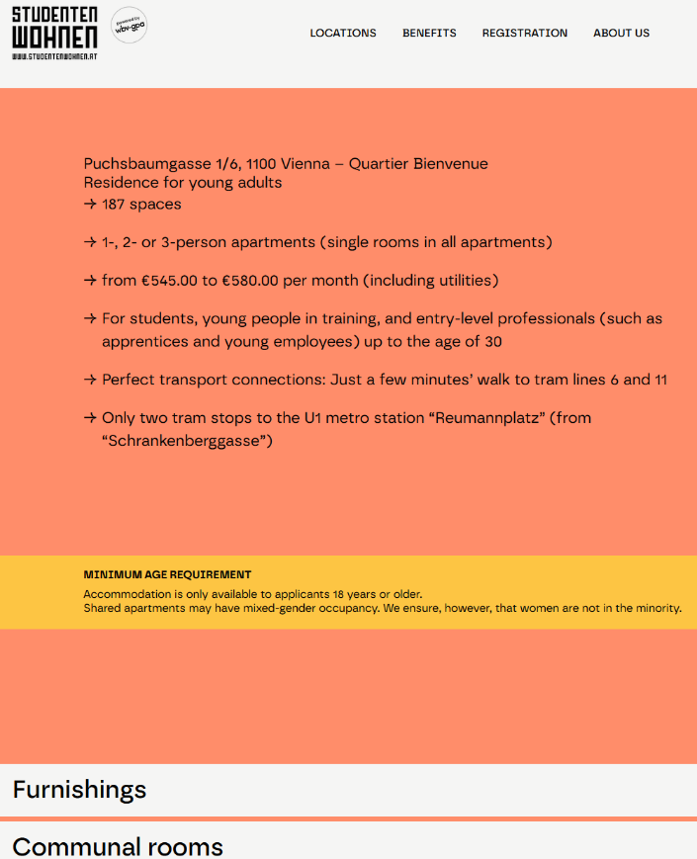
Recent non-for-profit PBSA in Vienna.
The Vienna case: Learnings and emerging contestations.
Picture: Franz, 2019
Shared public spaces
Recreation areas open to all
Pictures: Franz, 2025.
Screenshot: https://www.studentenwohnen.at/en/locations/heimvorteil-ankerbrotfabrik/ [last access: 23.05.2025]

Slide 15
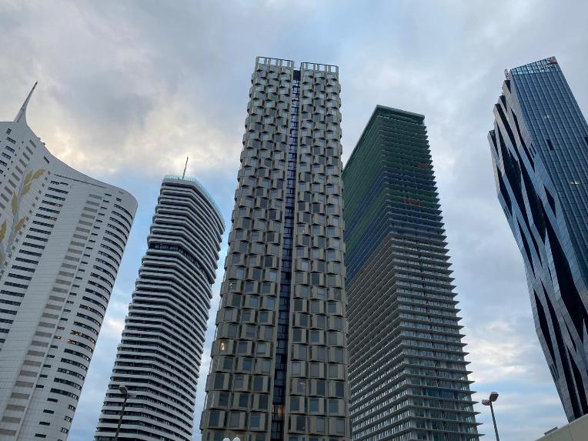
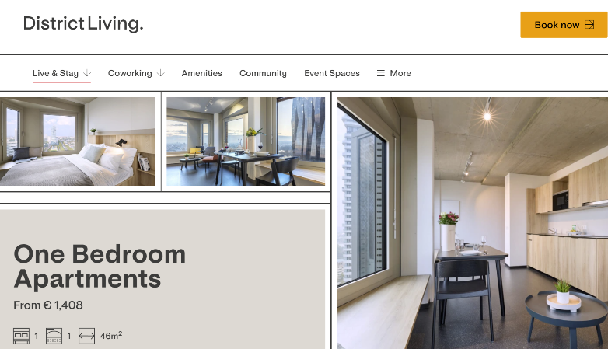

Recent for-profit PBSA in Vienna.
The Vienna case: Learnings and emerging contestations.
2025
Picture: Franz, 2019
Privatized student life.
Picture: Franz, 2025.
Source: https://www.district-living.at/live-stay/long-stay/one-bedroom/ [last access: 25.05.2026]
2026

Slide 16
About “sense of community” amongst for-profit and non-for-profit PBSA developers
The Vienna case: Learnings and emerging contestations.
Non-for-profit PBSA developers/operators:
consider themselves as ‘caretakers’ for new residents in the city;
differences depending on the (long-term) self-image of the operating institution.
For-Profit PBSA developers/operators:
Less emphasis on the social aspect of housing
No communal spaces
  cost efficiency due to lower maintenance costs; no social program management.
Global (PBSA) network: financial product based on student numbers and international curricula.
Focus on international students
  short length of stay
See: Franz & Gruber (2022); Gruber & Franz (2023).

Slide 17
Effects of changes on the supply side of PBSA
The Vienna case: Learnings and emerging contestations.
PBSAs are evolving
from a basic necessity
into a segment of the financialised housing market.
  Students as ‘reliable’ and predictable temporary customers in the private housing market submarkets (including, e.g., micro-flats, co-housing).
This financialization process impacts
overall housing affordability and availability of sub-segments in the local housing market,
supply diversification, and
living quality in socially cohesive neighbourhoods.
concept of ‘social infrastructure’ contributing to social cohesion is under pressure.
See: Franz & Gruber (2022); Gruber & Franz (2023).

Slide 18
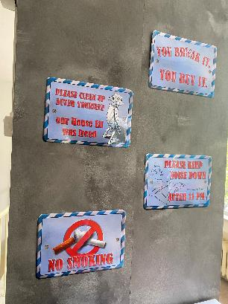
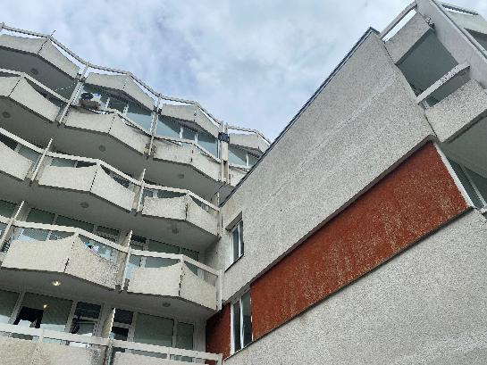
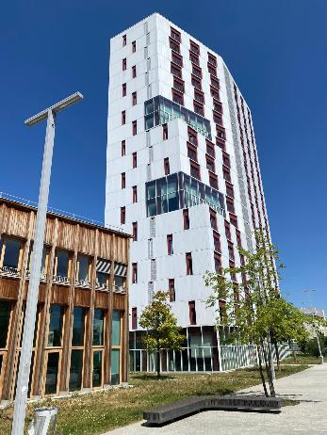
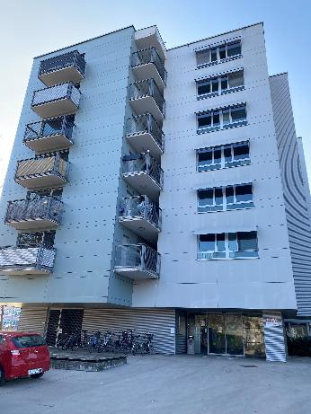
Contestations already prevalent
The Vienna case: Learnings and emerging contestations.
Picture: Yvonne Franz, 2025
Similar to other Central (Eastern) European university cities, Vienna is facing increasing housing shortage
particularly for vulnerable social groups
including young people and single-headed households due to
  rising land prices (in Vienna: + 244% between 2010-2023) and construction costs, hindering non-for-profit-housing developers in social housing construction (Ritt & Verlic, 2026: 15 pp.)
  real estate-driven accumulation regime transforming housing into an asset class (Aigner, 2020)
PBSA in Vienna.
On campus PBSA in Varna.
Picture: Yvonne Franz, 2018
On campus PBSA
in Paris.
Off campus PBSA
in Ljubljana.
All Pictures: Franz, 2024 & 2025.

Slide 19
Action for affordable student housing
The Vienna case: Learnings and emerging contestations.
Not only Vienna, known as the “city of social housing”, but other cities with an affordable housing stock are at risk of losing their attractiveness as vibrant cities for young people through policy‐induced commodification of housing for entry-level professionals.
(Aopted by the author. Based on quote in Franz & Gruber, 2022: 10).

Slide 20
Critical reflections & recommendations
03

Slide 21
European Affordable Housing Plan
Critical reflections & recommendations
“Developing and reinforcing scalable, innovative financing models building on successful examples” (p. 8)
  Draw on empirical evidence from international researchers and studies.
  Appreciate the diversity of national and regional housing and planning contexts (no one-fits-all solution).
  Scale up the achievements of non-for-profit housing measures and decommodified housing options to ensure positive community effects.
“Identify and disseminate innovative accommodation models for students and young people” (p. 17)
  Define “students and young people” more precisely
  Create robust data for evidence-based policies.
  Take into account young people’s attitudes toward education and careers.
“[…] Erasmus+ can provide housing support to students to facilitate and increase access to mobility, volunteering and learning.” (p.9)
  Need for inflation update: Rising housing costs are not represented in Erasmus+ student grants;
  Non-EU Erasmus+ students face higher risk for housing market discrimination due to
    lack of family support networks; lack of knowledge on housing market mechanism.

Slide 22
Thank you
Yvonne.franz@univie.ac.at

Slide 23
List of references
Aigner, A. (2020) What's wrong with investment apartments? On the construction of a ‘financialized’ rental investment product in Vienna, Housing Studies, DOI: 10.1080/02673037.2020.1806992.
BOKU University Development Plan 2030 (2024). https://boku.ac.at/universitaetsleitung/rektorat/informationen-des-rektorats/entwicklungsplan. [last access: 01.06.2026].
Bundesministerium für Frauen, Wissenschaft und Forschung (2025). Statistisches Taschenbuch. Hochschulen und Forschung 2025. https://www.bmfwf.gv.at/wissenschaft/hochschulsystem/hochschulstatistik-unidata.html [last access: 29.05.2026].
Dibiasi, Anna; Ikas, Tabea; Haag, Nora; Dau, Johanna; Gajdošová, Katarína; Thaler, Bianca; Unger, Martin & Zaussinger, Sarah (2026): Studierenden-Sozialerhebung 2025 auf einen Blick. IHS, Wien.
European Commission (2025): The European Affordable Housing Plan. COM(2025) 1025 final.
Franz, Y., Gruber, E. (2022). The Changing Role of Student Housing as Social Infrastructure. In: Urban Planning. 7(4), pp. 457–469. https://doi.org/10.17645/up.v7i4.5661.
Franz, Y. (2015): Gentrification in Neighbourhood Development. Case Studies from New York City, Berlin and Vienna. Vienna University Press. Göttingen.
Gruber, E. & Franz, Y. (2024). Studierendenwohnen als Asset Class: Veränderungsprozesse am österreichischen Studierendenwohnungsmarkt am Beispiel Wien und Innsbruck. In: Robert Musil, Christian Smigiel, Christian Zeller (ed.) Stadt, Land, Wohnen. Regionale Wohnungsmärkte zwischen Book und Krise. ISR Forschungsbericht 60. Wien: Verlag der Österreichischen Akademie der Wissenschaften. 147-157.
Gruber, E. & Franz, Y. (2019). What Can the Housing Market Teach Us? University Fieldtrips Identify Current Transitions in Vienna’s Urban Development and Housing Market Policies. Annals of the Austrian Geographical Society, Vol. 161, pp. 379–394. Open Access: https://austriaca.at/0xc1aa5576_0x003b6146.pdf.
Hauschildt, Kristina (Ed.), Christoph Gwosć, Hendrik Schirmer, Sylvia Mandl, Cordelia Menz (2024): Social and Economic Conditions of Student Life in Europe. EUROSTUDENT 8 Synopsis of Indicators 2021–2024. wbv Media. DOI: 10.3278/6001920ew.
Latham, A., & Layton, J. (2022). Social infrastructure: Why it matters and how urban geographers might study it. Urban Geography, 43(5), 659–668. https://doi.org/10.1080/02723638.2021.2003609.
Layton, J., & Latham, A. (2022). Social infrastructure and public life—Notes on Finsbury Park, London. Urban Geography, 43(5), 755–776. https://doi.org/10.1080/02723638.2021.1934631.
Musil R. & Eder J. (2013), Wien und seine Hochschulen: Regionale Wertschöpfungseffekte der Wiener Hochschulen. In: ISR Research Report, 40. Wien, ISR.
Ritt, Thomas; Mara Verlic (2026): Der Wiener Wohnungsmarkt im europäischen Vergleich. Struktur, Wirkung und aktuelle Herausforderungen. In: Verlic (Ed.). Wohnungsmärkte in Europa unter Druck. Stadtpunkte 46.13-18. https://emedien.arbeiterkammer.at/resolver?urn=urn:nbn:at:at-akw:g-7338894. [last access: 29.05.2026].
Technische Universität Wien (2025). Entwicklungsplan 2030 der Technischen Universität Wien. https://www.tuwien.at/fileadmin/Assets/tu-wien/Ueber_die_TU_Wien/Berichte_und_Dokumente/Entwicklungsplan/TUW_Entwicklungsplan_2030.pdf [last access: 01.06.2026].
Universität Wien (2023). Entwicklungsplan Universität Wien 2031. https://rektorat.univie.ac.at/strategie/entwicklungsplan/ [last access: 01.06.2026].
WKO (Austrian Economic Chambers) (2025). Lehrlinge nach Sparten: 2002-2025 mit Bundeslandauswahl. https://www.wko.at/zahlen-daten-fakten/daten-lehrlingsstatistik [last access: 01.06.2026]

