Slide 1
Housing for students and young people in training in the EU
Trends, impacts and recommendations
Constance Uyttebrouck
Luxembourg Institute of Socio-Economic Research (LISER)
Notes:
Accessibility - Instructions for the end user:
The slide 1 should always have the European Parliament logo as first item in the reading order / Selection Pane (note that the Selection Pane shows the objects in the reverse reading order. The object at the bottom of the list is the first one the be read out. The first on the list is the last one).
You can find the selection panel under the Home menu > Arrange > Position Objects > Selection Pane (In this particular slide you will see the correct reading order – remember, it’s from bottom to top – 1st EP Logo, 2nd Title and 3rd Subtitle)
Every slide should have a title and the title should be unique for each slide inside one PPT. If several slides belong to the same section, example: (Media Section) Media: Press; Media: Video: Media; Live events.

Slide 2
Agenda
Trends in the provision of housing for students and young people in training
Impacts of current trends on the availability and access to decent, sustainable and affordable housing
Critical analysis of current actions and recommendations

Slide 3
Trends in student housing provision
01

Slide 4
Changes in student housing provision
Trends in the provision of housing for students and young people in training
Expansion and diversification of the student population (Verhetsel et al., 2017) // HEI internationalisation (Aalbers, 2026) > increase of student trajectories in foreign housing markets (Fang & van Liempt, 2021)
Structural shortage of traditional student housing residences in university cities (Smith & Hubbard, 2014)
Studenthood may be the start of an independent housing pathway, but student housing pathways are very diverse and precarious (Revington, 2023)
Difficulties to access suitable and affordable student accommodation, in the face of declining institutional support and global patterns of housing financialisation and assetisation (e.g., Revington & Benhocine, 2023; Schwittay, 2025) > Student protests in several cities (e.g., in Milan; Costarelli & Mugnano, 2024 – also in Amsterdam, Lisbon, Durham, Dublin,…)

Slide 5
Types of student housing provision
Trends in the provision of housing for students and young people in training
Non-profit/limited-profit student housing provision shrinking and presenting quality issues (Macintyre, 2003)
Off-campus, shared housing in the private-rented sector growing (e.g., in German university towns; Miessner, 2021)
Purpose-Built Student Accommodation (PBSA) widespread in the UK (Heslop et al., 2023), emerging in continental Europe (provision rates still tiny but massive investment expected; JLL, 2025) and targeting international students (e.g., in Lodz [PL] and Turin [IT]; Zasina & Antczak, 2023)
Youth collaborative housing (e.g., in Milan; Costarelli, 2026) and student cooperatives initiatives emerging (e.g., in the UK; Schwittay, 2025)
No specific housing offer catering to young people in training documented in the scientific literature

Slide 6
Zoom in on for-profit student housing
Trends in the provision of housing for students and young people in training
Existing stock: landlords providing shared accommodation for students following buy-to-let logic maximise rent extraction at the expense of affordability for students (Miessner, 2021)
New housing provision: market-led PBSA as a preferred, alternative ‘niche asset class’ for real estate and financial actors (Oxenaar et al., 2024) > financialisation of PBSA reconfiguring student housing (Aalbers, 2026)
Hybrid models mixing PBSA with hospitality to maximise occupancy rates (see, e.g, the PBSA company The Social Hub)
PBSA in secondary cities: enabled by the combination of several actors, policies and strategies that rely on knowledge economy’s development (Heslop et al., 2023), consider international students as drivers of urban renewal (Mulhearn and Franco, 2018) and need to increase their housing supply

Slide 7
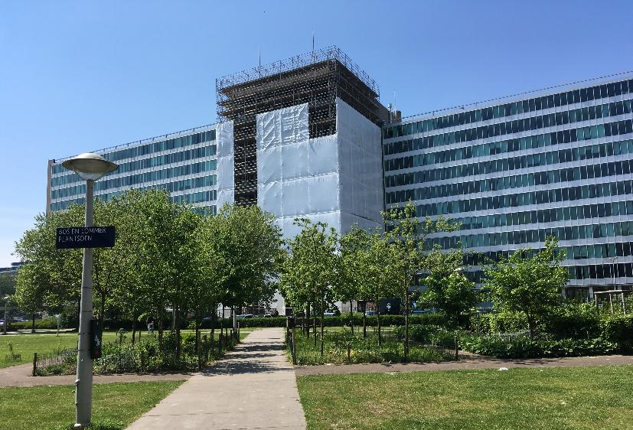
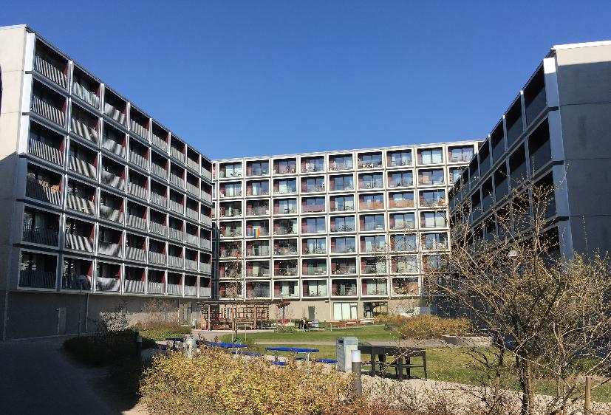
Shared housing for students and young professionals
Trends in the provision of housing for students and young people in training
PBSA x shared housing for young professionals (i.e., 20-35 y.o. entering the labour market) in both private and mixed initiatives involving public/non-profit actors (e.g., in the peripheries of large cities as well as in post-industrial, university towns: Uyttebrouck, 2020; Uyttebrouck, 2025)
Illustrations showing:
  A project combining student housing and privately-owned studios, involving public and private actors
  Non-profit rental housing for young people aged 18-30
Projects requiring specific governance arrangements…and improved regulations to avoid undesired outcomes (e.g., regarding long-term affordability, spatial quality)
Author’s picture - Amsterdam, 2018
Author’s picture - Stockholm, 2019

Slide 8
Impacts of current trends
02

Slide 9
Tenant perspective
Impact of current trends
Student housing as a ‘hidden curriculum’ (i.e., variations in student housing experiences > uneven academic trajectories; Sotomayor et al., 2022) that stratifies students according to class, gender, and race
Discrimination and structural disadvantages experienced in the tenant selection process as well as housing precarity, especially among international students (Fang and van Liempt, 2021; Waldron, 2023), who are more subject to ‘chaotic’ housing pathways (Druta, 2025)
Illusion of flexibility in market-led shared housing putting young tenants in insecure or precarious situations that may become permanent (Hoolachan et al., 2017)
Pressure of becoming a ‘resourceful tenant’ in collaborative youth housing projects (using criteria such as ‘commitment’ or ‘motivation’ in resource-based allocation systems; Costarelli, 2026)

Slide 10
Housing provision perspective
Impact of current trends
PBSA and related niche asset classes offer higher profitability for investors but contribute to worsening the financialisation of housing and related housing affordability crisis (Oxenaar et al., 2024)
Increase in international student numbers, public-private partnerships and flexible planning frameworks have paved the way for financialised PBSA companies (Aalbers, 2026)
To better steer such developments, local governments need reinforced regulations, effective enforcement means and specific actors and instruments supporting them in this endeavour (Uyttebrouck, 2025)

Slide 11
Urban perspective
Impact of current trends
Attracting students is especially key to the regeneration and economic development of post-industrial cities (Heslop et al., 2023) … as well as a process enhancing youth-driven forms of gentrification (e.g. Moos, 2016)
The related socio-spatial exclusion patterns are also the result of urban transformations that support the knowledge economy and act as ‘university-related fixes’ for capitalist urbanisation (Cenere et al., 2023)
Local authorities seem to consider students as less demanding newcomers and an easy target group in urban regeneration areas (which may come at the expense of a mix with other uses and target groups; Uyttebrouck, 2025)
Student room rentals in existing apartment buildings can also lead to ‘financialisation-led densification’ and further inner-city change (Zasina & Żelazowski, 2025)

Slide 12
Critical analysis & recommendations
03

Slide 13
European Affordable Housing Plan
Critical analysis & recommendations
“Help build more student housing by mobilising investments ”… but market-led student housing provision has proved to fuel housing financialisation and assetisation (cf. slide 9)
“Reduce or eliminate the need for a security deposit” > A key issue requiring further research
“Identify and disseminate innovative accommodation models for students and young people” > Be critical of “innovation” in the discourses of market intermediaries offering “new” forms of temporary and/or shared accommodation (surface responses to crises may be yet another way of avoiding addressing structural issues; Uyttebrouck & Paccoud, 2026)

Slide 14
Policy recommendations
Critical analysis & recommendations
Support and federate Student Housing Observatories to improve the knowledge of the nature and geography of the housing stock catering to students and young people in training across Europe
Support Higher-Education Institutions in the provision of affordable and high-quality student housing
Support non-profit and limited-profit organisations intermediating affordable and decommodified shared housing for students and young people more broadly

Slide 15
Thank you constance.uyttebrouck@liser.lu

Slide 16
List of references
Aalbers, M. B. (2026). The Financialization of Rental Housing 3.0: Expanding Frontiers in Global Niche Asset Classes. Housing, Theory and Society, 1–24. https://doi.org/10.1080/14036096.2026.2671022
Cenere, S., Mangione, E., Santangelo, M. and Servillo, L. (2023), Setting up a University City. Geographies of Exclusion in North Turin. Tijds. voor econ. en Soc. Geog., 114: 400-414. https://doi.org/10.1111/tesg.12550
Costarelli, I. (2026). The Construction of Resourceful Tenants in Collaborative Housing for Young People in Milan. Housing, Theory and Society, 43(1), 14–33. https://doi.org/10.1080/14036096.2025.2498468
Costarelli, I., & Mugnano, S. (2024). Abitare studentesco e dinamiche urbane in Italia. Sociologia Urbana e Rurale, 134, 7–12. https://doi.org/10.3280/SUR2024-134-S001
Druta, O. (2025, 30 January). Intergenerational support and the differentiated housing trajectories of international students in a midsized Dutch city. Paper presented at the workshop “Housing young people in the affordability-crisis context: A European view on family support, market supply and policy responses”, Luxembourg
Fang, C., & van Liempt, I. (2020). ‘We prefer our Dutch’: International students’ housing experiences in the Netherlands. Housing Studies, 0(0), 1–21. https://doi.org/10.1080/02673037.2020.1720618
Heslop, J., Chambers, J., Maloney, J., Spurgeon, G., Swainston, H., & Woodall, H. (2023). Re-contextualising purpose-built student accommodation in secondary cities: The role of planning policy, consultation and economic need during austerity. Urban Studies, 60(5), 923–940. https://doi.org/10.1177/00420980221121569
Hoolachan, J., McKee, K., Moore, T., & Soaita, A. M. (2017). ‘Generation rent’ and the ability to ‘settle down’: economic and geographical variation in young people’s housing transitions. Journal of Youth Studies, 20(1), 63–78. https://doi.org/10.1080/13676261.2016.1184241
JLL (2025). European PBSA in 2030: Sizing up the opportunity: International appeal and demographic growth exacerbate PBSA supply gap. https://www.jll.com/en-uk/insights/european-pbsa-investing-in-the-future
Macintyre, C. (2003). New Models of Student Housing and Their Impact on Local Communities. Journal of Higher Education Policy and Management, 25(2), 109–118. https://doi.org/10.1080/1360080032000122598
Moos, M. (2016). From gentrification to youthification? The increasing importance of young age in delineating high-density living. Urban Studies, 53(14), 2903–2920. https://doi.org/10.1177/0042098015603292
Miessner, M. (2021). Studentification in Germany: How investors generate profits from student tenants in Goettingen and the impacts on urban segregation. European Urban and Regional Studies, 28(2), 133–154. https://doi.org/10.1177/0969776420934850
Oxenaar, M., Conte, V., & Aalbers, M. B. (2024). Emerging financialization in Brussels: Institutional investment in niche rental housing markets. European Urban and Regional Studies. https://doi.org/10.1177/09697764241294179
Revington, N. (2023). Housing advantage, hidden curriculum, habitus: students’ past and future housing pathways revisited. Journal of Youth Studies. https://doi.org/10.1080/13676261.2023.2271860
Revington, N., & Benhocine, C. (2023). Financializing Through Crisis? Student Housing and Studentification During the Covid-19 Pandemic and Beyond. Tijdschrift Voor Economische En Sociale Geografie. https://doi.org/10.1111/tesg.12549
Schwittay, A. (2025). Students take over: prefiguring urban commons in student housing co-operatives. Housing Studies, 40(4), 966–987. https://doi.org/10.1080/02673037.2024.2334816
Smith, D. P., & Hubbard, P. (2014). The segregation of educated youth and dynamic geographies of studentification. Area, 46(1), 92–100. https://doi.org/10.1111/area.12054
Sotomayor, L., D. Tarhan, M. Vieta, S. McCartney, and A. Mas. (2022). When Students are House-Poor: Urban Universities, Student Marginality, and the Hidden Curriculum of Student Housing. Cities, 124 (103572). https://doi.org/10.1016/j.cities.2022.103572
Uyttebrouck, C. (2020). New ways of working, new ways of living...What housing and planning implications? Ontologies and governance of live-work mix. A comparison of Amsterdam, Brussels and Stockholm. http://hdl.handle.net/2268/251615
Uyttebrouck, C., van Bueren, E., & Teller, J. (2020). Shared housing for students and young professionals: evolution of a market in need of regulation. Journal of Housing and the Built Environment. https://doi.org/10.1007/s10901-020-09778-w
Uyttebrouck, C. (2025). Enabling the emergence of shared housing for young adults in post-industrial cities: Between common interests and regulatory challenges. European Urban and Regional Studies. https://doi.org/10.1177/09697764251361738
Uyttebrouck, C., & Paccoud, A. (2026). Hyper-commodified housing products and the triple crisis: regulating the symptom or rethinking housing provision? Regional Studies, 60(1). https://doi.org/10.1080/00343404.2026.2626500
Verhetsel, A., Kessels, R., Zijlstra, T., & van Bavel, M. (2017). Housing preferences among students: collective housing versus individual accommodations? A stated preference study in Antwerp (Belgium). Journal of Housing and the Built Environment, 32(3), 449–470. https://doi.org/10.1007/s10901-016-9522-5
Waldron, R. (2023). Experiencing housing precarity in the private rental sector during the covid-19 pandemic: the case of Ireland. Housing Studies, 38(1), 84–106. https://doi.org/10.1080/02673037.2022.2032613
Zasina, J., & Antczak, E. (2023). The ‘gown’ unconcerned with the town? Residential satisfaction of university students living in off-campus private accommodation. Housing Studies, 38(8), 1536–1559. https://doi.org/10.1080/02673037.2021.1961692
Zasina, J., & Żelazowski, K. (2025). Rooming flats: How financialisation-led densification is spurring inner-city studentification in Lodz, Poland. Urban Studies, 0(0). https://doi.org/10.1177/00420980251342404

