Slide 1


The Use of Cohesion Policy in Natural Disaster Response and Recovery
Presentation of a study carried out for
The Policy Department of DG CASP, European Parliament
Andrea Ciffolilli
May 6, 2026

Slide 2
Coming up
01 INTRODUTION
Study aim and methodology
02 KEY FINDINGS
The role of Cohesion Policy: strengths and weaknesses
The "Build Back Better" (BBB) approach
03 CONCLUDING RECOMMENDATIONS
How Cohesion Policy can be enhanced
Recommendations for integrating BBB in 2028-2034

Slide 3
Introduction: study aim and methodological approach
01

Slide 4

Introduction
Study aim and methodological approach
Study aim: how Cohesion Policy supports EU regions in dealing with disasters ex-ante and ex-post; how the “Build Back Better” principle is integrated and how it can be further reinforced in the future.
Methodology: a combination of desk and field research
  Review of literature & policy evaluations; Statistical analysis of open data
  Survey of Managing Authorities; 5 case studies and interviews with key stakeholders
Limitations: financial analysis based on fields of interventions, EU expenditure tracking system, which do not provide info on disaster types or phase; survey data reflect perspective of respondents.
Notes:
Limitations: first timing and budget, then FOI and survey data.

Slide 5
Key findings
Role of Cohesion Policy and
Build Back Better approach
02

Slide 6
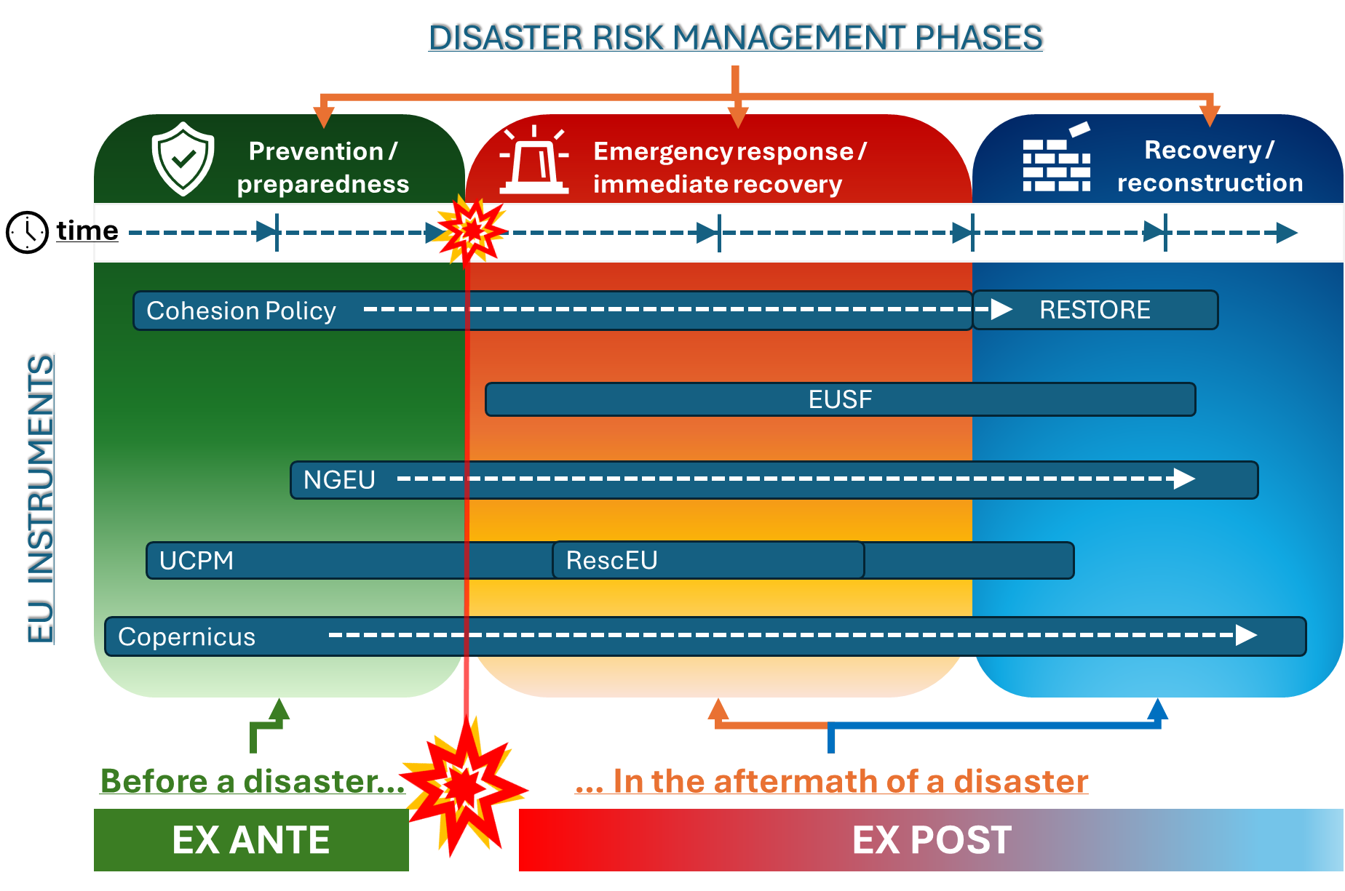
EU instruments by disaster management phases
Key findings
There is a comprehensive set of EU instruments for disaster risk management – from ex ante (prevention and preparedness) to ex post (emergency response, recovery and reconstruction)
Instruments are effective but partially overlap, streamlining desirable. Limited evidence on contribution to long-term reconstruction & territorial resilience
Cohesion Policy plays an important role in prevention and resilience
Notes:
The most important instruments are UCPM, EUSF.
In the current programming, integrated by RRF and RESTORE
Copernicus Emergency Management service is important in providing supporting data (early warning, on demand and exposure mapping)
Cohesion policy plays a role especially in prevention

Slide 7
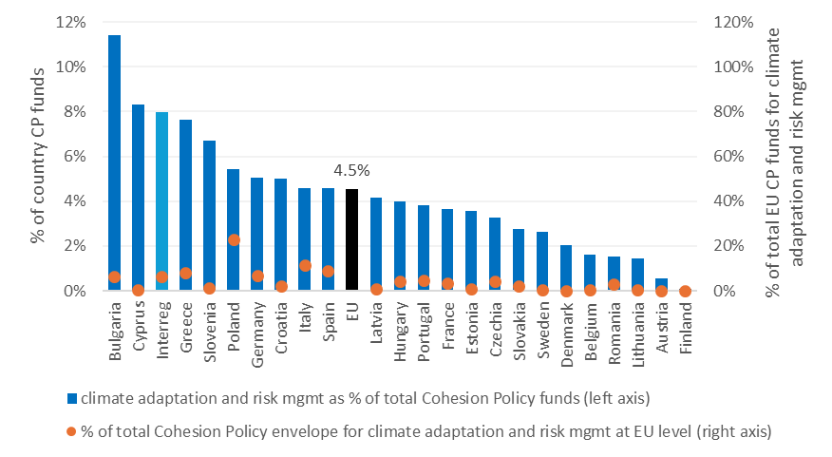
Role of Cohesion Policy (1/3)
Key findings
Average EU share of Cohesion Policy allocated to adaptation / risk management in 2021-27
Focus on climate change adaptation, preventing floods and landslides
Fosters cooperation among regions facing similar risks
Small financial weight: 4.5% of total budget (€18b/396b of ERDF, CF and JTF) allocated in 2021-2027
Percentage varies across Member States and regions: highest in Bulgaria (11.4), Cyprus (8.3%), Greece (7.8%), Slovenia (5.3%), Poland (5.2%) and Croatia (5%)
4.5%
Notes:
53% goes to floods and landslides; 31% to storms, drought, other risks; 17% to fires.
Fields of intervention:
058 Adaptation to climate change measures, and prevention and management of climate related risks: floods and landslides (including awareness raising, civil protection and disaster management systems, infrastructures and ecosystem based approaches);
059 Adaptation to climate change measures and prevention and management of climate related risks: fires;
060 Adaptation to climate change measures and prevention and management of climate related risks: others, e.g. storms and drought.

Slide 8

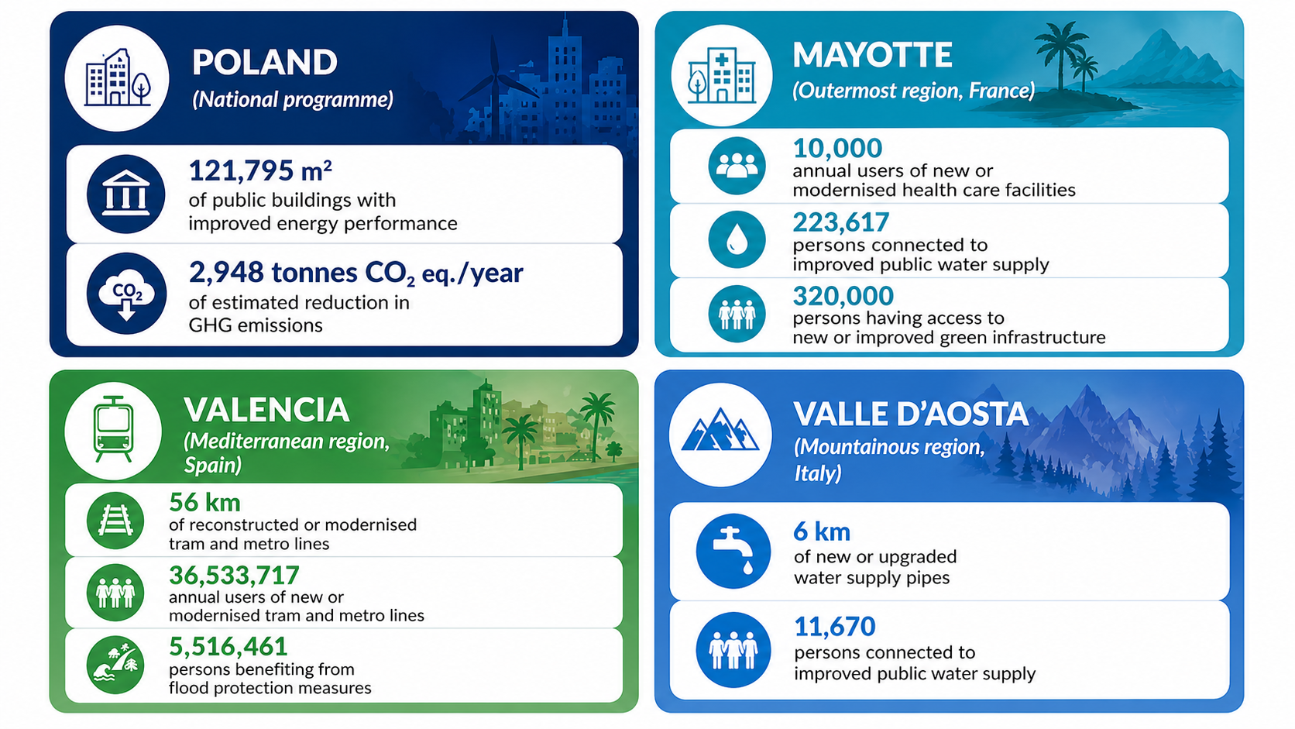
Role of Cohesion Policy (2/3)
Key findings
The policy has evolved:
RESTORE (Regional Emergency Support to Reconstruction) adopted in December 2024
new specific objective to support investments aimed at reconstruction
So far: EUR 1.6 billion allocated in 5 countries and by 14 Programmes
"Build Back Better" to be prioritised in the selection process but… integration still weak
Notes:
Investments under RESTORE include repair of damaged infrastructure (public infrastructure or investment in fixed capital for businesses and equipment) and the restoration of natural areas, biodiversity, and green infrastructure, including Natura 2000 sites.
In the report you can find examples of the use of RESTORE.
For instance…

Slide 9


Role of Cohesion Policy (3/3)
Key findings
STRENGTHS...
positive impact: strengthens preparedness & resilience, combines physical protection with planning, digitalisation, and governance improvements, flexibility, innovation, cross-border cooperation
Predictable long-term funding
WEAKNESSES…
Administrative delays, low absorption in some regions, project selection criteria not linked to vulnerability, monitoring does not capture resilience outcomes
Slow/complex (not for emergencies), focus on certain risks, overlaps with other funds, less financially significant or rapid than RRF
Reconstruction focused on restoring pre-disaster situation, not "Build Back Better"
Notes:
insufficient coordination between key actors (Managing Authorities, civil protection bodies and environmental authorities), a lack of consistently risk-based project selection criteria, outdated territorial risk assessment tools, and monitoring systems do not adequately capture long-term resilience & adaptation outcomes.
70% of survey respondents encountered challenges in programming or implementing disaster-related operations. These include: delays (e.g. due to late closure of 2014– 2020, changes in programme priorities, or administrative and technical hurdles in reconstruction projects); bureaucracy and complex procedures; eligibility issues (difficulty in defining measures that fit the programme scope); lack of co-financing.
Apart from known weaknesses, EU instruments and CP focus on restoring pre-disaster situation rather than BBB.

Slide 10
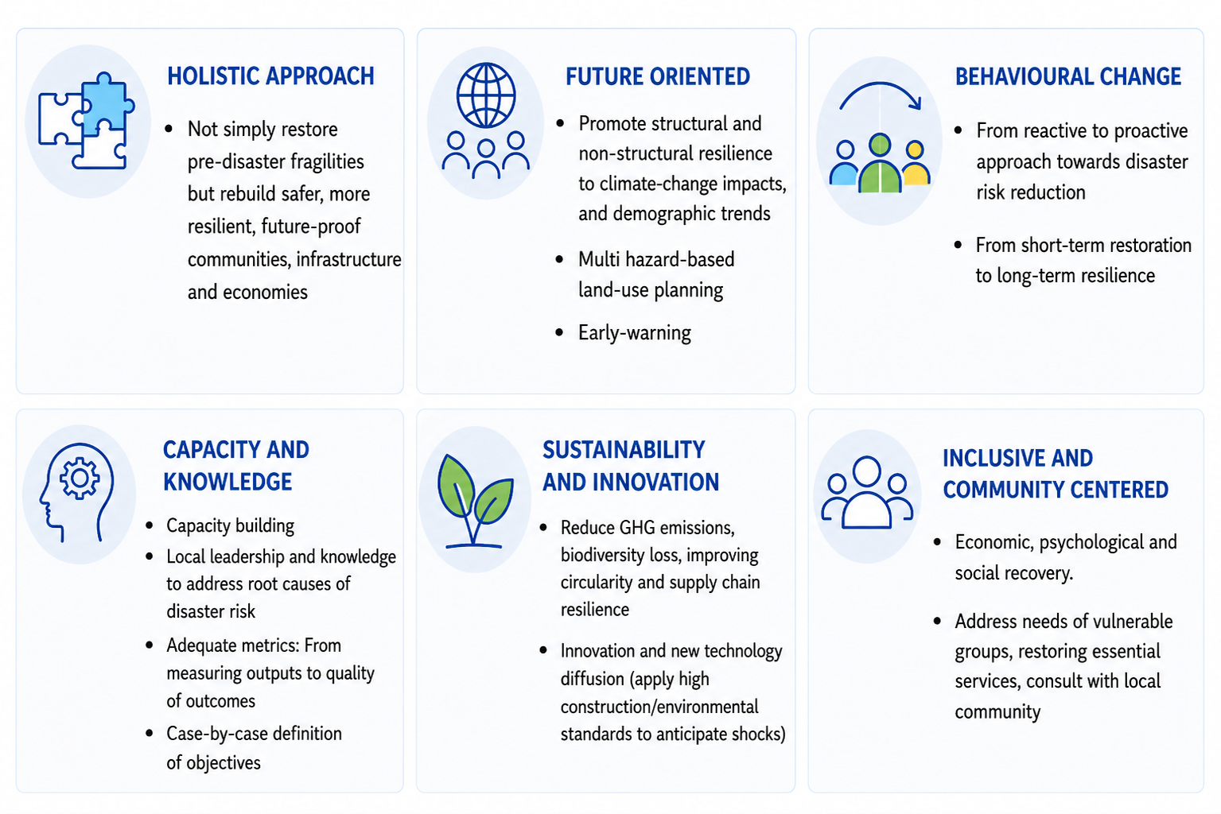
"Build Back Better": key features
Key findings
Notes:
This concept became known after the 2005 Tsunami. It was first introduced in 2006 by the United Nations Secretary-General’s Special Envoy for Tsunami Recovery. In 2015, BBB was incorporated in the Sendai Framework for Disaster Risk Reduction 2015–2030.
Then it was further developed by the G20 DRR working group, OECD, Asian Dev. Bank… etc.

Slide 11
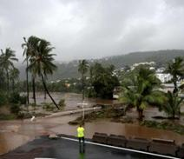
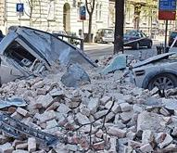
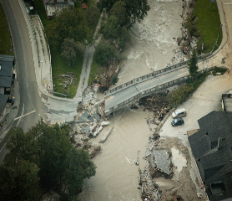
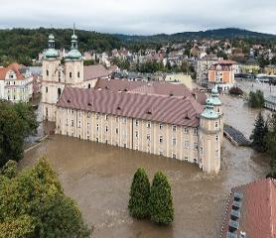
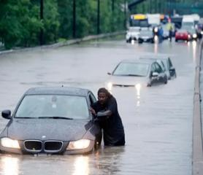
Cyclones in La Réunion (2025)
Some insights from case studies
Earthquakes in Croatia (2020)
Floods in Slovenia
(2023)
Floods in Poland (1997 + 2024)
Canada’s Disaster Financial Assistance Arrangements (DFAA)
resilient rebuilding after Cyclone Garance
EUR 45 m allocated to climate change adaptation and prevention/mgmt. of risks. EUR 108 m programmed under RESTORE
rapid deployment of funds for reconstruction of essential infrastructure, schools, hospitals, heritage sites. EUR 1 billion EUSF used after the event, 125 m CP
post flood recovery strongly relied on EU funds
EUR 400 m EUSF + 125 m CP
EU-backed prevention projects boost safety for 1.3 M people.
EUR 4 b for adaptation/risk management, 636 m under RESTORE
From post-disaster focus to resilience. Incentives for high resilience standards,
consultation of indigenous peoples, technical assistance to strengthen local capacity, digitalization of processes
Notes:
Good achievements in DRM thanks to combination of instruments (EUSF, CP) to recover and rebuild (FR, SI). Rapid deployment of funds (HR). Prevention in PL
But: Coordination challenges, administrative complexity, need for streamlining and less bureaucracy (supporting documentation and receipt of reimbursements vs. FNLC); lack of capacity.
BBB intended to be applied but difficult to implement in practice, lack of guidance, lack of measures. Need for recovering and using resources quickly.
Structural investments ok, while non-structural resilience is not really pursued.
pre-disaster planning and risk zoning essential conditions for BBB

Slide 12
Concluding recommendations
03

Slide 13

How Cohesion Policy can be enhanced to support Member States and regions facing disasters
Conclusions and recommendations
EU level (1/3)
Streamline procedures, application process, simplify contracting and procurement, facilitate monitoring through digitalisation, standardised templates
Promote innovation, encourage cross-border projects as laboratories for innovation, knowledge exchange, digital tools—hazard mapping, digital twins, and resilience dashboards…
Incorporate BBB in NRPP + Technical assistance and guidance to make it operational, including catalogue of off-the shelf measures/best practices (e.g. BBB-compliant, eligible measures aligned with DRR and climate adaptation best practice)
Notes:
explicitly incorporate BBB principles into National and Regional Partnership Plans
"Cookbook" / menu of off-the-shelf measures.
Examples of BBB eligible investments: wetlands, retention basins, slope stabilisation

Slide 14

How Cohesion Policy can be enhanced to support Member States and regions facing disasters
Conclusions and recommendations
EU level (2/3)
Promote risk-based reconstruction strategies, risk-informed planning (e.g. reconstruction based on multi-hazard risk assessments and updated spatial data)
Different co-financing for resilience upgrades
Ensure regional/local participation in disaster risk management policy and strengthen institutional awareness of EU tools
Notes:
Risk should be explicitly incorporated in planning
Reward investment in resilience
Find a way to make sure that regional / local entities count in NRPP

Slide 15
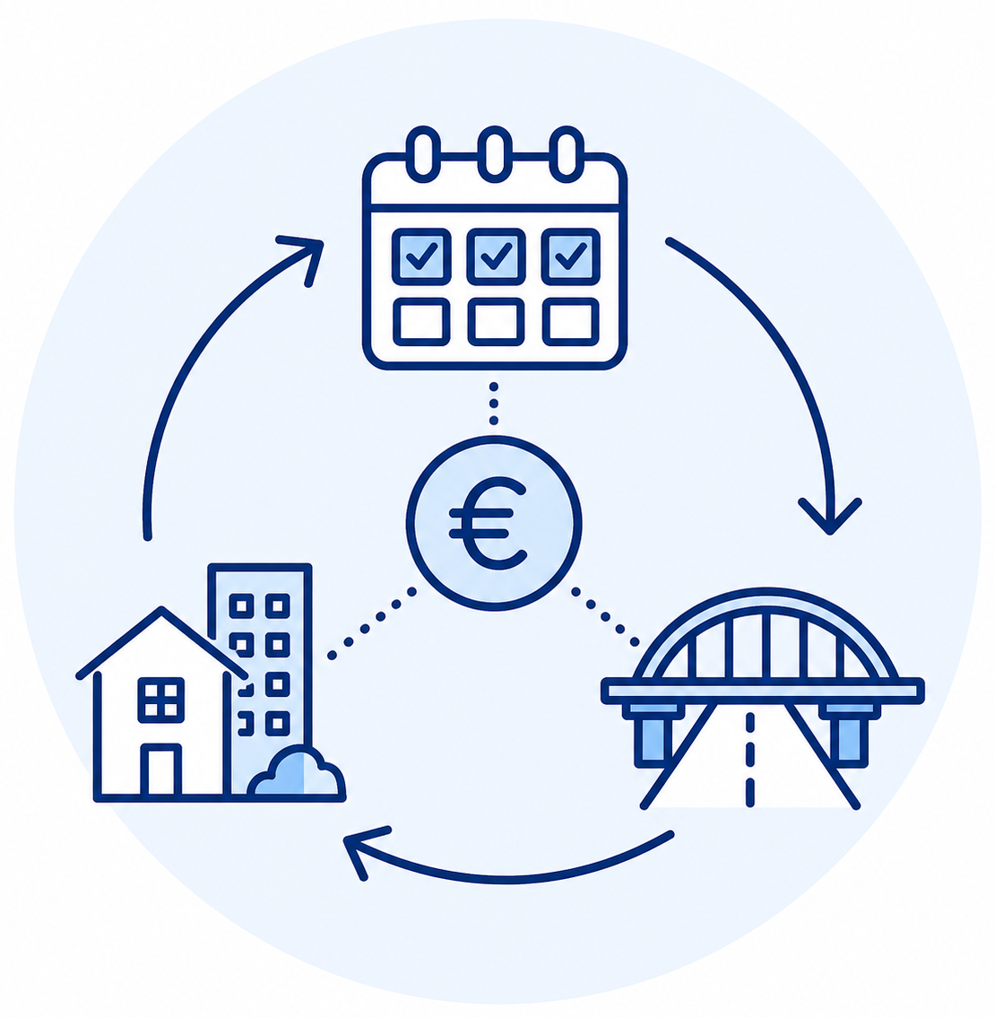
How Cohesion Policy can be enhanced to support Member States and regions facing disasters
Conclusions and recommendations
EU level (3/3)
Ensure sufficient funding, from preparedness to recovery and reconstruction; Strengthen RESTORE or similar flexibility provisions in the future
Improve financial tracking and outcome monitoring (e.g. BBB indicators)
ensure multi-cycle financing or rolling commitments that guarantee continuity for large-scale projects (e.g. rebuilding housing stock, rehabilitating transport infrastructure).
Notes:
Examples of BBB indicators: % of rebuilt assets exceeding pre-disaster standards; estimated financial losses avoided; downtime reduction or service continuity metrics; % of projects integrating NBS or digital resilience tools.

Slide 16

How Cohesion Policy can be enhanced to support Member States and regions facing disasters
Conclusions and recommendations
MS / Regional level
Build local capacity, improve coordination and planning, also based on vulnerability and spatial data
Consult with local communities to identify needs and define reconstruction objectives
Integrate structural and non-structural support, economic and social dimensions, prioritise preventive infrastructure and provide incentives to BBB
Selection criteria promoting long term resilience

Slide 17

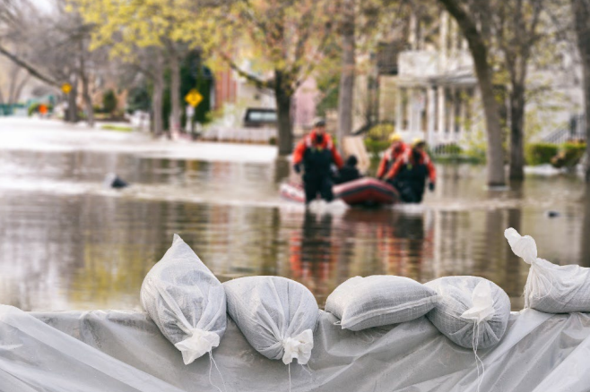
Study team
Andrea CIFFOLILLI (Research leader), andrea.ciffolilli@ecorys.com
Marco POMPILI, Luca PAVAN, Stefania SCLOCCO (ECORYS)
Claudia BERCHTOLD, Maike VOLLMER, Sonja GRIGOLEIT (FRAUNHOFER)
The use of Cohesion Policy Funds in natural disaster response and recovery

Slide 18
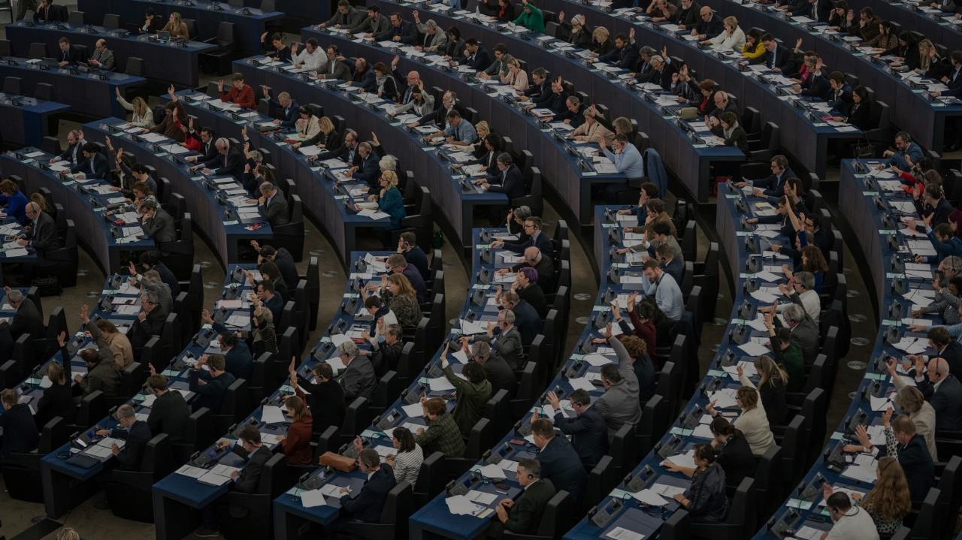

Thank you

