Slide 1
Improving Essential Services in EU regions: The role of Cohesion Policy
Final study results
Requested by REGI Committee
Arndt Münch, ÖIR GmbH | 25 February 2026

Slide 2
Agenda
Demographic change, territorial disparities and implications for essential services
EU support to essential services in remote and shrinking regions
Barriers and approaches for the provision of essential services in vulnerable regions
Recommendations and policy options for 2028-2034

Slide 3
Demographic change, territorial disparities and implications for essential services
01

Slide 4
Demographic change and territorial disparities in the EU
Improving Essential Services in the EU regions: The role of Cohesion Policy
Demographic dynamics vary in rural Europe: out-migration, low birth rates and ageing in peripheral and rural regions, moderate growth in rural areas closer to urban centres due to migration or suburbanisation
Islands, outermost regions and mountain areas share structural vulnerabilities linked to remoteness and low accessibility
Development traps regions (often middle-income areas with economic stagnation) also face worsening social and economic conditions
Source: ÖIR GmbH based on Eurostat

Slide 5
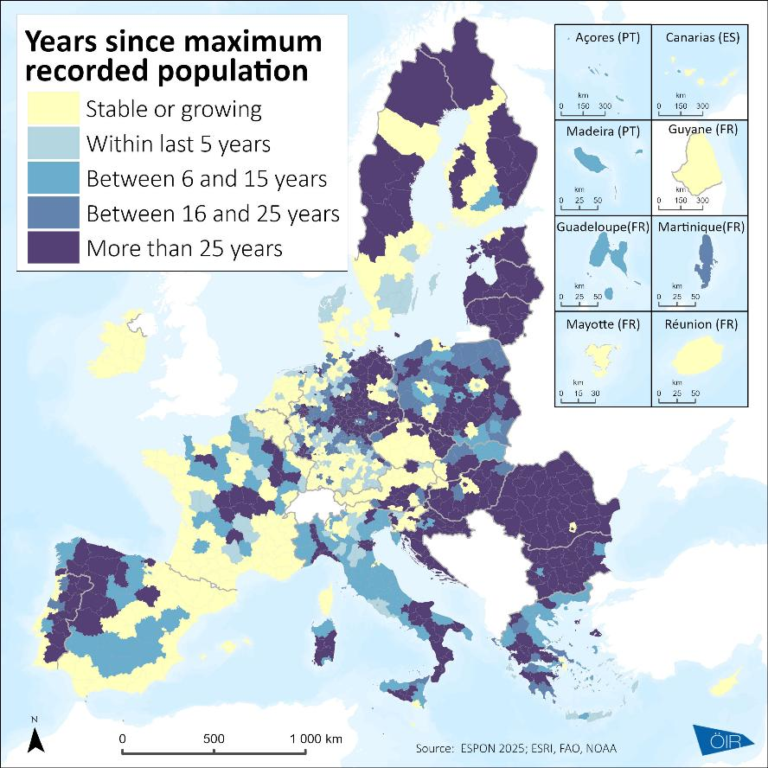
Implications for essential services
Improving Essential Services in the EU regions: The role of Cohesion Policy
Essential services under scope of this study include health services, child-care and services to individuals
Remoteness and accessibility barriers: longer travel times, higher transport costs and limited availability of facilities
Low population density intensifies service delivery challenge in peripheral and interior regions
These factors combine with demographic decline and shrinking or changing tax bases, making it increasingly difficult to maintain local services
Source: ÖIR GmbH based on Eurostat

Slide 6
EU support to essential services in remote and shrinking regions
02

Slide 7
Main EU instruments targeting remote and depopulated regions
Improving Essential Services in the EU regions: The role of Cohesion Policy
The EU supports essential services with Cohesion Policy, the Recovery and Resilience Facility and the Common Agricultural Policy. With three major EU instruments, regulatory complexity is high: differences in delivery approaches, rules on eligible expenditure and high numbers of individual funding programmes.
The Recovery and Resilience Facility provides significant spending in most Member States to support essential services for healthcare, childcare and other services to people over the 2021-2027 period – generally with limited territorial targeting
Some Member States (e.g. CZ, IE, LV, RO, AT) use Common Agricultural Policy interventions (investment support or LEADER) to support investments in essential services
Cohesion Policy is used in most Member States to support essential services. It uses territorial ringfencing and territorial tools to direct funding for essential services to sparsely populated, rural, mountain and island regions

Slide 8
Cohesion Policy (2021–2027) support for essential services
Improving Essential Services in the EU regions: The role of Cohesion Policy
PO4 (Social Europe) and PO5 (Europe closer to citizens) feature Cohesion Policy investments in essential services
EUR 15.7 billion in EU funding dedicated to healthcare, childcare and long-term care – EUR 15.2 billion from ERDF & ESF+ alone
EUR 12.4 billion in EU funding targets less developed, outermost, northern and sparsely populated regions
Source: Project team based on Cohesion Data (31.12.2024)

Slide 9
Cohesion Policy (2021–2027) support for essential services with territorial tools
Improving Essential Services in the EU regions: The role of Cohesion Policy
Integrated Territorial Investments (ITI) and Community-Led Local Development (CLLD) mobilise EUR 983 million in EU support for essential services
Territorial tools are mostly applied for rural and coastal/island regions.
ITI and CLLD strengthen coherence between essential service investments and wider regional support
Source: Project team based on Cohesion Data (31.12.2024)

Slide 10
Barriers and approaches for the provision of essential services in vulnerable regions
03

Slide 11
Place-based approaches in Cohesion Policy [1/2]
Improving Essential Services in the EU regions: The role of Cohesion Policy
The analysed Cohesion Policy investments and interventions showcase that Member States have applied specific and place-based approaches to counterbalance the effects of demographic decline and outmigration on essential service provision
Examples include welcoming programmes to attract new inhabitants, medical and care services in remote regions, health care infrastructure, mobility services for elderly, as well as initiatives including integrated territorial investments
Cohesion Policy funding plays an important role in the funding mix supporting essential service investments, as national and regional co-financing tend to be low in vulnerable regions
The reliance on EU investments to support essential services can affect the financial sustainability of the supported services. Besides costs tied to the infrastructure and equipment for the service, additional costs arise from providing the service

Slide 12
Place-based approaches in Cohesion Policy [2/2]
Improving Essential Services in the EU regions: The role of Cohesion Policy
Programme-based approaches: Programming and implementation instruments linked to multi-fund national or multi-regional programmes specifically targeting rural and depopulating areas
Integrated territorial strategies: Integrated strategies designed combining a holistic approach designed at national/regional level with the empowerment of local actors for implementation, with territorial concentration (functional areas, groups of municipalities, territorial delineations)
Single operations at municipal level: Individual mono-fund projects implemented through standard calls (e.g. hospital modernisation, transport services, care facilities)
The design and implementation of the examined projects highlight several barriers affecting the effectiveness of policy interventions. At national and regional level, key issues include overlapping policies and funding schemes, lack of collaboration among different national administrations in policy design and discontinuous policy efforts

Slide 13
The use of performance-based schemes for essential services
Improving Essential Services in the EU regions: The role of Cohesion Policy
Integrated Community Services – ESF+ & ERDF in Romania
One of the first financing not linked to cost schemes for essential services
Target: 2 000 rural communities with limited access to health & social services
Payments triggered by:
Creation of integrated community teams
Facilities equipped and operational
Number of staff trained and certified
450,000 vulnerable people receiving integrated services
A performance-based funding approach: payments are made achievement of milestones and results, not for incurred costs
Advantages include potential for faster implementation, encouragement of impact orientation and predictable cashflows for programmes once milestones are met
Risks include non-payment if milestones and results not met, technical complexity in ex-ante design
Using population-based output and result indicators for essential services (COM(2025) 545) to measure progress towards achieving milestones and targets risks placing rural areas, remote areas at a disadvantage due to higher cost of service provision per user compared to similar investments elsewhere

Slide 14
Recommendations and policy options for 2028-2034
04

Slide 15
Recommendations and policy options [1/2]
Improving Essential Services in the EU regions: The role of Cohesion Policy
Pre-allocation and higher funding intensities for rural and remote regions. Any ringfencing of EU funding for such regions should consider the broad spectrum of needs in rural and remote areas, not only those related to the farming sector
Strengthen result-oriented monitoring for services to people, healthcare, childcare and other essential services by measuring results, rather than technical outputs of investments
Investments into physical assets in essential services should be complemented by adequate investments in training and recruiting qualified personnel. Physical structures and equipment address important needs, but lack of qualified personnel can remain a crucial gap to service delivery in many disadvantaged regions

Slide 16
Recommendations and policy options [2/2]
Improving Essential Services in the EU regions: The role of Cohesion Policy
Increased and more innovative use of CLLD, ITI and territorial tools for essential services. These tools can improve the territorial relevance of investments for essential services by enhancing coherence with regional policy frameworks and needs
Strengthen the role of regions in the NRPPs, particularly in relation to the targeting of structural needs – including beyond essential services – in rural, remote and vulnerable regions
Maintain Cohesion Policy’s funding structure while exploring streamlining options. This includes promoting clearer responsibilities and reducing overlap in the number of EU funds supporting essential service investments in rural, remote and vulnerable regions

Slide 17
Thank you for your attention
Arndt Münch
ÖIR GmbH
muench@oir.at
00 43 676 901 44 77

