Slide 1
Assessing the impact of seafood imports on EU self-sufficiency
Notes:
Good afternoon everyone.
My name is Tim Huntington, and I am a director of fisheries and aquaculture consultancy Poseidon Europe.
I appreciate this opportunity to present the results of this study entitled ‘Assessing the impact of seafood imports on EU self-sufficiency’ prepared for DG CASP of the European Parliament.
The study was co-authored by myself – who led the aquaculture elements – and my colleague Rod cappell who led the capture fisheries components. Sadly Rod cannot be here today as he is currently at sea somewhere in the Pacific Ocean.

Slide 2
Agenda
Introduction to the study
Extra-EU seafood imports
Competitiveness in capture fisheries
Competitiveness in aquaculture
Innovation in EU aquaculture production
Stimulating investment in EU aquaculture
Policy and regulatory mechanisms
Policy recommendations
Notes:
This presentation will take around 15 minutes allowing plenty of time for discussion.
There are either main elements to this delivery …..

Slide 3
Introduction to the study
01

Slide 4
Background
01
In 2023 the EU supply of fishery and aquaculture products (FAPs) for human consumption – including both domestic production and imports – totalled 12.38 million tonnes.
Of this, the EU imported 8.48 million tonnes (68%), while only producing 3.9 million tonnes (32%).
The overall self-sufficiency rate was 38.1% in 2023, down from 46.1% in 2014.
Objective of the study
The overall objectives of this study are therefore to provide:
A robust, up-to-date assessment of the evolution, impact and policy implications of extra-EU imports of FAPs, and
a critical assessment of the potential options of increasing the self-sufficiency rate in the different market segments of EU seafood production.
Notes:
Background
In 2023 the EU supply of fishery and aquaculture products (FAPs) for human consumption – including both domestic production and imports – totalled 12.38 million tonnes.
Of this, the EU imported 8.48 million tonnes (68%), while only producing 3.9 million tonnes (32%).
The overall self-sufficiency rate was 38.1% in 2023, down from 46.1% in 2014.
Objective of the study
The overall objectives of this study are therefore to provide:
A robust, up-to-date assessment of the evolution, impact and policy implications of extra-EU imports of FAPs, and
a critical assessment of the potential options of increasing the self-sufficiency rate in the different market segments of EU seafood production.

Slide 5
Extra-EU seafood imports
02
Notes:
Here we provide an overview of the current state of play …

Slide 6
State of play
02
EU self-sufficiency continues to decline over time and in 2023 was 38%.
Assuming all production remains within the EU, the EU domestic supply represents 31% of the total available supply. After EU exports, EU domestic production covers only 14% of total EU consumption.
Groundfish account for 21% of total EU apparent consumption. But only 1 in 5 groundfish come from the EU production. EU landings of these species are under quota management and decreased by 43% between 2020 and 2023.
Inflation and raw material supply constraints due to Ukraine war and Brexit have led to reduced EU seafood consumption and increased reliance on cheaper non-EU imports.
Notes:
EU self-sufficiency continues to decline over time and in 2023 was 38%. This overall number masks the true level of dependence on non-EU imports, as 36% of the total catch by the EU fleet comprises small pelagics, much of which is exported, while other pelagic species are imported.
Assuming all production remains within the EU, the EU domestic supply represents 31% of the total available supply. After EU exports, EU domestic production covers only 14% of total EU consumption.
Groundfish (cod, hake, Alaska pollock, saithe) account for 21% of total EU apparent consumption. But only 1 in 5 groundfish come from the EU production. EU landings of these species are under quota management and decreased by 43% between 2020 (beginning of EU27) and 2023.
Inflation and raw material supply constraints due to Ukraine war and Brexit have led to reduced EU seafood consumption and increased reliance on cheaper, non-EU imports.

Slide 7
Competitiveness in capture fisheries
03

Slide 8
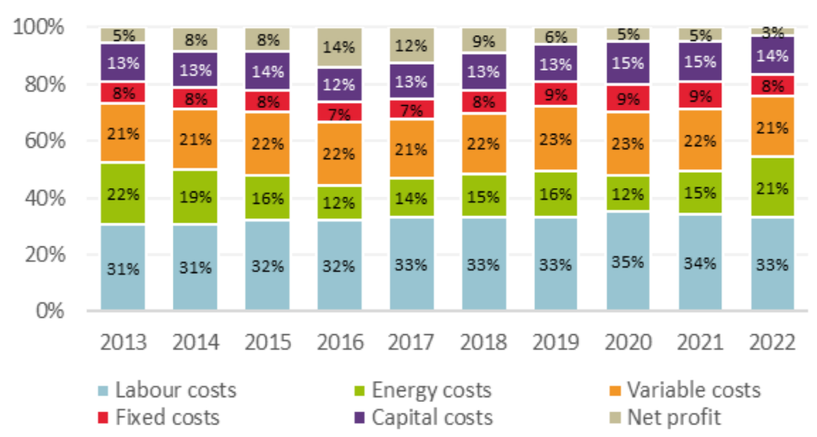
Competitiveness in capture fisheries
03
Competitiveness is strongly impacted by production costs, which for fishing are mainly wages (33%), fuel (21%) and other variable costs (21%).
Wages in some of the main non-EU countries supplying seafood to the EU market are significantly lower than those of most EU producers.
Several key non-EU supplier countries also have lower energy prices, creating a comparative benefit for non-EU processing companies.
Despite EU Member States subsidising the fuel costs of fishing fleets, fuel prices are still higher than of those of some non-EU fishery products suppliers.
Competitiveness is not only impacted by the unit cost of production inputs, but also the productivity and efficiency of production.
Notes:
Competitiveness is strongly impacted by production costs, which for fishing are mainly wages (33% of total revenue in 2022), fuel (21%) and other variable costs (21%).
Wages in some of the main non-EU countries (Chile, Türkiye and Morocco) supplying seafood to the EU market are significantly lower than most EU producers.
But other key suppliers (Iceland, Norway and the UK) show higher average wages.
Now looking at energy prices, several key non-EU supplier countries (including northern European suppliers) also have lower energy prices, creating a comparative benefit for non-EU processing companies, even if this is just freezing and storing product for export.
Despite continued fuel subsidies for fishing fleets by EU Member States, fuel prices are still higher than some non-EU suppliers of fishery products (e.g. Morocco), but other suppliers such as Norway, Iceland and the UK have higher average fuel prices.
Competitiveness is not only impacted by the unit cost of production inputs, but also the productivity and efficiency of production. Despite higher unit costs for fuel and wages, Iceland and Norway can supply the EU with seafood as their fisheries are productive (a high catch per unit effort) and harvested by modern, efficient fishing fleets.

Slide 9
Competitiveness in aquaculture
04

Slide 10
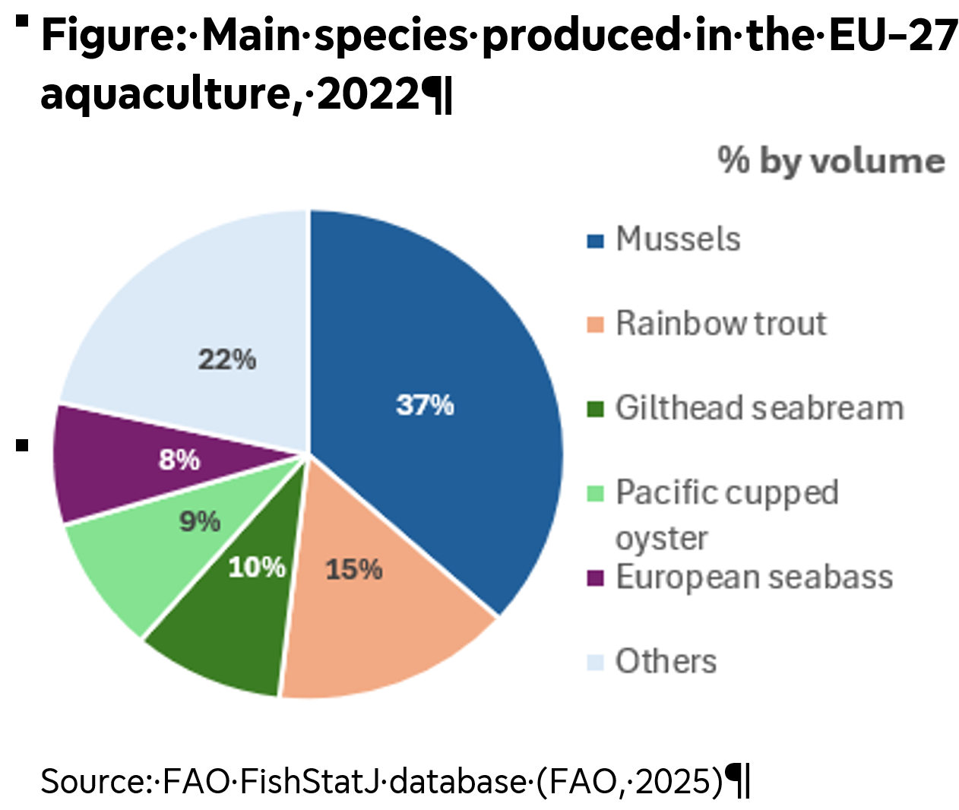
Competitiveness in aquaculture
04
European aquaculture production of around 1 million tonnes.
The competitiveness of EU aquaculture has been challenged by a combination of rising costs, environmental challenges and imports from third countries, such as Türkiye and Chile.
Turkish seabass/seabream farms have extensive vertical integration and a lower cost base than Greece. Output prices are similar, but Greece can leverage its processing capability and EU access to penetrate niche and premium markets.
The cost of mussel production in Galicia is around EUR 0.74 per kg vs. EUR 0.69 per kg in Chile, reflecting the latter’s lower wage and energy costs. Chile’s main advantage is its willingness to adopt more modern farming techniques than Galicia’s traditional batea rafts.
Notes:
European aquaculture production of around 1 million tonnes is dominated by mussels (37%), trout (15%), seabream (10%), oyster (9%) and seabass (8%).
The competitiveness of EU aquaculture - whose growth has remained largely stagnant for the last decade - has been challenged by a combination of rising costs, environmental challenges and imports from third countries, such as Türkiye (seabass, seabream, trout) and Chile (salmon, mussels).
Looking at our two case studies:
Türkiye has extensive vertical integration with a focus on large-scale enterprises that benefit from economies of scale compared to Greece. Türkiye also has a lower cost base than Greece, both for wages and energy costs. Feed costs are also slightly higher in Greece. Output prices are similar between the two countries, but Greece can leverage its processing capability and access to nearby Member States markets to penetrate niche and premium markets. Seabass and seabream production in Türkiye used to benefit from fiscal production incentives, but this has no longer been the case since at least 2020. In contrast so some EU states it does, however, enjoy the full-hearted policy support from the Turkish government.
The cost of mussel production in Galicia is around EUR 0.74 per kilogram (although some sources say this is as high as €1.18/kg), whereas in Chile it can be as low as EUR 0.69 per kilogram. Although not mentioned in the study, the cost of transporting frozen mussels to the EU market from Chile is around 8- 20 Euro cents per kg.
As well as the lower wage and energy costs in Chile, the main advantages of Chile’s mussel farming industry are its large scale and willingness to adopt more modern farming techniques than Galicia’s traditional batea rafts. Despite these challenges, Galician mussels enjoy a price premium and fetch higher prices in live fresh form, unlike the mainly frozen, mass-market Chilean mussel products.

Slide 11
Innovation in EU aquaculture production
05

Slide 12
Innovation in EU aquaculture production
05
With finite capture fisheries resources, increasing aquaculture production is the main avenue to growing the FAPs supply.
Innovation is well supported through both Horizon and EMFAF funding. Despite this, uptake of new and innovative aquaculture practices is slow, and upscaling limited.
Moving bivalve shellfish production offshore: traditional extensive bivalve aquaculture has limited option for growth, but moving offshore has challenges. Research is needed help automate production, adapt to changing conditions and allow real-time remote monitoring.
Upscaling and diversifying EU aquaculture thorough RAS: RAS can be used to reduce freshwater use, control environmental impacts and diversify the species grown. There are technical challenges, but these can be overcome through innovation and adaptive research.
Notes:
Bullet 1: With finite capture fisheries resources, increasing aquaculture production is the main avenue to growing the fishery & aquaculture product supply.
Bullet 2: Innovation is a means to build resilience to both climate-change as well as competition from third countries. Innovation is at the forefront of EU policy for aquaculture development and is well supported through both Horizon and EMFAF funding. Despite this, uptake of new and innovative aquaculture practices is slow, and upscaling limited.
Bullet 3: Moving bivalve shellfish production offshore: traditional onshore or inshore extensive bivalve aquaculture has limited option for growth. But moving offshore has challenges, including obtaining permissions and leases, the difficult oceanographic conditions, the long distance from shore and the additional costs in infrastructure, operations and site monitoring. Additional research is needed to reduce predation, introduce adaptive systems for responding to incoming storms or marine heatwave events, and remote systems to reduce the need for shore-based support and fuel-intensive transport systems.
Bullet 4: Upscaling and diversifying EU aquaculture thorough recirculating aquaculture systems (RAS): RAS can be used to reduce freshwater use, control environmental impacts and potentially allow diversification into new species from outside the EU. The main barriers are technical challenges to upscaling, higher energy requirements, biosecurity and technical know-how. These can be overcome through innovation, e.g. in energy-efficient pumping and filtration systems, as well as on-farm power generation and storage. The dissemination of successful solutions amongst EU RAS practitioners is needed to increase uptake.

Slide 13
Stimulating investment in EU aquaculture
06

Slide 14
Stimulating investment in EU aquaculture
06
The EU aquaculture sector has strong potential but requires more coordinated and targeted investment to reach scale.
Public funding should be better aligned across the EU. A coordinated, mission-oriented approach would channel capital towards sustainability and competitiveness.
Private capital is crucial to scale-up aquaculture innovation. The EU should support blended and de-risking mechanisms; facilitate bond, equity, and revenue-based financing for sustainable projects; offer tax incentives; and improve market access and predictability.
By aligning public and private capital around innovation, resilience, and sustainability, the EU can make aquaculture a key pillar of the Blue Economy.
Notes:
The EU aquaculture sector has strong potential but requires more coordinated and targeted investment to reach scale. Current funding primarily comes from public sources − mainly through the European Maritime, Fisheries and Aquaculture Fund (EMFAF), InvestEU, and Blue Invest – which have supported over 2 000 operations worth EUR 210 million since 2021. However, investment remains fragmented and often short-term, limiting the sector’s ability to innovate and attract private capital.
Public funding should be better aligned across EU, national, and regional programmes (Horizon Europe, EMFAF, and national Blue Economy plans). A coordinated, mission-oriented approach –framing aquaculture within the Green Deal and Blue Economy – would channel capital towards sustainability and competitiveness.
Private capital is crucial to fund the scaling-up of innovations such as recirculating aquaculture systems (RAS), alternative feeds, offshore and regenerative aquaculture. To unlock private finance, the EU should support blended and de-risking mechanisms; facilitate green and blue bonds, equity, and revenue-based financing for sustainable projects; offer tax incentives for low-carbon technologies and energy-efficient systems; and improve market access and predictability, including faster permitting, stable offtake contracts, and harmonised sustainability standards. DG MARE is launching a new study on private funding of EU aquaculture through the AAM.
By aligning public and private capital around innovation, resilience, and sustainability, the EU can ensure aquaculture is a key pillar of the Blue Economy − enhancing food security, creating green jobs, and ensuring long-term economic viability across Europe’s coastal regions.

Slide 15
Policy and regulatory mechanisms
07

Slide 16
Policy and regulatory mechanisms
07
The EU has identified that the key risks to it remaining competitive require it to close the innovation gap, decarbonise the economy and reduce dependencies.
There are several FAP-specific policies and regulations that apply environmental and social standards to EU production. The competitiveness of EU production is negatively impacted by the absence of reciprocal requirements for imports or the ability to differentiate these standards in the market.
2026 sees the introduction of sustainability criteria associated with autonomous tariff quotas (ATQs) to ensure minimum environmental and social standards. But to date non-EU countries are not required to meet the same high standards as EU seafood production.
Notes:
The EU has identified that the key risks to it remaining competitive require it to close the innovation gap, decarbonise the economy and reduce dependencies.
There are several FAP-specific policies and regulations that apply environmental and social standards to EU production. The competitiveness of EU production is negatively impacted by the absence of reciprocal requirements for imports or the ability to differentiate these standards in the market.
2026 sees the introduction of sustainability criteria associated with autonomous tariff quotas (ATQs) to ensure minimum environmental and social standards. But to date non-EU countries are not required to meet the same high standards as EU seafood production and there is not a requirement to inform EU consumers of standards associated with the seafood they consume.

Slide 17
Policy recommendations
08

Slide 18
Policy recommendations
08
Strengthen direct support & introduce innovative funding mechanisms for green and digital transition.
Develop a fisheries-specific technology policy to introduce efficiency gains.
Increase emphasis on growing and diversifying EU aquaculture.
Strategic realignment of EU aquaculture to adapt to, and benefit from, climate change.
Develop coexistence between aquaculture, local communities and other marine economic activities.
Develop a coordinated, focused approach to encourage investment in aquaculture, framing aquaculture within the Green Deal and Blue Economy.
Ensure seafood imports are consistent with the EUs commitment to sustainable trade agreements
Expand marketing standards and consumer labelling to include sustainability criteria.
Notes:
Strengthen direct support, address constraints and introduce innovative funding mechanisms to fisheries sector operators in the green and digital transition.
Develop a fisheries-specific technology policy to introduce efficiency gains from artificial intelligence (AI), digital tools and automation in the fisheries sector and its governance.
Increase emphasis on the need to grow and diversify EU aquaculture. Supporting innovation will be key to this.
Consider a long-term strategic realignment of EU aquaculture to adapt to, and benefit from, the expected consequences of climate change.
Support the development of coexistence between aquaculture, local communities and other marine economic activities.
Develop a coordinated, focused approach to encourage investment in aquaculture, framing aquaculture within the Green Deal and Blue Economy.
Ensure seafood imports are consistent with the EUs commitment to sustainable development in trade agreements.
Expand marketing standards and consumer labelling to include sustainability criteria.

