Slide 1
GNSS Interference in Polish Maritime Areas of Gulf of Gdansk:
Status, Sources, Operational Impact and Countermeasures
Jaroslaw CYDEJKO
GDYNIA MARITIME UNIVERSITY, POLAND

Slide 2
Outline of presentation
GNSS Interferences Categories and Observation Area
Statistics of GNSS Interference Events
Operational Impact for Marine Navigation
Localization of GNSS Interference Sources
Possible Countermeasures
Conclusions and Recommendations

Slide 3
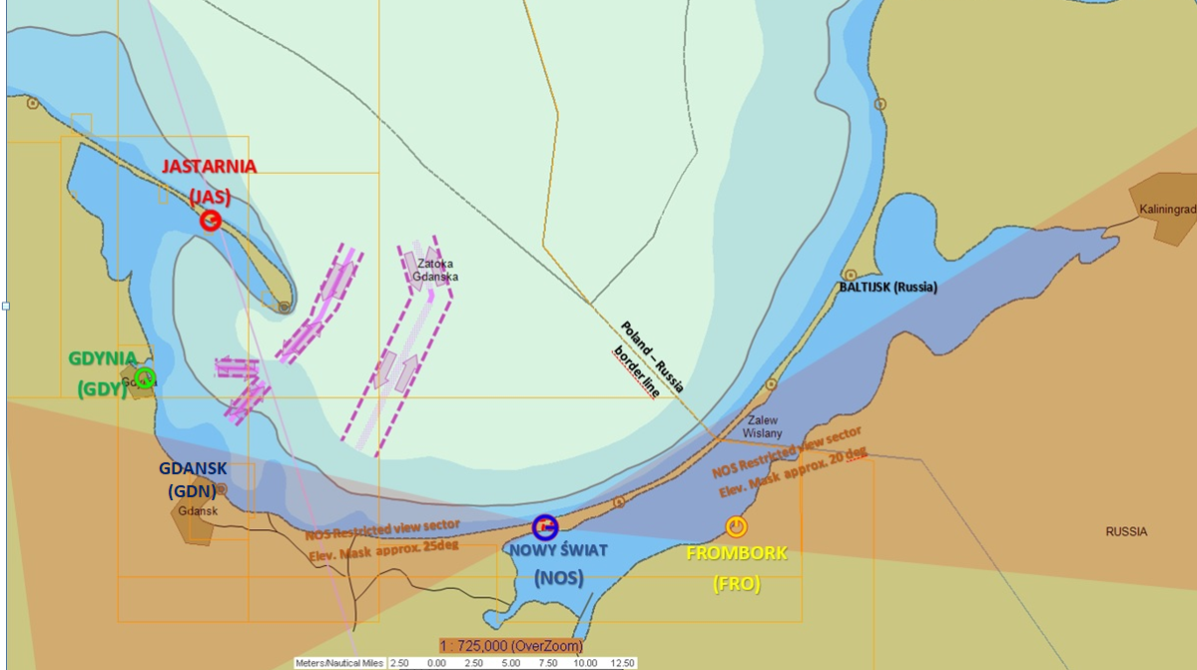
Gulf of Gdansk Area
1. GNSS Interferences Categories and Observation Area (1)
Polish Harbours :
Gdansk, Gdynia
Distance to Kaliningrad Enclave marine border – 50 km
Distance to Kaliningrad Enclave coast – 90-110 km
Observation points– along Polish Coast – RTK GPS service reference stations (Maritime Office in Gdynia infrastructure)

Slide 4
GNSS Interferences Categories
1. GNSS Interferences Categories and Observation Area (2)
JAMMING:
Satellite signal is „covered” with stronger emission on the same frequency or band coming from the jammer.
The GNSS receiver is not able to distinguish the true satellite signals to execute pseudo-range measurements and decode data.
As a result, the GNSS receiver stops calculating the user position.
SPOOFING:
Spoofer is emiting the signal, which is „simulating” satellite constellation navigational signals or data for the false position.
GNSS receiver uses spoofer signal to calculate user position.
GNSS receiver do not stop displaying the position but the position is false.
Usually the same spoofed position is „injected” to all users in the area, so it is not seamless for users.

Slide 5
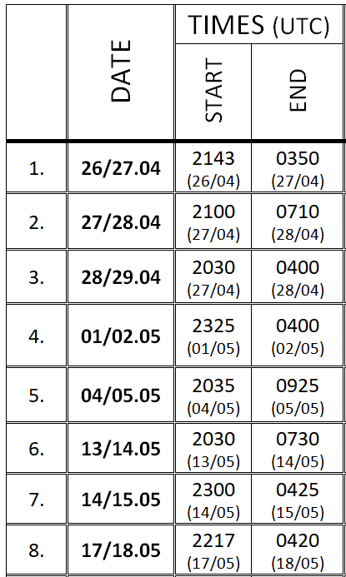
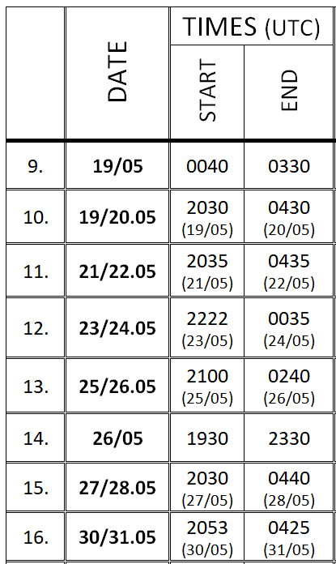
April/May 2024 – first intensive GNSS interferences
2. Statistics of GNSS Interference Events (1)
Type – JAMMING, NO SPOOFING
Events – 16 long, continous interferences
Duration – total 86.5 hours – 12 % of month
Single event duration up to 13 hours
All GNSS interferences during night hours

Slide 6
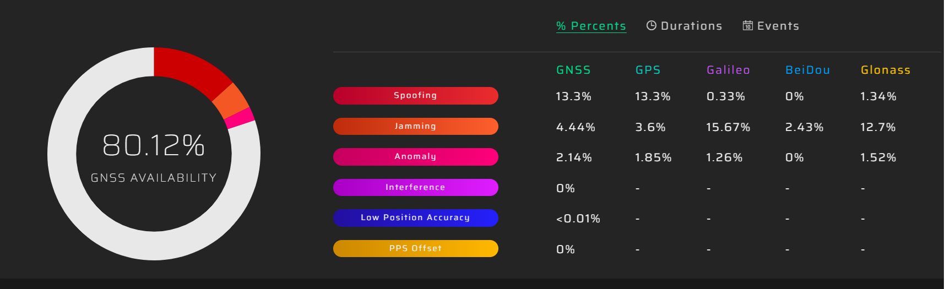
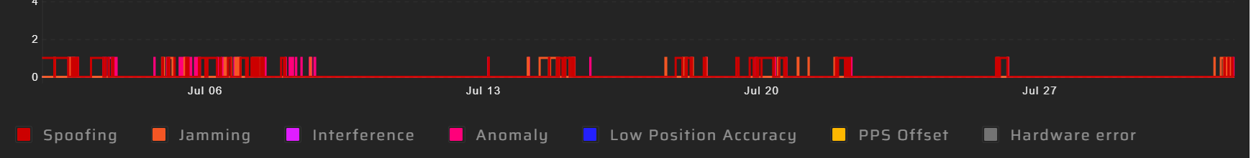
July 2025 GNSS Availability
2. Statistics of GNSS Interference Events (2)
July 2025 GNSS interference occurances during all month

Slide 7
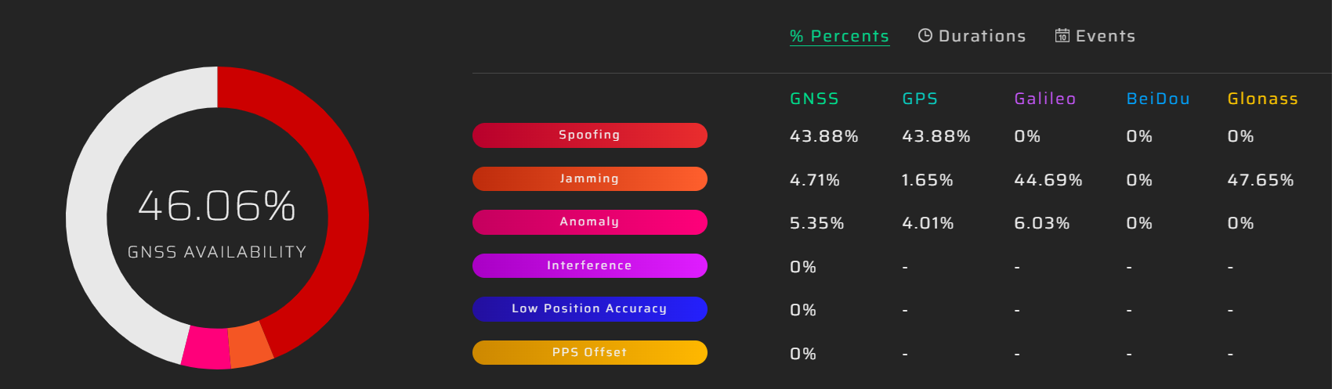
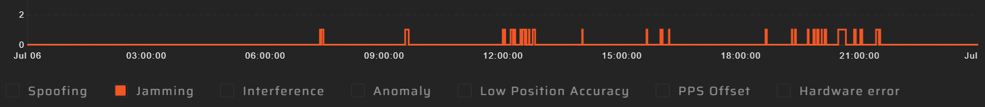
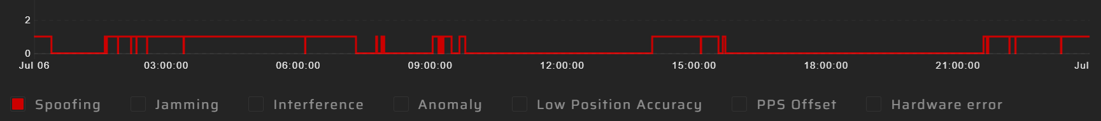
6th July 2025
2. Statistics of GNSS Interference Events (3)
SINGLE DAY EXAMPLE
JAMMING EVENTS
SPOOFING EVENTS
6th July 2025 daily jamming and spoofing periods (single day example)

Slide 8
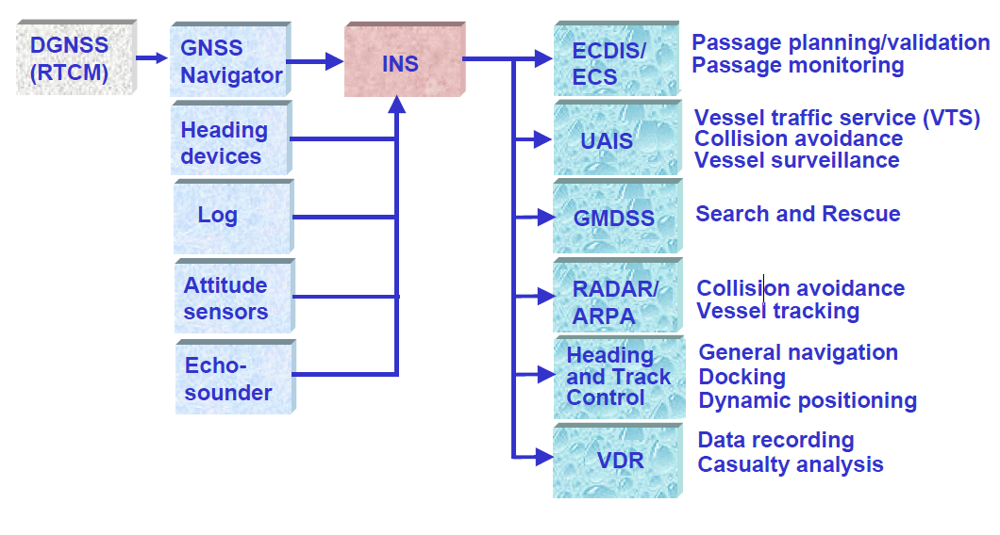
3. Operational Impact for Marine Navigation (1)
Functional description of marine INS (Integrated Navigation System)
GNSS position sensor interfaces many essential navigation devices responsible for:
Passage planning and monitoring;
Collision avoidance;
Search and Rescue;
General Navigation;
Docking or Dynamic Positioning;
Data recording (casualty analysis)
GNSS position sensor is very convenient in automating navigation processes
but the competent crew
should be ready to switch to other means of navigation if necessary.

Slide 9
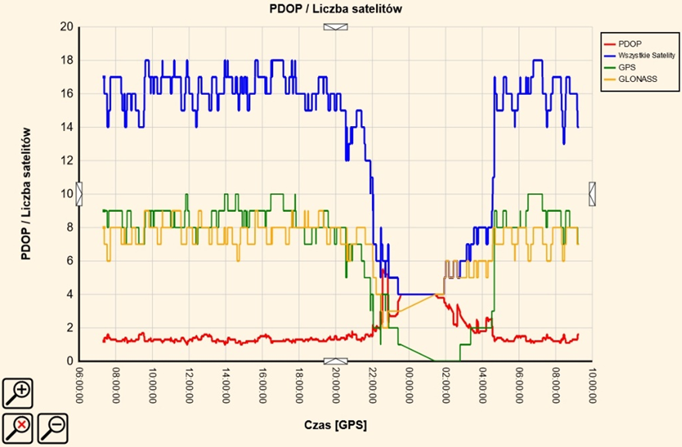
3. Operational Impact for Marine Navigation (2)
GNSS Jamming Impact
Number of available satellites reduces;
Geometrical accuracy factors PDOP and HDOP increasing giving degradation in accuracy;
Finally if number of available satellites falls below 4 all position estimation process stops and LOSS OF POSITION occurs.
JAMMING PERIOD
NUMBER OF SATELLITES
TIME

Slide 10
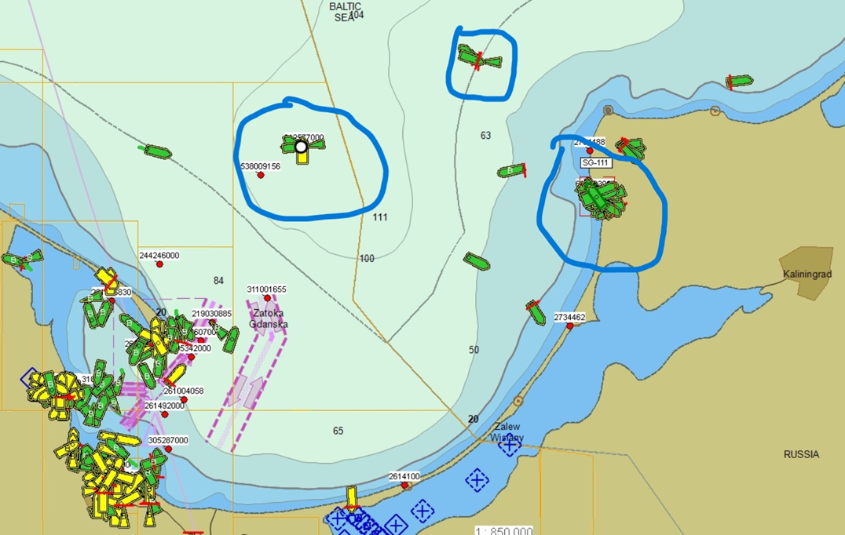
3. Operational Impact for Marine Navigation (3)
GNSS Spoofing Impact
VESSELS REPORTING FALSE POSITION via AIS
GNSS receivers reporting false position;
Devices of integrated navigation system (INS) are fed with false data and alarming;
Vessels in vicinity receiving false information about other ships which may create confusion;
However, usually the false position injected by spoofer jumps tens of kilometres, what is easy to be noticed and identified as GNSS interference.
True vessels position should be :
Gdańsk and Gdynia port areas

Slide 11
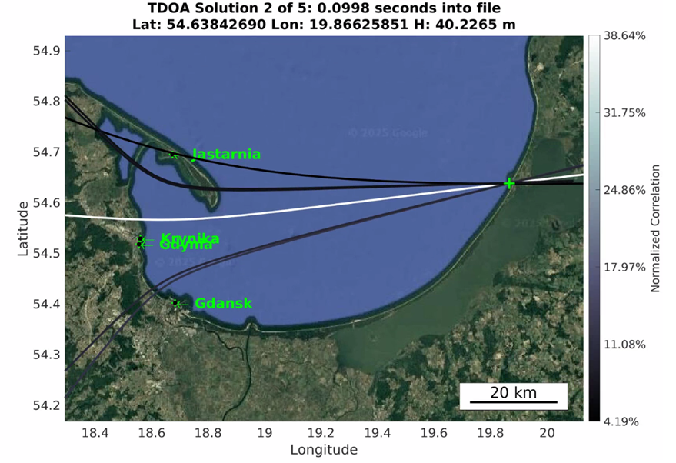
4. Localization of GNSS Interference Sources (1)
Jammer pinpointing results
29th March 2025 1534 UTC
System measures jammer/spoofer signal Time Delay Of Arrival (TDOA) between two nodes (sensors) in two locations;
4 nodes (sensors) network, 6 hyperbolas intersection creates the solution;
Source of jamming identified in the area of Russian port - Baltijsk (Kaliningrad enclave); range 90-110 km.

Slide 12
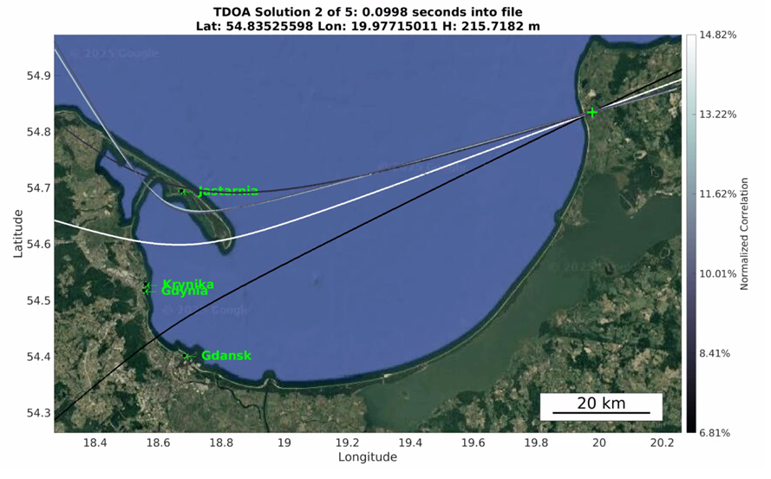
4. Localization of GNSS Interference Sources (2)
Spoofer pinpointing results
01st May 2025 2007 UTC
Source of spoofing identified at the probable military installations on the coast of Russian enclave Kaliningrad;
Range (distance) to the emitter unusually long;
Refraction and ducting created by hydro-meteo conditions may explain the phenomenon.

Slide 13
Protect clear and truthful signal reception
5. Possible Countermeasures (PTA – Protect, Toughen, Augment) (1)
Detect and monitor jamming and spoofing of GNSS signal;
Identify and localize the source of interferences;
Create the warning to users;
Eliminate the source (if achievable);
Prosecute (if achievable).
In general:
Develop means to detect, measure, locate and mitigate GNSS radio interference or jamming
at national level.

Slide 14
Toughen user’s receivers
5. Possible Countermeasures (PTA – Protect, Toughen, Augment) (2)
IMO minimum requirements for GNSS receivers are set at very low level; majority of the vessel’s receivers are GPS-only and single frequency (L1);
Experience shows that multiconstellation (GPS+GALILEO+BeiDou) and multifrequency (L1,L2C,L5, E1,E5,E6, B1,B2,B3) receivers are more robust and resilient to jamming and spoofing;
Advanced antennas are key element in making the GNSS receiver less vulnerable to interference: „choke ring” antennas widely used for precise positioning not often installed on vessels; CRPAs (Controlled Reception Pattern Antennas) – still expensive but protect from surface interference to the great extent.

Slide 15
Augment existing or add new positioning sources
5. Possible Countermeasures (PTA – Protect, Toughen, Augment) (3)
Use of additional GNSS signals (GPS: L5, L2C, L1C; Galileo: E6, E5);
Implement NavData and Ranging Authorization services:
Galileo Open Service Navigation Message Authorization (OSNMA) - in progress;
Galileo Open Service Ranging Signal Authorization (OSRSA) – still to be developed;
Low Earth Orbit (LEO) satellites based services possible and may deliver more
strong and distinguish ranging signals;
Terrestrial radionavigation systems to be developed to create back up for GNSS:
Ranging Mode (R-Mode) - EU Project in progress on The Baltic Sea;
eLORAN – abandon project, worth to be restored due to its complete resilience to spoofing and
jamming;

Slide 16
Conclusions:
6. Conclusions and Recommendations (1)
GNSS Interferences observed in Polish Maritime areas of Gulf of Gdansk has been localized with its sources indentified on the coast of Kaliningrad Russian enclave;
The intensity of the events varies but in certain periods GNSS availability is reduced to 80% during long term (monthly) observation period with GNSS availability reduced to 46% in short time (daily) observations;
The GNSS interference events are observed with varying intensity since January 2024 and started with intensive jamming incidents but lately, since March 2025, the predominant is the GNSS spoofing;
Our working hypothesis is that the observed GNSS interference occurs due to activity in the area of Kaliningrad enclave, the intensive anti-drone Russian defence electronic warfare aimed for airborne targets;
For the surface navigation at sea the GNSS interferences cause significant inconvenience and may create confusion unless the crew implements the secondary means of navigation based on terrestrial, radar or navigational marks observations.

Slide 17
Recommendations:
6. Conclusions and Recommendations (2)
Develop at national level means to detect, measure, locate and mitigate (warn about) GNSS radio interference or jamming.
Define the operational conditions for „electronic fog” scenario including monitoring, warnings and procedures which should be executed in such circumstances both for maritime GNSS users and administration.
Implement in operational risk assessments for marine operations the „electronic fog” as a case demanding adequate control measures and contingences to be put in place.
Promote or put requirements for use more robust and resilient GNSS receivers in the maritime navigation (multifrequency, multiconstellation, signal authorization services enabled, advanced antennas in use).
Promote or put requirements on maintaining navigators practical skills and competence of effective conducting terrestrial and radar navigation.
Develop the GNSS back up radionavigation systems and services (terrestrial: R-Mode, eLoran or LEO satellite-based).

Slide 18
Thank you for your attention
Jaroslaw CYDEJKO, PhD, Master Mariner
Gdynia Maritime University, Poland
j.cydejko@wn.umg.edu.pl
jarekcydejko@gmail.com

