Slide 1
The multiannual plan for the Baltic Sea: A change in management needed
Christian Möllmann
University of Hamburg
Institute for Marine Ecosystem and Fisheries Science
Committee on Fisheries (PECH) - 4 September 2025
Notes:
Accessibility - Instructions for the end user:
The slide 1 should always have the European Parliament logo as first item in the reading order / Selection Pane (note that the Selection Pane shows the objects in the reverse reading order. The object at the bottom of the list is the first one the be read out. The first on the list is the last one).
You can find the selection panel under the Home menu > Arrange > Position Objects > Selection Pane (In this particular slide you will see the correct reading order – remember, it’s from bottom to top – 1st EP Logo, 2nd Title and 3rd Subtitle)
Every slide should have a title and the title should be unique for each slide inside one PPT. If several slides belong to the same section, example: (Media Section) Media: Press; Media: Video: Media; Live events.

Slide 2
Aims of the presentation
Introduction
Why did the Baltic MAP fail its main objectives to ...
contribute to the achievement of the overarching objectives of the CFP
restore and maintain fish populations above levels capable of producing maximum sustainable yield (MSY)
implement the ecosystem-based approach to fisheries management
recognize and take into account the biological dynamics and interactions between fish stocks

Slide 3
Overview
Most Baltic fish stocks are in an unsustainable state
Stock | Spawner biomass | Fishing pressure | State
Eastern Baltic cod | far below limits | fisheries basically closed | critically endangered
Western Baltic cod | far below limits | fisheries basically closed | critically endangered
Western Baltic spring spawning herring | far below limits | fisheries basically closed | critically endangered
Central Baltic herring | close to limits | below F_{MSY} | in danger
Gulf of Bothnia herring | close to limits | below F_{MSY} | in decline
Gulf of Riga herring | far above limits | below F_{MSY} | safe
Baltic sprat | slightly above limits | above F_{MSY} | in decline
Notes:
Accessibility - Instructions for the end user:
Writing alternative text for complex images is crucial for ensuring that all users, including those with visual impairments, can understand the content and context of the image. Complex images may include charts, graphs, infographics, diagrams, and images with multiple elements.
Consider the following when you need to describe complex images.
1. Understand the Image
Take the time to thoroughly examine the image and understand its purpose and the information it conveys. Identify the key elements and the relationships between them.
2. Be Descriptive
Provide a clear and concise description of the image. Describe what the image shows and the information it presents.
3. Focus on Content and Context
Consider the context in which the image appears and the information it adds to the surrounding content. Ensure that your alt text conveys this information accurately.
4. Start with a Short Description
Begin with a brief summary of the image in a few words or a sentence, capturing the main message or theme.
5. Expand with Specific Details
Elaborate on the key elements in the image, providing more specific details without being overly verbose.
6. Use simple Language
Write in clear and simple language, avoiding jargon or technical terms that might be unfamiliar to some users.
7. Include Numerical Data
If the image contains numerical data or statistics, include these in the alt text to ensure users have access to the relevant information.
8. Describe Visual Relationships
If the image represents a relationship between elements (e.g., a flowchart or network diagram), explain the connections between the different components.
9. Indicate Colour Information
If colour is a critical aspect of the image, mention it in the alt text. However, avoid using colour as the sole means of conveying information.
10. Be Objective and Impartial
Provide information in an objective manner, avoiding opinions or biased language.
11. Consider User Needs
Anticipate the needs of users who rely solely on the alt text to understand the image. Ensure that your description is sufficient to convey the image's meaning.
The Alt-text of charts will need to include relevant data information (products or services, percentages, relation between data, etc.).
Same principle applies to complex tables.

Slide 4
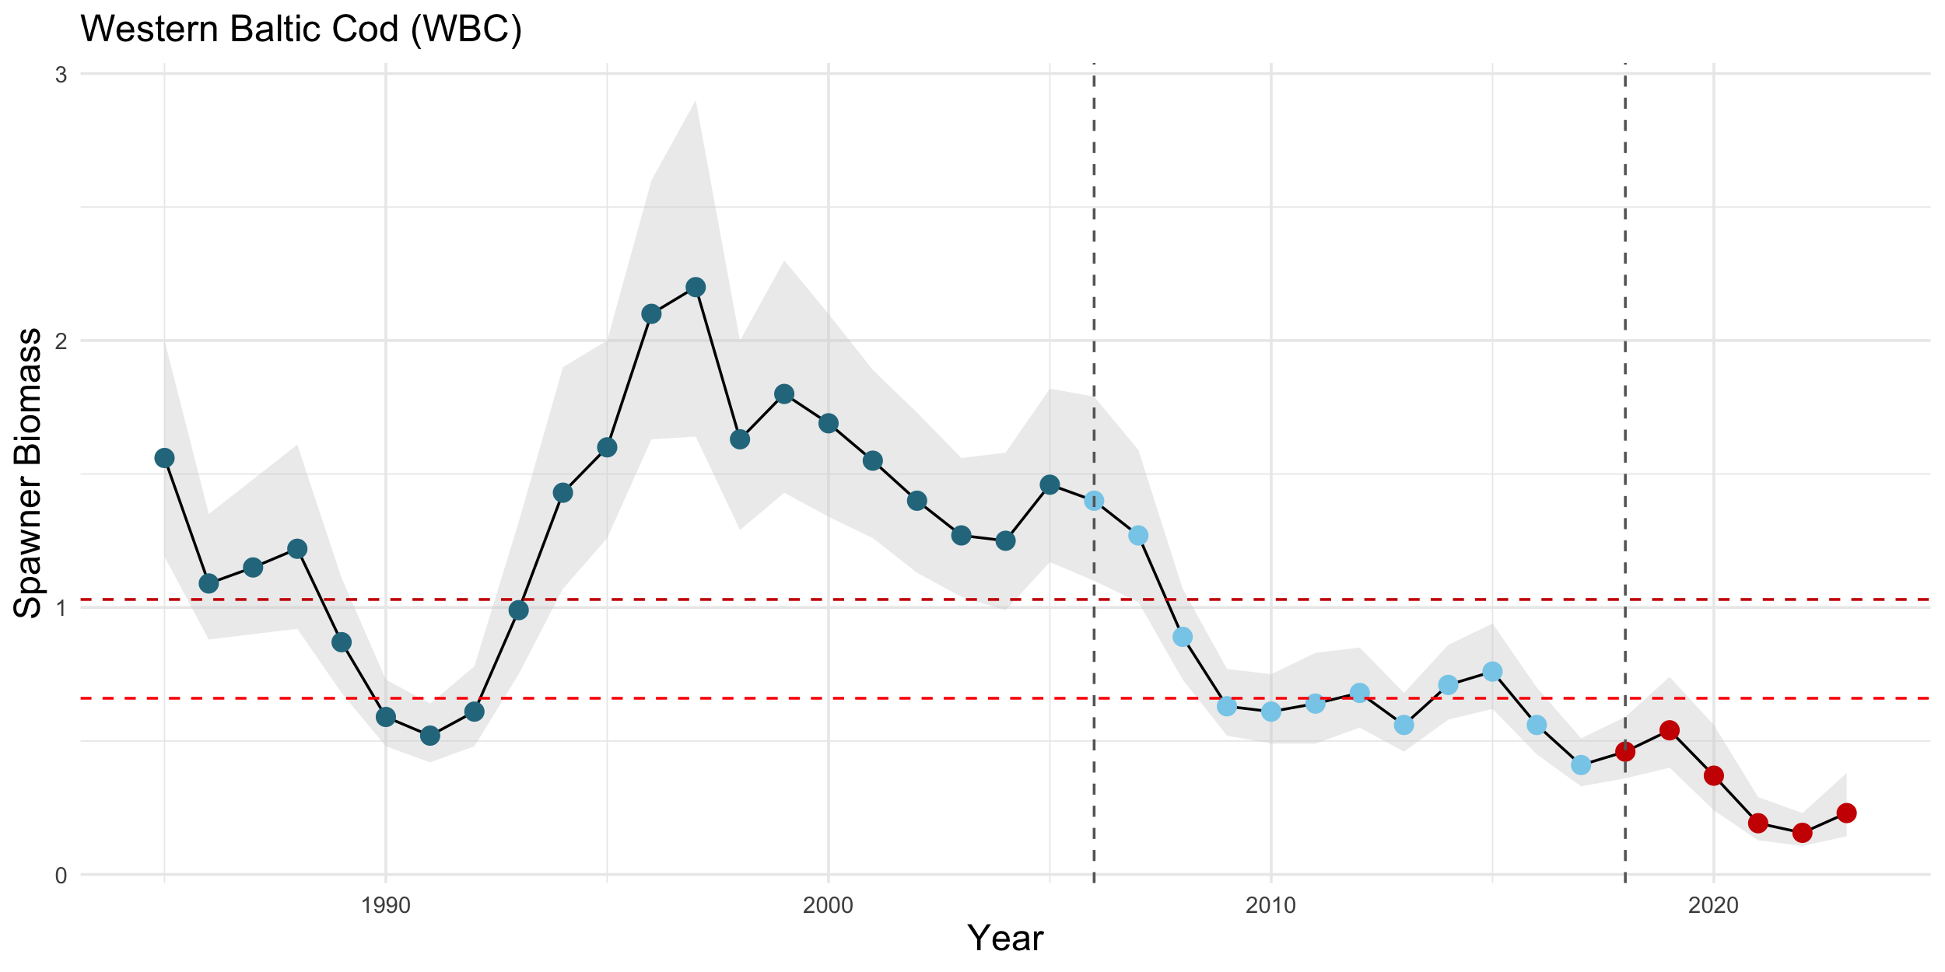
Historical overfishing caused low productivity states
Causes for the depletion of Baltic fish stocks
before EU management
EU management
MAP
MSY B_{trigger}
B_{lim}

Slide 5
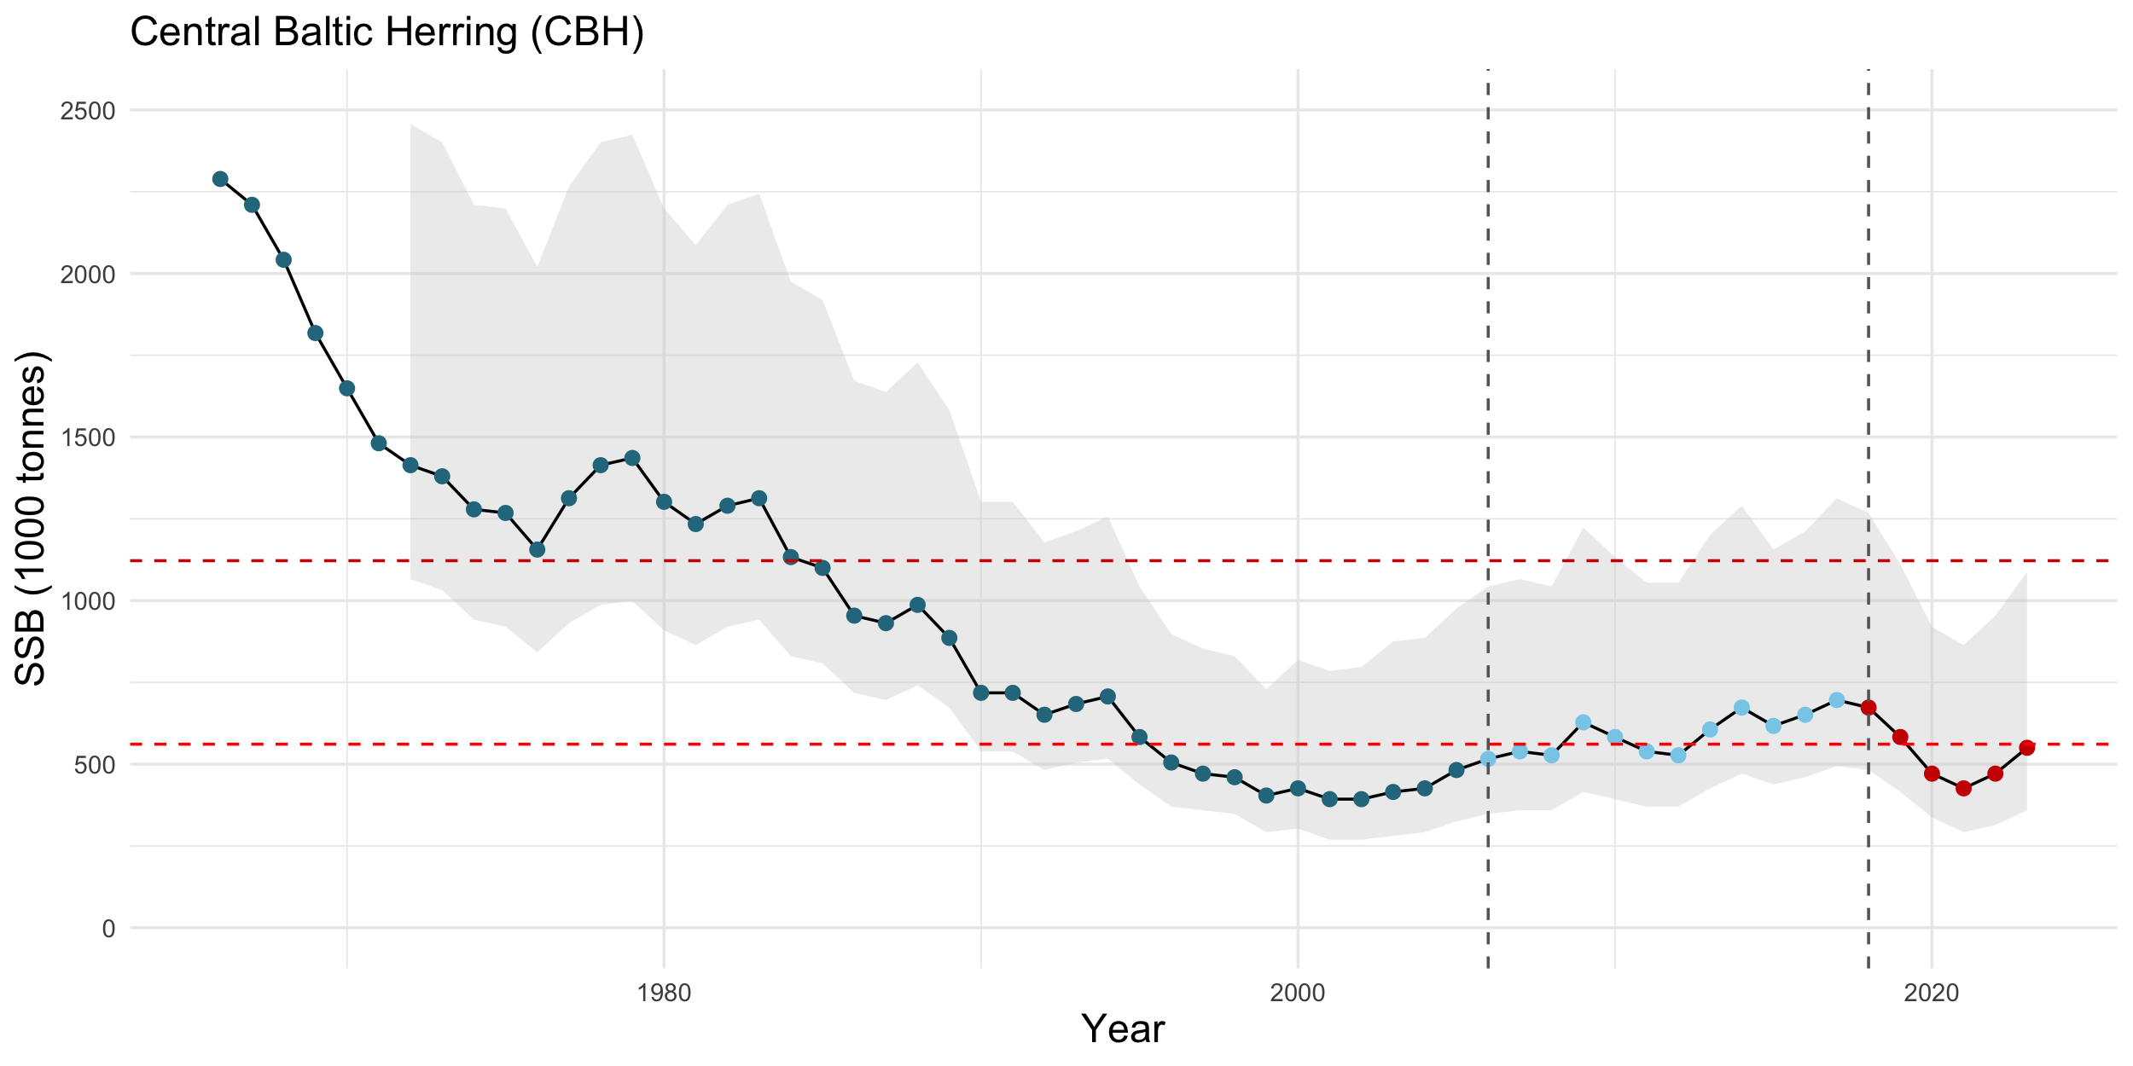
Causes for the depletion of Baltic fish stocks
Historical overfishing caused low productivity states
before EU management
EU management
MAP
MSY B_{trigger}
B_{lim}

Slide 6
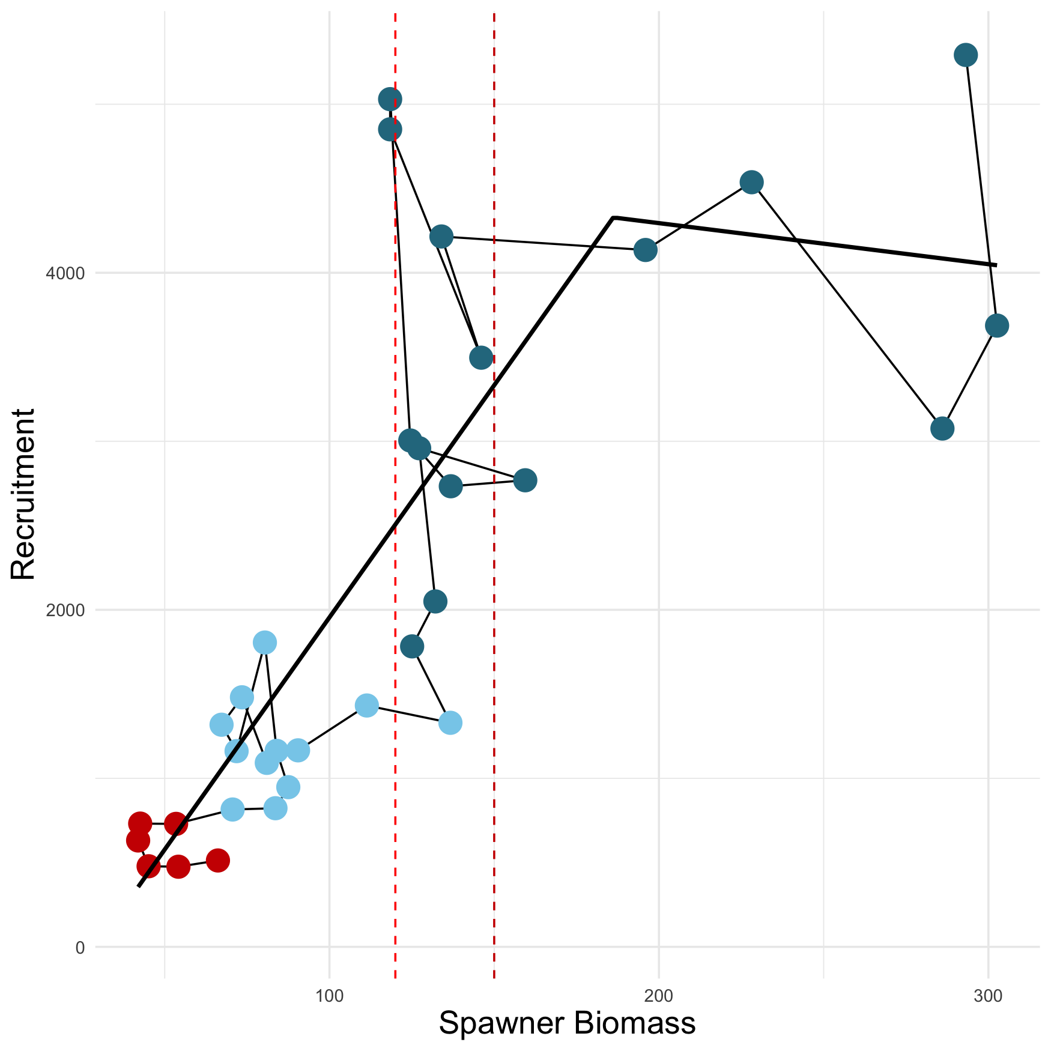
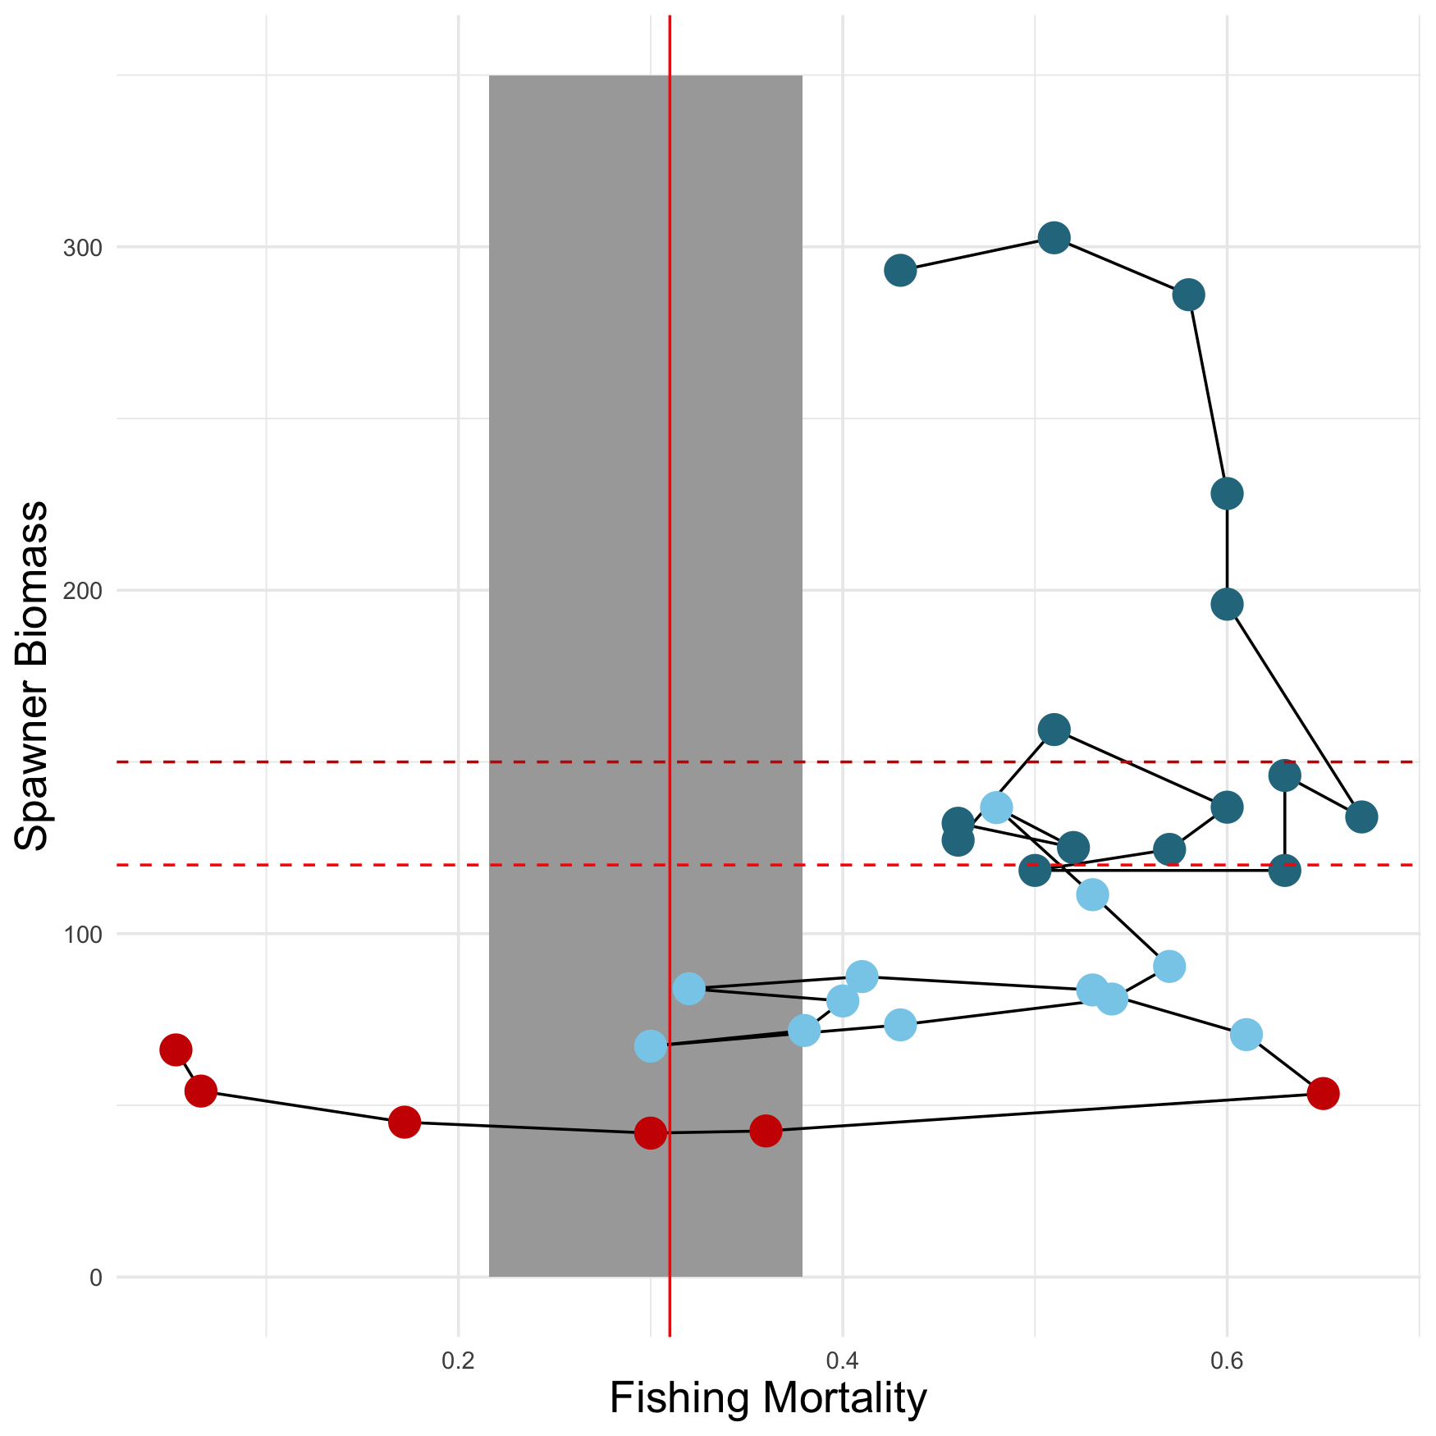
Low biomass impairs productivity
Consequences of overfishing Baltic fish stocks
Stock size becomes decoupled from fishing pressure
F_{MSY}
B_{lim}
MSY B_{trigger}
Western Baltic spring spawning herring

Slide 7
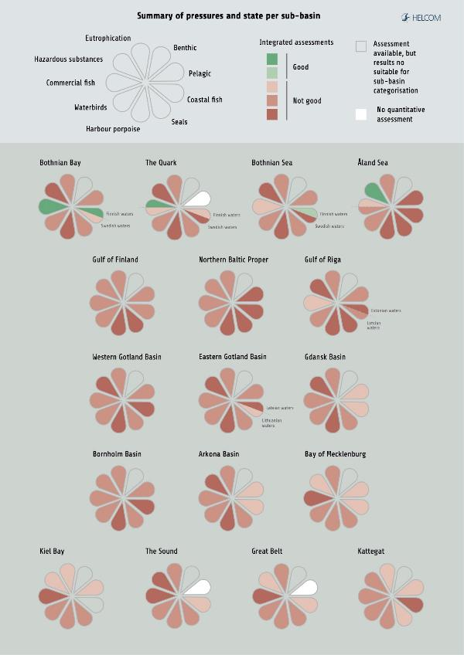
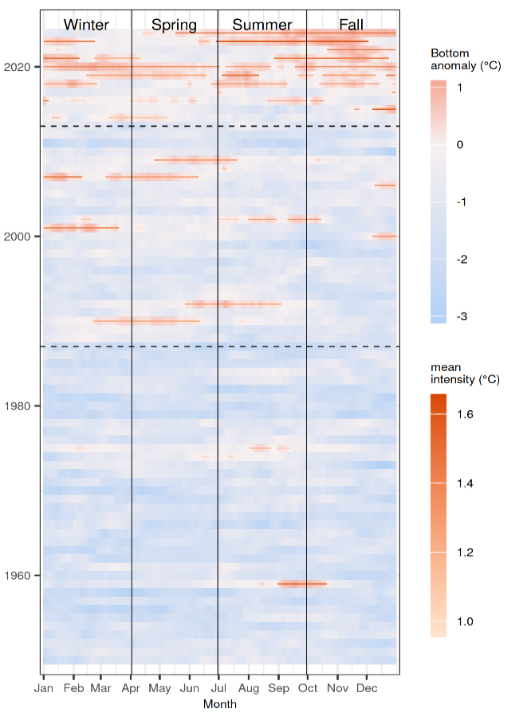
Eutrophication and climate change
Factors limiting recovery
Pinto et al. unpub.
Warming in the Western Baltic
HELCOM HOLAS 3

Slide 8
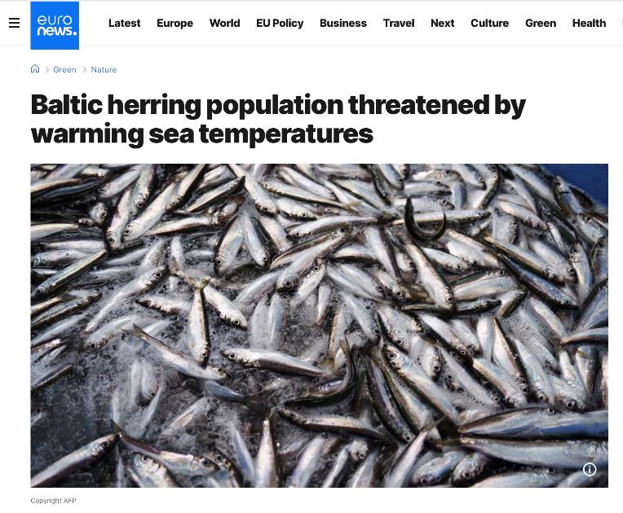
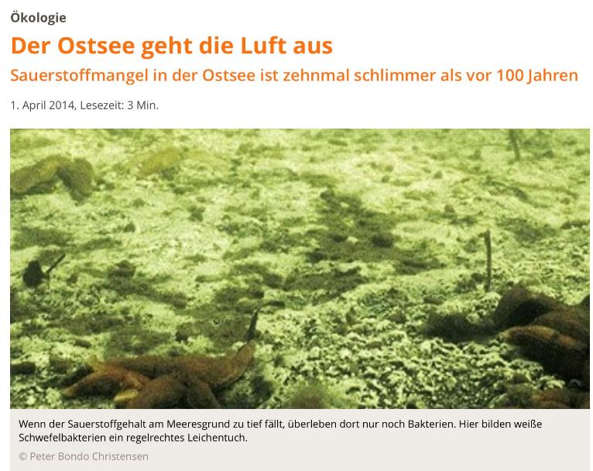
Effects of environmental degradation
Factors limiting recovery
https://www.scinexx.de/news/biowissen/der-ostsee-geht-die-luft-aus/

Slide 9
More reasons why the current system fails in recovering depleted stocks
Baltic MAP issues
The Council frequently sets TACs higher than the scientific advice provided by ICES.
F ranges are an incentive to allow TACs to be set higher than F_{MSY}.
“Zero catch" advice for critically depleted stocks often ignored by the Council.
Current stock assessments and short-term predictions often lead to overly optimistic scientific advice on catch limits.

Slide 10
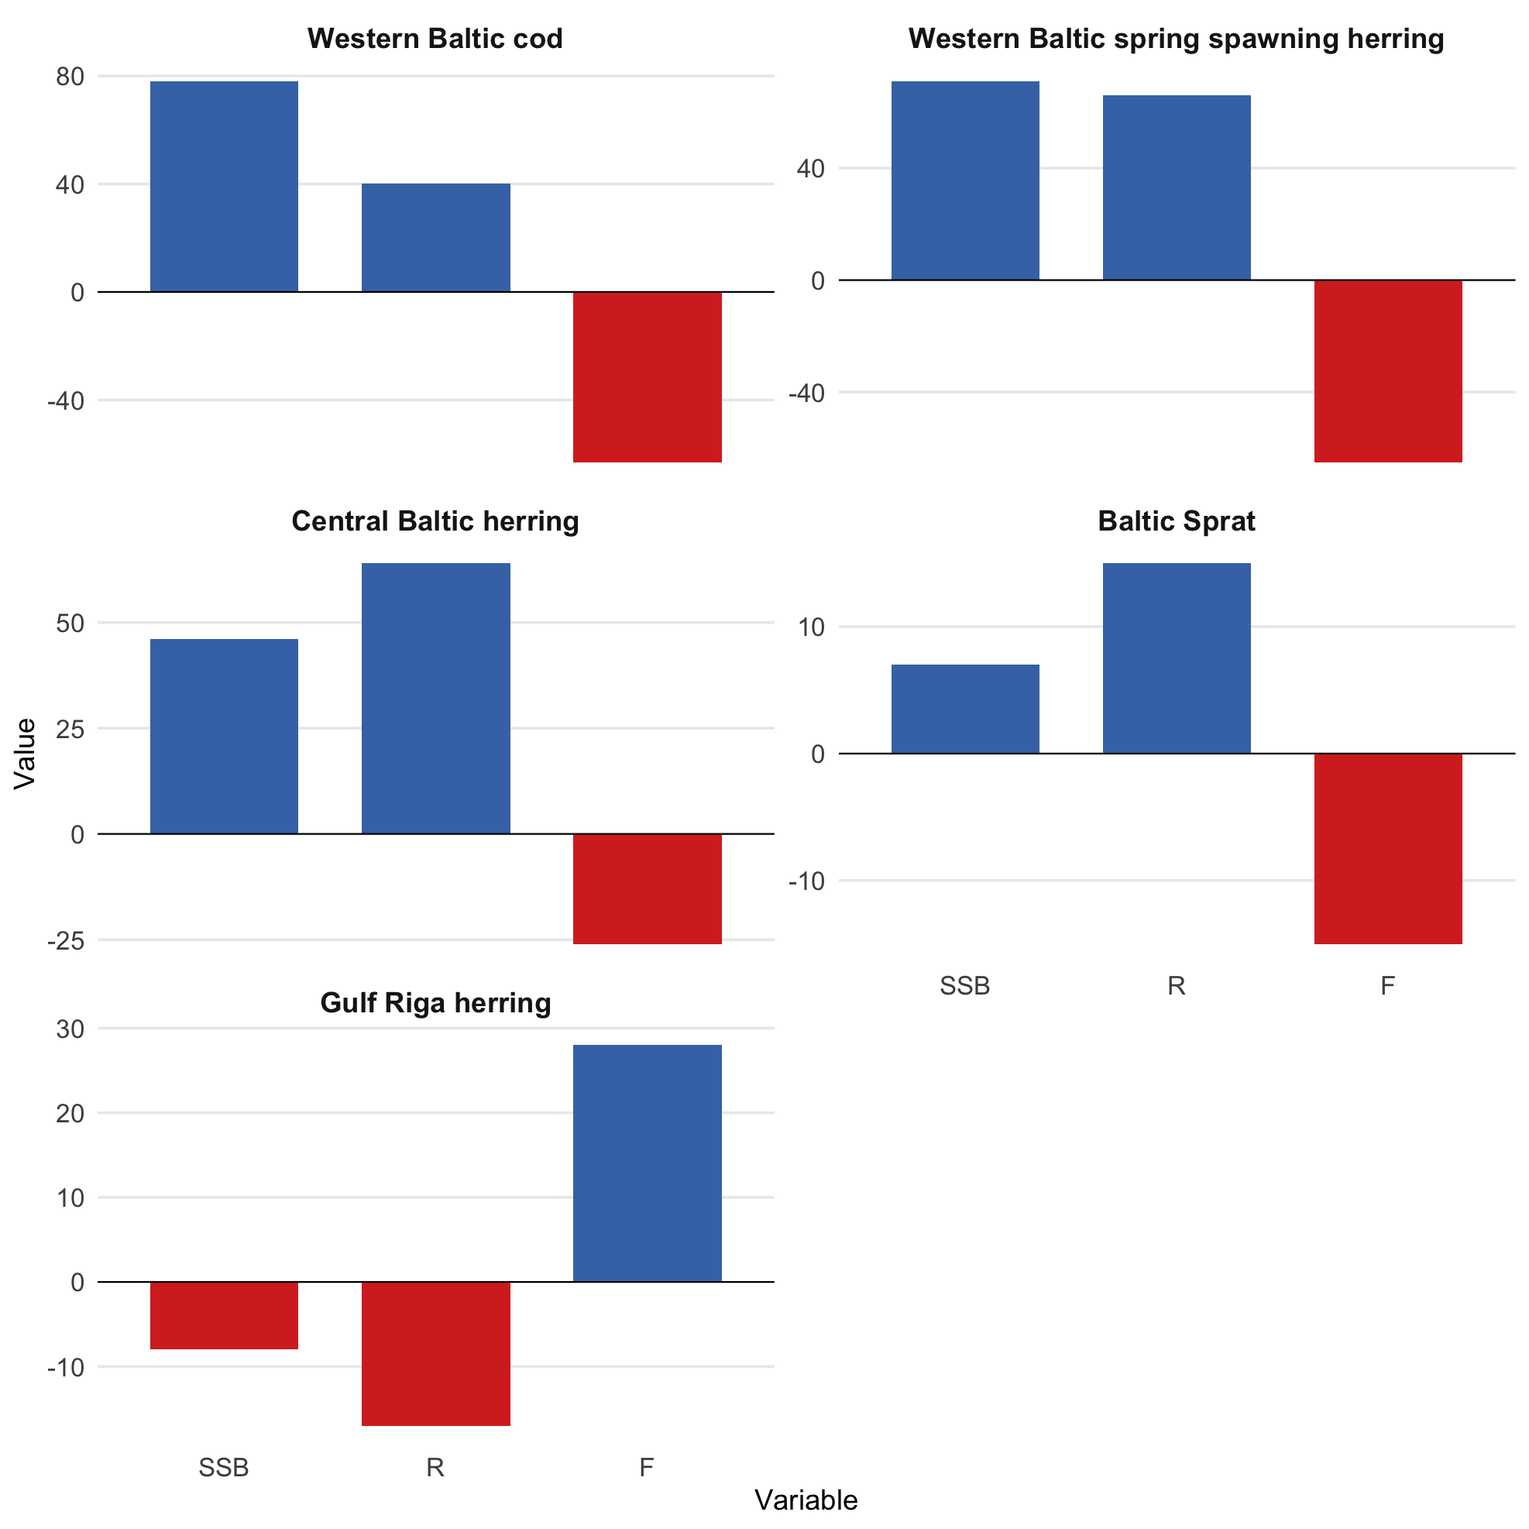
Advice unsuitable for stocks with impaired productivity
Factors limiting recovery
For low productivity stocks
SSB (spawner biomass) is overestimated
R (recruitment – year-class strength) is overestimated
F (fishing mortality) is underestimated
This translates into overly high TAC advice!

Slide 11
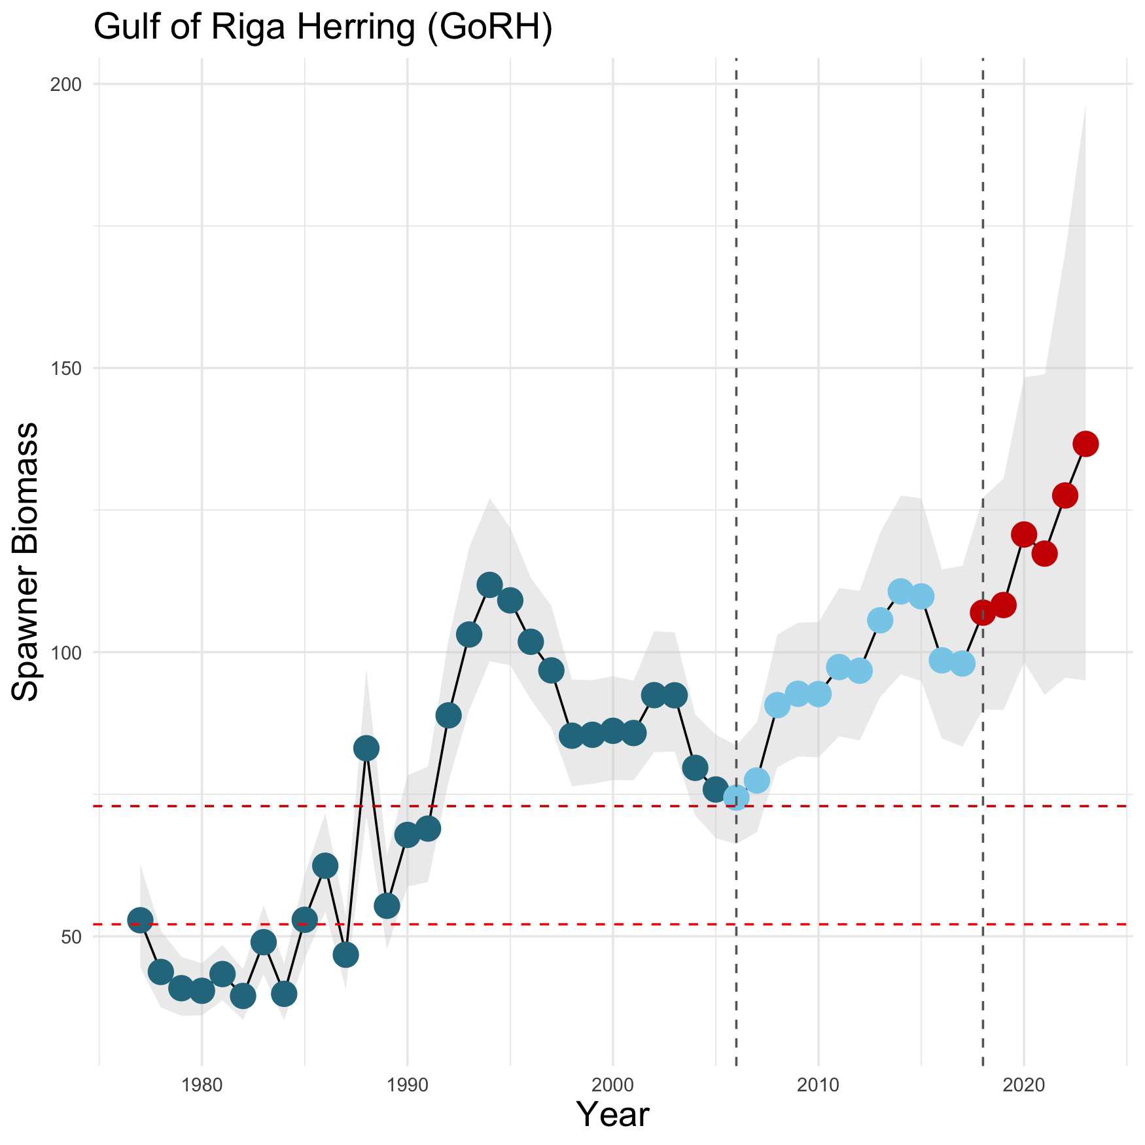
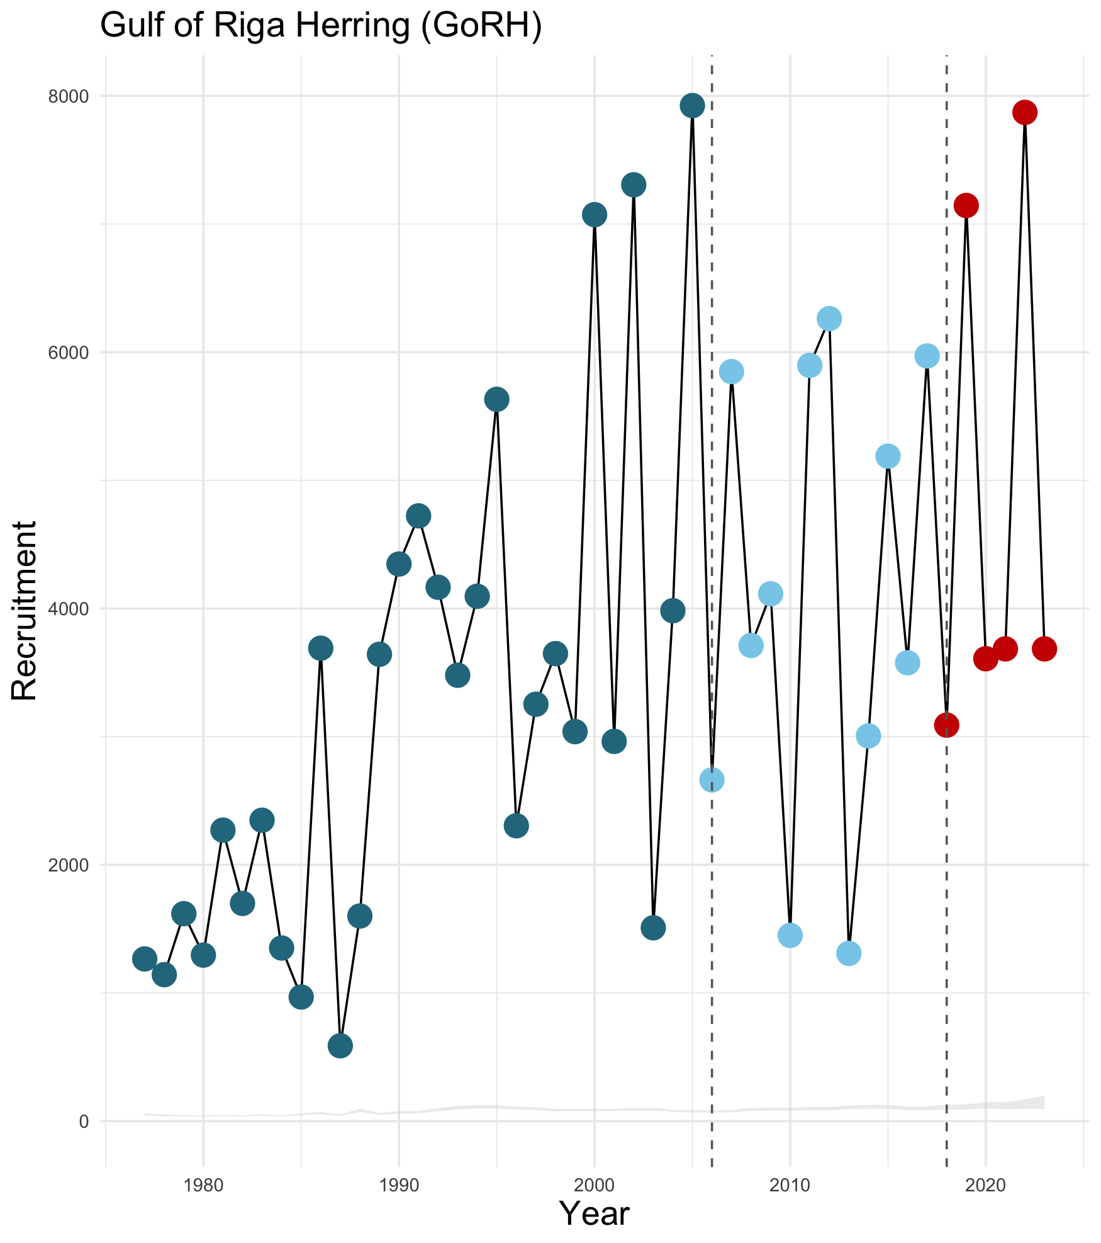
Gulf of Riga herring as evidence
The exception
Fishing often at or below target F_{MSY}
Increasing temperature seems to be supportive
Top-predator cod has disappeared
before EU management
EU management
MAP

Slide 12
A true & precautionary ecosystem approach is needed
Conclusions & Recommendations
The Baltic MAP largely failed, because MAP rules for scientific advice and TAC setting ...
are ill-equipped for stocks trapped in low productivity states
ignore environmental change/degradation
ignore species interactions & food web changes (MAP still represents single-species management)
ignore long-term perspectives (MAP still represents short-term annual management)
still set incentives for unsustainable TACs (ranges around F_{MSY})

Slide 13
A true & precautionary ecosystem approach is needed
Conclusions & Recommendations
Ecosystem-based advice & management does entail ...
multi-species advice
safer biomass targets (i.e. B_{MSY}), as well as single-species, multi-species and ecosystem reference points informed by environmental change and species interactions
using existing modern tools such as ecosystem state and trend assessments as well as ecosystem modelling
exploring short-term AND long-term perspectives using multi-species fisheries and ecosystem models that allow the consideration of eutrophication and climate effects
a monitoring programme within the Data Collection Framework (DCF) that provides more environmental information.

Slide 14
THANK YOU!

