Slide 1
Sanctions and Russia’s shadow fleet
Laura Solanko, BOFIT Bank of Finland
The views and opinions are strictly those of the author, and do not necessarily reflect the views of the Bank of Finland or the Eurosystem.

Slide 2
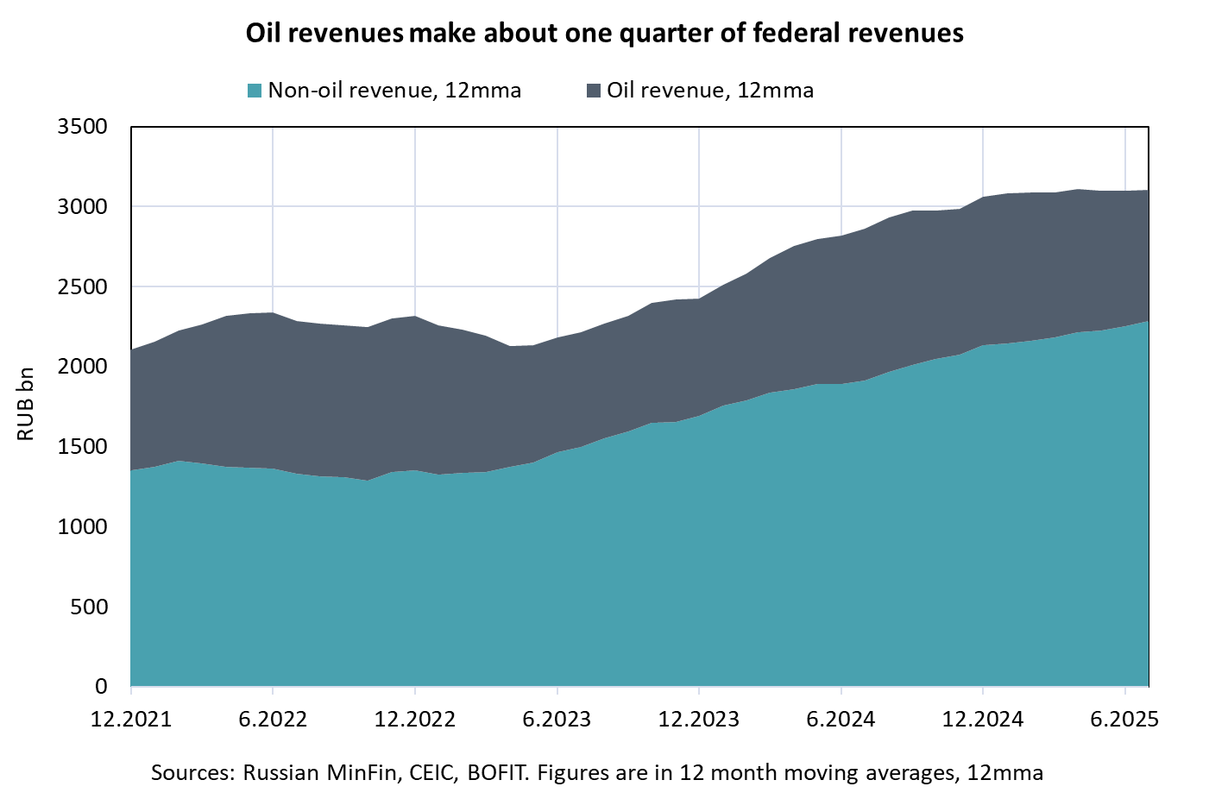
Western sanctions aim to limit Russia’s capacity to fund the invasion on Ukraine
The key oil sanctions measures:
Partial EU oil embargo (crude oil and petroleum products)
G7 + EU imposed oil price caps (crude oil and petroleum products)
Additionally, many restrictions on financial market operators increase Russia’s export costs.

Slide 3
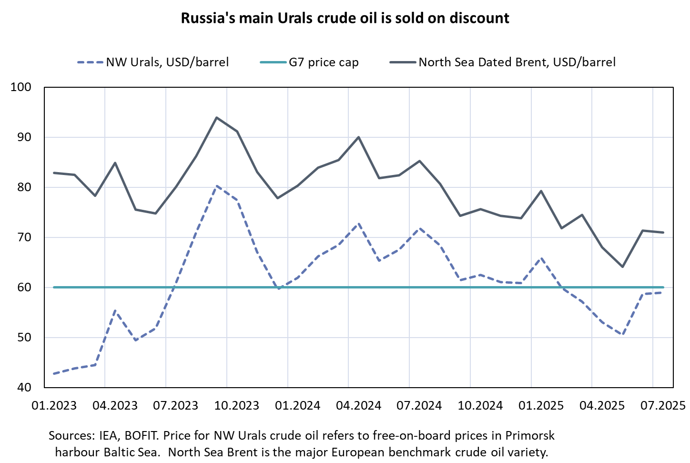
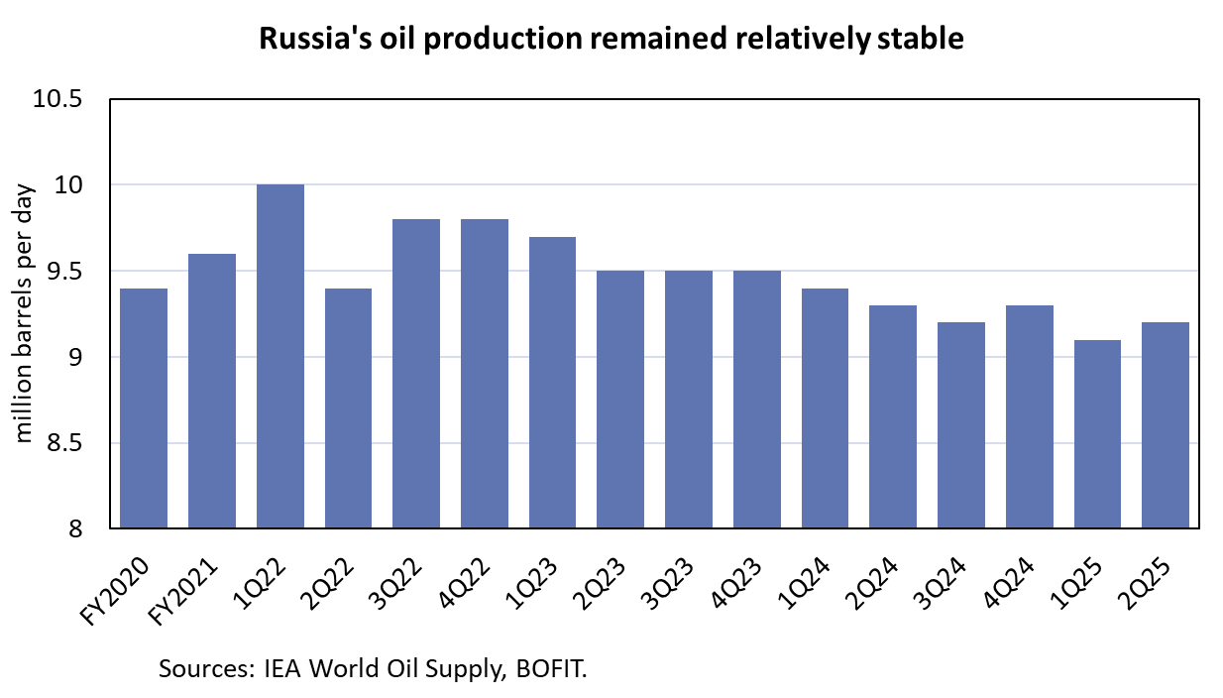
Oil sanctions have worked (almost) as planned

Slide 4
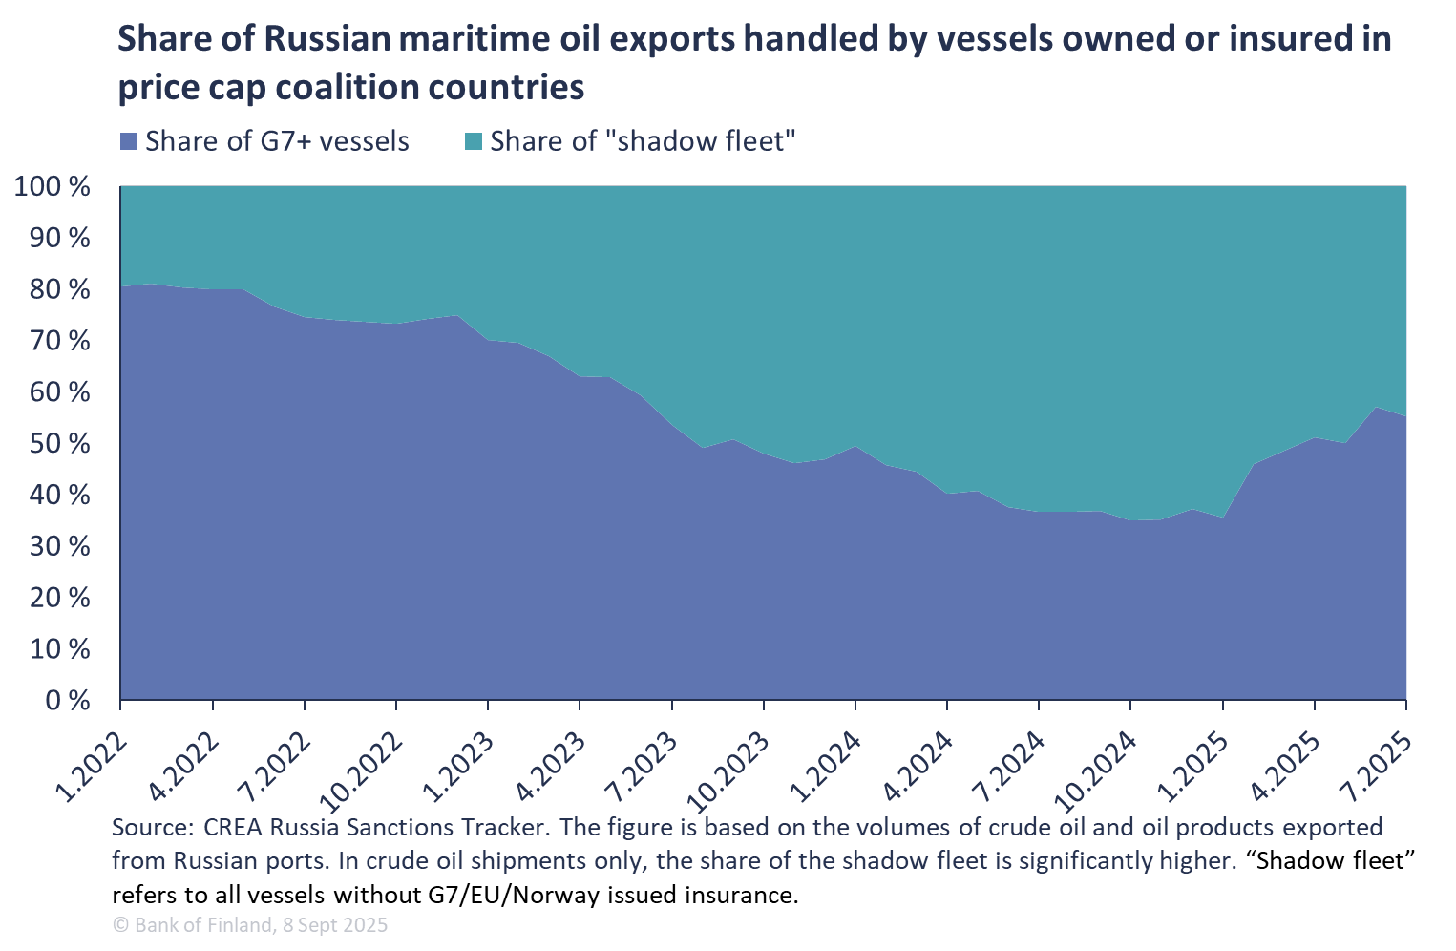
Why the price caps are not binding ?
Russian oil exporters have all the incentives to avoid the price caps (both political and economic)
Finding new buyers in Asia
Gathering fleet of oil vessels not dependent on Western services
“Russian shadow fleet”
Used to circumvent oil price cap

Slide 5
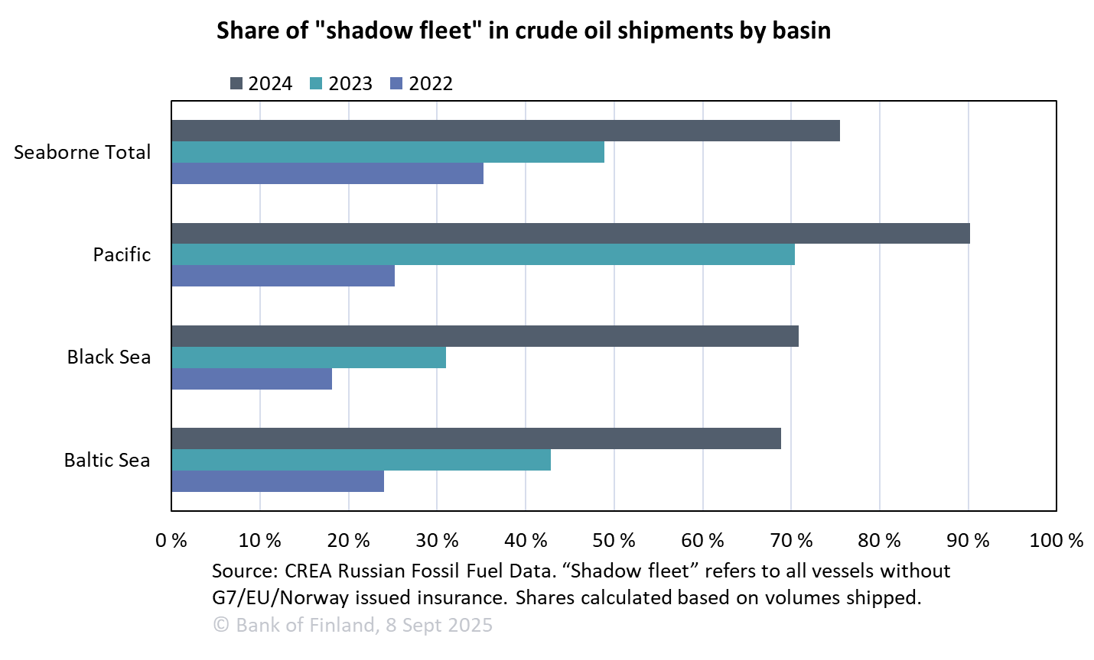
In the Baltic Sea, 70% of Russia’s crude oil is handled by ”shadow fleet” vessels

Slide 6
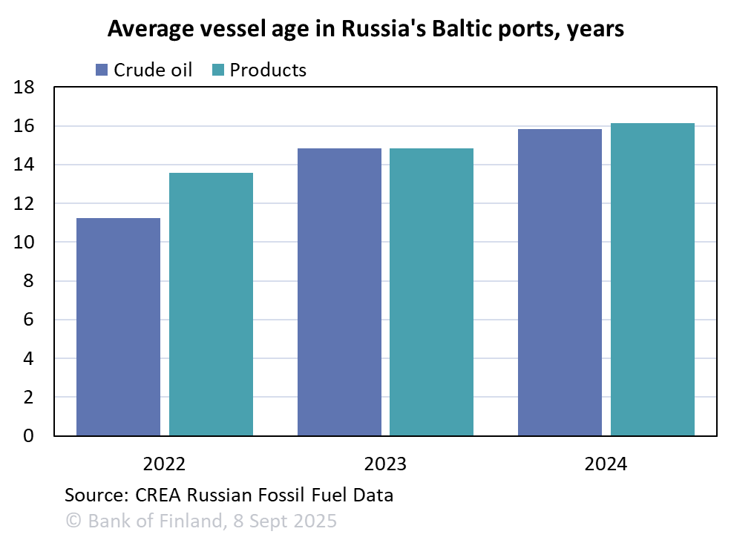
As more vessels are sanctioned, the “shadow fleet” gets increasingly opaque
To better enforce the oil price cap, those violating the regulation have to be sanctioned
Increasing number of sanctioned vessels
This makes it harder for Russian actors to operate the “shadow fleet”
More very old tankers with dubious certificates
Increasingly opaque networks of owners, insurers, and flag states
More incentives for AIS spoofing, GPS jamming etc to obscure vessel operations

Slide 7
Maritime risks and the ”shadow fleet”
Vessels violating the oil price cap
Old or new, experienced or unexperience crews, Russian or Western
May be sanctioned
B) Vessels violating international practices and regulations
Falsified flag states, missing inspections
Dubious or falsified insurance
Unexperienced crews, missing ice strenghtening
Risks for accidents increase
Baltic Sea is shallow, average depth 54m (Mediterranean 1500m)
Due to low salinity, the northern Baltic Sea freezes every year for several months. Ships need to be ice-classed and assisted to navigate safely
GPS jamming may be fatal in the narrow and congested shipping lanes

Slide 8
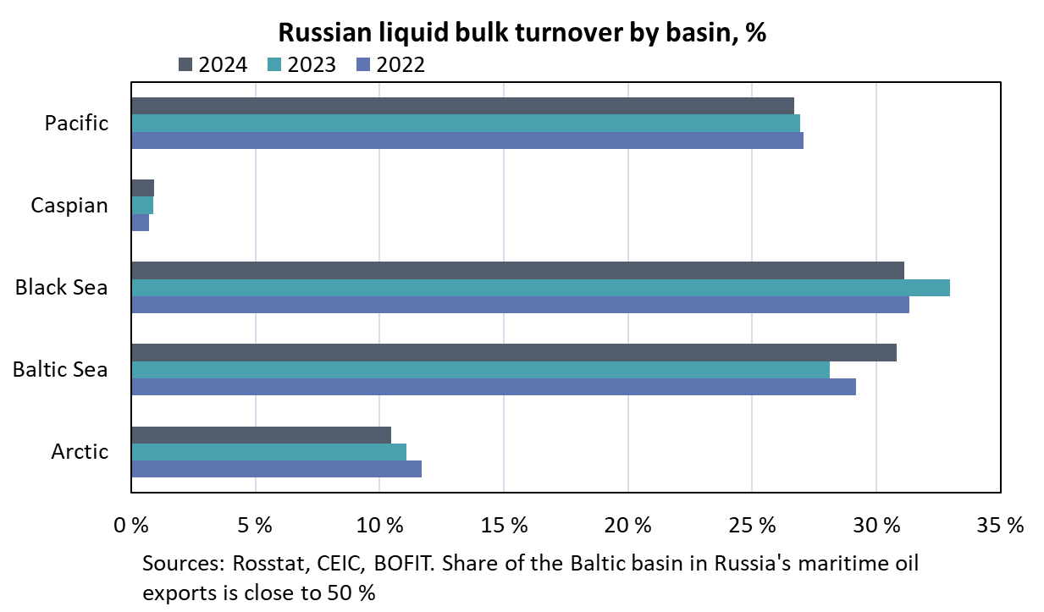
Baltic Sea is indispensable
Baltic Sea is difficult to navigate and vulnerable
And it’s an extremely important trade route
Over 95 % of Finland’s foreign trade in goods
About 30 % of Russia’s seaport freight turnover
50 % of Russia’s maritime oil exports

Slide 9
To summarize: oil sanctions do work
Global supply is not affected
Russian export prices are lower
Freight & insurance costs for Russian oil are higher
Primorsk to Indian cost, from 2.5 to 5-8 million USD per Suezmax
Direct costs on the EU side are smaller but need to be addressed
Loss of market share in Russian oil trade, shipping and insurance
Noncompliance with international practices, UNCLOS regulations
Increasing concerns on environmental safety, especially in the Baltic Sea

Slide 10
THANK YOU ! Further analysis at www.bofit.fi/en Linkedin: bofit-institute-for-emerging-economies Bluesky @bofit.suomenpankki.fi

