Slide 1
Beyond shadows
Sanctions, grey zone tactics, and the transnational challenge of substandard shipping
Professor Christian Bueger, University of Copenhagen
Notes:
Accessibility - Instructions for the end user:
The slide 1 should always have the European Parliament logo as first item in the reading order / Selection Pane (note that the Selection Pane shows the objects in the reverse reading order. The object at the bottom of the list is the first one the be read out. The first on the list is the last one).
You can find the selection panel under the Home menu > Arrange > Position Objects > Selection Pane (In this particular slide you will see the correct reading order – remember, it’s from bottom to top – 1st EP Logo, 2nd Title and 3rd Subtitle)
Every slide should have a title and the title should be unique for each slide inside one PPT. If several slides belong to the same section, example: (Media Section) Media: Press; Media: Video: Media; Live events.

Slide 2
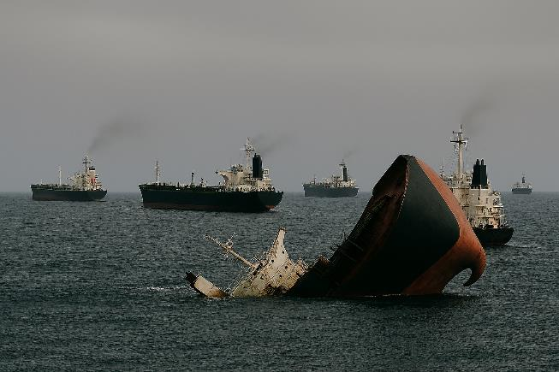
Overview
Beyond Shadows – Prof. Bueger
Conceptual ambiguities
Not one, but 3 problems
Sanctions
Substandard shipping
Grey zone warfare
EU challenges
Institutional complexity
Legal harmonization
Information sharing
Expertise
How to fix it: 10 recommendations

Slide 3


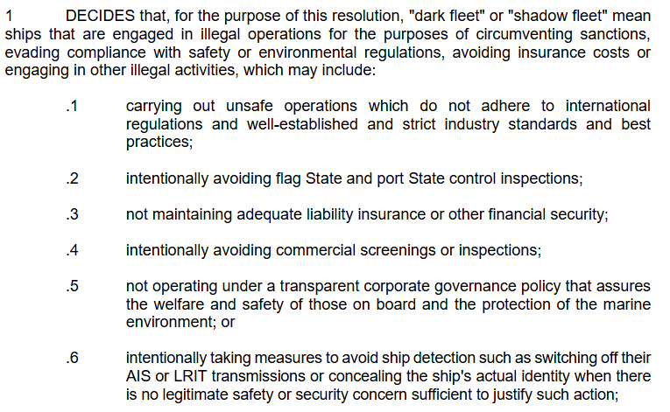

Conceptual ambiguities
Beyond Shadows – Prof. Bueger
Historically: Ghost / Dark / Shadow Fleet = either switching off Automated Identification System (AIS) or engaged in crime
Journalists populate the term and link it to sanction evasion
Remains fuzzy term, but

Slide 4
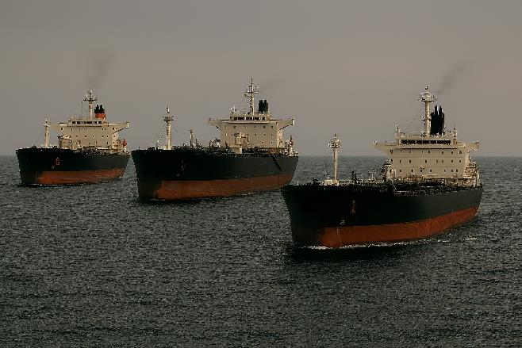
Not one, but 3 problems
Beyond Shadows – Prof. Bueger
Need to disentangle what is at stake
Problem 1: How to design and implement effective sanctions on the Russian war economy to pressure it to stop military aggression?
Problem 2: How to address the global growth of substandard shipping practices and the marine safety and environmental risks it implies?
Problem 3: How to respond appropriately to Russia’s sophisticated grey zone strategies?
Focus on 2 and 3

Slide 5
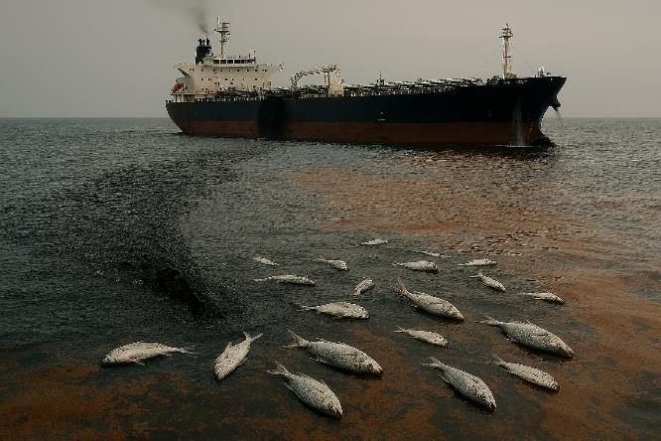
Global growth of substandard shipping
Beyond Shadows – Prof. Bueger
‘Old challenges’ that are the outcome of UN Convention on Law of the Sea (UNCLOS) and weak regulatory status of International Maritime Organization (IMO)
Flag state regime:
‘Flags of convenience’ with limited regulation and enforcement
‘Flag hopping’, possibility to change flag state in short notice
Coastal state regime:
Historically weak: Freedom of navigation, flag state consensus
But: growing environmental law and related IMO provisions (e.g. ship-to-ship transfer)
Weak global surveillance and monitoring (IMO & UN Conference on Trade and Development UNCTAD)
Automated Identification System (AIS)
Largely privatized in registries and insurance (P&I Clubs)

Slide 6
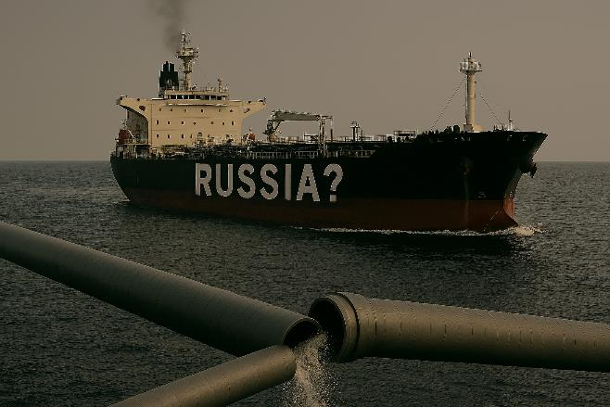
Russian ‘grey zone’ tactics I
Beyond Shadows – Prof. Bueger
Provocative and coercive actions
Not clearly illegal or relying on ‘innovative’ legal interpretations (lawfare)
Small scale, but add up
Cheap for adversary, expensive to respond
Difficult to attribute to a state
Complemented by misinformation campaigns
Clearly prevalent in Baltic Sea & North Sea, less well understood in other regional seas

Slide 7
Russian ‘grey zone’ tactics II
Beyond Shadows – Prof. Bueger
Jamming and spoofing of signals (AIS, GPS), and other cyber attacks on maritime industries
Link to Critical Maritime Infrastructure Protection in Baltic Sea (since Baltic Connector, 2023)
Weaponization of the Environment: deliberately taking environmental damage into account as part of warfare strategies
Tankers as weapons in more open military confrontation for sea denial
Misinformation (see UN Security Council 7/2025):
Sanctions as Unilateral Coercive Measures, illegal under International Humanitarian Law
Impact on developing economies & Global South

Slide 8
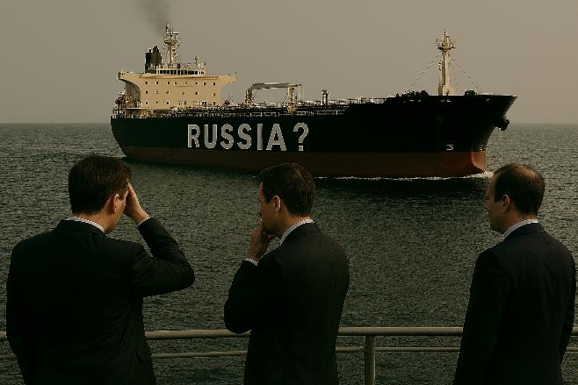
EU Challenges
Beyond Shadows – Prof. Bueger
Institutional complexity and struggle over competencies in maritime domain
EU – Member States
DGs and Agencies: EMSA, EFCA, Frontex, EEA, ENISA, EEAS, EDA,
Lack of legal harmonization across Member States in the maritime domain
Insufficient culture of information sharing across EU navies and coastguards
Lack of awareness and expertise
Shipping expertise among sanctions community
Grey zone expertise in maritime communities

Slide 9
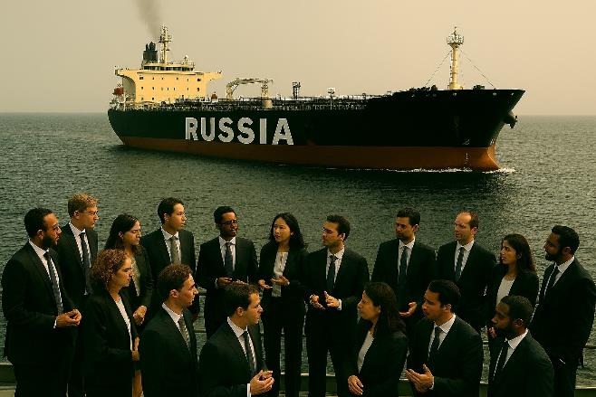
Recommendations: Internal
Beyond Shadows – Prof. Bueger
Promote the effective use of the Common Information Sharing Environment (CISE) and Maritime Surveillance (MARSUR) to enhance information sharing (EMSA, EDA)
Install a legal expert body comprised of law of the sea (UNCLOS) and maritime law (IMO) experts to work towards the harmonization of legal interpretations and concerted international strategies (Frontex?)
Strengthen EU coast guard cooperation and sharing of best practices by upgrading EU Coast Guard Function Forum
Develop cross-sectoral training programmes to enhance understanding of maritime transport industry and grey zone tactics
Review maritime emergency response and preparedness plans and role of industries and societal actors

Slide 10
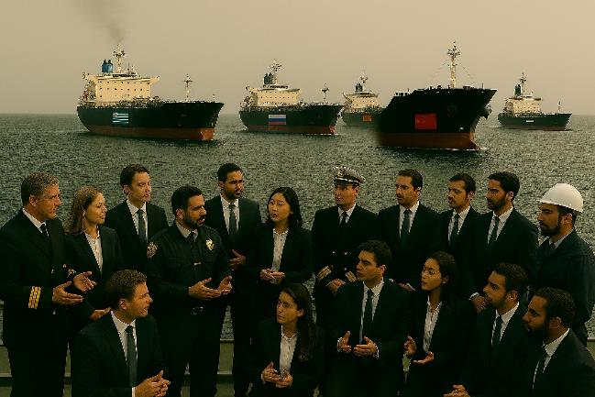
Recommendations: External
Beyond Shadows – Prof. Bueger
Promote a global understanding of the impacts of substandard shipping risks around the world, to enable stronger regulation, and counter Russian narratives (EEA, EMSA, EEAS)
Rally an international ‘high ambition coalition’ in the fight on substandard shipping practices (EMSA, EEAS)
Enhance global monitoring and tracking of substandard shipping practice (e.g. better access to EMSA data)
Coordinate ‘EU shadow fleet policy’ across international organizations, beyond the IMO (EEAS)
Increase pressure on flag states, including by drawing on development aid and trade policy toolbox (EEAS)

