Slide 1
Labelling of plant-based seafood substitutes
Scope and issues at stake
Bertrand LE GALLIC (University of Brest)
Presentation for the Committee on Fisheries, 16 July 2025
Notes:
Accessibility - Instructions for the end user:
The slide 1 should always have the European Parliament logo as first item in the reading order / Selection Pane (note that the Selection Pane shows the objects in the reverse reading order. The object at the bottom of the list is the first one the be read out. The first on the list is the last one).
You can find the selection panel under the Home menu > Arrange > Position Objects > Selection Pane (In this particular slide you will see the correct reading order – remember, it’s from bottom to top – 1st EP Logo, 2nd Title and 3rd Subtitle)
Every slide should have a title and the title should be unique for each slide inside one PPT. If several slides belong to the same section, example: (Media Section) Media: Press; Media: Video: Media; Live events.

Slide 2
Introduction
Labelling of plant-based seafood substitutes
The plant-based seafood substitutes market has developed worldwide since the end of the 2010s, and especially in 2022/2023 → recent phenomenon → new attention required
Objective of the study:
Provide a snapshot of the current state of play in the development of plant-based substitutes for fisheries and aquaculture products;
Discuss potentially misleading labelling practices in the EU market as regards plant-based substitutes for fisheries and aquaculture products;
Review the EU legal framework for labelling of plant-based substitutes for fisheries and aquaculture products.

Slide 3
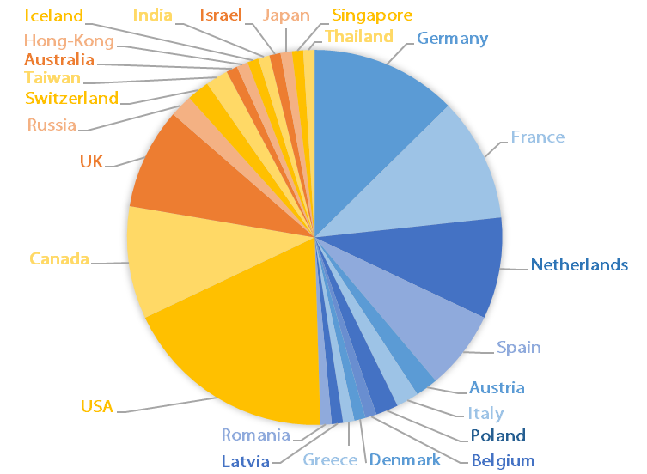
State of play
Labelling of plant-based seafood substitutes
Countries involved; species imitated;
ingredients used; production methods
The study has identified 102 companies, supplying 228 different products.
These companies are based in 26 countries, including 12 EU Member States, which account for around 47% of the firms listed.

Slide 4
State of play
Labelling of plant-based seafood substitutes
Companies involved: key trends
Large agrofood companies have recently entered the market (this includes for instance Nestlé, Birdeye, Unilever, Gardein)
While initially the products were mainly distributed in specialised shops and online, they are now supplied by major retailers, whether in North America (e.g. with Tesco) or in the EU (e.g. Carrefour, Aldi, Spar, Auchan / Alcampo, Delhaize)
Seafood processing companies are progressively diversifying their supply with the development of plant-based products (e.g. Thai Union with John West and Petit navire; Insuperabile; Karavela)

Slide 5
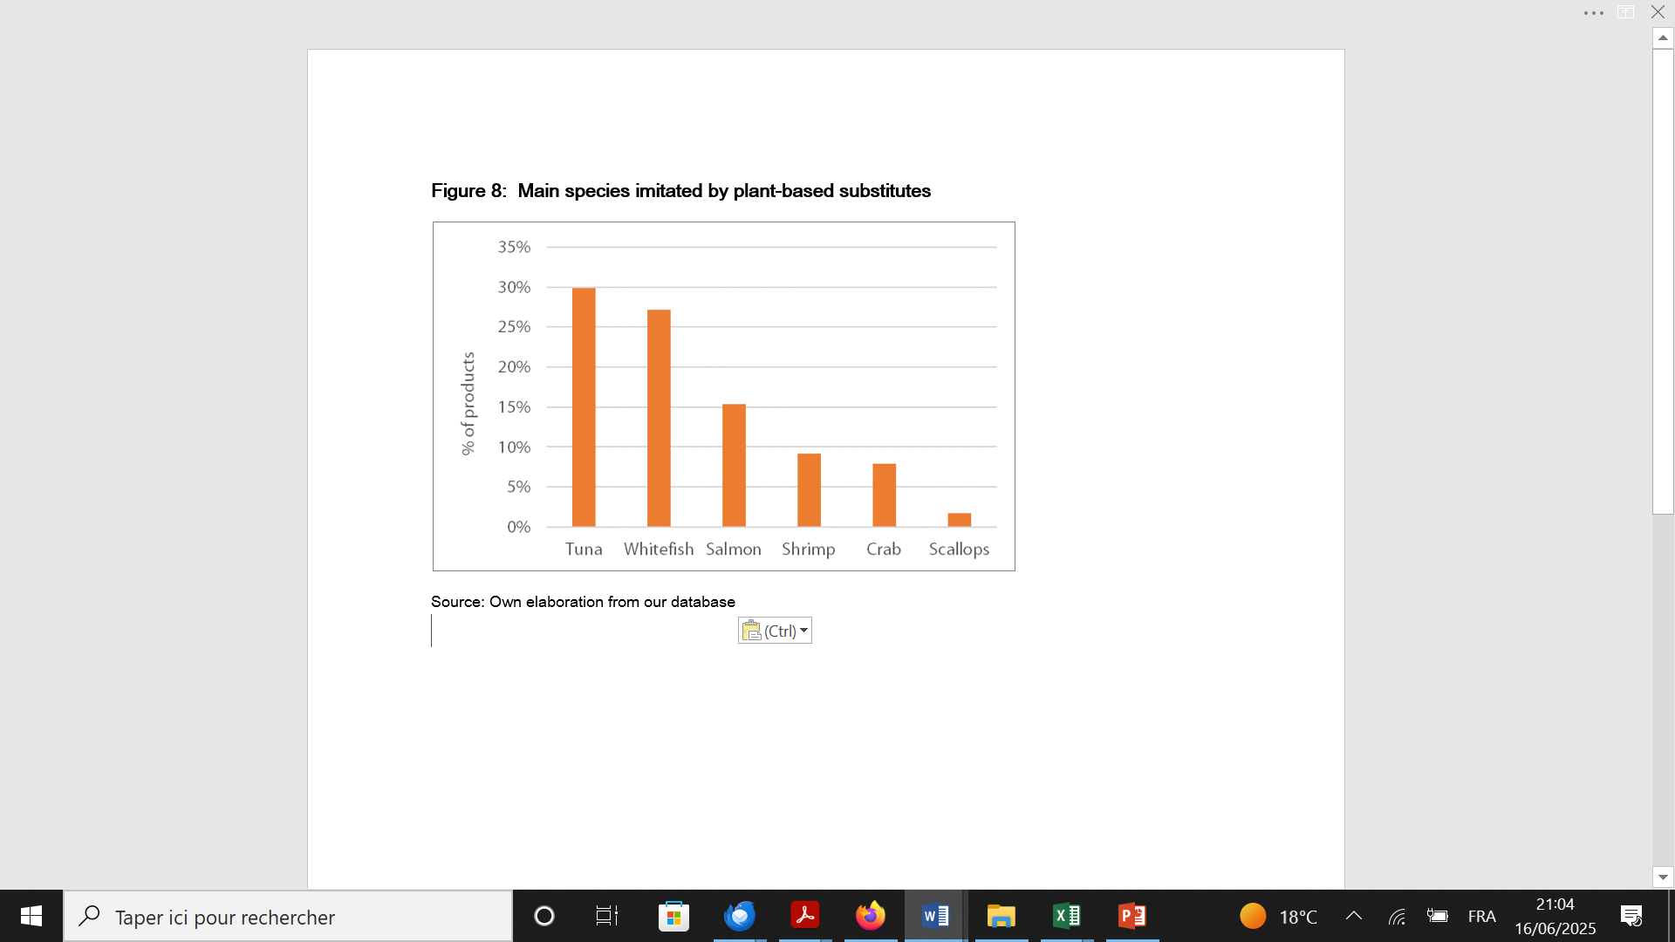
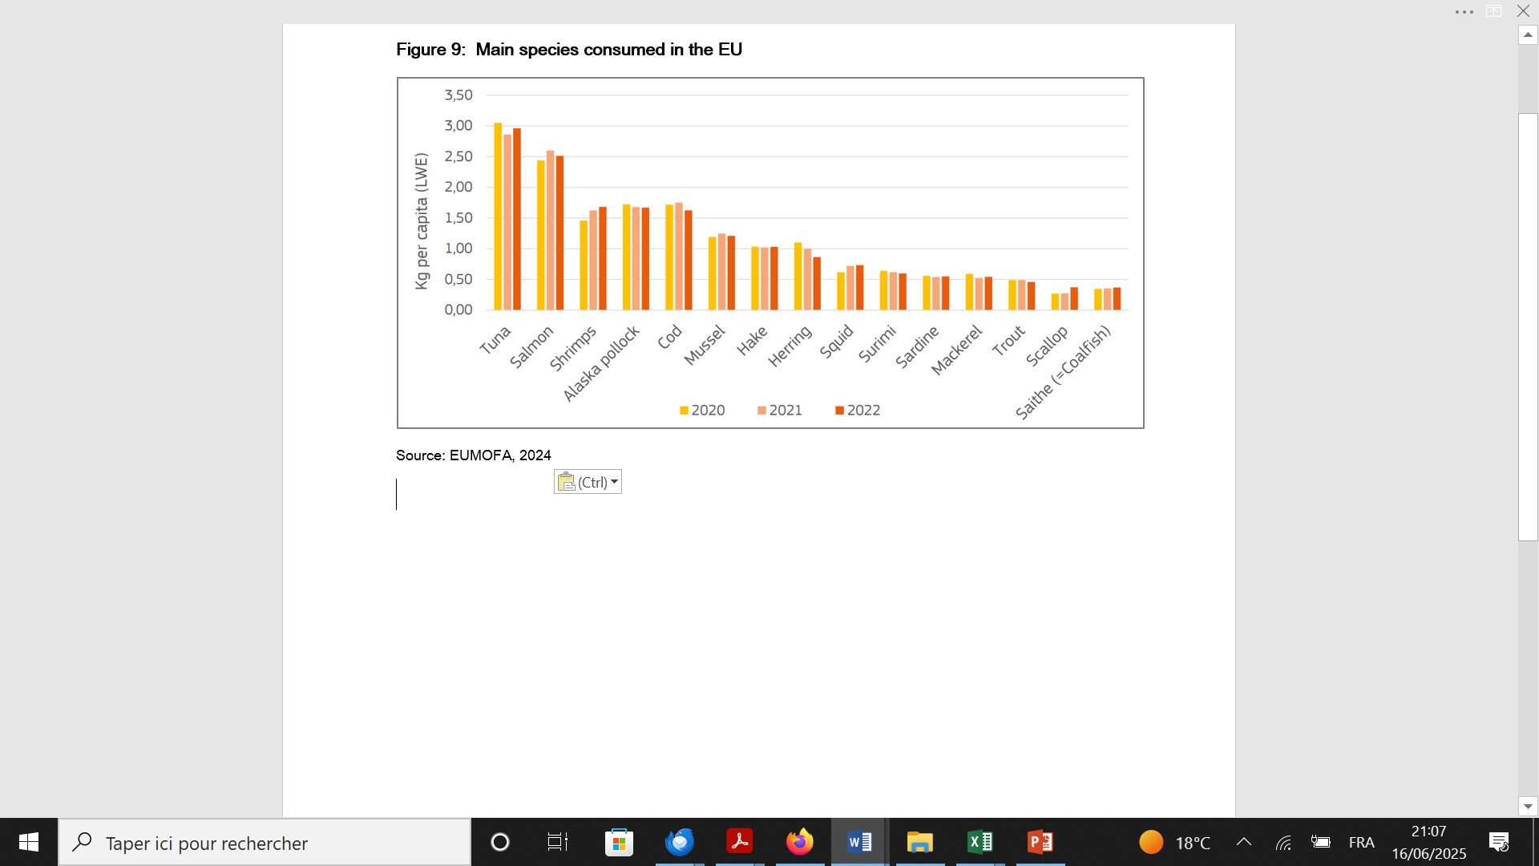
State of play
Labelling of plant-based seafood substitutes
Main species imitated
Main species imitated
The main species imitated are tuna, whitefish (for fish finger-like products), salmon, shrimp and crab (with crab cake and similar products mostly sold in the North American market), which account for around 78% of the 228 products listed in our database.
These most-imitated species are also the most-consumed species in the EU. This finding shows that the production of plant-based substitutes mirrors the actual consumption of genuine seafood products→ competition
Main species consumed in the EU

Slide 6
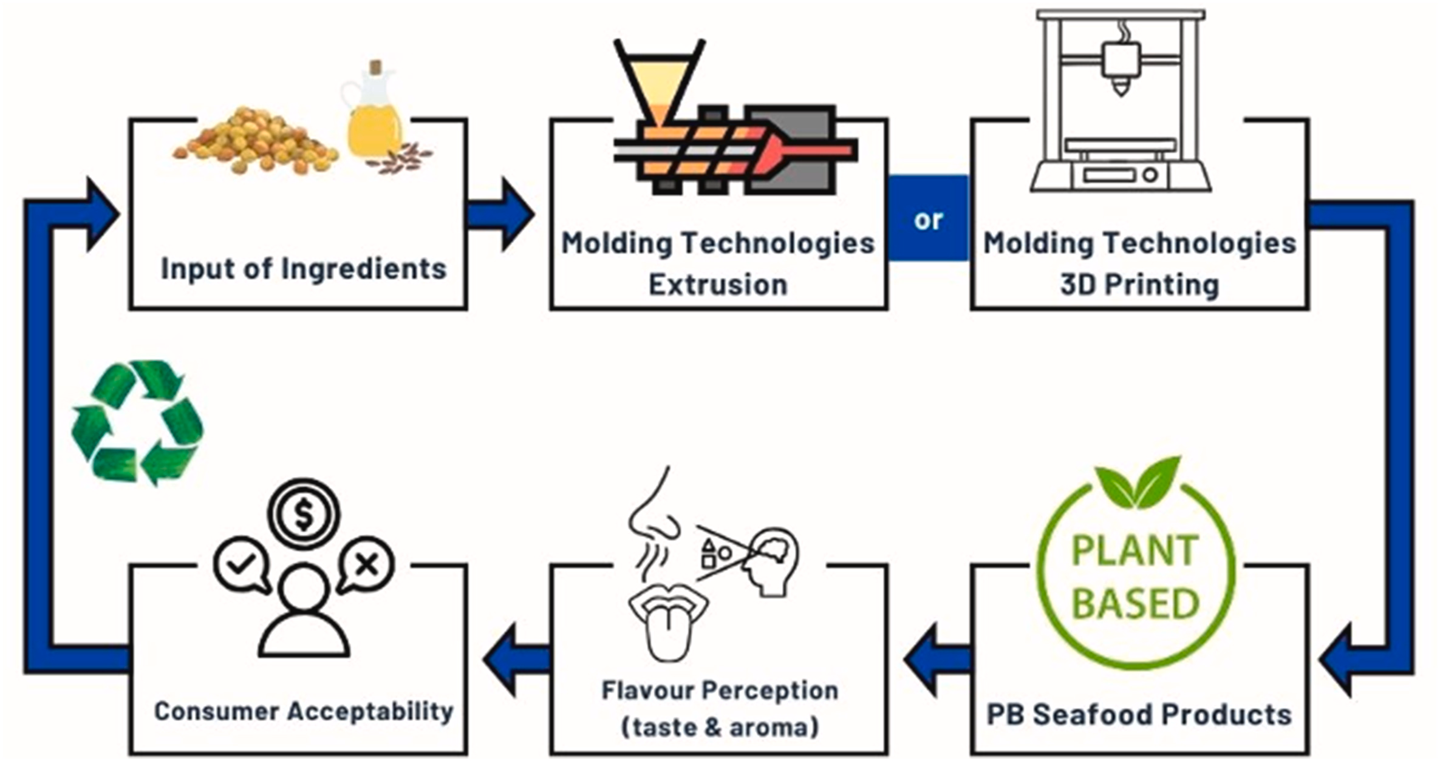
State of play
Labelling of plant-based seafood substitutes
Main ingredients
  Soy, peas and wheat are the main sources of protein → allergens
  Additives are always needed, which can include salt, fat or other ingredients, which in general are not in line with the characteristics of authentic seafood products.
  Plant-based seafood substitutes are the result of a highly complex industrial process
    several steps, including extrusion, electrospinning, wet spinning and 3D-printing
    environmental footprint associated with the transport of (mostly imported) ingredients (e.g. konjac for imitated shellfish) and high-energy consumption may challenge the organic or vegan nature of the products.
Main steps involved in the development of plant-based seafood alternatives (Abotsi et al. (2024)

Slide 7
Labelling issues
Labelling of plant-based seafood substitutes
Regulatory frameworks
    Seafood products must abide by the marketing and labelling rules laid down under Article 35 of Regulation 1379/2013 on the Common Market Organisation (the CMO Regulation) AND respect the rules laid down under the Regulation 1169/2011 on Food Information to Consumers (the FIC Regulation).
    Plant-based substitutes only have to comply with the FIC Regulation, except if made from seaweed or algae.
    Prescriptions on fair information practices laid down under Article 7 of the FIC Regulation provide that “Food information should not be misleading”, inter alia, as to the nature and the identity of the food (Paragraph a) or by suggesting, by means of the appearance, the description or pictorial representations, the presence of a particular food or an ingredient which actually has been substituted with a different one.

Slide 8
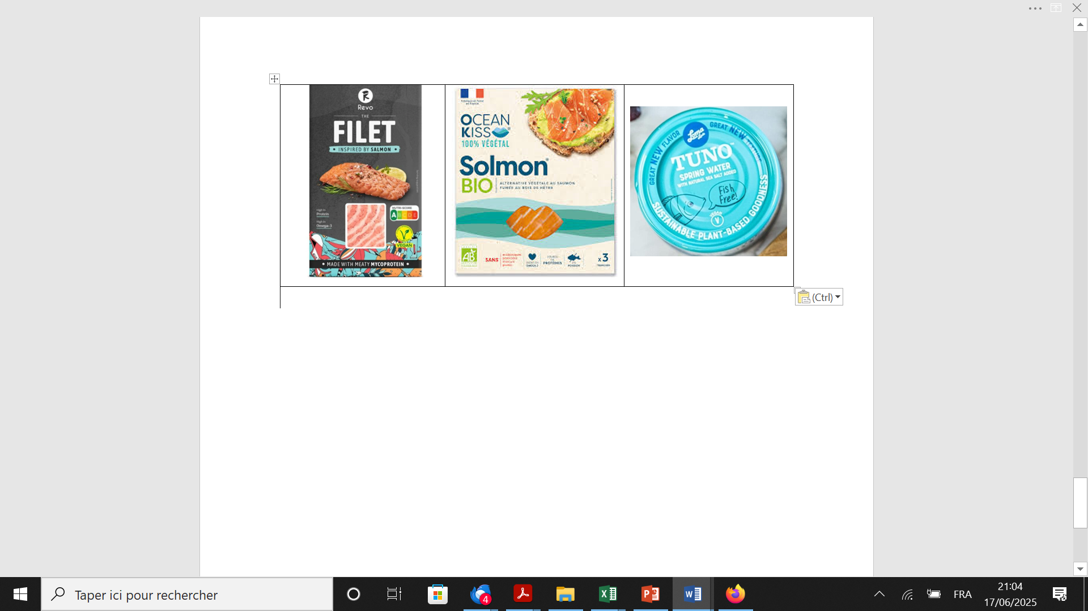
Labelling issues
Labelling of plant-based seafood substitutes
Potentially non-compliant practices

Slide 9
Labelling issues
Labelling of plant-based seafood substitutes
Examples of invented names
    Aubergeel
    Buñuelos Vacalao (tapas)
    Cap Végétal - Emietté Mariné
    Cap Végétal - Salade d'émietté végetale
    Cavi-art ® - kelp caviar
    Crispy chili shrimpz
    Crispy coconut shrimpz
    Crispy lemon shrimpz
    Delicias de Vegatun
    Filet Atlantik Tofu aux algues de la mer
    Filet XOXO
    Fishless Fingers Quorn
    Food·art® Seaweed pearls – Flavour pearls
    F'sh filets Happy Tyuna
    Kalamariz
    Kiss kiss nuggets
    Merlvza
    Mini cr'b cakes Mini Hug Filets
    Mini Hug Filets d’Onami Foods Not-fish bouillons cubes
    Ocean burger
    Ocean Steaks
    Omni tuna
    Plain shrimpz
    Plant Based Tunah
    Plant Zalmon Sashimi

Slide 10
Labelling issues
Labelling of plant-based seafood substitutes
Potentially non-compliant practices
Based on our survey, 45% of the products use invented seafood-related names, often with little information to provide a fully descriptive denomination.
In 57% of the cases, a direct reference to the name ‘fish’ or ‘fish species’ is made, with 13% of the cases referring to both invented name and fish species name.
→ Although the FIC Regulation might be considered sufficiently prescriptive to avoid misleading practices, interpretations and actual controls by national agencies may differ between Member States. This might call for further clarification regarding the labelling practices, as revealed by the current French and German initiatives, as well as the recent ECA special report about food labelling in general.

Slide 11
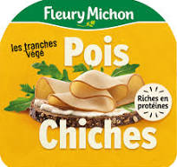
Policy recommendations
Labelling of plant-based seafood substitutes
In general, forbidding the use of the commercial designation of aquatic species for a product that does not contain seafood would clearly avoid misleading practices.
As for products using invented names, additional information should be required to fully comply with Article 36 of the FIC Regulation, especially when the ambiguity generated by the name is reinforced by the use of a picture imitating the genuine corresponding seafood product.
A possibility to further facilitate both the marketing strategies of the producers and the consumers’ choices could be to impose the name of the main ingredient(s) used, as suggested current marketing practices in the EU agrofood sector.

