Slide 1
The role of commodity traders in shaping agricultural markets STUDY Requested by the AGRI Committee
Monica Pesce, EY
Barbara Kuepper, Profundo
Myriam Vander Stichele, SOMO

Slide 2
Structure of the Presentation
State of the art
Part I: Agri-commodity traders
Trends and challenges
Regulatory state of play
Conclusions
Options for follow up actions
Part II: Agri-commodity derivatives markets
Trends and challenges
Regulatory state of play
Conclusions
Options for follow up actions

Slide 3
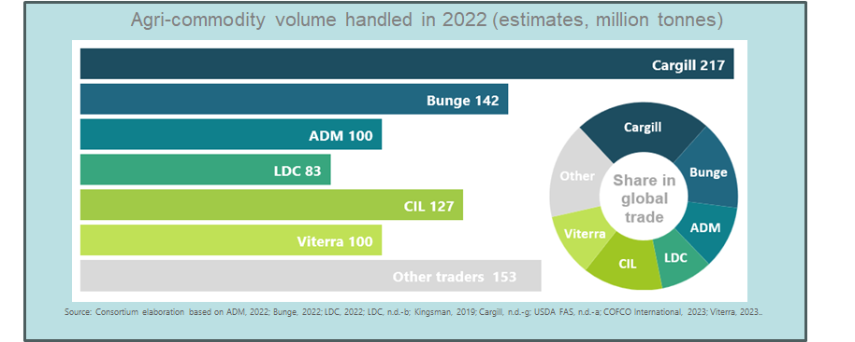
State of the art
Who are the leading agri-commodity traders?
ABCDs (ADM, Bunge, Cargill, LDC: leading players in global agri-commodity market) account for approx. 50-60% of global trade in essential cereals, oilseeds & protein crops (COPs)

Slide 4
State of the art
Traders’ role in managing food stocks
Capacity and inventory data is sparse.
Lacking stock transparency increases risk of price volatility.
Data extrapolation suggests joint ABCD capacity to store approx. 10% of current global COP stocks.

Slide 5
Part I: Agri-commodity traders

Slide 6
1. Trends and challenges
Integration and diversification processes
Modern food system marked by oligopolistic market structure.
Horizontal and vertical integration, diversification into new business segments:
Broader geographic and commodity exposure
Economies of scale
Reducing risks from supplier dependencies
Higher profit margins through value-adding

Slide 7
2. Regulatory state of play
Agricultural commodity markets
EU agri-commodity trade is subject to EU regulation and supervision at various levels:
Green Deal policies
Competition law
Financial markets regulations

Slide 8
3. Conclusions
Agricultural commodity markets
Transparency and accountability: fundamental for stable and affordable food supplies and fair trading practices.
Monitoring physical agri-commodity flows, stocks: dependent on broadened and standardised reporting requirements.
Market concentration: needs further investigation and international cooperation.

Slide 9
4. Options for follow up actions
Transparency of physical markets
Standardisation and strengthening of reporting requirements for COP stocks.
Reporting obligations for listed and private companies.
International cooperation to improve supervision of physical agri-commodity markets dominated by global actors.

Slide 10
4. Options for follow up actions
Investigating and regulating market concentration
Investigation of status and impacts of market concentration, across agri-food supply chain stages.
International cooperation on concentration issues.
Expanded ordinary legislative procedure to include EP in competition law reviews and development.
Research into tax avoidance, and potential for windfall tax on excessive agri-food sector profits.

Slide 11
Part II: Agri-commodity derivatives markets

Slide 12
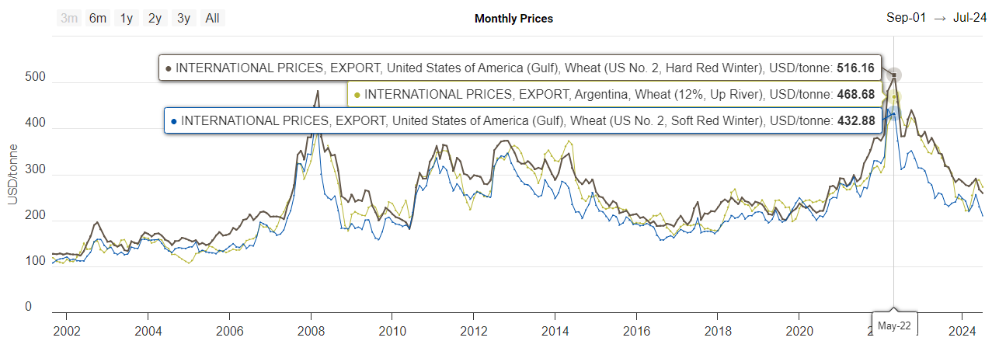
1. Trends and challenges
Financialisation
Spikes and volatility in agri-commodity prices: example of wheat prices
Fluctuations of international wheat prices, 1 January 2000 – 1 March 2024

Slide 13
1. Trends and challenges
Derivatives markets
Pricing on agricultural commodity derivatives markets: influenced by various factors.
Complex distinction: fundamentals vs. undue price setting and financial profit-making.
EU milling wheat market analysis: substantial non-hedging positions.

Slide 14
2. Regulatory state of play
Commodity derivatives markets
MiFID/MiFIR (Market in Financial Instruments Directive/Regulation) for orderly pricing, incl.:
Definition of hedging
Position limits & controls
Ancillary activity exemption
Reporting & supervision
EMIR (European Market Infrastructure Regulation): OTC derivatives trading reports & risk management
Market abuse Directive and Regulation

Slide 15
3. Conclusions
Commodity derivatives markets
Lack of public data for MEPs to improve accountability.
Need for full analysis: info fundamentals, hedging vs. excessive speculative trading, non-EU traders, concentration.
OTC agri-commodity derivatives: review of data, clearing and margin payments.
Gaps in joint overview & supervision physical and financial agri-commodity markets, incl. stocks.

Slide 16
4. Options for follow up actions
Orderly pricing and integrity of derivatives markets
Improve disclosure of financial risks by all traders, incl. non-listed, non-hedging, foreign affiliates.
Ensuring broad expert contributions to EC reports & legislative reviews on ancillary activity exemption (in 2024?) and effectiveness position limits regime (by 31 July 2025).
Assess whether agricultural commodity derivatives markets and pricing can face crises, e.g. climate impacts or geopolitics, and guarantee sustainable prices for farmers & consumers.

