Slide 1
Rural Areas : Levels of support and impact on competitiveness of farms 13 February 2024
Monika Beck (ADE)
Arndt Münch (ÖIR)

Slide 2
Structure of the presentation
Scope of the study
CAP support to farm competitiveness
Levels of support and MS strategies
Young farmers and women
CAP tools and indicators
Recommendations

Slide 3
1. Scope of the study
Objectives of the study
Multifaceted objectives
CAP support (EAGF and EAFRD) and state aid to farm competitiveness
Through an analysis of current and upcoming challenges of farm competitiveness
Levels of support to farm competitiveness in 2014-2022 and 2023-2027
Role of women and young farmers and their support
Methodological approach
Literature review and 28 CSPs on competitiveness, women and young farmers
Financial data and CAP indicators, agricultural and trade statistics
Elaboration of intervention logics
Workshops with experts and triangulation
Main limitation
2014-2022 ex post evaluations of Rural Development Programmes (EAFRD) only due in 2026

Slide 4
2. CAP support to farm competitiveness
CAP 2023-2027
INTERVENTIONS
IMPACT INDICATORS
Complementary income support for YF (CIS-YF 30)
Coupled income support (CIS 32)
I.6 Increasing factor productivity in agriculture
Pillar I EAGF
Sector specific support
SO2 – Fostering competitiveness
CMO provisions (CAP)
I.7 Harnessing agri-food trade
Productive investments, including investments in irrigation (73-74)
Cooperation, including EIP AGRI Operational Groups (77)
EU Trade policy
Pillar II EAFRD
EU Cohesion policy
Exchange of knowledge and dissemination of information (78)
EU Competition policy
Risk management tools (76)
Setting-up of YF (75)
Research & Innovation

Slide 5
3. Levels of support and MS strategies (1)
2023-2027 CAP budget for competitiveness (in share of total EU planned expenditures)
Levels of support
Continuity over the two periods 2014-2022 and 2023-2027 with around 20% of EU funded CAP budget
Source: Project team 2023, based on the ‘Catalogue of CAP interventions’, DG AGRI (via AGRIDATA portal)

Slide 6
3. Levels of support and MS strategies (2)
Various Member States strategies with 10-30% of EU funded budget
2023-2027 CAP budget for competitiveness (in share of total EU planned expenditures)
Project team 2023, based on the ‘Catalogue of CAP interventions’, DG AGRI (via AGRIDATA portal) data programmed 2023-2027

Slide 7
3. Levels of support and MS strategies (2)
Various Member States strategies with 10-30% of EU funded budget
2023-2027 CAP budget for competitiveness (in share of total EU planned expenditures)
Project team 2023, based on the ‘Catalogue of CAP interventions’, DG AGRI (via AGRIDATA portal) data programmed 2023-2027

Slide 8
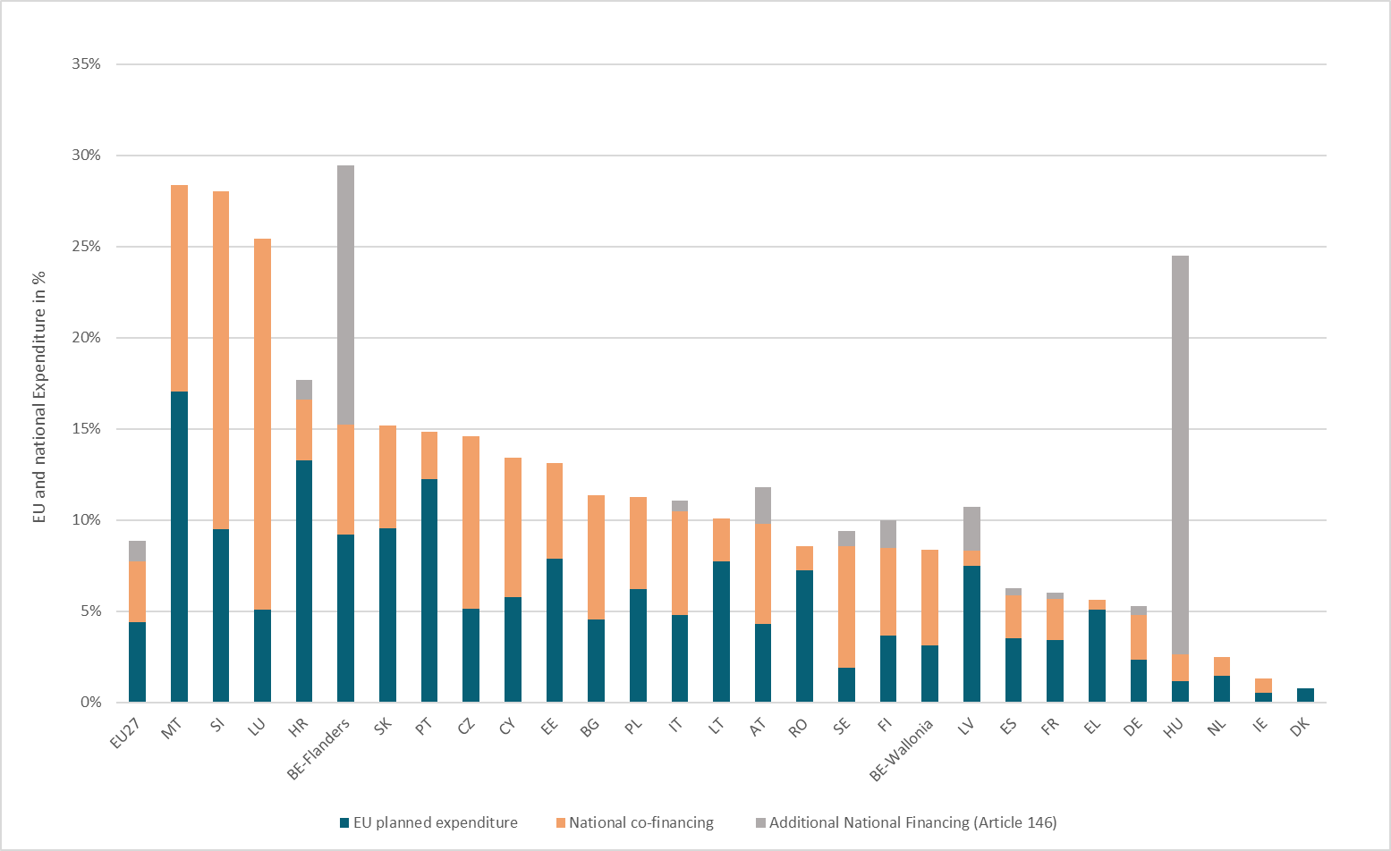
3. Levels of support and MS strategies (3)
Investment support to competitiveness by Member State (% total public funding)
Source : Project team 2023, based on ‘Catalogue of CAP interventions’’, DG AGRI (via AGRIDATA portal).

Slide 9
4. Young farmers and women
Essential for the vitality of rural areas
Key role in current and future farm competitiveness
Generational renewal:
A priority of the 2023-2027 CAP, with mandatory budgets (1.1-6.3%)
Access to land and capital, price of land etc. depend on national legislations
Gender: included in a new CAP specific objective (SO8)
Recognised by Member States (MS) – included in LEADER
Women in agriculture: targeted by a minority (8 MS) and only 1 MS considers female farmers under competitiveness (SO2)
Challenges of recognition, legal status, social security or access to land: depend on national legislations

Slide 10
5. CAP “tools” and indicators
The CAP: provides tools to support farm competitiveness
“Tools” diversely used by MS
Budget for knowledge exchange and cooperation remains small
Many aspects
Implemented outside the CAP: risk management
Beyond the scope of the CAP: access to land, social security, legal status of women farmers
Linked to other EU policies: Trade, Competition, Cohesion, Research
Productivity indicators (TFP and others)
Aspects not included:
Sustainability
Resilience

Slide 11
Recommendations (1)
Sustainability and competitiveness at the heart of future policies
Competitiveness indicators should integrate sustainability aspects
Investigate about potential benefits of moving from compensatory payments to rewarding payments for the production of public goods
Coherence with other EU and national policies
Assess tangible effects of policy coherence with other EU policies in biannual CSP performance reviews and strengthen coherence
Strengthen coherence between the CAP and national policies on generational renewal and gender
Future public interventions in rural areas should rest on global strategies in response to needs for the vitality of rural areas, including provisions for young farmers and women beyond agriculture

Slide 12
Recommendations (2)
Knowledge exchange and cooperation:
Actively promote CAP knowledge exchange and cooperation tools, central for CAP competitiveness despite constraint budget
New and digital technologies:
Provide an enabling environment for the adoption and use of suitable new and digital technologies by farmers
Risk management:
Design a comprehensive approach to risk management supported by knowledge exchange and in collaboration with farmers

Slide 13
Thank you for your attention!

