Slide 1
Forest Fires of Summer 2022 – Lessons to Draw from the Cohesion Policy Response January 2024
Lindon Pronto
Pau Costa Foundation

Slide 2
Structure of the Presentation
  Overview of the severity and amplitude of the summer 2022 forest fires in the EU
  Overall mechanism of the EU response to tackle fires and the subsequent crisis management
  Use of Cohesion policy funds and EU Solidarity Funds
  Discussion and assessment of relevant funding impacts on wildfire management
  Further considerations
  Key policy recommendations and take-home message

Slide 3
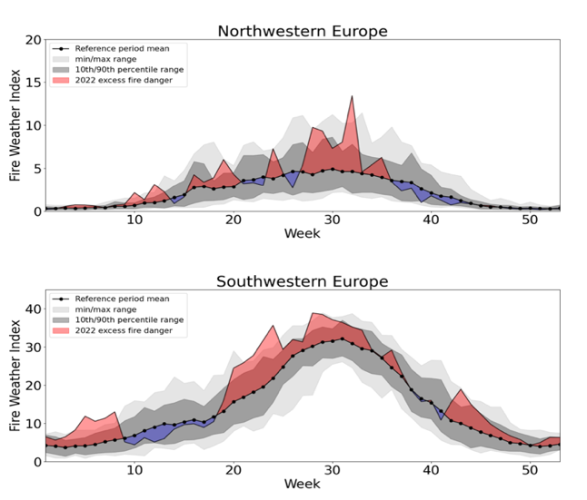
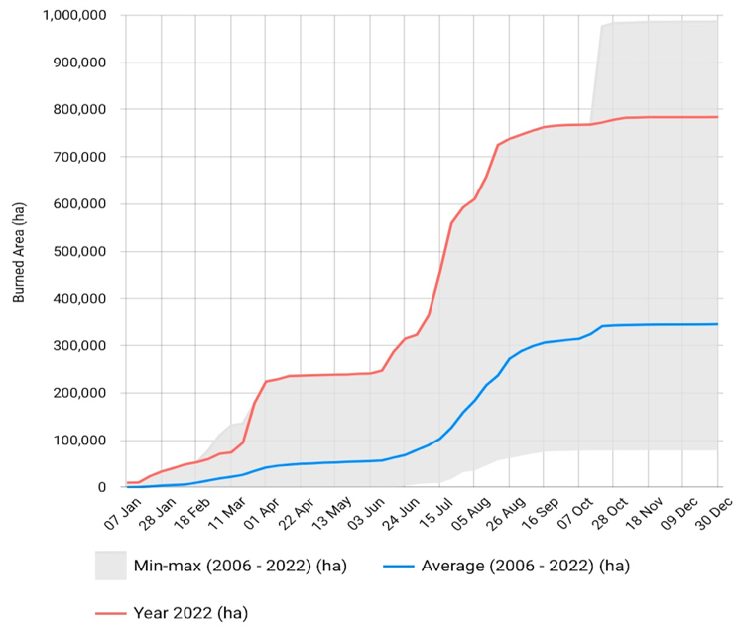
1. Overview of the severity and amplitude of the summer 2022 forest fires in the EU
Key Findings
Significant increase in wildfire activity, e.g., France, Spain, Romania, Germany, Czechia, and Slovenia, experiencing burned area 5-13 x 10-year average.
The total burned area equivalent to more than three times size of Luxembourg.
Traditionally non-fire prone environments (i.e., the alpine region) and countries (e.g., Germany and Czechia) experienced not only large fires, but also extreme fire behaviour posing containment challenges.
Fire Weather Index weekly average anomalies for European regions in 2022 (excess)
EFFIS Cumulative weekly area burned

Slide 4
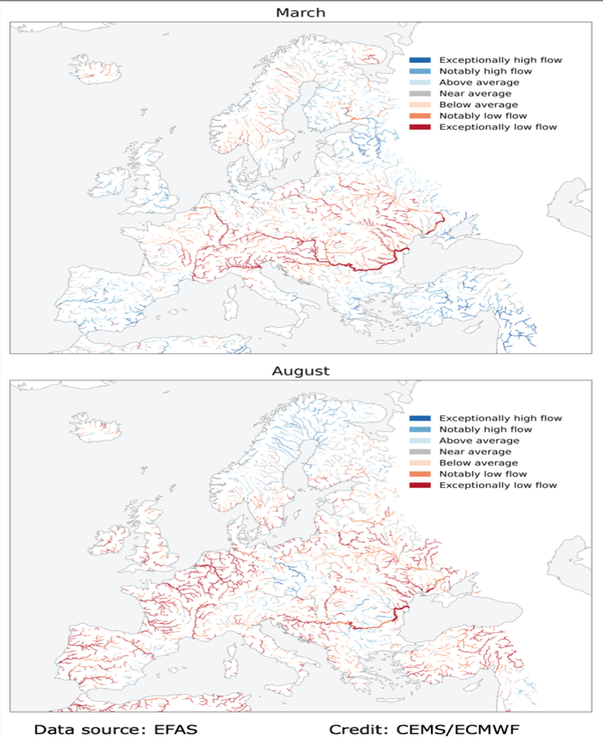
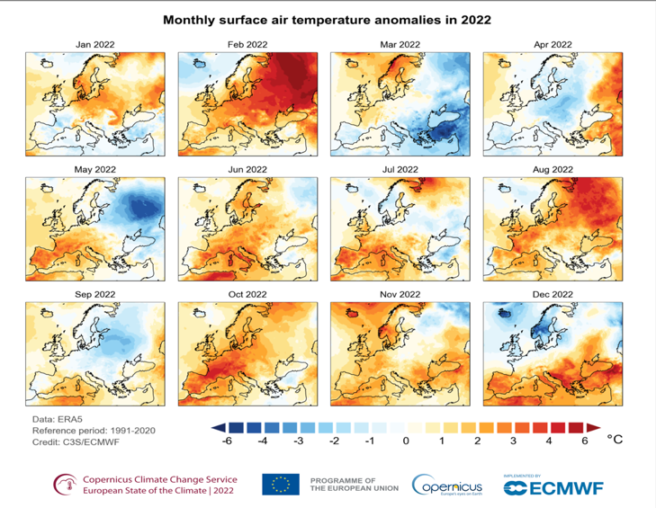
2022 driest year on record (area affected); 63% of rivers below-average discharge.
Prolonged heatwaves, early spring droughts (alps), wind patterns (Med), pyro-cumulonimbus columns (Iberian Pen.).

Slide 5
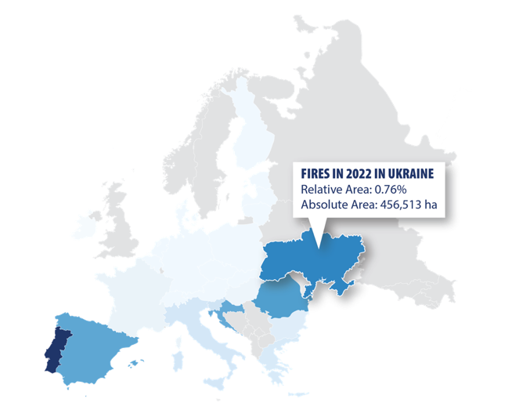
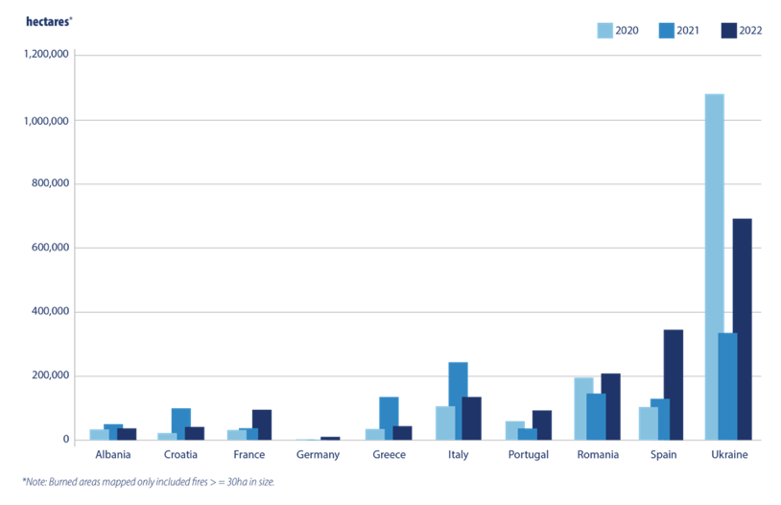
Key Finding
Regions with unexploded ordinances (UXO) very affected, with big concerns raised by incidents in Slovenia, Germany, and heightened risks in conflict zones like Ukraine which was the 2nd most burned country in Europe in 2022.

Slide 6
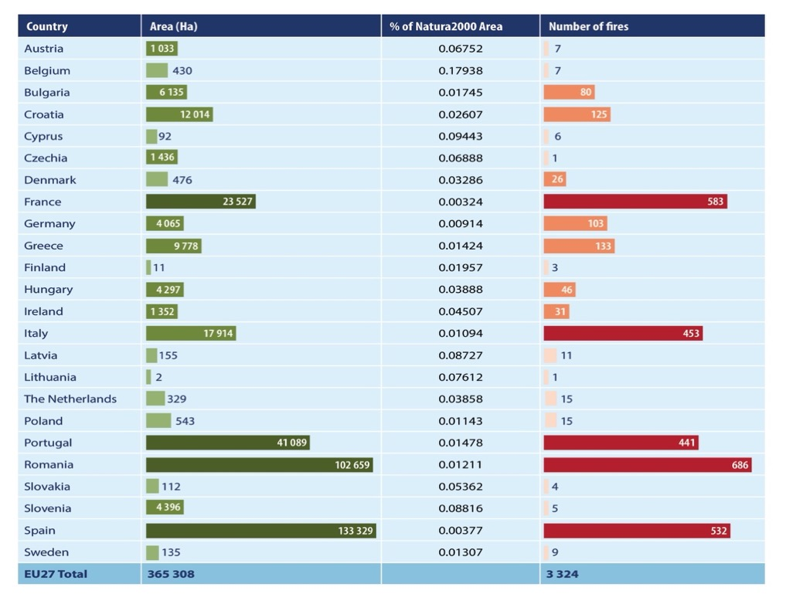
Key Finding
Natura2000 sites disproportionally affected. Protected areas lack comprehensive fire management strategies
Total burned area and number of fires in Natura2000 sites
Source: PCF with data from the JRC.

Slide 7
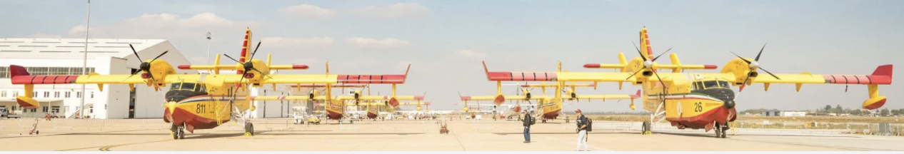
2. Overall EU response to tackle fires and subsequent crisis management
Key Findings
In 2022 UCPM responded to many wildfire activations, leveraging resource pooling and fast responses; however, inconsistent training among other, emerged as challenges
As the EU bolsters its rescEU firefighting fleet, it's crucial to also enhance operational management and coordination capabilities of MS to ensure safety and efficacy.
DG-ECHO's Knowledge Network is a new initiative to centralize DRR activities, preserve project outputs, support collaboration, training, and community engagement.
Europe's varied operating standards hinder a unified firefighting response, pilot programmes under the ERCC emphasized the benefits and challenges of cross-training and cooperation, underscoring the need for a standardized framework and training before facing high-risk wildfire situations.

Slide 8
3. Use of Cohesion policy funds and EU Solidarity Funds
Key Findings
The Cohesion Policy framework includes several funds, four of them are being used to directly support wildfire risk management:
Cohesion Fund: during the cycle 2014-2020 Poland, Portugal and Hungary used funds for wildfire risk reduction and fire management; the 2021-2027 programme more clearly supports investments in wildfire management.
Interreg programme: clear impact of Interreg on wildfire risk reduction, e.g., cross-border Interreg Spain-Portugal, funded 11 projects directly addressing wildfire management.
EU Solidarity Fund: between 2002-2022 the fund was used for the recovery efforts of 8 wildfire events in Europe, however, none since 2017.
European Regional Development Fund: during the cycle 2014-2020 a total of 17 European regions have benefited. The 2021-2027 cycle expands funding on disaster risk management to 15 countries; which countries will invest in wildfire risk reduction is unclear

Slide 9
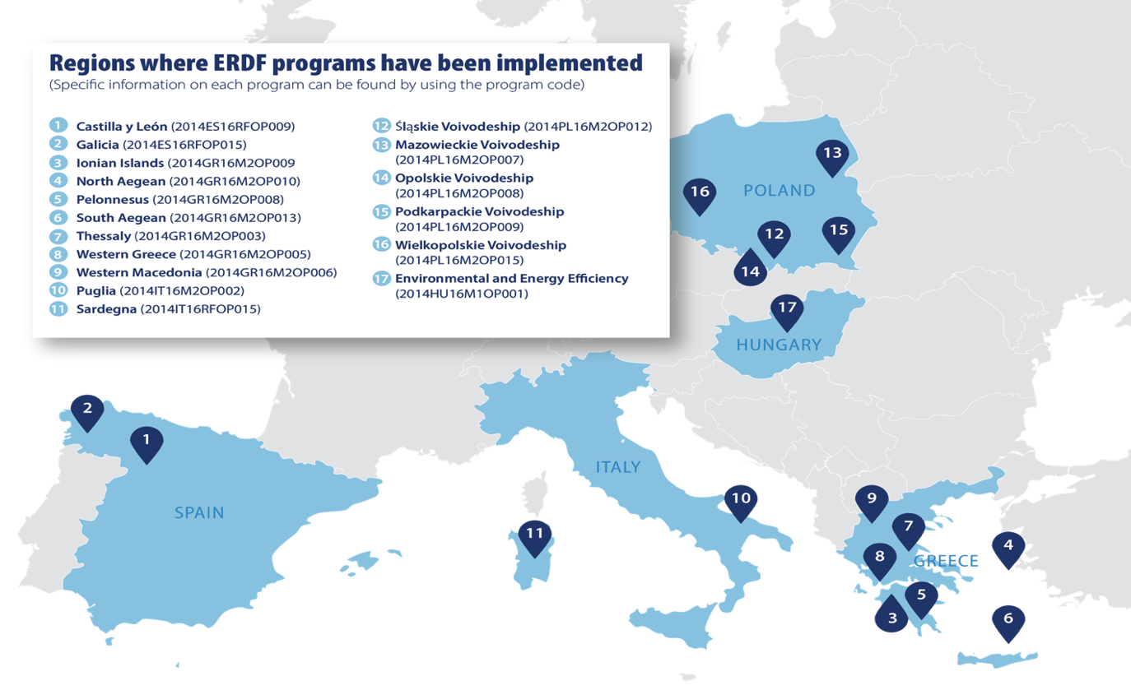
Source: PCF with data from EU Cohesion website.

Slide 10
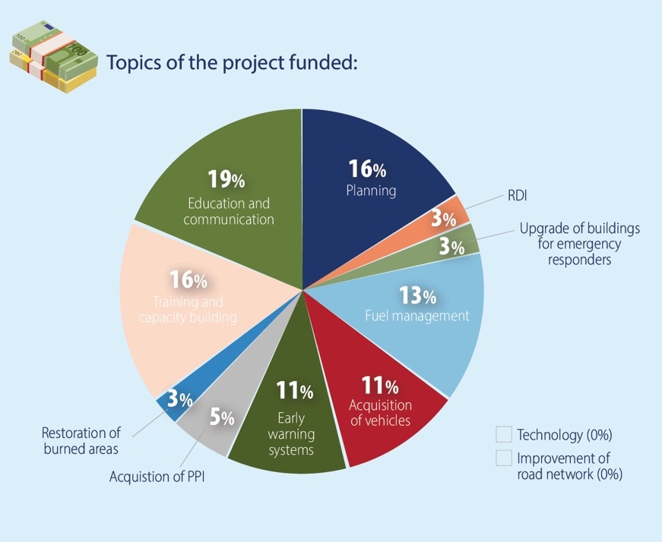
Holistic approach:
Source: PCF with data from EU Cohesion website.

Slide 11
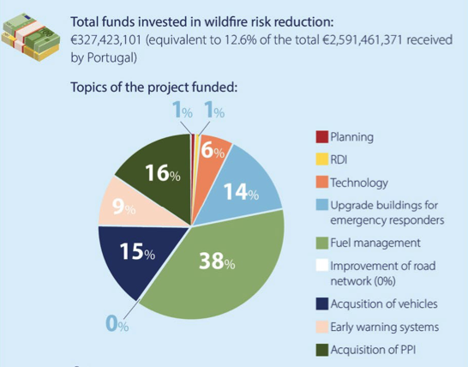
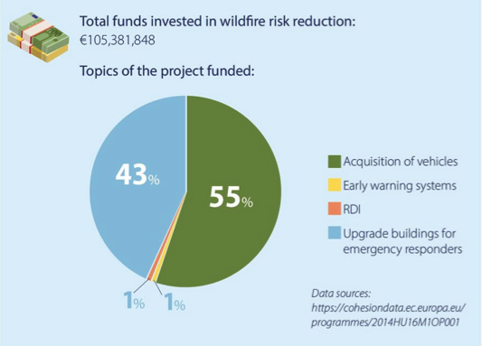
Comprehensive approach:
Simple approach:
The Cohesion Policy funding did not have a direct impact on the 2022 fire season. However, investments since the 2014 cycle have contributed to reducing the risk of extreme wildfires by building capacity for response systems, implementing landscape management approaches, and raising risk awareness amongst the population.
Source: PCF and Cohesion Funds website

Slide 12
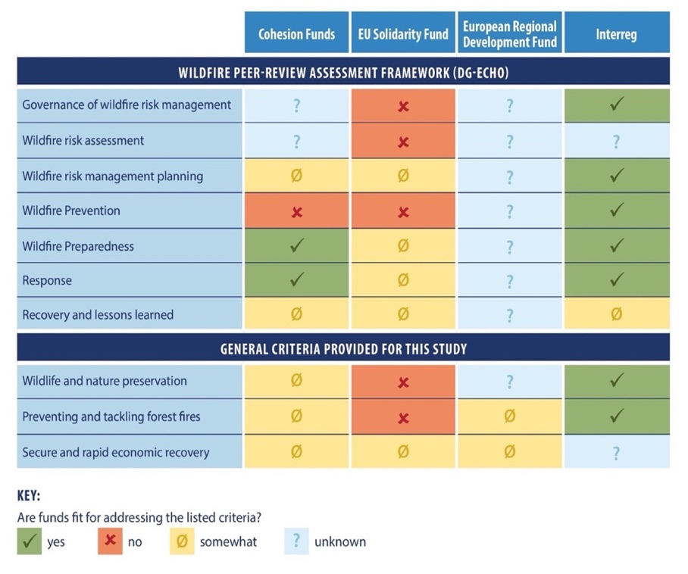
4. Discussion and assessment of relevant funding impacts on wildfire management
Appropriateness of evaluated funding schemes fit to Integrated Fire Management
Source: PCF (authors analysis). Note: Based on the available information, the table analyses the perceived current appropriateness of the Cohesion Policy to ensure wildlife and nature conservation, prevent and tackle forests fires, and secure a rapid economic recovery offering a suggested level of fitness for each relevant policy/ fund based on how funds were used.

Slide 13
Key Findings
Management of Cohesion Policy funds between the EU and national agencies difficult to understand, access, and properly use, reducing potential impact on wildfire management.
Wildfire management expertise lacking within ministries / agencies responsible for designing and implementing programmes leading to oversimplified investments that only focus on preparedness and response.
Measures for fire detection and response well-funded, but net impact on nature preservation is unclear. More burned protected areas indicate wildfire risks not mitigated.
Experts advocate for more proactive measures like fuel management and prescribed fire application, to ensure a balanced approach: prevention and landscape resilience over mere fire suppression.
Adequate training and capacity building is lacking; only a few countries (e.g., Spain, Croatia, and Portugal) assess firefighters as being adequately trained for current / future wildfire challenges and many countries expressed concerns about over-dependence on aircraft or water-based approaches.

Slide 14
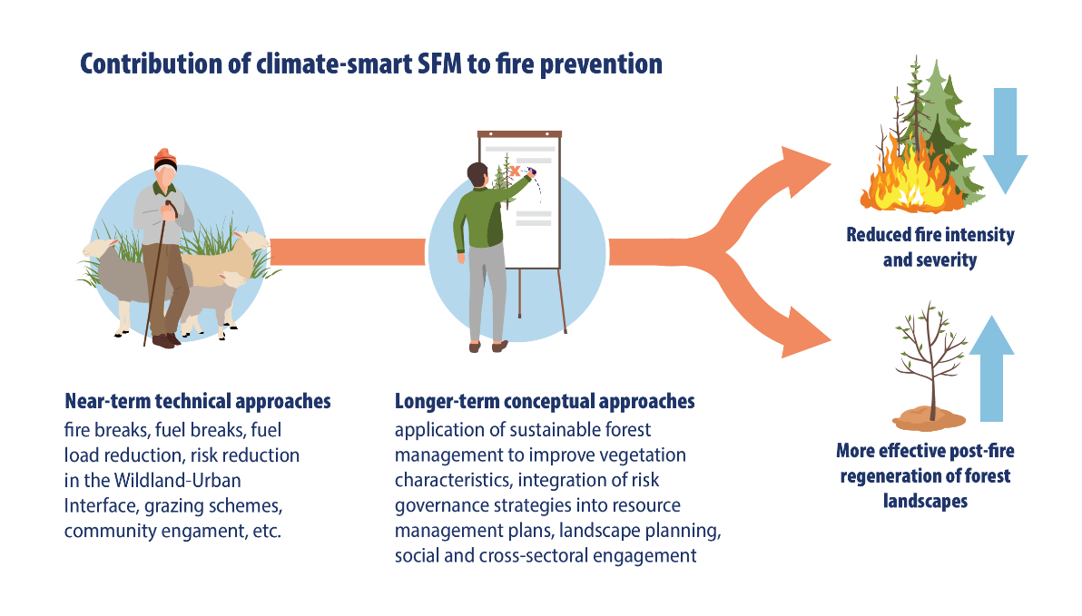
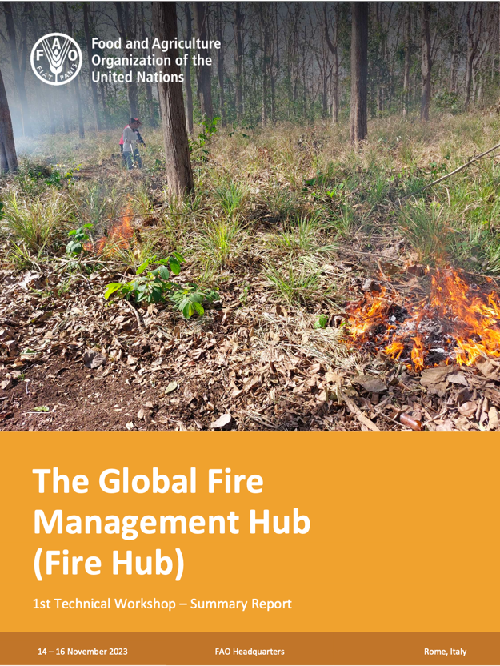
5. Further considerations
Key Findings
European Institutions should align funding instruments to work closely with accumulated expertise of international organizations and other institutions in fire management.
Climate-smart Sustainable Forest Management contributes to fire prevention, reduces fire intensity and severity, and promotes faster and more effective post-fire regeneration.

Slide 15
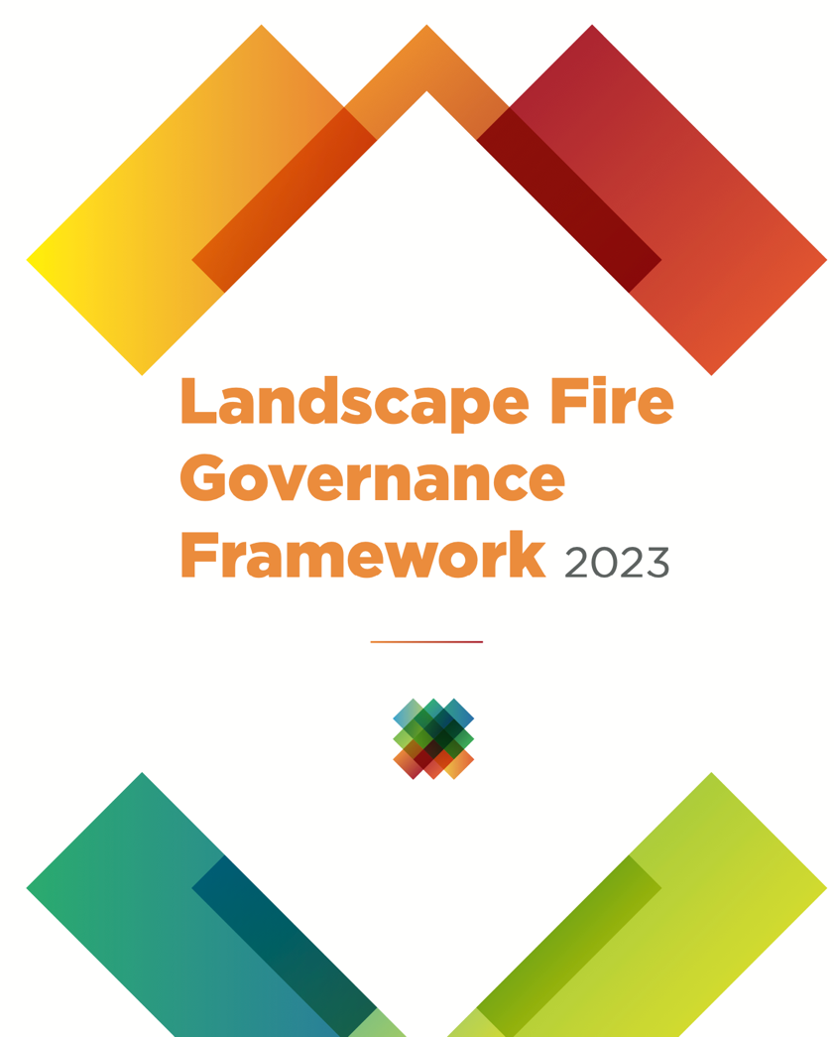





Five Priorities for Action of the Landscape Fire Governance Framework
Training and qualification
Strengthen the governance model
Value rural areas
Actively manage rural areas
Change attitude and behaviour

Slide 16
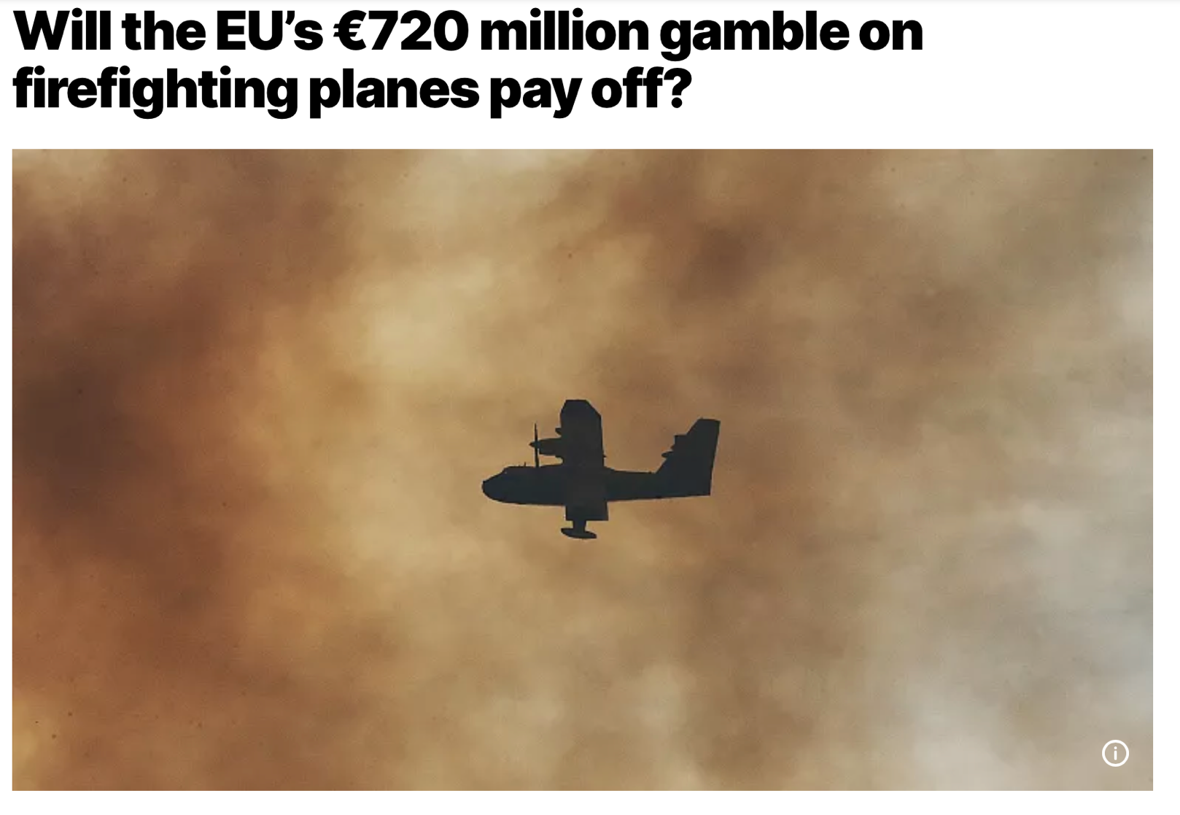
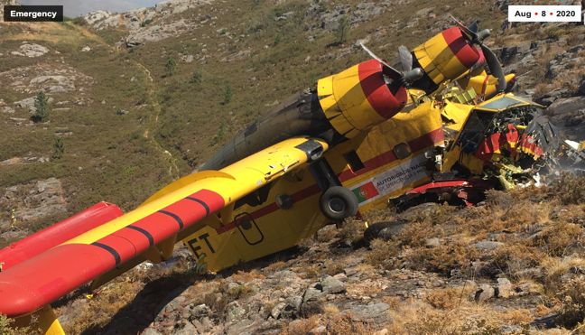
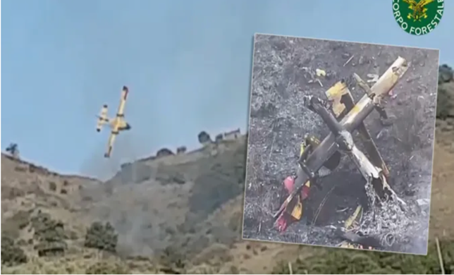
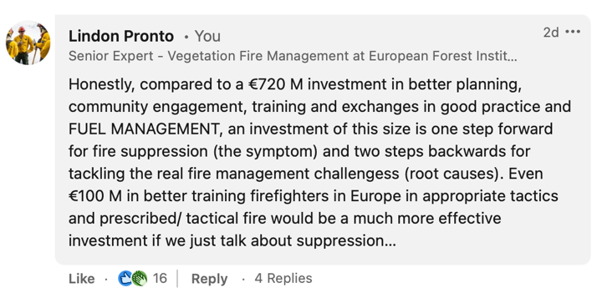
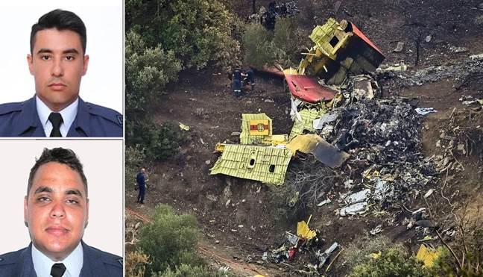
Costs
Portugal, 2020
Italy, 2022
Greece, 2023

Slide 17
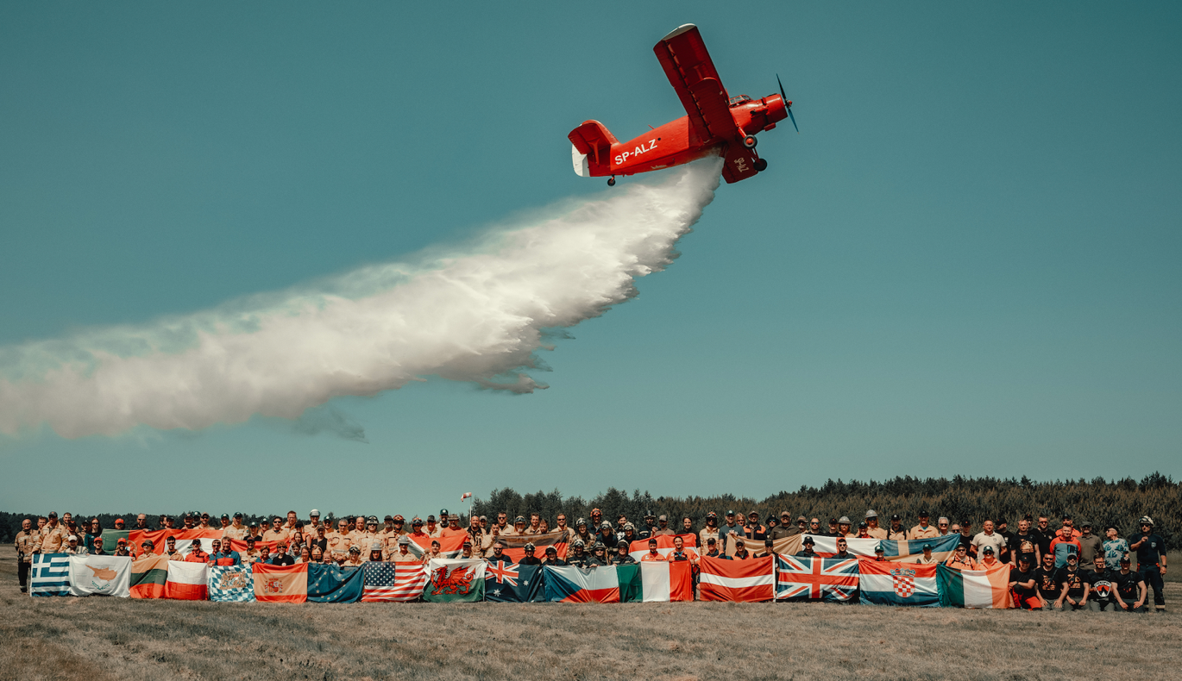



Power and necessity of networks and exchanges
22 countries
5 continents
120 participants
Friendships, networks, learning, growing together.
Nobody died.

Slide 18
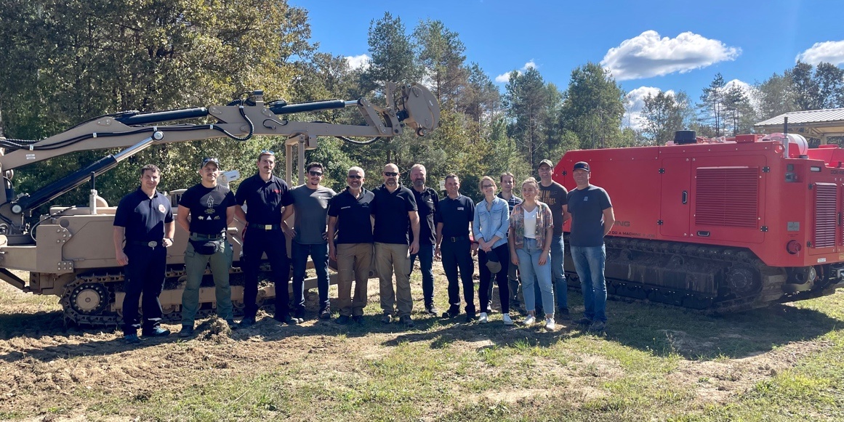
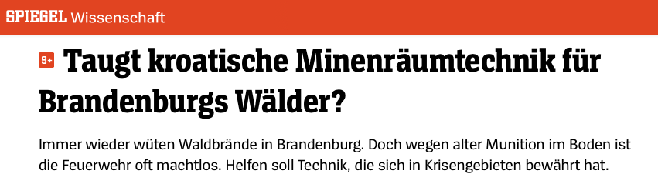
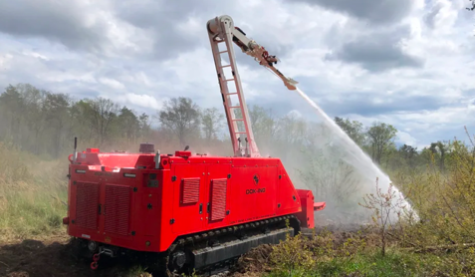
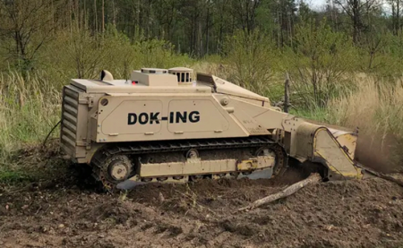
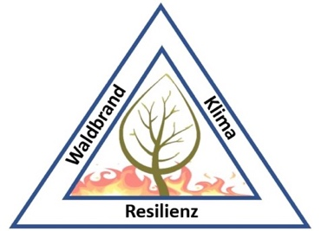
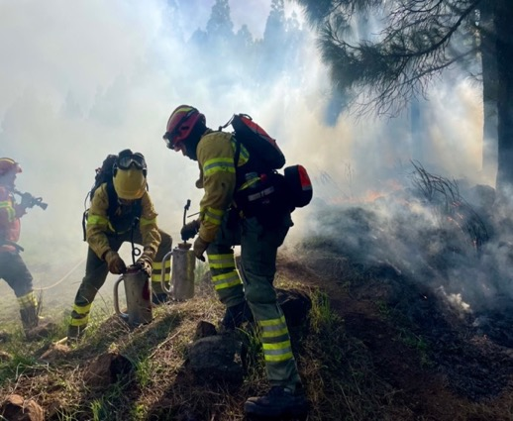
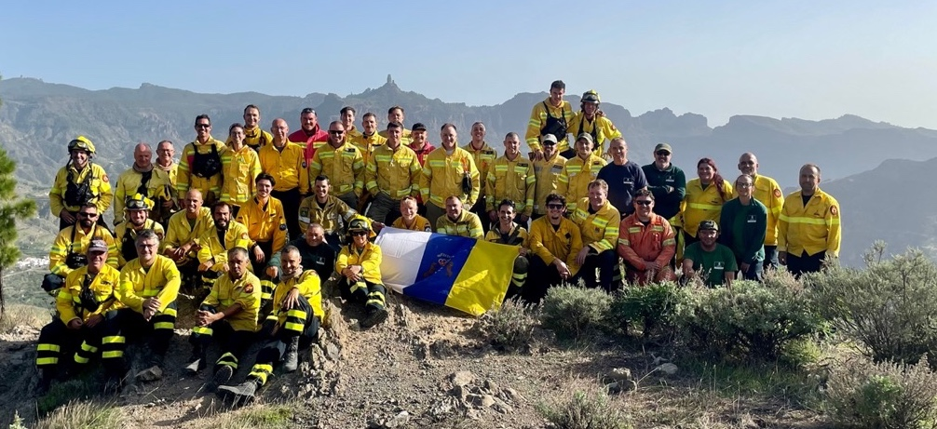
Measurable impact

Slide 19

Where to invest?
Assuming the 5 Canadairs above never fly… they cost ca. €300M
30K Exchange of Experts in Croatia benefitting 300K experts
10K week-long prescribed fire training courses (25 ppl) in Gran Canary and 250K people trained in the use of fire
Prevention vs. response
Times 4-16x
Adjusted potetial relative impact:
120K – 480K Exchange of Experts to Croatia beneffiting 1.2M – 4.8M experts
40K – 160K Prescribed burning trainings in Gran Canary resulting in 1M – 4M people trained in prescribed burning and tactical fire application

Slide 20
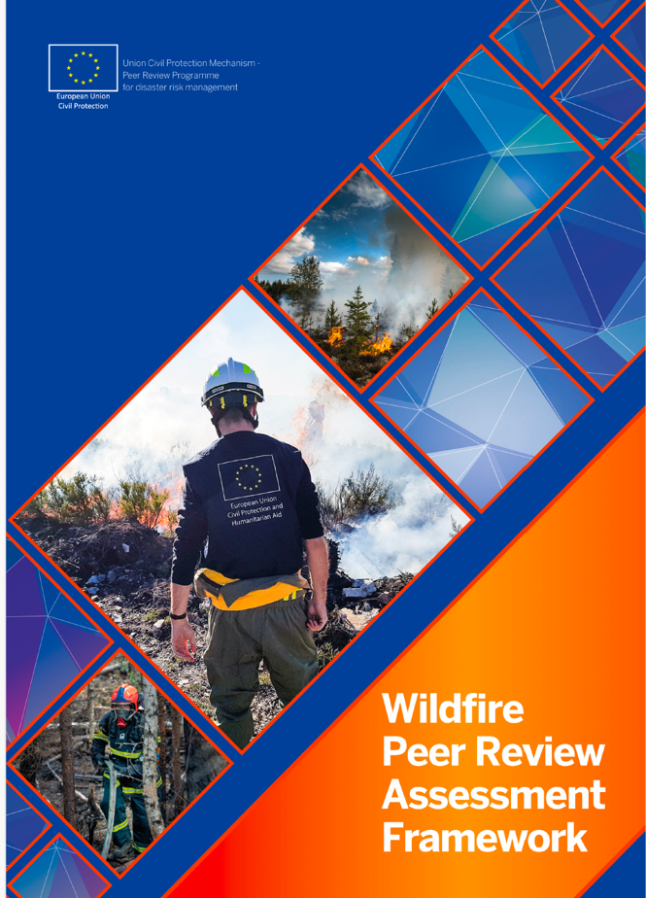
6. Key policy recommendations
Ensure access to wildfire expertise for ministries and national agencies to facilitate impactful and sustainable investments in wildfire risk reduction and support integrated fire management at landscape level across diverse stakeholder groups.
Prioritise mid- long-term risk reduction investments and strategies over preparedness and response capabilities mostly in the form of equipment.
The “Build Back Better Approach” of the Sendai Framework must be adopted to enhance resilience against future disasters (i.e., EU Solidarity Fund).
Enhance coordination among funding mechanisms and with other EU instruments related to wildfire management.
Promote multi-stakeholder approaches by funding cross-cutting initiatives in integrated wildfire management (IFM).
Tailored guidance for new fire-prone countries.
Ensure adequate funding for wildfire governance support provided through DG-ECHO (e.g., Wildfire PRAF)

Slide 21
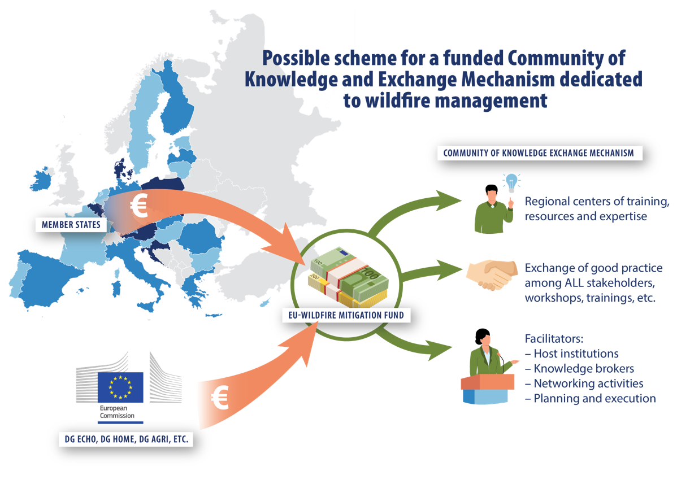
Expand the scope of the DG-ECHO Expert Exchange Programme to include important fire management stakeholders outside of only civil protection authorities.
Develop guidelines for safe and effective prescribed and tactical fire use
Promote international collaboration and highlight good practices; collaborate with relevant organizations, support global initiatives like the Global Fire Management Hub
Invest in/develop training and standardization frameworks for safe operations.
Establish a European Wildfire Mitigation Fund as a dedicated sustainable fund for capacity development (trainings, exchange of experts, study tours, workshops, etc.) focused on civil society actors, NGOs, institutions, and networks addressing integrated fire management at the landscape level.

Slide 22
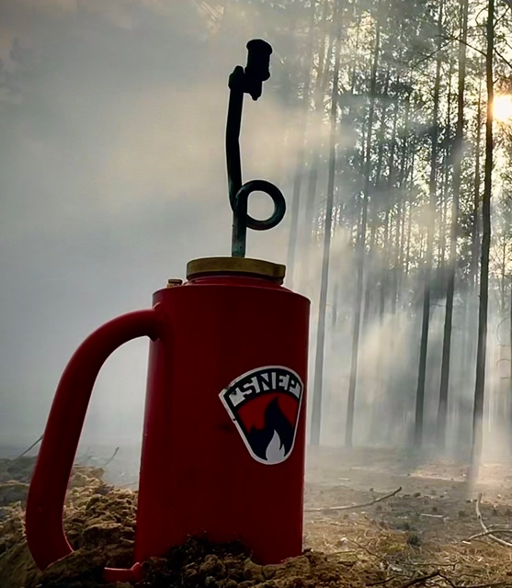

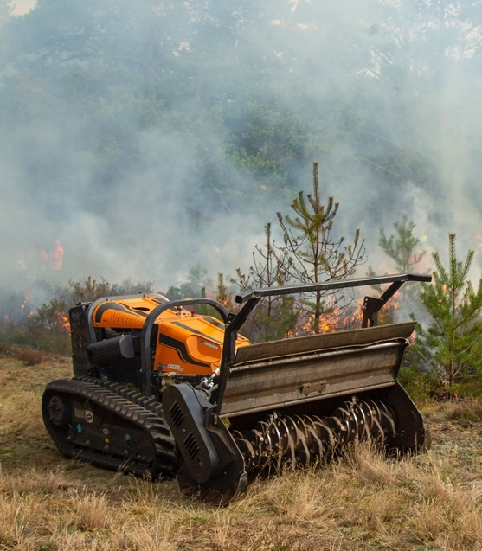
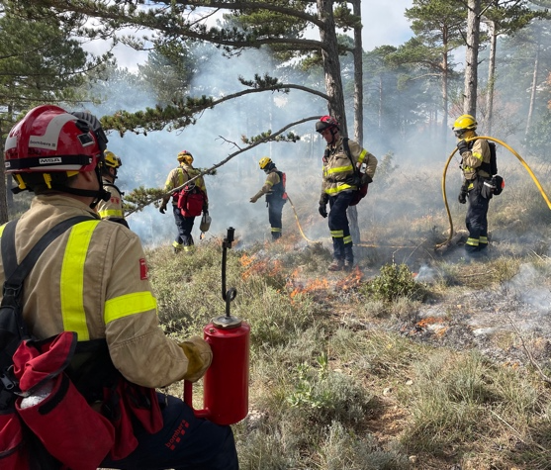
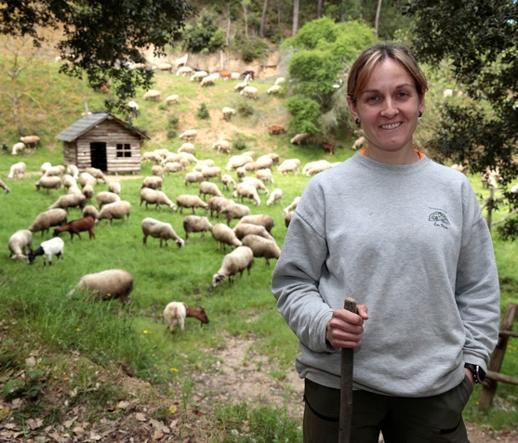
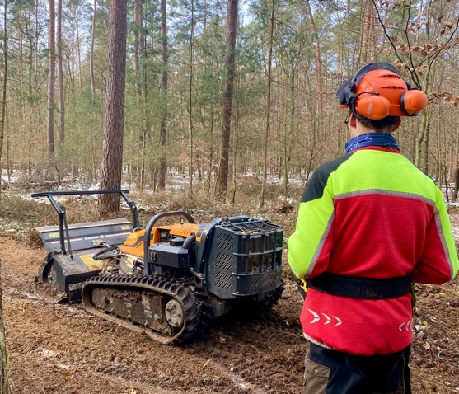
Invest in the landscape: Vegetation management

Slide 23
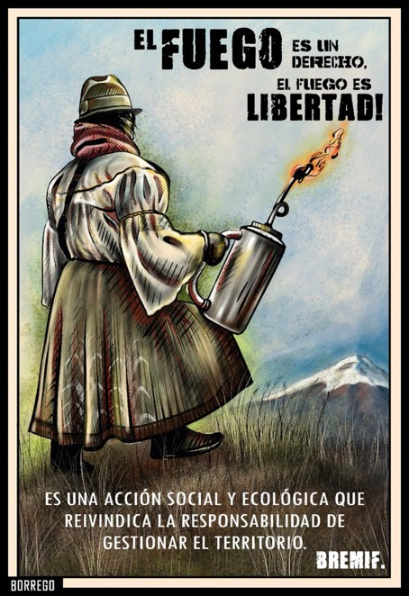
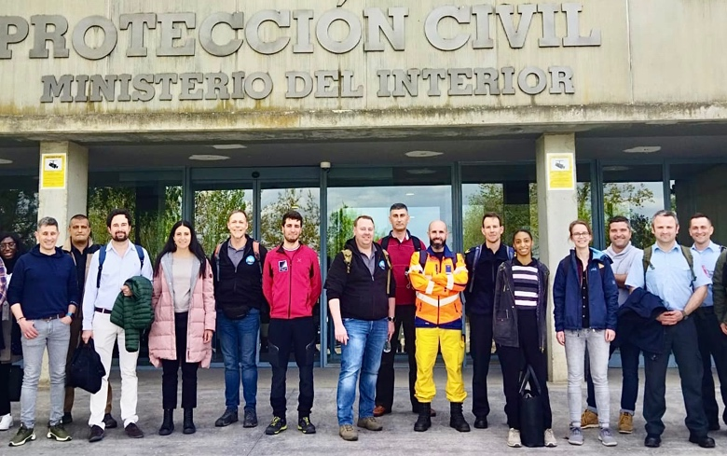
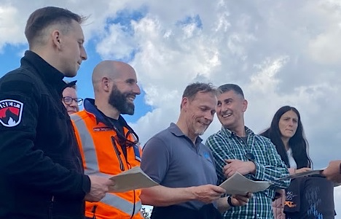
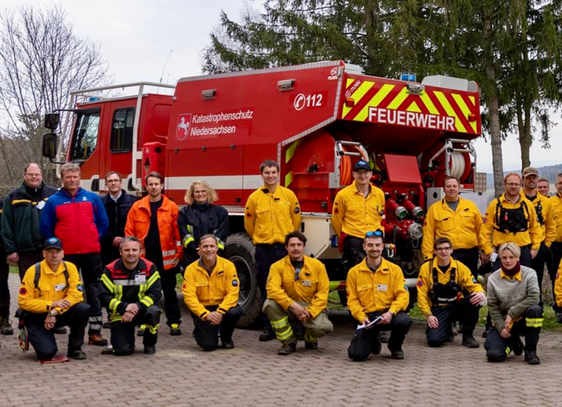
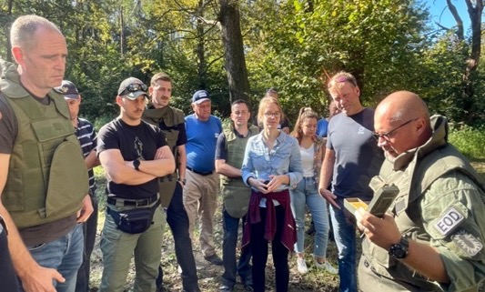
Invest in the people: Capacity development
Identify great ideas… but invest in PEOPLE
Informed, empowered, and inspired people produce and apply great ideas!

Slide 24
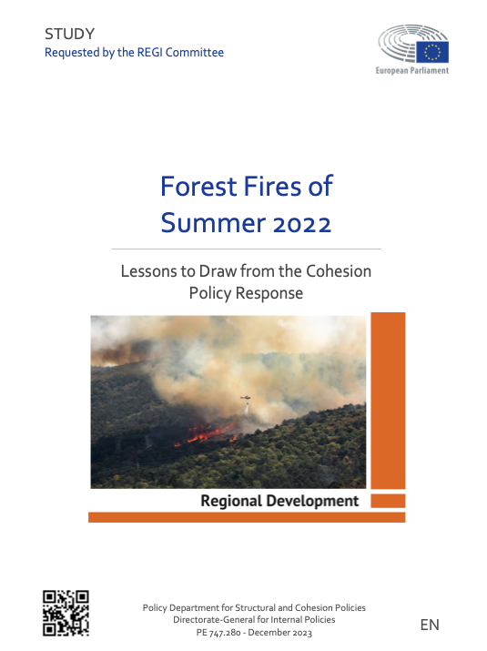
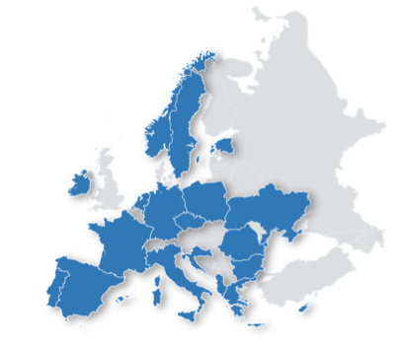
Thank you kindly for your attention!
AUTHORS
Pau Costa Foundation: Lindon PRONTO
Contributing authors: Nuria PRAT-GUITART (Cohesion Funds), Juan CAAMAÑO /PCF (fire meteorology, UCPM response), Laurent ALFONSO / DGSCGC (France case study), José ALMODOVAR and Nicolas Lopez MOLINA (Spain case study), Petr OŠLEJŠEK / HZSCR (Czech case study), Nicolas FAIVRE / REA (EC investments in fire research), and Jordi VENDRELL/PCF (summary of PCF Declaration). Graphics: Jodie WATT for Pau Costa Foundation
STUDY METHODOLOGY
An expert survey of 17 EU member states and Albania was conducted representative of diverse contexts.
Additional experts from European institutions and international organisations were interviewed.
Three case studies were prepared with help from authorities from France, Spain and Czechia.
Expertise and experience of the study team was integrated into the findings and policy recommendations.

