Slide 1
Protecting cultural heritage from armed conflicts in Ukraine and beyond
Dr. Evelien Campfens & Dr. Dmytro Koval

Slide 2
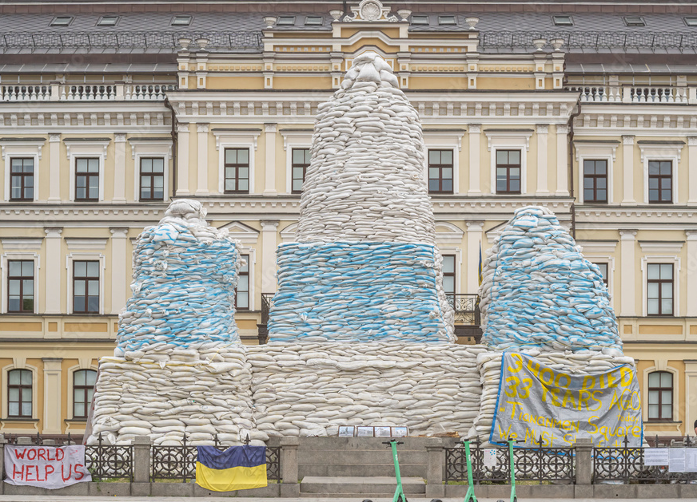
Structure of the Presentation
Introduction: threats to cultural heritage (CH)
Background: the situation in Ukraine
Main findings
Recommendations

Slide 3
Introduction: threats
Cultural heritage is a broad concept. CH is often targeted and may even be at the centre of armed conflicts. Distinction can be made between:
Movable heritage Cultural goods, such as artefacts or archives. “Where there is a war there is looting”. Such objects often appear on the market much later (e.g. Iraq, Syria, Cyprus).
Immovable heritage Built structures, such as historic monuments or religious buildings. Destruction in 2012 of historic mosques, mausoleums and shrines in Timbuktu, Mali, gave rise to the prosecution by the International Criminal Court (ICC).
Archaeological sites Archaeological sites are vulnerable in times of armed conflict, either as collateral damage or for financial gain. The last because there still is a market for unprovenanced antiquities.
Intangible (living) heritage E.g. traditions, customs and forms of artistic expression. “Attacks on one form of heritage are often accompanied by assaults on the other, and it is because heritage are living resources that have meaning for people that their destruction goes deeper than the dismantling of the stones that form them.” [UN Special Rapporteur for Cultural Rights, A. Xanthaki}

Slide 4
The dynamics of threats to CH in Ukraine
The attacks unfolded against the background of neo-imperial rhetoric
“Crimea, ancient Korsun, Khersones, Sevastopol - all of them bear an enormous civilisational and sacral meaning for Russia, just as the Temple Mount of Jerusalem does for those who profess Islam and Judaism.” [President Putin, 2014]

Slide 5
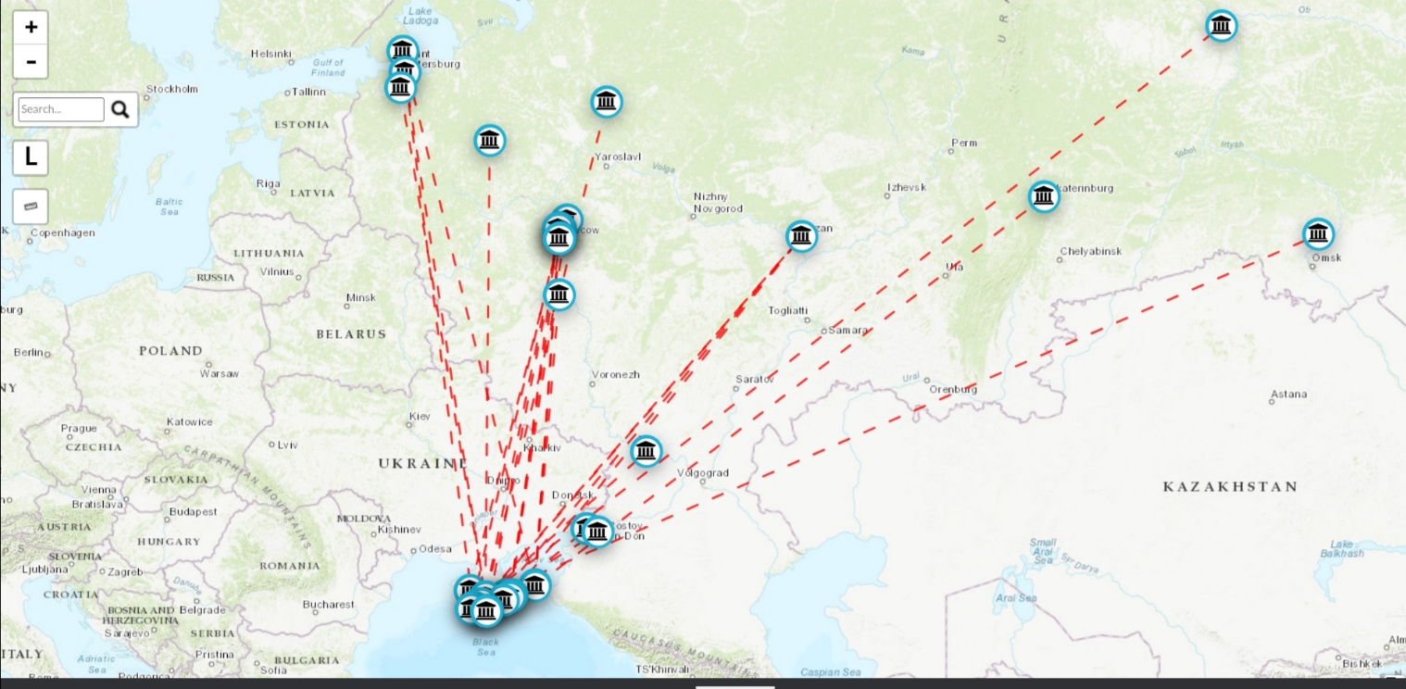
Movable cultural heritage
Export of cultural objects from Ukrainian occupied territory to Russia:
2016 Aivazovsky exhibition at Tretyakov Gallery (38 artefacts from Crimea)
2017 Panticapaeum and Phanagoria exhibition at Pushkin museum
Pillage by Russian forces or its proxies of at least 40 museums as of October (e.g., 2000 artworks from Mariupol museums).
Known cases of export from Crimean museums [source: Crimean Institute for Strategic Research]

Slide 6
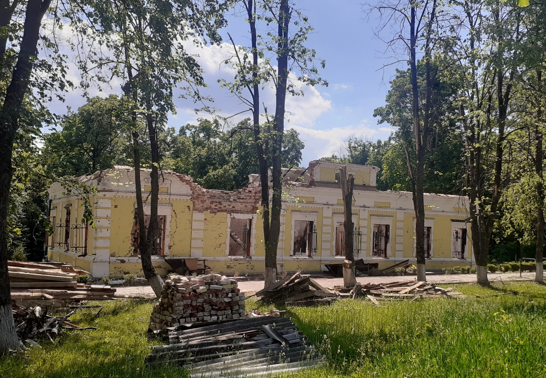
Immovable cultural heritage
Destruction:
Extensive destruction of built heritage in cities Chernihiv, Mariupol, Kharkiv, Sumy
Direct attacks on institutions and monuments of symbolic importance to Ukraine (Skovorodynivka, Sviatohirsk, Ivankiv)
Misuse:
Validation of Russian historic metanarratives
Undermining the evidences of the presence of other ethnic groups in the occupied territories
Museum in Skovorodynivka [photo made on Truth Hounds’ field mission]

Slide 7
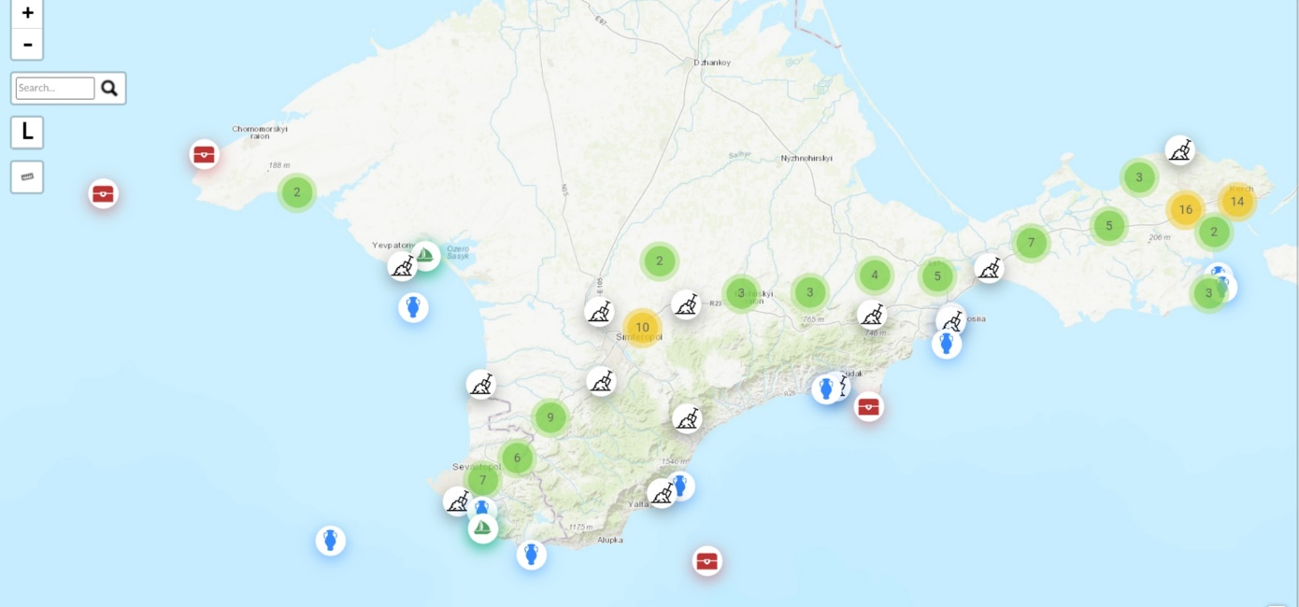
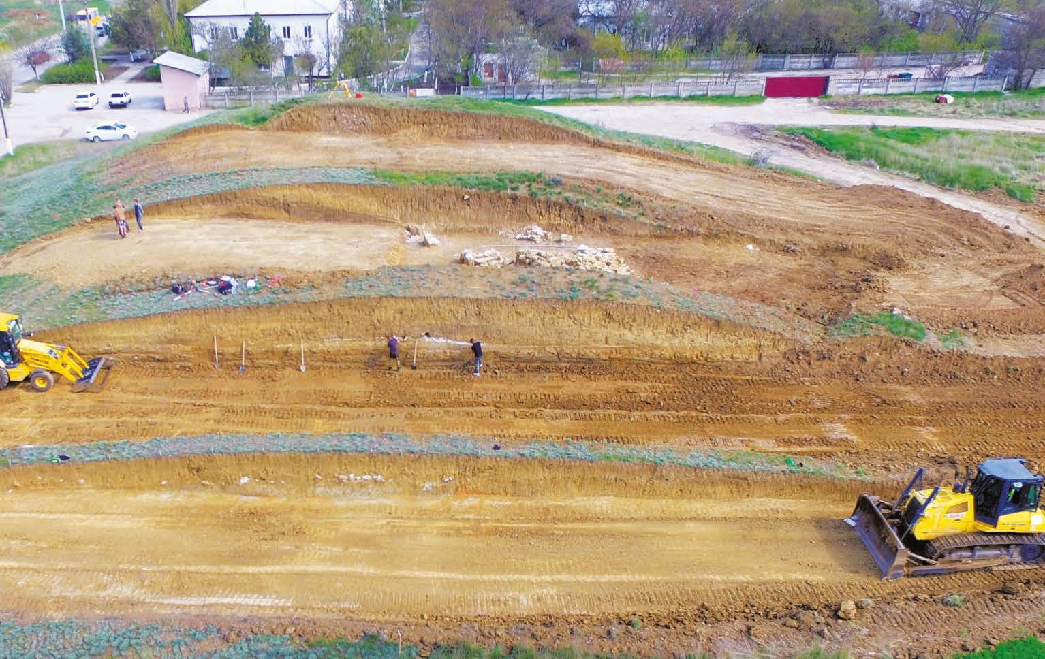
Archeological sites
Conducting unnecessary and unlawful excavations in occupied territories (410 instances reported in Crimea in 2014-2020). Consequences:
Unavailability of data for Ukrainian or foreign research institutions
A selective study of materials that serves the Russian historic metanarrative
Map of unlawful excavations [Crimean Institute for Strategic Research]
Unlawful excavations of the burial mound “Hospitalny”

Slide 8
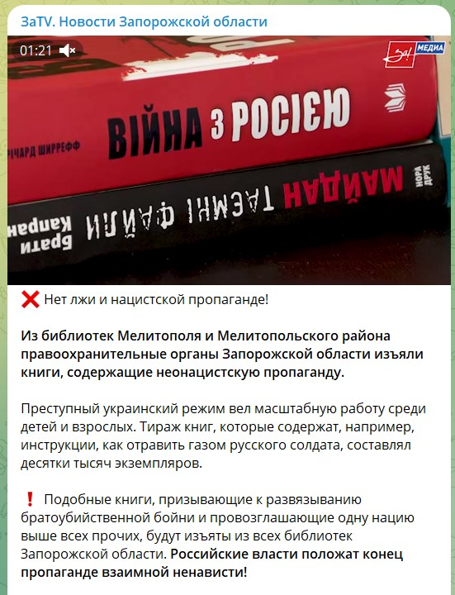
Intangible cultural heritage
Eliminating Ukrainian literature and history from school curricula
Russification and militarization of the educational space
Impeding the enjoyment of the right to take part in cultural practices inspired by religion
Threats to languages (as vehicle of intangible cultural heritage)
Message on Russian telegram channel calling for a ban of Ukrainian books

Slide 9
Main findings
What are the threats? Cultural heritage is a vehicle of cultural identity. Hence, it may be damaged for military but also for ideological reasons. Breakdowns in the rule of law also lead to looting for economic gain.
Why protection? Destruction and looting of cultural heritage are widely acknowledged as threats to the sustainable development of societies and to peace and security. Besides, the trade in ‘conflict antiquities’ is linked to organised crime and terrorism.
What rules apply? Legal protection has a solid basis in international law: it is covered by humanitarian law, human rights law, cultural heritage law and criminal law. Besides, EU law and policy apply (e.g., Regulation (EU) 880/2019). The legal framework, however, is fragmented.
How does international aid operate in Ukraine and beyond? International initiatives in Ukraine are numerous, and many actors are involved with overlapping mandates. Also at the EU level fragmentation creates a challenge to a coherent EU policy.
This calls for action by the EU and its Member States

Slide 10
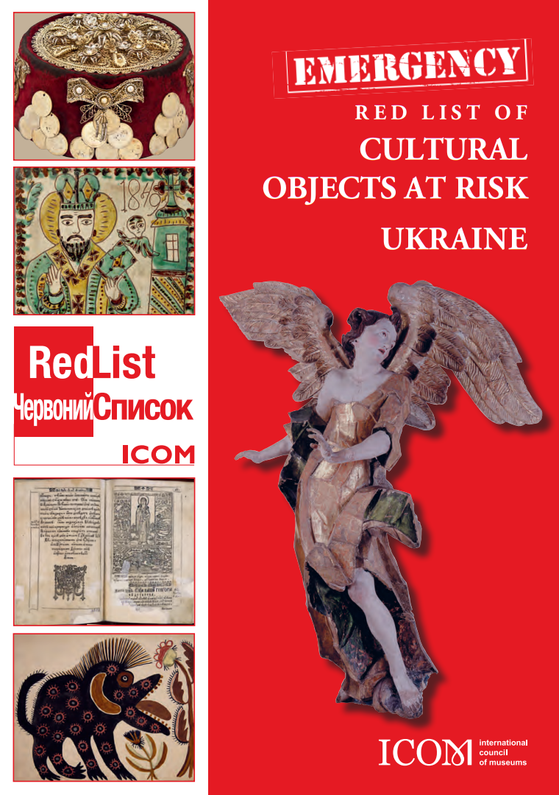
How to protect CH better?
More attention for preparatory measures by states
> Measures to protect domestic cultural heritage (e.g., by preparing inventories and emergency plans)
> Measures to protect foreign cultural heritage (e.g., by training law enforcement and by adopting laws and measures to intercept looted cultural objects).
Integration of emergency relief measures
Cultural heritage protection needs to be better integrated within the system for humanitarian aid, as well as peacekeeping mechanisms.
Set up an (independent) monitoring system Monitoring of the impact of armed conflicts on cultural heritage would enhance: > accountability (e.g. prosecution of crimes) as well as > post-conflict peacebuilding efforts.

Slide 11
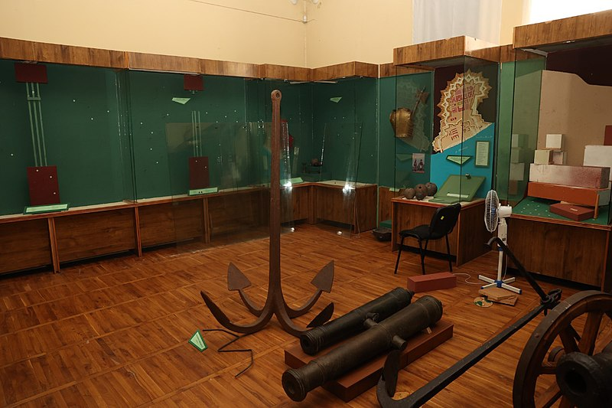
Recommendations (6 sets)
Address emergencies in Ukraine: - Address gaps in emergency relief (e.g., digitization of inventories) - Support a clear strategy for post-war recovery in Ukraine - Raise awareness on looted cultural objects from Ukraine - Protect the cultural rights of Ukrainian refugees
Close the accountability gap for CH crimes:
Ensure the independent monitoring of attacks to CH
Ensure consideration of heritage-related crimes by the Joint Investigation Team, and prepare legislation for prosecution
Adopt measures to prevent that EU entities support institutions or persons that engage in the unlawful removal of cultural objects or excavations of archeological sites

Slide 12
Recommendations
Coordinate measures and policies at the EU level: - Establish a dedicated EU body for the protection of CH - Integrate CH protection into the broader field of, e.g., humanitarian aid - Coordinate matters concerning the illicit trade - Regulate the issue of safe havens to safeguard collections from conflict zones
Ensure preparatory measures in EU Member States: - Support the setting-up of inventories and their digitisation - Support the development of (emergency) preparedness policies - Promote the setting-up and training of (sizeable) dedicated units in the military and law- enforcement, including border control.

Slide 13
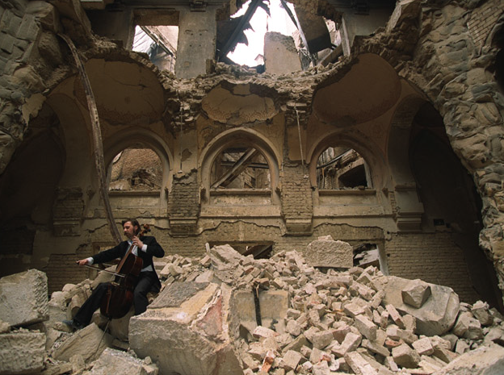
Recommendations
Address the illicit trafficking in cultural objects from conflict zones: - Raise awareness that looted cultural objects circulate on the EU market - Introduce mandatory due diligence standards for the trade in cultural goods, to mitigate the risks of looted cultural objects from conflict zones being traded - Create an open access database of national legislation pertaining to cultural heritage (or support an update of the UNESCO database)
Focus on community participation and memorialisation in recovery phase: Ensure that local communities are involved in decision-making processes of recovery and reconstruction

Slide 14
Thank you for your attention
Q&A

