Slide 1
Children’s digital practices in home and school contexts
Presentation for the Committee on Culture and Education (CULT) at the European Parliament
1st March 2023
Rosanna Di Gioia, Joint Research Centre
Directorate T - Digital Transformation and Data
Unit T.2 - Cybersecurity and Digital Technologies unit

Slide 2



Science for policy
ANTICIPATE
Our purpose
The Joint Research Centre provides independent,
evidence-based knowledge
and science, supporting
EU policies to positively
impact society.
INTEGRATE
IMPACT

Slide 3
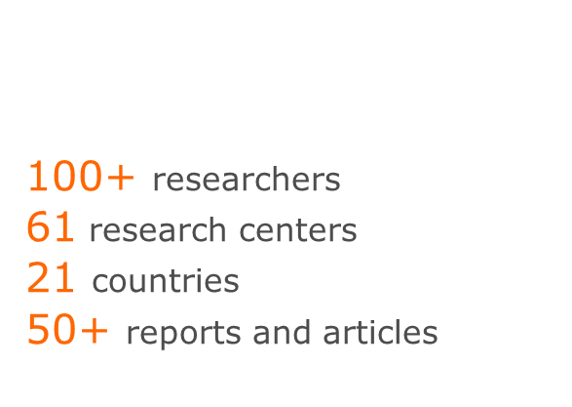
Cybersecurity for citizens
Studies coordinated by
Rosanna Di Gioia and Stéphane Chaudron in collaboration with:
YOUNG CHILDREN’S DIGITAL ENGAGEMENT
CHILD-FRIENDLY & CREATIVE TOOLS
To raise awareness of online safety, data protection rights and privacy risks for young citizens and adults
Understanding young children’s digital engagement (0-8)
IMPACT OF DIGITAL TECHNOLOGY ON OUR FAMILIES' LIFE
ARTIFICIAL INTELLIGENCE AND CHILDREN'S RIGHTS
Views and perspectives of young people on Artificial Intelligence (AI) and its impact on children’s rights
New ecosystems in Covid-19 times
PREVENTING AND COMBATING CHILDREN'S EXPLOITATION AND ABUSE
Help seeker and perpetrators prevention initiatives
2013
2023

Slide 4
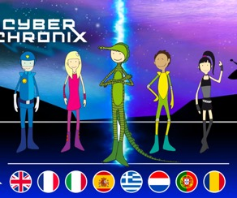
Happy Onlife and CyberChronix
Child-friendly and creative tools such as (video)games and storytelling for education and awareness raising
2015-2023

Slide 5

Child-friendly and creative tools such as games and videogames for education and awareness raising
Through participatory research, we observed:
Children lack reflective and critical thinking as well as awareness about opportunities and risks such as cyber-bullying and exploitation
Adults seem to be poor active mediators and in need themselves of practical tools of empowerment.
Lack of dialogue on digital and online experiences among generations
We recommend:
There is an urgent need for child-friendly, ready-for-use resources for education in cybersecurity, online safety, personal data protection, artificial intelligence, etc. to boost digital literacy and skill development
Edutainments as effective tools to promote dialogue among generations

Slide 6

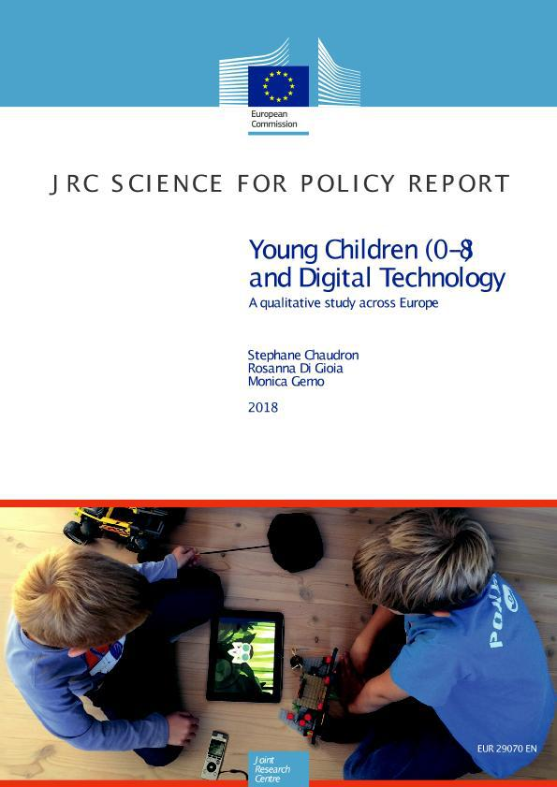
Young children’s digital engagement
  Understanding young children’s digital engagement (0-8)
2014-2018

Slide 7

Young Children 0-8 years old
Through cross-national and longitudinal study, we observed:
Young children usually have their first experiences with digital technology in their home. Children are growing up in media rich homes and there is an increasing evidence that many are at ease with digital technologies from infancy, even before learning to speak
Preferred device by children aged 0-8 is tablet and they acquire digital skills by mirroring parents and siblings.
We recommend:
Integration of Digital Technology and Literacy from early age in pre-schools and schools but also in Libraries and Museums
Fostering specific goals and possibilities offered by Digital technologies for learning (IoT, social robotics, coding, etc.)
Encourage highly positive digital content

Slide 8



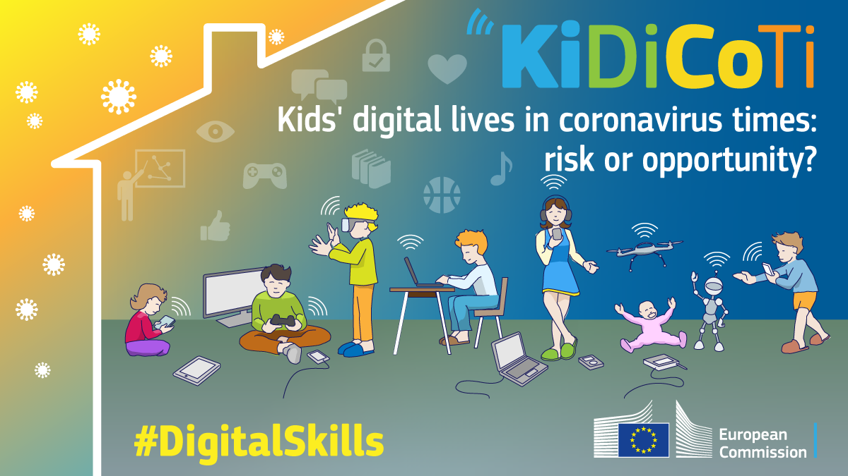
KiDiCoTi
To provide a renewed perspective for the future
6-12 year old
Interviews
10 Countries
104 interviews
10-18 year old
Online Surveys
11 Countries
6195 respondents
+
2019-2023

Slide 9
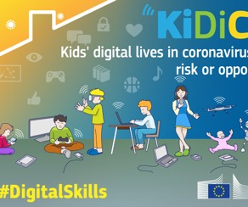
KiDiCoTi –Kids Digital lives during Covid-19 times
Provide a renewed perspective for the future
Through cross national study and mixed method analysis, we observed:
Contextual changes in sleep, diet, digital consumption habits *
Increased digital divide and shift in the traditional roles in education
Increased risks of cybersecurity, hate speech, disinformation, of self-harm and violent or gory content.
Misuse of personal data
Increase of autonomy, digital skills and creativity
* https://knowledge4policy.ec.europa.eu/health-promotion-knowledge-gateway/topic/food-non-alcoholic-beverage-marketing-children-adolescents_en
We recommend:
Design inclusive digital learning and increase investments in learning systems that reach the most marginalised.
Trustable information for all
Sustaining creativity for all

Slide 10
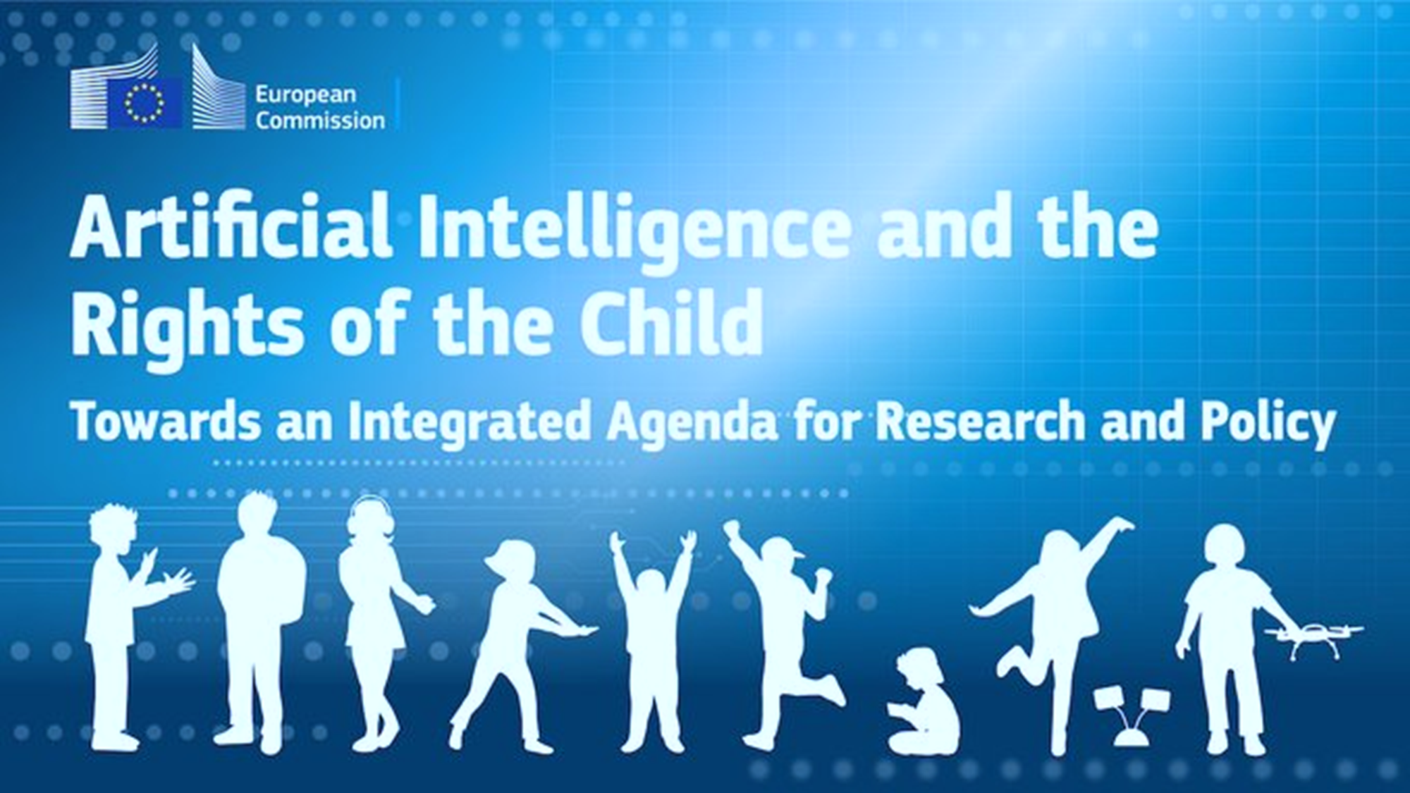
AIRoC
Artificial Intelligence and Children's Rights
2021-2023
Authors
This report was authored by Vicky Charisi, Stéphane Chaudron, Rosanna Di Gioia, Riina Vuorikari, Marina Escobar-Planas, Ignacio Sanchez and Emilia Gómez.
DG.JRC
Digital Economy
Cyber and Digital Citizen’s Security
Human Capital and Employment

Slide 11

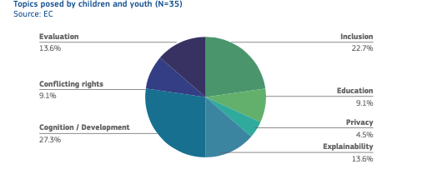


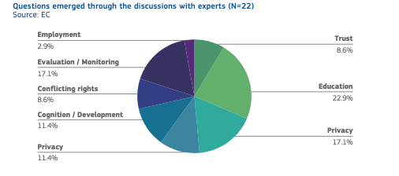

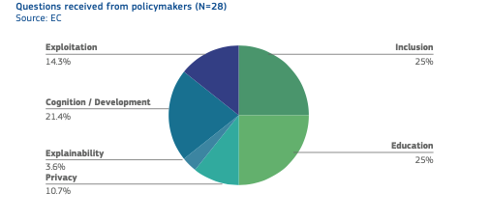

A triangulation of perspectives

Slide 12
AIRoC
Artificial Intelligence and Children's Rights
Through the triangulation of perspectives, we observed:
Different actors have different agendas
Knowledge gaps on children cognition and social-emotional capacities, development and play.
Young people ask for:
  transparency, explicability, communication and accountability
  More protective rules
  Knowledge and skills
We recommend:
Multistakeholder collaboration and Children’s participation
Anticipation, evaluation and monitoring
Balancing conflicting rights
AI minimization, valuable purposes and sustainability
Inclusion and non-discrimination
Privacy and data protection

Slide 13
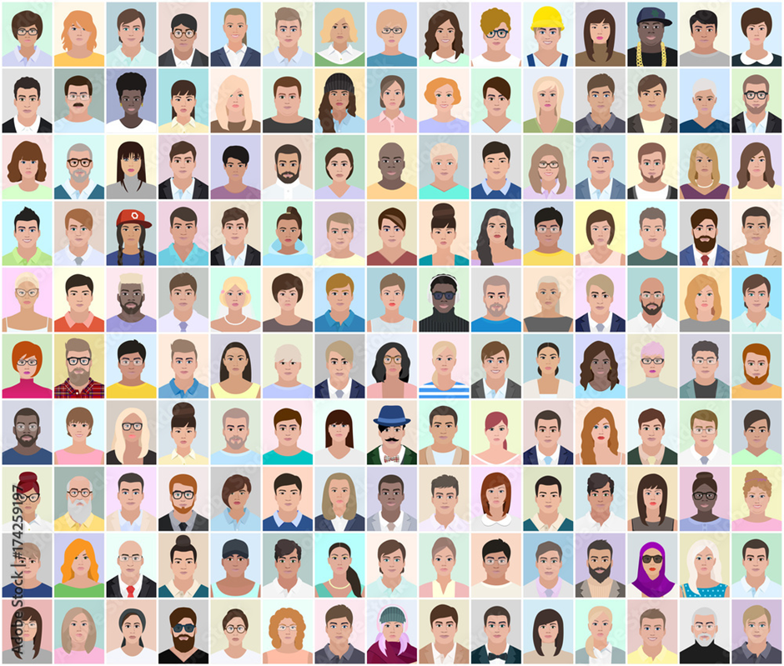
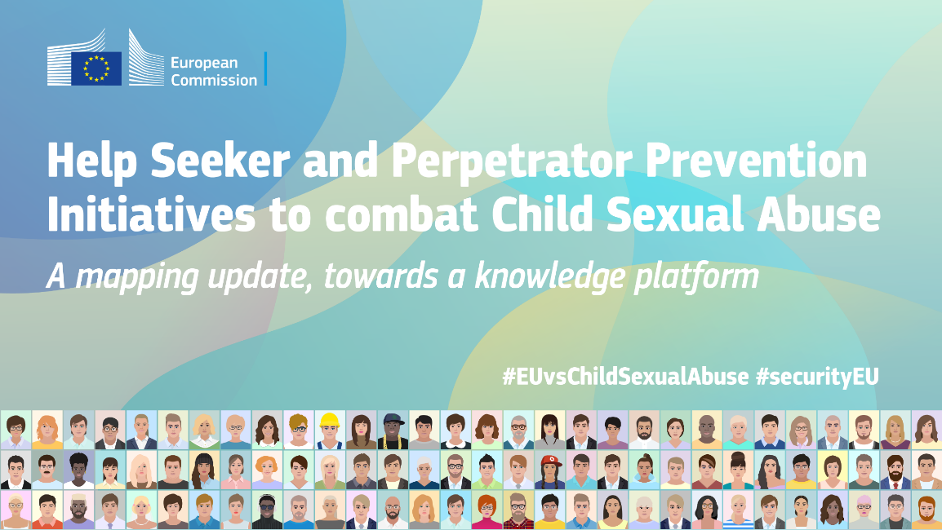
CSAE - Child Sexual Abuse and Exploitation
Help Seeker and Perpetrator Prevention
People who fear they may offend
Juveniles, minors
Convicted offenders in prisons
Convicted offenders after they leave the prison to fight against recidivism
2017-2023

Slide 14

CSAE - Child Sexual Abuse and Exploitation
Help Seeker and Perpetrator Prevention Initiatives
We observed:
Increase of Child Sexual Abuse and Exploitation crimes
Social conditioning of boys and girls during formative years affects gender related roles and behaviour, which can have an impact on patterns of violence and victimisation that carry on to their later lives
First exposure to child sexual abuse material CSAM under the age of 18
We recommend:
Digital competences to recognise online risks related to sensitive issues
Raise youngsters’ awareness on gender roles and stereotypes, consent, and the implications of pornography on intimate relationship
Holistic prevention
Awareness of prevention initiatives and programmes for juveniles and minors seeking for help

Slide 15

Thank you
Please feel free to reach me at:
Rosanna.Di-Gioia@ec.europa.eu
Play and learn Online safety & Privacy with Happy Onlife & Cyber Chronix
Young children and digital technology https://publications.jrc.ec.europa.eu/repository/handle/JRC110359
KiDiCoTi study:
https://ec.europa.eu/jrc/en/publication/how-children-10-18-experienced-online-risks-during-covid-19-lockdown-spring-2020
https://ec.europa.eu/jrc/en/publication/eur-scientific-and-technical-research-reports/how-families-handled-emergency-remote-schooling-during-covid-19-lockdown-spring-2020
https://publications.jrc.ec.europa.eu/repository/handle/JRC125787
https://www.t20italy.org/2021/08/25/digital-learning-for-every-child-closing-the-gaps-for-an-inclusive-and-prosperous-future/
Artificial Intelligence and the Rights of the Child: Towards an Integrated Agenda for Research and Policy https://publications.jrc.ec.europa.eu/repository/handle/JRC127564
Artificial Intelligence and the Rights of the Child - Young people’s views and perspectives https://publications.jrc.ec.europa.eu/repository/handle/JRC129099
Help seeker and Perpetrator Prevention Initiatives - Child Sexual Abuse and Exploitation https://publications.jrc.ec.europa.eu/repository/handle/JRC131323
© European Union 2023
Unless otherwise noted the reuse of this presentation is authorised under the CC BY 4.0 license. For any use or reproduction of elements that are not owned by the EU, permission may need to be sought directly from the respective right holders.

